Slide 1
Temporal-Difference Learning

Slide 2
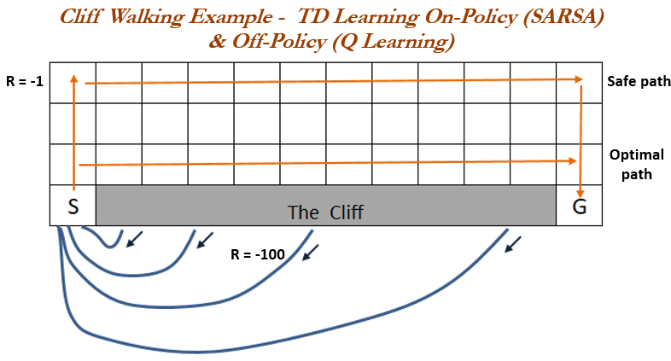
TD Learning
Similar to Monte-Carlo methods, Temporal-Difference (TD) Learning is model-free and learns from episodes of experience. However, TD learning can learn from incomplete episodes and hence we don’t need to track the episode up to termination. TD learning is so important that Sutton & Barto (2017) in their RL book describes it as “one idea … central and novel to reinforcement learning”.

Slide 3
Q-Learning vs. SARSA

Slide 4

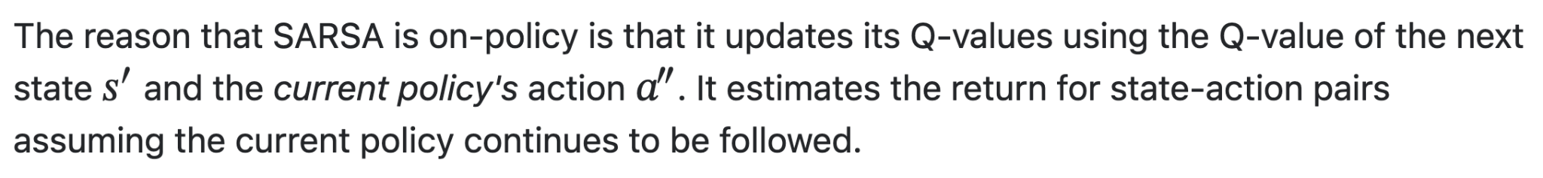

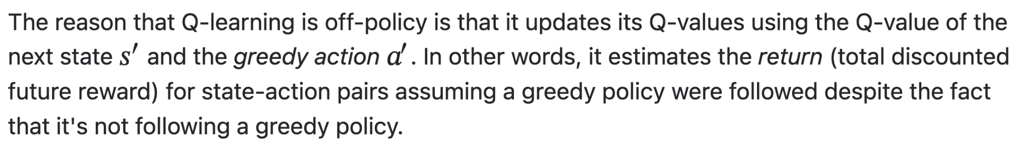
Q-Learning vs. SARSA
SARSA (On-Policy)
Q-Learning (Off-Policy)

Slide 5
Parameters
Both algorithms need the following parameters:
The epsilon (ε): the chance that an agent chooses an exploration step
The learning rate (α): the rate at which the agent learns from new observations
The discount value (γ): the amount future rewards get discounted because direct rewards are more important than future rewards

Slide 6
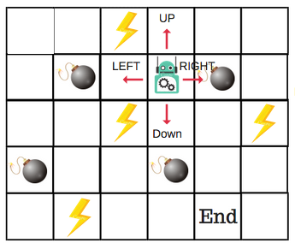
Introducing the Q-Table
Q-Table is just a fancy name for a simple lookup table where we calculate the maximum expected future rewards for action at each state. Basically, this table will guide us to the best action at each state.

Slide 7
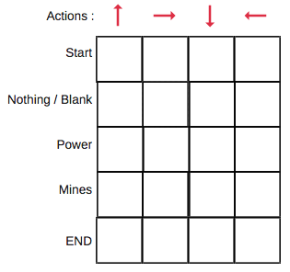
Modeling environment in Q-Table
Each Q-table score will be the maximum expected future reward that the robot will get if it takes that action at that state. This is an iterative process, as we need to improve the Q-Table at each iteration.

Slide 8
Questions:
How do we calculate the values of the Q-table?
Are the values available or predefined?

Slide 9
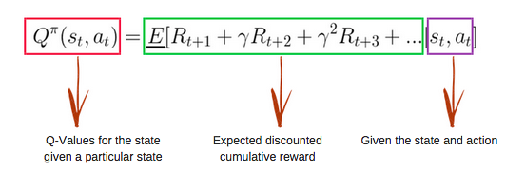
To learn each value of the Q-table,
we use the Q-Learning algorithm
Mathematics: the Q-Learning algorithm
Q-function
The Q-function uses the Bellman equation and takes two inputs: state (s) and action (a).
Using the above function, we get the values of Q for the cells in the table.
Firstly, all the values in the Q-table are zeros.
There is an iterative process of updating the values. As we start to explore the environment, the Q-function gives us better and better approximations by continuously updating the Q-values in the table.

Slide 10
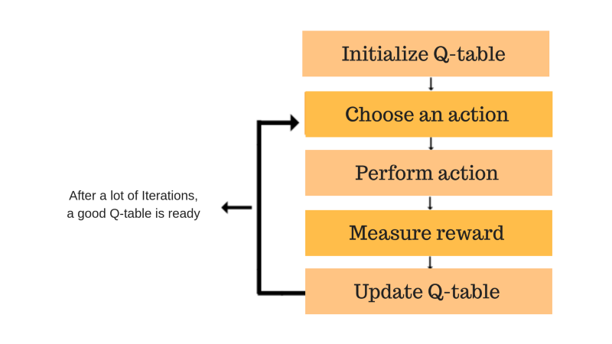
Introducing the Q-learning algorithm process
The Q-function uses the Bellman equation and takes two inputs: state (s) and action (a).
Using the above function, we get the values of Q for the cells in the table.
Firstly, all the values in the Q-table are zeros.
There is an iterative process of updating the values. As we start to explore the environment, the Q-function gives us better and better approximations by continuously updating the Q-values in the table.

Slide 11
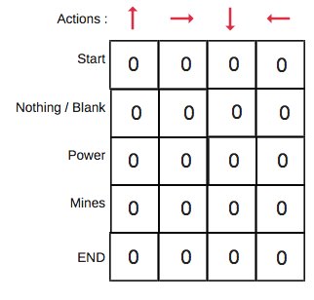
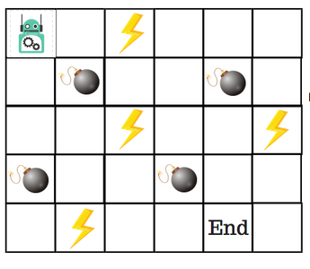
Step 1: initialize the Q-Table
We will first build a Q-table. There are n columns, where n= number of actions. There are m rows, where m= number of states. We will initialise the values at 0.
In our robot example, we have four actions (a=4) and five states (s=5). So we will build a table with four columns and five rows.

Slide 12
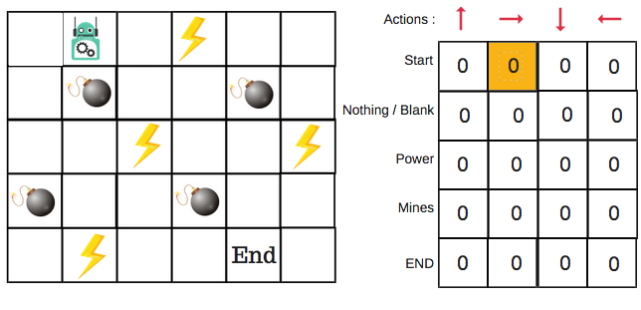
Steps 2 and 3: choose and perform an action
We will choose an action (a) in the state (s) based on the Q-Table. But, as mentioned earlier, when the episode initially starts, every Q-value is 0.
So now the concept of exploration and exploitation trade-off comes into play.
We’ll use something called the epsilon greedy strategy.
In the beginning, the epsilon rates will be higher. The robot will explore the environment and randomly choose actions. The logic behind this is that the robot does not know anything about the environment.

Slide 13
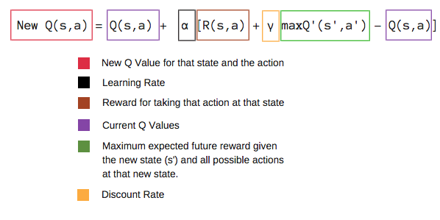
Steps 4 and 5: evaluate
In the case of the robot game, to reiterate the scoring/reward structure is:
power = +1
mine = -100
end = +100

Slide 14
Comparison
QL and SARSA are both excellent initial approaches for reinforcement learning problems.
A few key notes to select when to use QL or SARSA:
Both approach work in a finite environment (or a discretized continuous environment)
QL directly learns the optimal policy while SARSA learns a “near” optimal policy. QL is a more aggressive agent, while SARSA is more conservative. An example is walking near the cliff. QL will take the shortest path because it is optimal (with the risk of falling), while SARSA will take the longer, safer route (to avoid unexpected falling).
In practice, if you want to fast in a fast-iterating environment, QL should be your choice. However, if mistakes are costly (unexpected minimal failure — robots), then SARSA is the better option.
If your state space is too large, try exploring the deep q network.

