Slide 2

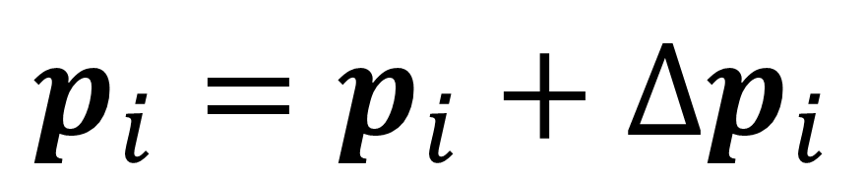

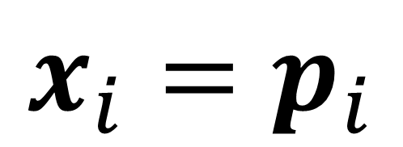




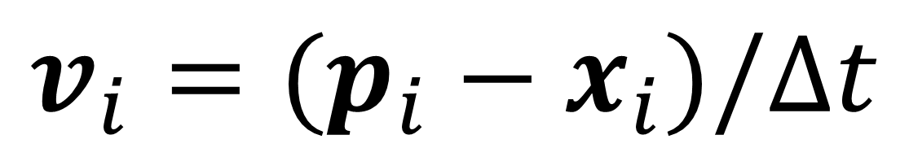

PBDにおける位置修正の制約
$$∆p_{i}$$
$$v_{i}=(p_{i}−x_{i})/∆t$$
$$x_{i}=p_{i}$$
$$x_{i}$$
$$v_{i}$$
$$p_{i}^{0}$$
$$p_{i}^{1}$$
$$p_{i}^{n}$$
$$n$$
$$p_{i}=p_{i}+∆p_{i}$$

Slide 3






距離制約
$$C_{dist}\left(p_{1},p_{2}\right)=\left|p_{1}−p_{2}\right|−d$$
$$d$$
$$p_{1}$$
$$p_{2}$$
$${∆p}_{1}$$
$${∆p}_{2}$$

Slide 4



弾性体制約
$$∆p_{i}=α\left(g_{i}\left(t\right)−p_{i}\left(t\right)\right)$$
$$g_{i}$$
$$p_{i}$$

Slide 5



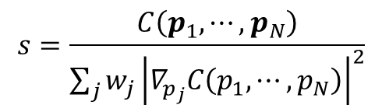
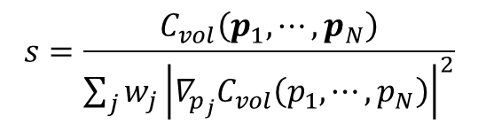
体積保存制約の式
$$∆p_{i}=−w_{i}s∇_{p_{i}}C_{vol}\left(p_{1},⋯,p_{N}\right)$$
$$∆p_{i}=−w_{i}s∇_{p_{i}}C\left(p_{1},⋯,p_{N}\right)$$
$$C_{vol}\left(p_{1},⋯,p_{N}\right)=vol\left(p_{i}\right)−V_{i}$$
$$s=\frac{C_{vol}\left(p_{1},⋯,p_{N}\right)}{\sum_{j}{w_{j}{\left|∇_{p_{j}}C_{vol}\left(p_{1},⋯,p_{N}\right)\right|}^{2}}}$$
$$s=\frac{C\left(p_{1},⋯,p_{N}\right)}{\sum_{j}{w_{j}{\left|∇_{p_{j}}C\left(p_{1},⋯,p_{N}\right)\right|}^{2}}}$$

