Slide 1
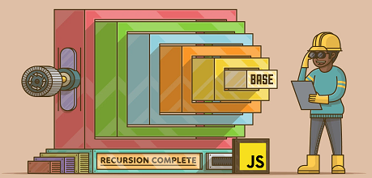
Recursive Functions
Recursion, Tail Recursion, Arrays
SoftUni Team
Technical Trainers
Software University
https://softuni.bg

Slide 2
Table of Contents
Recursion
Recursion: Exercises
Multiple Recursion
Arrays
Arrays Methods
Tail Recursion
Tuples and Records

Slide 3
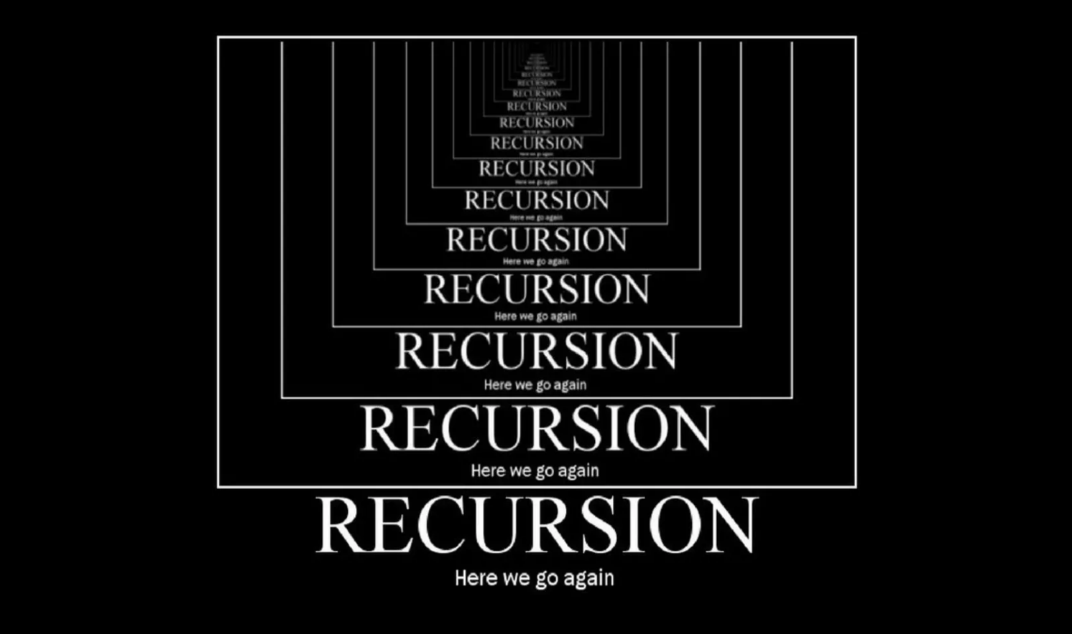
Recursion
Defining a Problem in Terms of Itself

Slide 4
What is Recursion?
Recursion is a process of calling itself
Very powerful tool in writing algorithms
Problem solving technique
Divides each problem into subproblems of the same type
function recurse() {
// function code
recurse();
}
recurse();
function
call

Slide 5
What is Recursion?
Recursion reduces a function call to a simpler one
A recursive function calls itself until someone stops it
If no one stops it, it will recurse forever and crash your program
Recursion must have a bottom (base case)
Each step of the recursion must aim for the bottom thus defined
function recurse() {
if (condition) {
...
}
recurse();
}
recurse();
Recursive bottom

Slide 6
Two Ways of Thinking: Iteration vs. Recursion
Implementation of pow( )
Iterative approach: the for loop
Recursive approach: simplify the task and call self
function pow(x, n) {
let result = 1;
for (let i = 0; i < n; i++)
result *= x;
return result;
}
console.log(pow(2, 3)); // 8
function pow(x, n) {
if (n == 1) {
return x;
} else {
return x * pow(x, n-1);
}
}
console.log(pow(2, 3)); // 8

Slide 7
Recursion is Shorter!
Recursion is usually shorter
We can use the conditional operator ? instead of an if statement
Thus we make pow( ) more terse and still very readable
function pow(x, n) {
return (n == 1) ? x : (x * pow(x, n - 1));
}
Function arguments
Recursion
Loops
Variables

Slide 8

Countdown Function – Example
Iterative approach (loops)
Recursive approach
function countDownFrom (number) {
for (let i = number; i > 0; i--) {
console.log(i);
}
}
countDownFrom(5);
function countDownFrom (number) {
if (number === 0) {
return number;
}
console.log(number);
countDownFrom(number - 1);
}
countDownFrom(5);

Slide 9
Problem: Sum of Natural Numbers
Calculate the sum of natural numbers from 1 to n using the recursion technique
To do that, you need to define the sum() recursively as follows:
function sum(n) {
if (n <= 1) {
return n;
}
return n + sum(n - 1);
}
console.log(sum(5)); // 15
Bottom of recursion
sum(n) = n + sum(n-1)
sum(n-1) = n - 1 + sum(n-2)
...
sum(1) = 1
Check your solution here: https://judge.softuni.org/Contests/Practice/Index/3535#0

Slide 10
Problem: Repeat String
Write a recursive function which return given string n times
function repeatString(str, count) {
if (count == 1) {
return str;
} else {
return str.concat(repeatString(str, count - 1)); }}
console.log(repeatString("ho", 3)); // hohoho
Check your solution here: https://judge.softuni.org/Contests/Practice/Index/3535#1

Slide 11
Problem: String Reversal
Write a recursive function which reverses given string
function stringRev(text) {
if (text.length == 1) { return text;
} else {
return text.slice(-1) + stringRev(text.slice(0, -1));
}
}
stringRev("SoftUni"); // inUtfoS
Check your solution here: https://judge.softuni.org/Contests/Practice/Index/3535#2

Slide 12


Infinite Loops
Infinite loop will halt your program
Can prevent them by always adding a stopping condition
while (true) {
console.log('Infinity');
}
for (i = 0;;) {
console.log('Infinity ');
}
x = 0;
while (x < 3) {
console.log(x); x++;
}
for (x = 0; x < 3; x++) {
console.log(x);
}
Bottom of recursion
Bottom of recursion

Slide 13


Infinite Recursion
Recursion also presents the same danger
Without a stopping condition, run() will forever call itself
function run() {
console.log('running');
run();
}
run();
// running, running, ...
Bottom of recursion
function run(x) {
if (x === 3) return;
console.log('running');
run(x + 1);
}
run(0);

Slide 14
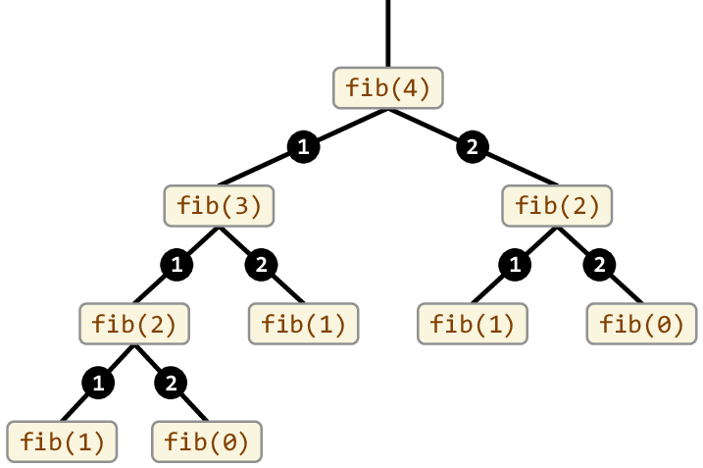
Recursion
Exercises

Slide 15
Problem: Factorial
Create a function that takes the number n as a parameter and returns n factorials as the result (5! = 5*4*3*2*1)
function factorial(n) {
let product = 1;
for (let i = n; i > 0; i--) {
product = product * i;
}
return product;
}
factorial(5);
// 120
function factorial(number) {
if (number == 0) {
return 1;
}
return (number *
factorial(number - 1));
}
factorial(5);
// 120
Recursive approach
Iterative approach

Slide 16
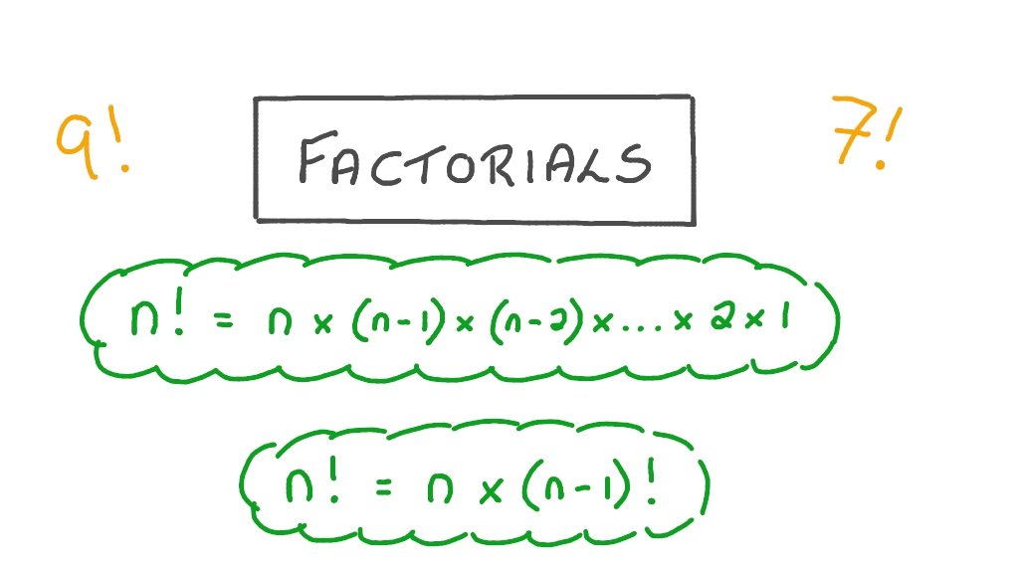
Problem: Factorial
Call Stack
1*factorial(0)
1 * 1
2 * 1
2*factorial(1)
3*factorial(2)
3 * 2
Global Execution Context
4 * 6
4*factorial(3)
5*factorial(4)
5 * 24
factorial(5)
120
Check your solution here: https://judge.softuni.org/Contests/Practice/Index/3535#2

Slide 17
Problem: Fibonacci Sequence
Create a function that takes the number n as a parameter and returns the nth number in the Fibonacci sequence
The Fibonacci sequence starts with 1
Each subsequent number is equal to the sum of the previous two
Example: F4
fib(4)
fib(3)
fib(2)
fib(2)
fib(1)
fib(1)
fib(0)
Fn = Fn-1 + Fn-2
fib(1)
fib(0)

Slide 18
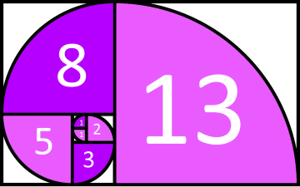
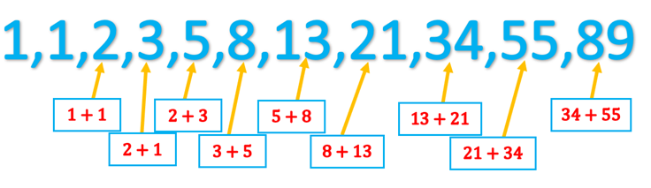
Solution: Fibonacci Sequence
const fibonacci = n => {
if (n <= 1) {
return n;
}
return fibonacci(n - 1) +
fibonacci(n - 2);
};
Check your solution here: https://judge.softuni.org/Contests/Practice/Index/3535#3

Slide 19
Recursion and Effectiveness
Beware of the effectiveness!
The below code will be very slow for n > 40
Try fib(35), fib(40), fib(45), fib(50)
const fib = n => {
if (n <= 1) {
return n;
}
return fib(n - 1) +
fib(n - 2);
};
fib(4)
fib(3)
fib(2)
fib(2)
fib(1)
fib(1)
fib(0)
fib(1)
fib(0)
fib(2) is calculated many times!

Slide 20
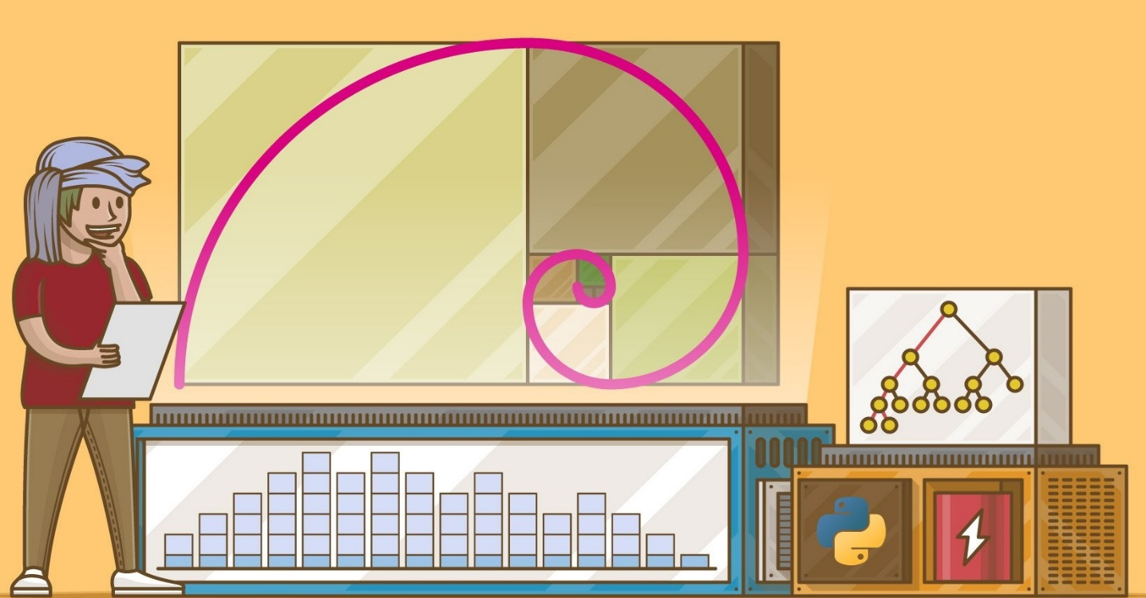
Multiple Recursion
Multiple recursion – the activation of a method can cause more than one recursive activations of the same method
The recursive method for computing the n-th Fibonacci number is an example because of the multiple call of fib()
const fib = n => {
if (n <= 1) {
return n;
}
return fib(n - 1) +
fib(n - 2);
};

Slide 21
Recursion + Memoization
Memoization is an optimization technique
Memoization makes applications more efficient and hence faster
Memoization storing computation results in cache
If we need computation result again, we can get them from cache
Fibonacci sequence using memoization
const fibMemo = function(n, memo) {
memo = memo || {};
if (memo[n]) { return memo[n]; }
if (n <= 1) { return 1; }
return memo[n] = fibMemo(n-1, memo) + fibMemo(n-2, memo);
}

Slide 22
Arrays, Head and Tail
[]
Array == Ordered List of Values

Slide 23
What is an Array?
An array is an ordered list of values
Each value is called an element specified by an index
Array can hold values of mixed types
The size of an array is dynamic and auto-growing
Arrays are a special type of objects
0
1
2
3
Index
1st
2nd
3rd
4th
Element
const cars = ['Saab', 'Volvo', 'BMW'];
console.log(cars[1]); // Volvo

Slide 24
Arrays Methods
Array length
Array slice() – slices out a piece of an array into a new array
slice() method creates a new array
slice() method does not remove any elements from the source array
const fruits = ['Banana', 'Orange', 'Apple', 'Mango'];
console.log(fruits.length); // 4
const fruits = ['Banana', 'Orange', 'Lemon', 'Apple', 'Mango'];
const citrus = fruits.slice(1);
console.log(citrus); // ['Orange', 'Lemon', 'Apple', 'Mango'];

Slide 25
Head and Tail
Get the head of an array (first element)
Get the tail
Head
1
2
3
4
5
6
function head(arr) {
return arr[0];
}
head([1,2,3]); // 1
Tail
const arr = [1,2,3];
const [head, ...tail] = arr;
console.log(head); // 1
console.log(tail); // [2,3]
function tail(arr) {
return arr.slice(1);
}
tail([1,2,3]); // [2,3]
Using ES6 spread operator

Slide 26
Problem: Sum an Array of Numbers
Write a function that sums an array of numbers using recursion
function sum(array) {
if (array.length === 0) {
return 0;
} else {
return array[0] + sum(array.slice(1));
}
}
sum([1, 2, 3, 4, 5]); // 15
function sum(array) {
if (array.length === 0) {
return 0;
} else {
let [head, ...tail] = array;
return head + sum(tail);
}
}
sum([1, 2, 3, 4, 5]); // 15
ES6
Check your solution here: https://judge.softuni.org/Contests/Practice/Index/3535#4

Slide 27

Head and Tail Functions
Head and Tail functions in JS:
const head = ([h]) => h;
const tail = ([, ...t]) => t;
const second = (arr) => head(tail(arr));
const arr = [10, 20, 30, 40];
console.log(head(arr)); // 10
console.log(tail(arr)); // [20, 30, 40]
console.log(second(arr)); // 20

Slide 28
Why We Need Hеad and Tail?
filter() implementation
map() implementation
function filter([ head, ...tail ], fn) {
const newHead = fn(head) ? [ head ] : [];
return tail.length ? [ ...newHead, ...(filter(tail, fn)) ] : newHead; }
let map = ([ head, ...tail ], fn) =>
( (head !== undefined && tail.length) ? ( tail.length ? [ fn(head), ...(map(tail, fn)) ] : [ fn(head) ] ) : []);

Slide 29
Problem: Salary
Create a salary() function that accept an array of elements and sums the money for a month. Using loops is not allowed!
The head of an array is the name of person
The tail is money for the month
function salary(array) {
let [name, ...peeks] = array;
let sum = function(array) {
return (array.length === 0) ? 0 : array[0] + sum(array.slice(1)); }
const sumOfPeeks = sum(peeks);
return (`${name} received ${sumOfPeeks} euro this month`); }
salary(['Petar', 1, 3]); // Petar received 4 euro this month
Check your solution here: https://judge.softuni.org/Contests/Practice/Index/3535#9

Slide 30
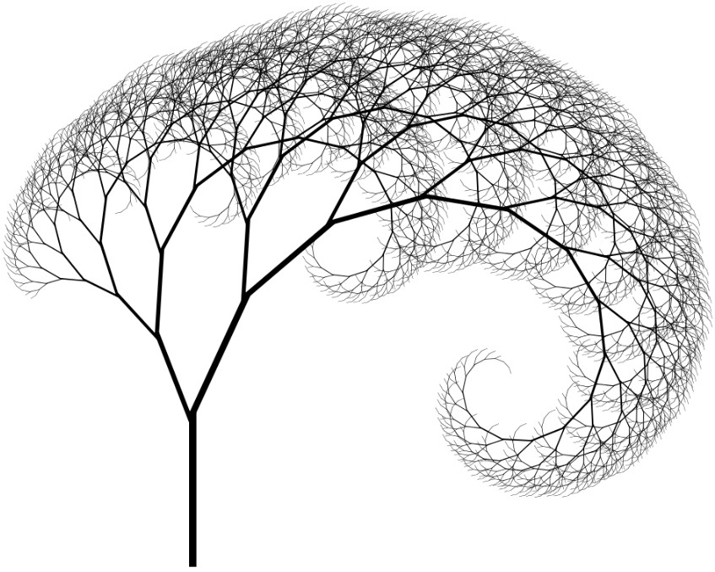
Tail Recursion
Special Form of Recursion

Slide 31
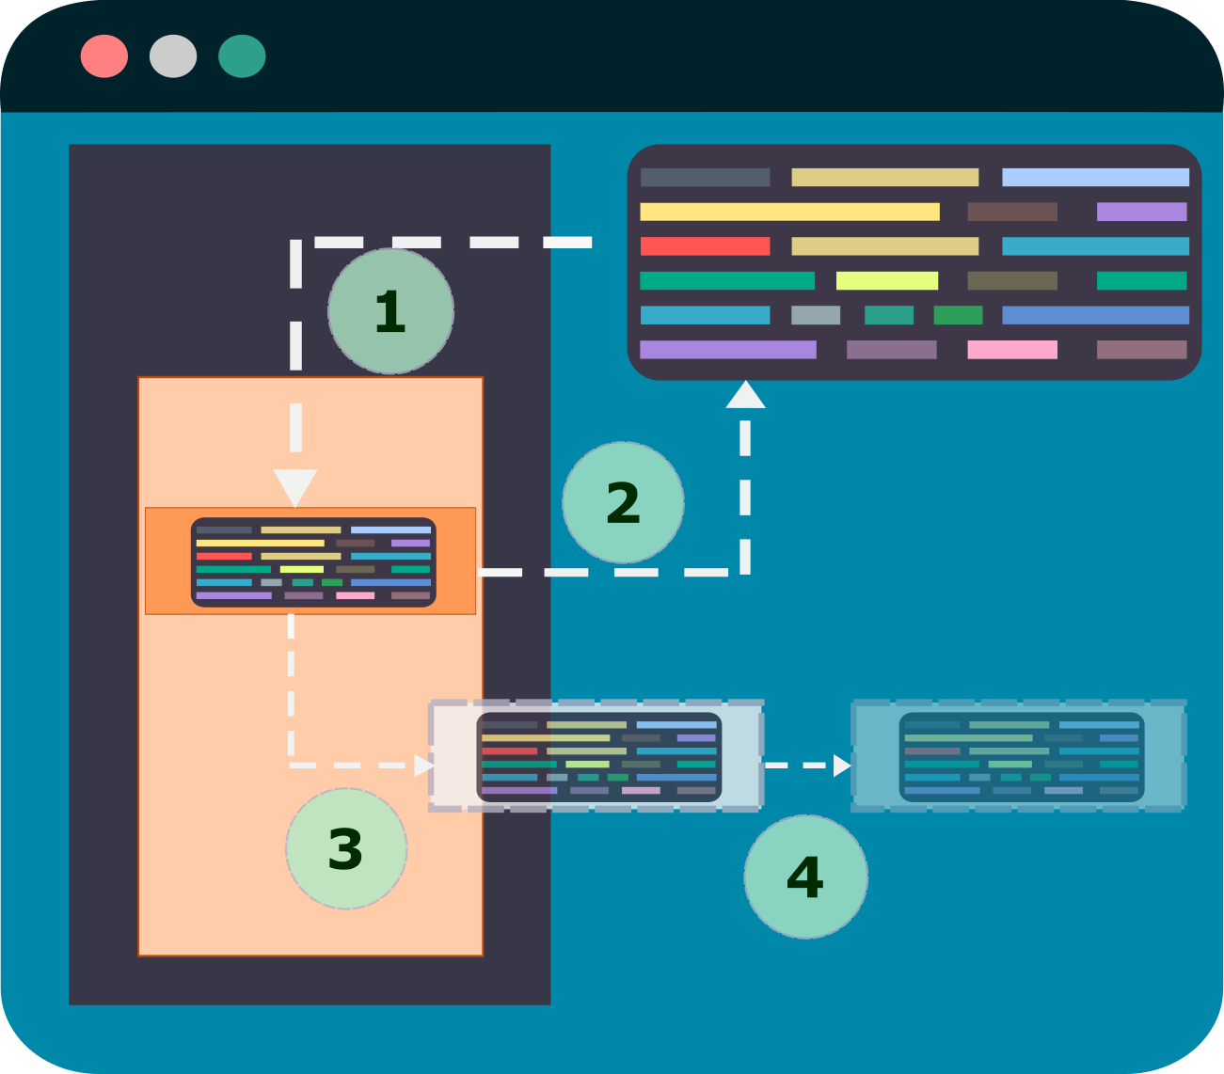
Tail Recursion
Tail recursion → the last action performed is a recursive call
More optimized recursion
Recursion is the concept of well-defined self-reference
Instead of a subsequent return, the recursion is realized with a non-return transition
An algorithm uses tail recursion

Slide 32
Tail Recursion vs Recursion
Basically, nothing is left to execute after the recursion call
function tailFact(number, result = 1) {
if (number == 1) {
return result;
} else {
return tailFact(number - 1,
result * number);
}
}
tailFact(5); // 120
function factorial(number) {
if (number == 0) {
return 1;
}
return (number *
factorial(number - 1));
}
factorial(5); // 120
Tail recursive approach
Recursive approach
Tail Call Optimization

Slide 33
Tail Recursion vs Recursion
Recursive approach
Tail recursive approach
factorial(5); // step 1
5 * factorial(4); // step 2
5 * 4 * factorial(3); // step 3
5 * 4 * 3 * factorial(2); // step 4
5 * 4 * 3 * 2 * factorial(1); // step 5
5 * 4 * 3 * 2 * 1; // step 6
Step 1: tailFact(5, 1)
Step 2: tailFact(4, 5)
Step 3: tailFact(3, 20)
Step 4: tailFact(2, 60)
Step 5: tailFact(1, 120)
Thus requires fewer operations and needs fewer items on a stack, which means more performant execution

Slide 34
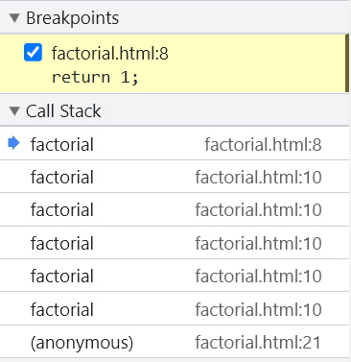
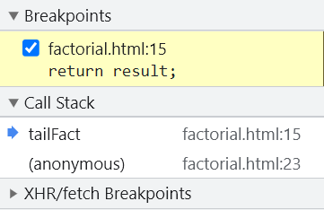
Tail Recursion: The Call Stack
The call stack without tail recursion optimization
The call stack with tail recursion optimization

Slide 35
Tail Call Optimization (TCO)
Modern compilers / runtime environments are expected to automatically optimize tail recursion calls
Unfortunately, it is not supported in JavaScript (as of Nov 2022)
See https://kangax.github.io/compat-table/es6/#test-proper_tail_calls_(tail_call_optimisation) for details

Slide 36

Records & Tuples
Compound Primitives

Slide 37
Records and Tuples
Record, a deeply immutable object-like structure:
#{ x: 1, y: 2 }
Tuple, a deeply immutable array-like structure:
#[1, 2, 3, 4]
Records and tuples are still not supported natively in JS and browsers
Test demo: here
const log = console.log;
const record = #{ prop: 1 };
const tuple = #[1, 2, 3];
log("simple",
#{ a: 1 } === #{ a:1 },
#[1] === #[1]);
// ["simple", true, true]

Slide 38
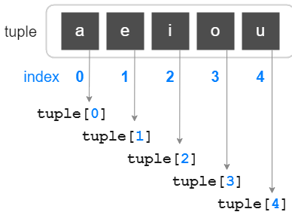
Tuples
A tuple is a typed array with a pre-defined length and types for each index
An array that is compared by value
It is immutable
JS does not have tuples
We can pretend tuples by array destructuring
By prefixing an array literal with #, we create a tuple
#['a', 'b'] === #['a', 'b']
// true

Slide 39
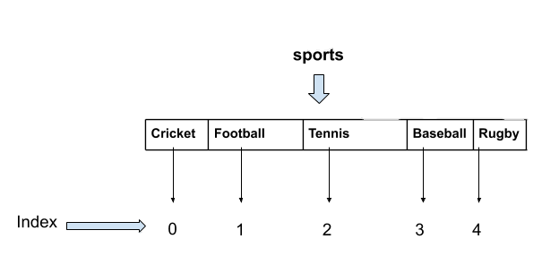
Tuple Benefits
Tuples are with finite size in nature i.e. we can’t add/delete elements to/from a tuple
We can search any element in a tuple
Tuples are faster than arrays, because they have a constant set of values
Tuples can be used as dictionary keys, because they contain immutable values like strings, numbers, etc.

Slide 40
Records
Compound value that is compared by value and immutable
JS does not have records
Analogous to an Object in JS but Record is not an Object
Records are deeply immutable primitive value
By prefixing an Object literal with a number sign (#), we create a record
Record is a data structure for storing a fixed number of elements
Using data structures with fixed size is an advantage in FP
#{x: 1, y: 4} === #{x: 1, y: 4}
// true

Slide 41
Restrictions
Records
Keys must be strings
Values must be primitives
Tuples
Elements must be primitives
typeof #{x: 1, y: 4}
// record
typeof #['a', 'b']
// tuple
If parameters are not primitive we will get an error
If parameters are not primitive we will get an error
Primitive values in JS: strings, numbers, symbols, record, tuples, etc.
Primitive values in JS: strings, numbers, symbols, record, tuples, etc.
Record({x: 1, y: 4})
// #{x: 1, y: 4}
Tuple.from(['a', 'b'])
// #['a', 'b']

Slide 42
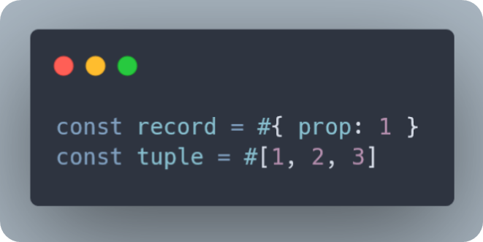
Tuples and Records are Deeply Immutable
Deeply immutable
Value must be immutable
Also, all of its subelements must be deeply immutable
Records and tuples can only contain primitive values == they are deeply immutable
All JS primitive values, including record & tuple, are deeply immutable
But only records and tuples have "subelements"

Slide 43
Tuples vs Arrays
Tuple
Array
Tuples are immutable, i.e., we can't update their data
Array are mutable, i.e., we can update their data
Tuples are denoted by round parenthesis around the elements
Arrays are denoted by square brackets around the elements
const tuple = #[1, 2, 3];
const array = [1, 2, 3];

Slide 44
Summary
…
…
…
Recursion – process of calling itself
Arrays – ordered list of values
Head (first element) and tail
Arrays methods – length(), slice()
Tail Recursion – the last action performed is a recursive call
Tuples and Records – compound primitives
Records and Tuples are still not supported natively in JS and browsers

Slide 45
Questions?

Slide 46

License
This course (slides, examples, code, demos, exercises, tutorials, homework, projects, documents, videos and other assets) is copyrighted content, created by SoftUni
Unauthorized copy, reproduction or use is illegal
© SoftUni – https://softuni.org
© Software University – https://softuni.bg

