Slide 1

Ancient poetry generation system based on pre-trained BERT model
Student Name : ZHU YANYAN
Student No : 20098533-I011-0031
Supervisor : LIANG ZHIYAO
2024.05. 08

Slide 2
Contents
01
02
03
03
Background and motivation
Introduction to operating conditions and architecture
The use of bert-base-Chinese attempts to generate poetry
Poetry generation using paddle framework
Code explaination
Results
Q&A
Implementation principle and necessary steps
Error analysis

Slide 3
Background and motivation

Slide 4




History
genetic algorithm
RNN/LSTM
Limitation of algorithm.
The poetry produced is of lower quality.
Better capture semantic and grammatical structures in poetry
1980s and early 1990s
early twenty-first century
1990-2000
2018
Statistical machine translation techniques
BERT
Statistic model.
Lack of fluency and coherence.
Bidirectional Encoder Representations from Transformers.
Bidirectional encoders and attention mechanisms.
Notes:
Subsequently, statistical machine translation technology was introduced into the field of automatic poetry generation. This approach attempts to turn the poetry generation problem into a language translation problem, using statistical models to predict the likelihood of each word. However, due to limitations on the structure of language, the resulting poems often lack fluency and coherence.In the early 21st century, deep learning models such as recurrent neural networks (RNN) and long short-term memory networks (LSTM) began to be applied to automatic poetry generation tasks. These models were able to better capture the semantic and grammatical structures in poetry, and the quality of the poems produced was significantly improved. However, due to the limitations of RNN and LSTM models, the generated poems still have some limitations.
Until 2018, Google proposed the BERT (Bidirectional Encoder Representations from Transformers) model, which marked a new level of natural language processing. BERT model utilizes bidirectional encoders and attention mechanisms to understand text context, and its powerful text representation and prediction capabilities provide new possibilities for poetry generation tasks. With the help of BERT model, researchers can produce more fluent and natural poetry works, which brings a new development opportunity for the field of automatic poetry generation.

Slide 5
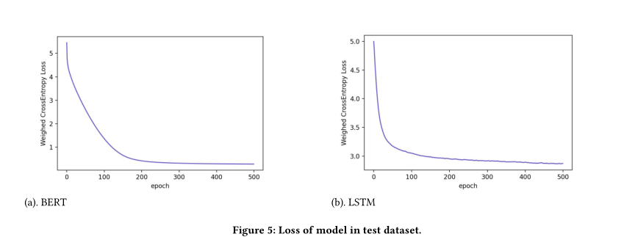
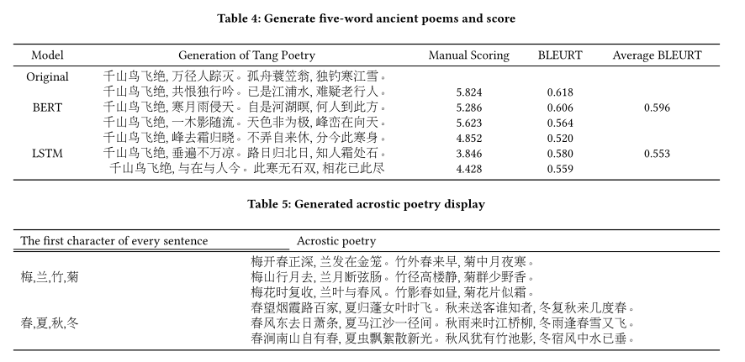
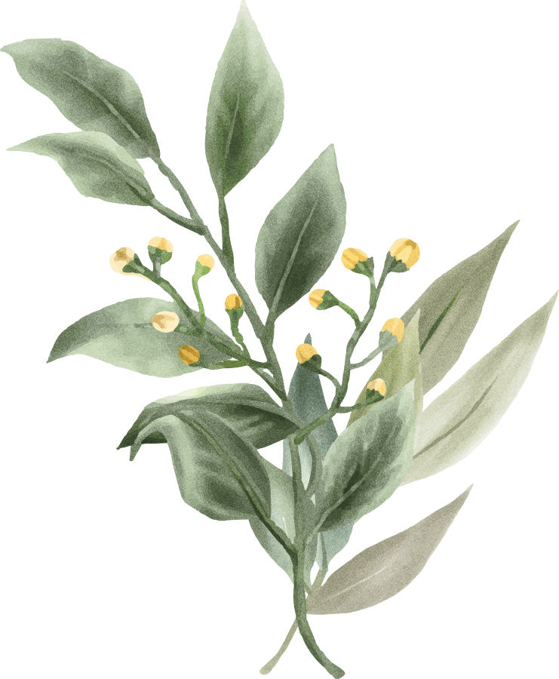
Why choose BERT
Compared to LSTM:
Loss change→Better fitting reasoning ability.
BLEURT→It can show the rhythmic characteristics in more depth.
Acrostic poetry→It can show the artistic conception of poetry
He Z , You J , Lin S P ,et al.Generation of Chinese Tang Dynasty Poetry Based on BERT Model[J].Proceedings of the 2022 11th International Conference on Networks, Communication and Computing, 2022.DOI:10.1145/3579895.3579940.
Notes:
In this paper, the researchers used the BERT model to generate ancient poems, and then compared with using the LSTM model, with the same parameter Settings and device configurations.
Figure 5 shows the loss changes for both models in the test data setIt can be seen that the loss of BERT model is not only smoother, but also smaller than that of LSTM model, indicating that BERT model has better fitting inference ability.
After that, the two models were given the first sentence of the five-character poem by Liu Zongyuan, and asked to continue writing down the rest of the poem, and then evaluate the original and generated verses using the BLEURT algorithm. The BLEURT model, which had a rating range of (-1,1), also found five experts and professors in the Chinese department to evaluate the poems, with an average score between 1 and 10. The results are shown in Table 4.
As can be seen from Table 4 above, the poetry generated by BERT model has significantly improved compared with the proposed LSTM model in the evaluation of BLEURT algorithm, indicating that ancient poetry generated by BERT method can more deeply show prosodic characteristics.
By changing the mask structure, the model can also receive some manually provided characters so that each character appears at the beginning of each poem. The results are shown in Table 5 above. It can be seen that the model has good expansibility and is helpful to the reference and research in the field of poetry generation.

Slide 6
Introduction to operating conditions and architecture

Slide 7


Key knowledge that are used
BERT
paddle
Tkinter
A pretrained deep learning model
A deep learning platform developed by Baidu
GUI library

Slide 8
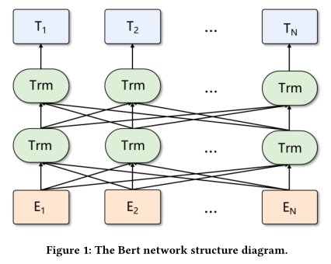
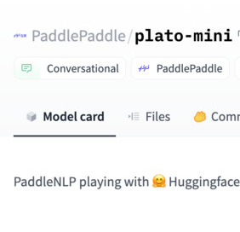
bert-base-chinese
BERT
structure
Bert-base-chinese
Pre-trained by Google AI
Difficult to train
Open sourced version
Could be used in paddle
Notes:
The BERT model (Bidirectional Encoder Representations from Transformers) is a pre-trained model proposed by Google AI Research Institute in 2018. It has made amazing achievements in the field of natural language processing (NLP), breaking multiple records. BERT models are very difficult to train, but fortunately, Google has open sourced several versions of the pre-trained model, including English, Chinese, and multilingual versions. My project uses a bert pre-training model "Bert-BASE-Chinese" that can be run on the paddle framework.

Slide 9
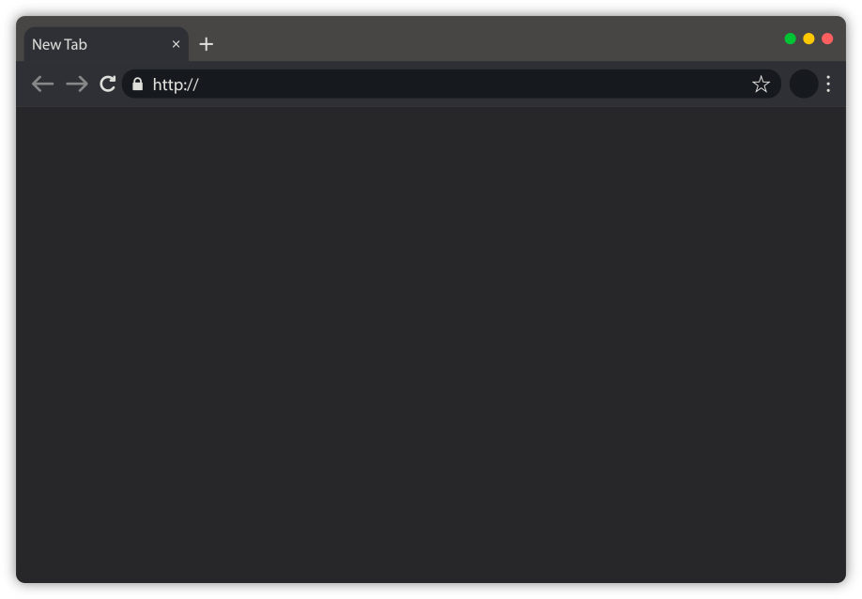
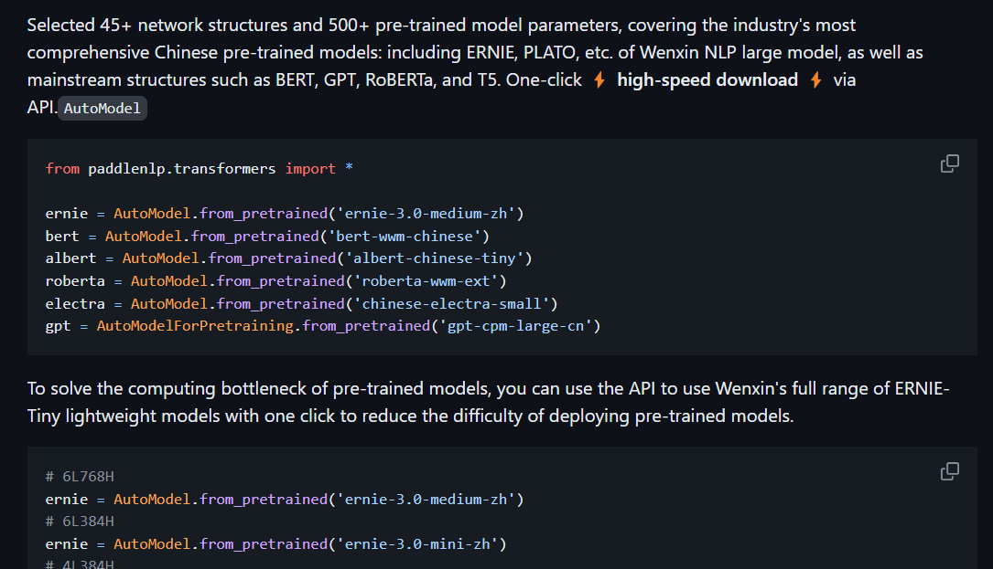
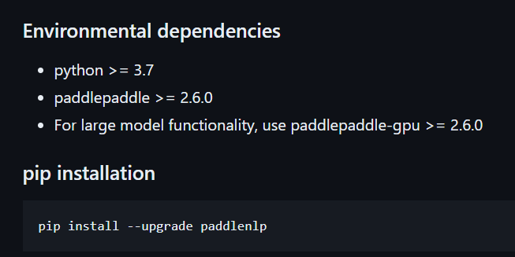
paddlepaddle
PaddlePaddle (or fly paddle) is a deep learning framework proposed by Baidu. It is easy to use, efficient, flexible, scalable, and designed to provide modelers with a convenient deep learning development experience. PaddlePaddle can be used to build, train, and deploy deep learning models. PaddlePaddle supports both CPU and GPU, and provides a rich API and model library.
https://paddlenlp.readthedocs.io/zh/latest/get_started/installation.html
Notes:
PaddlePaddle (or fly paddle) is a deep learning framework proposed by Baidu. It is easy to use, efficient, flexible, scalable, and designed to provide modelers with a convenient deep learning development experience. PaddlePaddle can be used to build, train, and deploy deep learning models. PaddlePaddle supports both CPU and GPU, and provides a rich API and model library.

Slide 10
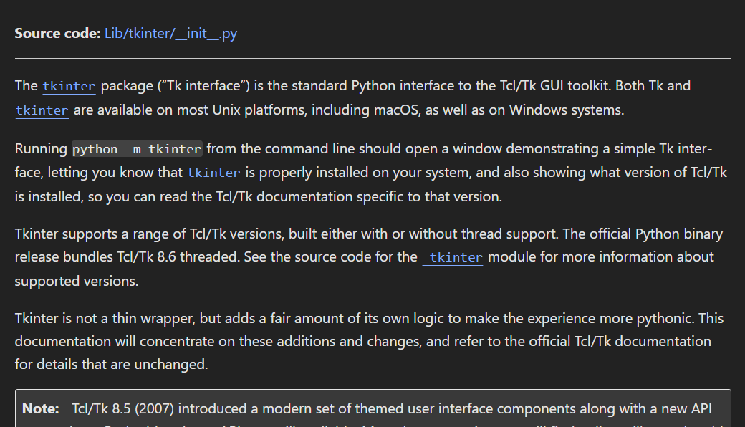
Tkinter
Tkinter is an interface to Python's standard Tk GUI toolkit. It is used to create graphical window interfaces, including buttons, text boxes, labels, and so on. Tkinter is a GUI interface that comes with Python and can be edited. I use this interface when working with the poems generated by the final display.
Notes:
This is the tool I use to show the graphics. Tkinter is an interface to Python's standard Tk GUI toolkit. It is used to create graphical window interfaces, including buttons, text boxes, labels, and so on. Tkinter is a GUI interface that comes with Python and can be edited. I use this interface when working with the poems generated by the final display.

Slide 11
The use of bert-base-Chinese attempts to generate poetry
Notes:
在了解了基础工具后，我试图实现诗歌生成

Slide 12
How to generate a poem
01.
Preprocessing
05.
Generation Process
Tokenization
Padding
Decoding strategy
Generate the next token
probabilityContinuation generation
02.
Model Loading:
03.
Fine-Tuning
06.
Evaluation
adapt it to the poetry generation task.
Evaluate the generated poetry
04.
Input Encoding
07.
Post-processing
Encode the input poetry prompts or keywords using the BERT tokenizer to generate input embeddings.
Notes:
Preprocessing:
Tokenization: The input text is tokenized into subwords or characters to create input sequences suitable for BERT.
Padding: The tokenized sequences are padded to ensure uniform length, allowing for batch processing.
Model Loading:
Load the pre-trained BERT-base-Chinese model .
Fine-Tuning:
Fine-tune the pre-trained BERT model on a specific poetry dataset .
Define the fine-tuning task, such as masked language modeling or sequence classification, depending on the specific poetry generation approach.
Input Encoding:
Encode the input poetry prompts or keywords using the BERT tokenizer to generate input embeddings.
Generation Process:
Generate poetry line by line or character by character using a decoding strategy such as greedy decoding, beam search, or nucleus sampling.
Feed the encoded input prompts along with optional control tokens into the BERT model to generate the next token probabilities.
Select the next token based on the probability distribution obtained from the BERT model and continue the generation process until the desired length or termination condition is met.
Evaluation:
Evaluate the generated poetry using metrics such as fluency, coherence, rhyme scheme adherence, and semantic relevance.
Refine the generation process and fine-tuning strategy based on the evaluation results to improve poetry quality.
Post-processing:
Perform post-processing steps such as detokenization, formatting, and rhyming pattern adjustment to enhance the readability and aesthetic appeal of the generated poetry.

Slide 13

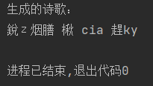
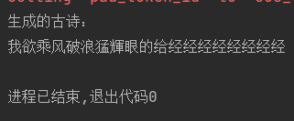
A failed attempt
BAD RESULTS！！
Notes:
Before fully understanding how to generate poetry, I first made an attempt to generate poetry using bert-base-chinese. Unfortunately, my code failed.可以看出我的结果非常糟糕且不稳定，因此我决定结合这次失败的经历重新生成诗歌。

Slide 14
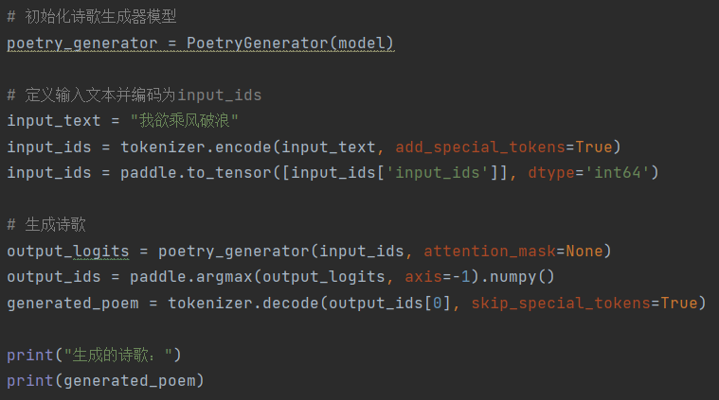


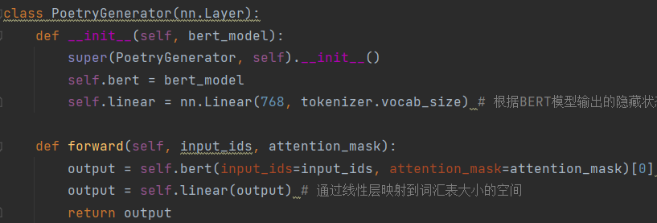
A failed attempt
Implementation steps：
Load the pre-trained BERT model and tokenizer
Define the poetry generator model
Generative poetry
Unimplemented step：
Model training
The introduction of attention mechanisms
Optimization of generation strategy
Notes:
Here are the steps and results of my code implementation. As you can see, the results are not ideal. Not only does it fail to make sense, but it also generates English and symbols. Therefore, I conducted a detailed analysis of my code and came to the conclusion that its shortcomings are mainly as follows.
Steps to implement:
1. Load pre-trained BERT model and tokenizer
2. ** Define the PoetryGenerator Model ** In the forward propagation method of the model, the input is passed to the BERT model, which is then mapped through the linear layer.
3. ** Generated poetry ** The input text is successfully passed to the poetry generator model and the logic of the output is obtained. Finally, the index of the word with the highest probability is obtained by the loss function 'argmax' function, and this index is decoded into the generated poem using a marker.
Unimplemented steps:
** Model training ** : model training process for the poetry generation task.
** Introduction of attention mechanism ** : The model does not introduce attention mechanism to capture important information of input text. The attention mechanism, which is crucial for improving the coherence and semantic richness of generated poetry, is not implemented in this document.
Optimization of generation strategy ** : easily leads to the repetition and lack of diversity of generated poems.

Slide 15
Poetry generation using paddle framework

Slide 16
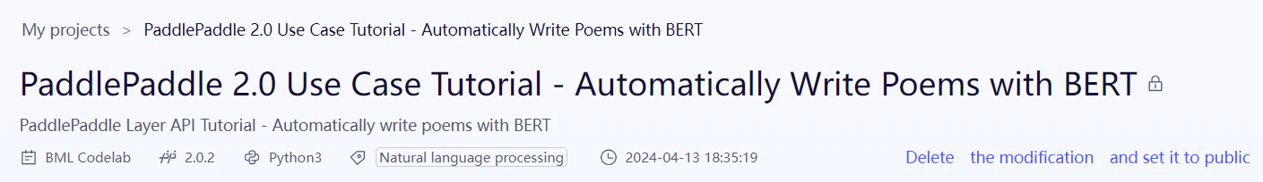
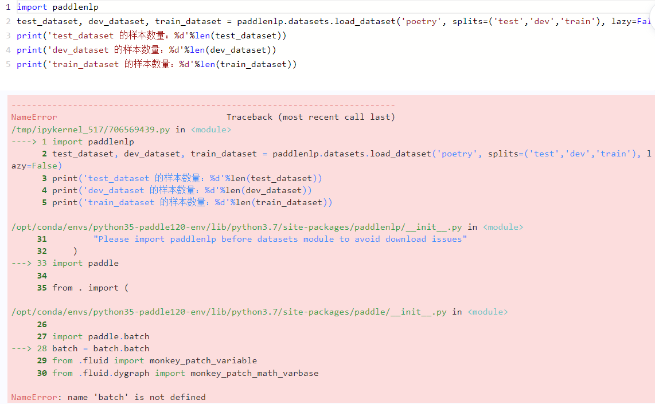
Studied projects
Error occurred when generate its data processing codes.
The project was trained using paddle's built-in data set and generated poems with a random style. But since it doesn't disclose its training for datasets, I chose to train a particular style of poetry on my own based on its code
Notes:
The project was trained using paddle's built-in data set and generated poems with a random style. But since it doesn’t open sourse its training for datasets, I chose to train a particular style of poetry on my own based on its code

Slide 17




Related files
Class: PoemDataDescription: The class responsible for loading, processing, and preparing a dataset of ancient poems.
Class: PoetryBertModel PoetryBertModelLossCriterionDescription: The generation model of ancient poetry and the related loss function classes are defined respectively.
No specific class, contains some functions and code snippets that generate ancient poems.
There are no specific classes, but some auxiliary functions and classes are used in the process of generating ancient poems.
There is no specific class, which contains the main script for the entire training process, relying on the PoemData class and the PoetryBertModel class for training.
Notes:
I have five documents to help me with this project.
dataset.py: This file is used to prepare and process data sets. It is responsible for loading the ancient poetry data from the data source and converting it into a format acceptable to the model. Other files, such as train.py, rely on this file for data.
Model.py: This file defines the poetry generation model. It contains the model structure and related loss functions for generating ancient poems. Other files, such as train.py, need to be trained and generated using the model defined in this file.
gen.py: This file contains the code for generating ancient poems. It relies on the model defined in Model.py and generates ancient poems by loading the model and entering text.
creator.py: This file defines helper functions and classes to help generate ancient poems. It is used with the gen.py file, but is not directly involved in the process of generating ancient poems.
Train.py: This file is the main script used to train the poetry generation model. It relies on the data processing logic defined in dataset.py and the model structure defined in Model.py for training.

Slide 18
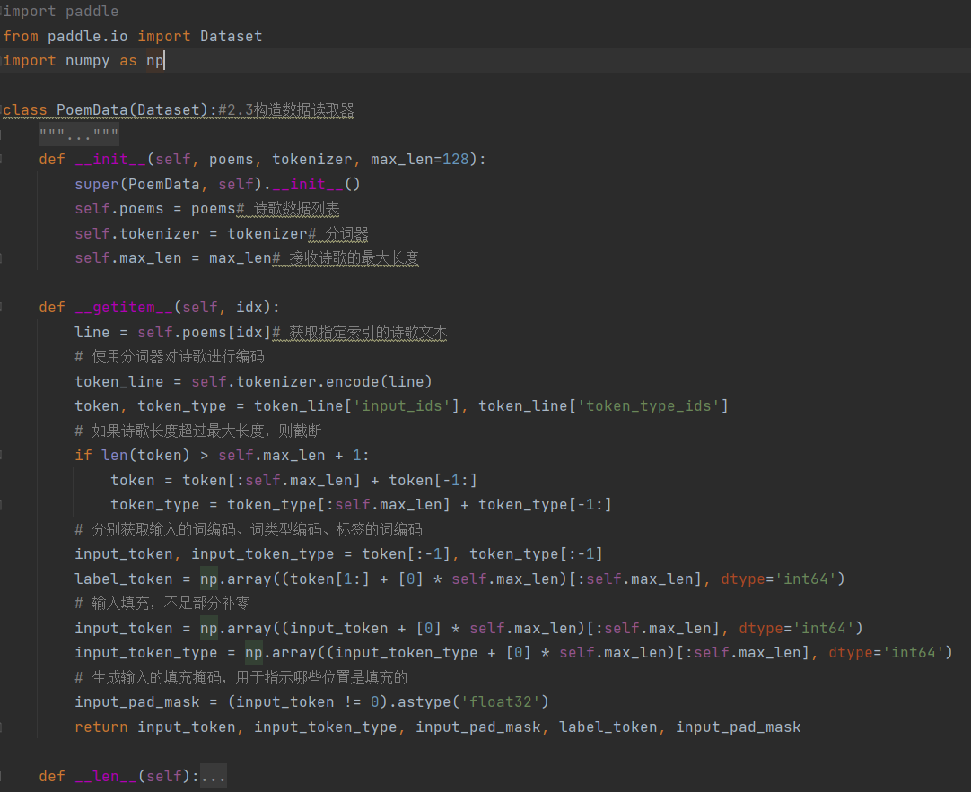
Dataset.py
The data of ancient poems are cleaned, marked and organized to facilitate subsequent training and generation.
Notes:
First, I load and prepare the poetry dataset through the dataset.py file. This step is critical because good data processing can provide high-quality input data to the model, which can affect the quality and fluency of the resulting poetry. In this process, I will clean, mark and organize the data of ancient poems to facilitate subsequent training and generation.

Slide 19
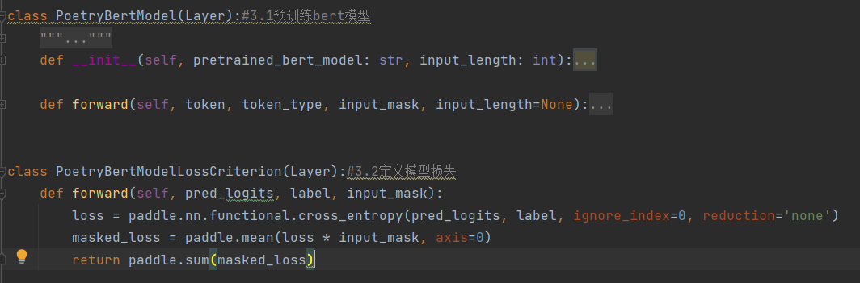
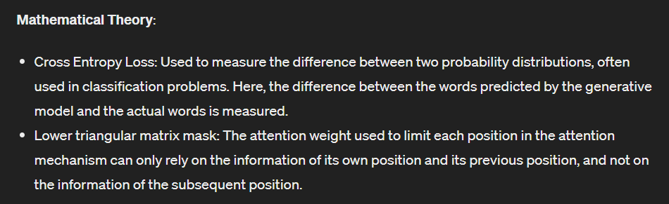
model.py
The model for generating poetry and the associated loss functions are defined in the model.py file. I chose to use the pre-trained BERT model as a base and built a poetry generator model on top of it.
Notes:
Then, in the model.py file, I define the model used to generate the poem and the associated loss function. In this step, I chose to use the pre-trained BERT model as a base and build a poetry generator model on top of it. By combining the powerful text representation capability of BERT model and the design of generator model, I was able to achieve accurate generation of ancient poems.

Slide 20
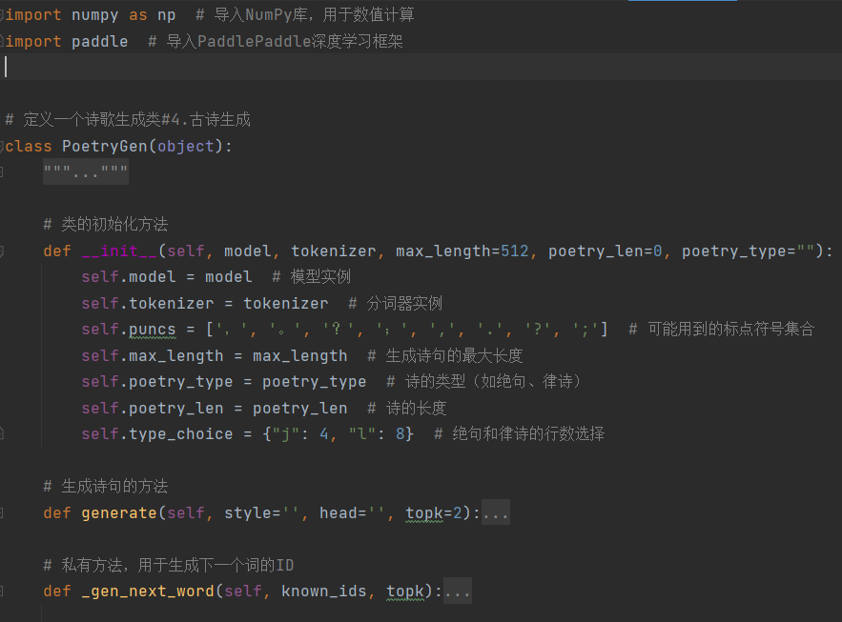
gen.py
Contains some auxiliary functions and code snippets for generating ancient poems. These functions and code snippets help to process text data during the generation process, call models to make predictions, and post-process the generated results to ensure the quality of the resulting poetry.
Notes:
Contains some auxiliary functions and code snippets for generating ancient poems. These functions and code snippets help us process text data during the generation process, call models to make predictions, and post-process the generated results to ensure the quality of the resulting poetry.

Slide 21
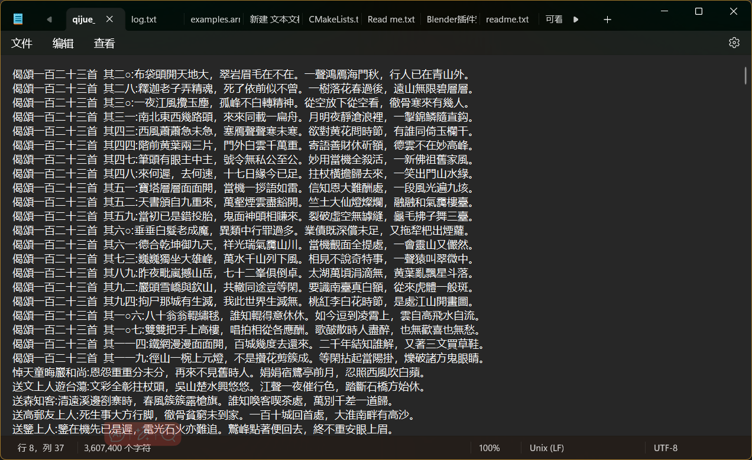
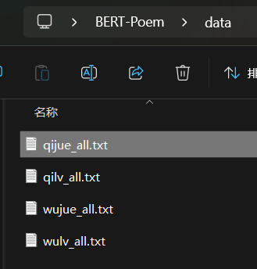

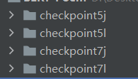
Train.py
The standard of division is that 4 sentences are quantas and 8 sentences are rhythmic poems, each sentence has five or seven words.
Notes:
In the data preparation phase, I need to prepare a poetry data set for training and evaluation. I used the open source database of ancient Chinese poetry on Github. In this section, I read and load the ancient poetry data file and prepare it in a format acceptable to the model. I trained the initial poetry dataset in four parts: five poems, five poems, seven poems, seven poems. The standard of the division is 4 sentences for quantifiers, 8 sentences for metrical poems, each sentence has 5 or 7 words. Below is a partial introduction to the segmented data set and the seven verse data set.

Slide 22
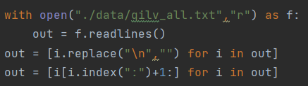
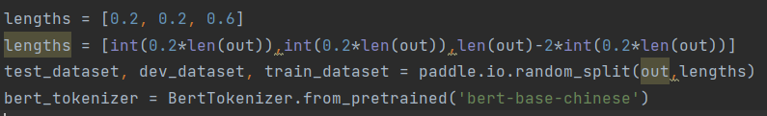
Data processing
By extracting the content after the colon, you get a pure poetic text.
The data set will be divided in a 6:2:2 ratio
Notes:
In the data processing stage, I need to further process the extracted poetry data, including word segmentation, coding and other operations, in order to facilitate the subsequent training and application of the model. The following code snippet reads data from a file called qilv_all.txt, which is used to train the generation of seven verses. This file may contain different types of poems, and I need to filter out anything related to seven-rhyme poems according to my needs. By extracting what comes after the colon, you get a purely poetic text.

Slide 23
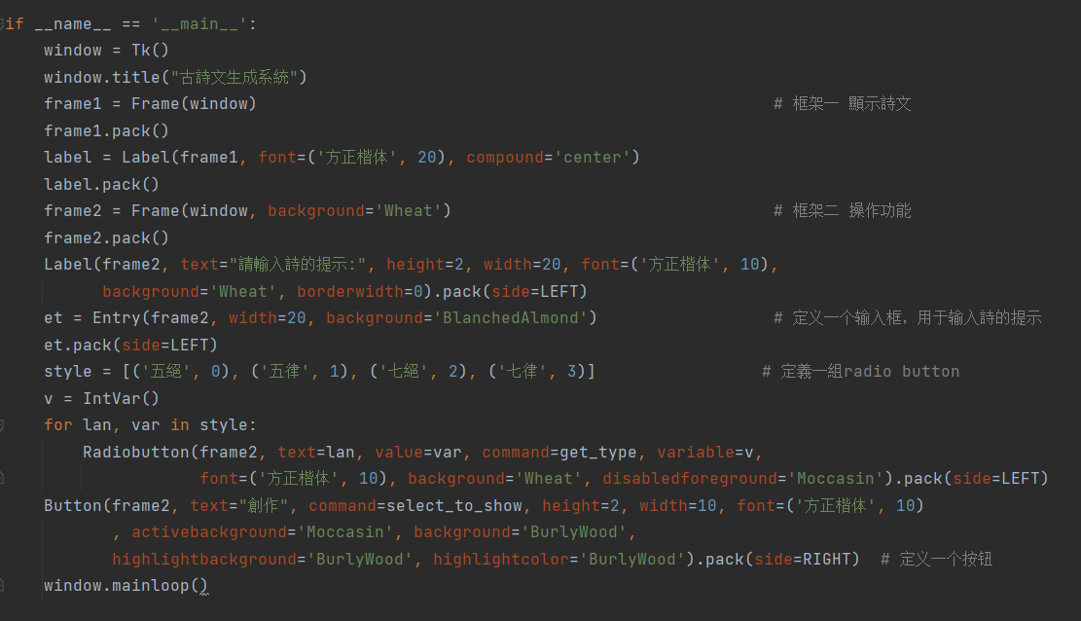
creator.py
Load Model: A function or class is defined to load a pre-trained poetry generator model for subsequent use.
Save the generated results: A function or class is defined to save the generated results of ancient poems to a file for later viewing or sharing.
Poetic-generating interface: A function or class is defined as an interface for the user to interact with the generator model by calling the interface to enter a piece of text and then get the result of the generated ancient poem.

Slide 24
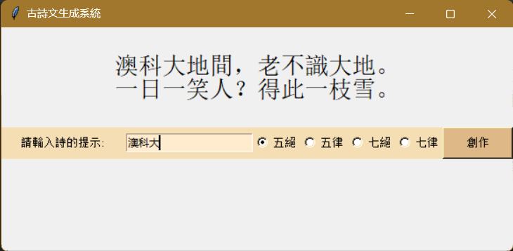
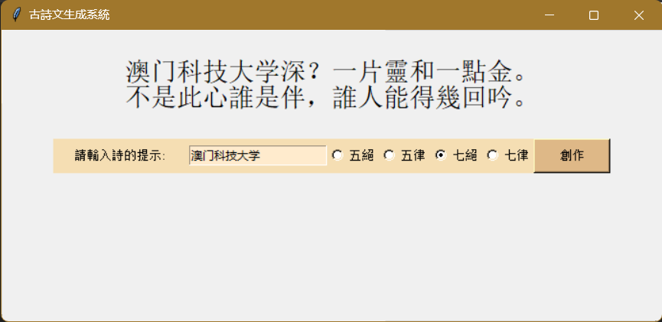
Summary&results
In my demo, I used a pre-trained BERT model, which is a deep learning model with powerful text representation capabilities. I generate poems by encoding the input text into a format that the model can understand and then feeding it into a poetry generator model defined by my code.

Slide 25
Q&A

Slide 26
Thanks !

