Slide 1

Chapter 8
Elasticity

Slide 2


Inter atomic forces
The binding force in between two atoms is known as inter atomic force .
It is electrical in nature.(10⁻¹⁰ m)
It is equal to the negative of gradient of corresponding potential energy function .
F= $\frac{−d (U(r))}{dr }$

Slide 3
Inter Molecular Forces
The force of attraction between molecules of a substance is called intermolecular force.
These forces are electrical in nature and act over very small distances (of the order of molecular separation).
They are responsible for the physical properties of matter such as elasticity, rigidity, and strength.
When a body is deformed, these intermolecular forces try to bring the molecules back to their original positions, which gives rise to elastic behavior.

Slide 4
Key terms
Deforming Force : The force that’s acting on a body that causes it to change its configuration .
Deformation : The change in shape or size of a body due to deforming force .
Restoring force : The internal forces developed on a body which tends to bring it back to original shape .

Slide 5
Stress
When deforming forces are applied on the body a restoring force is developed inside the body , the restoring force per unit area of the body is called stress the restoring force that is equal to the equal and opposite to the deforming force so stress can also be defined as the deforming force per unit area of the body
Types of Stress :
Normal Stress
Tangential Stress
Bulk Stress

Slide 6
Normal stress
The stress that acts perpendicular to the surface of the body is known as normal stress . It can further be classified into 2 types.
Tensile stress : If there is increase in length of the body in the direction of the force applied , it is known as tensile sress .
Compression stress : If there is decrease in length of the body in the direction of the force applied , it is known as compression stress .

Slide 7
Tangential Stress
If the deforming force is applied parallel to the surface of the body there is change in shape of the body without change in volume .
It is also known as shearing stress.
Bulk Stress
Bulk stress is the stress experienced by a body when it is subjected to uniform pressure from all directions, usually in a fluid.
It causes a change in the volume of the body without changing its shape.

Slide 8

Strain
Strain is defined as the ratio of change in dimension to the original dimension of a body when a deforming force is applied.
It measures the deformation produced in a material.
$\text{Strain}=\frac{\text{Change} \text{in} \text{dimension}}{\text{Original} \text{dimension}}$
Types of strain:
Longitudinal strain
Volumetric strain
Tangential strain

Slide 9
Types of strain
Longitudinal strain : The change in length per unit original length produced under action of deforming force .
Volumetric strain : The change in volume per unit original volume produced under action of deforming force .
Tangential strain : The angle through which the face of the body which is perpendicular to the fixed face is turned when it is under shearing stress /

Slide 10
Elasticity and perfectly elastic body
Elasticity :
Elasticity is the property of a material by which it regains its original shape and size after the removal of the deforming force.
It occurs due to restoring forces between molecules.
Perfectly elastic body :
A perfectly elastic body is an ideal material that completely regains its original shape instantly after the deforming force is removed. In reality, no material is perfectly elastic. The material closest to a perfectly elastic body is quartz fibre.

Slide 11

Hookes Law
Hooke’s law states that within the elastic limit, the extension produced in a body is directly proportional to the applied force.
$$F∝x$$
In terms of Stress and Strain (Young’s form)
Within the elastic limit, stress is directly proportional to strain.
$\text{Stress}∝\text{Strain}$
So, $\text{Stress}=Y×\text{Strain}$
Where Y = Young’s Modulus of Elasticity

Slide 12
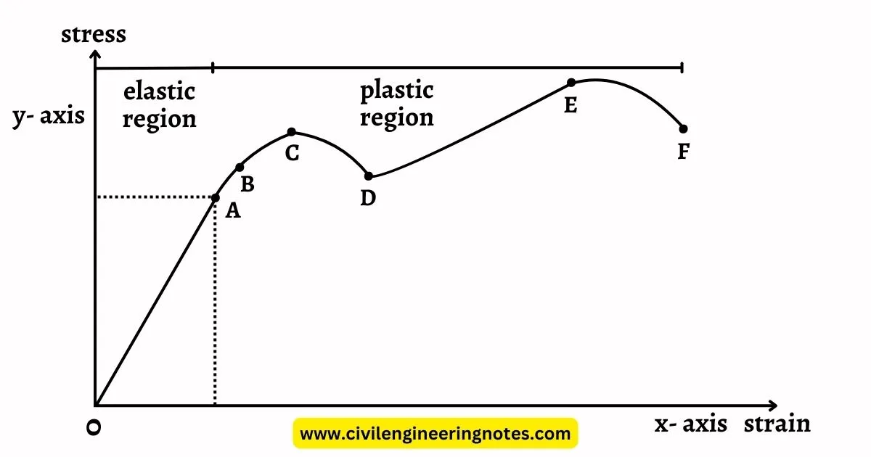
Stress and strain curve

Slide 13

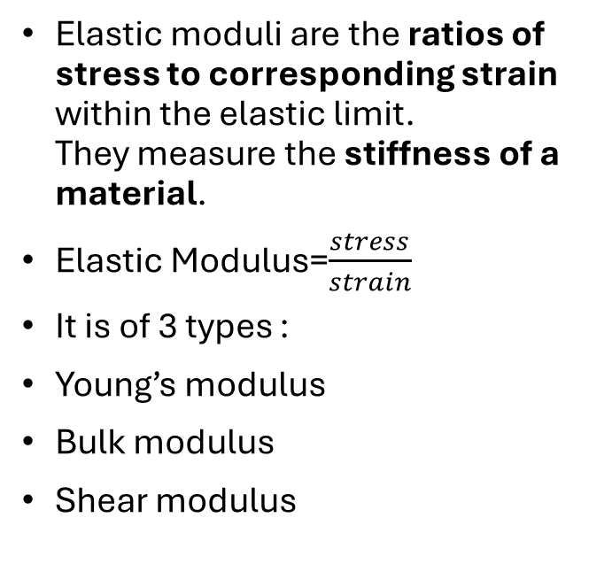
Elastic moduli
Elastic moduli are the ratios of stress to corresponding strain within the elastic limit. They measure the stiffness of a material.
Elastic Modulus=$\frac{stress}{strain}$
It is of 3 types :
Young’s modulus
Bulk modulus
Shear modulus

Slide 14

Youngs modulus
Young’s modulus is defined as the ratio of normal stress to longitudinal strain within the elastic limit of a material.
$Y=\frac{\text{Normal} \text{Stress}}{\text{Longitudinal} \text{Strain}}$
Explanation
It measures the resistance of a material to change in length when a tensile or compressive force is applied.
It tells us how stiff or elastic a material is in stretching.
Key Point
Higher Young’s modulus → material is more rigid and less stretchable

Slide 15

Bulk Modulus
Definition
Bulk modulus is defined as the ratio of normal stress to volumetric strain.
$K=\frac{\text{Normal} \text{Stress}}{\text{Volumetric} \text{Strain}}$
Explanation
It measures the resistance of a material to change in volume.
It applies when a body is subjected to uniform pressure from all directions.
Key Point
Higher bulk modulus → material is less compressible

Slide 16
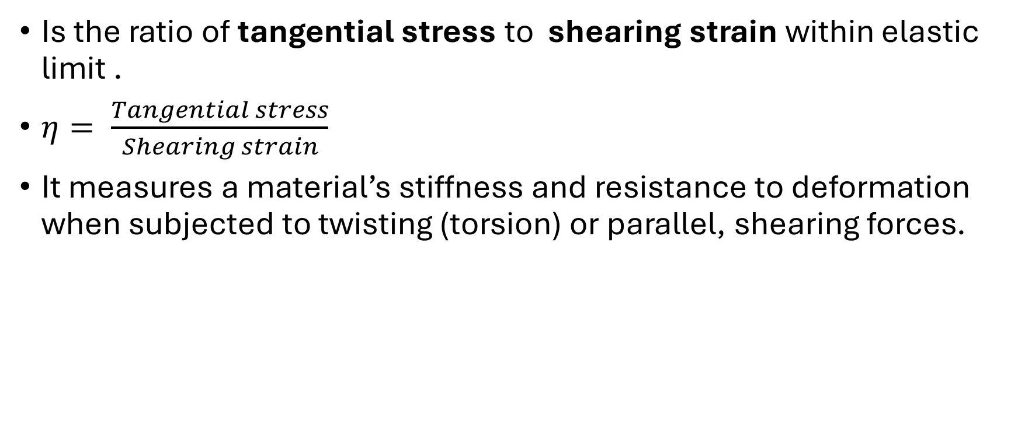
Shear modulus
Is the ratio of tangential stress to shearing strain within elastic limit .
$η= \frac{Tangential stress}{Shearing strain}$
It measures a material’s stiffness and resistance to deformation when subjected to twisting (torsion) or parallel, shearing forces.

Slide 17

Poissons ratio
Poisson’s ratio is defined as the ratio of lateral strain to longitudinal strain within the elastic limit.
$σ=\frac{\text{Lateral} \text{Strain}}{\text{Longitudinal} \text{Strain}}$
When a wire is stretched, it elongates in length.
At the same time, it contracts in diameter (sideways).
Poisson’s ratio describes this relationship between sideways contraction and lengthwise extension.
Depends only on the nature of the material.
Typical Range
For most materials: 0 to 0.5

Slide 18
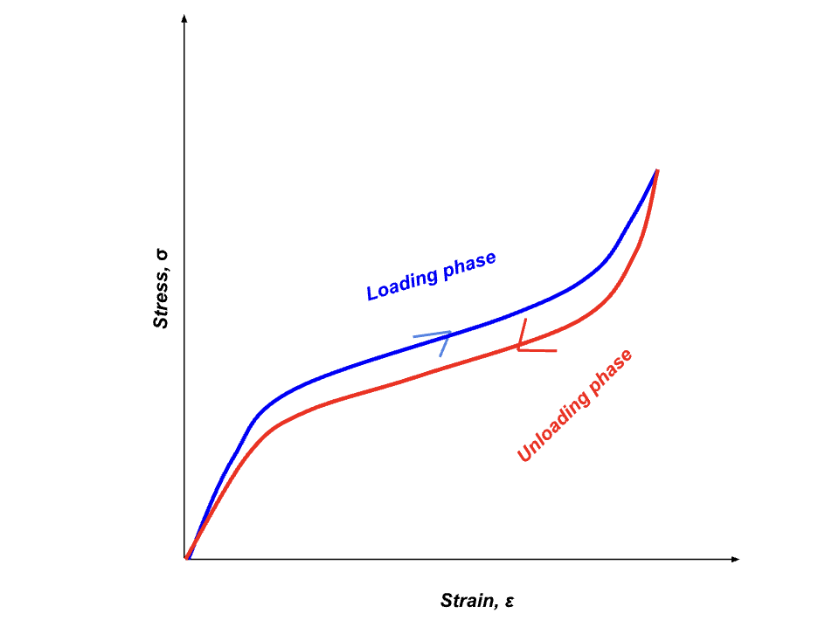
Elastic hysteresis
Elastic hysteresis is the phenomenon in which a material, when subjected to cyclic loading and unloading, follows different paths on the stress–strain curve during loading and unloading. As a result, a loop is formed between the two curves, known as the hysteresis loop. The area enclosed within this loop represents the energy lost as heat due to internal friction within the material during deformation. This effect is commonly observed in materials like rubber, where repeated stretching and releasing cause noticeable energy dissipation.

Slide 19
Elastic After Effect
Elastic after effect is the phenomenon in which a material does not immediately regain its original shape and size after the removal of a deforming force, but instead takes a certain amount of time to recover gradually. This delay in recovery occurs due to internal friction and the time required for molecules within the material to return to their equilibrium positions, and it is commonly observed in materials like rubber.

Slide 20
Elastic Fatigue
Elastic fatigue is the phenomenon in which a material gradually loses its elastic properties when it is subjected to repeated cycles of stress and strain. Due to continuous loading and unloading, the internal structure of the material weakens, causing it to behave more like a plastic material and eventually leading to fracture, as seen in objects like metal wires or paper clips that break after repeated bending.

