Slide 1

Certificate of Entitlement (COE) Analysis and Prediction

Slide 2
What is COE?
License for vehicle ownership in Singapore valid for 10 years
Traffic control tool to minimise congestion
Obtained via a competitive bidding process held twice a month

Slide 3
What is COE?
Five categories:
Category A: Cars up to 1600cc and 97kW
Category B: Cars above 1600cc and 97kW
Category C: Goods Vehicles and Buses
Category D: Motorcycles
Category E: Open

Slide 4
What is COE?
Vehicle quota is updated quarterly based on following:
50% of rolling average of de-registrations over the last two quarters
Provision of 0.25% per annum growth for goods vehicles and buses
Changes in the taxi population, replacement of commercial vehicles under the Early Turnover Scheme and expired COEs

Slide 5
What is COE?
Category | COE on 9 Jan 2019 | COE on 23 Nov 2022 | % Difference
Category A | $25,920 | $90,589 | + 250%
Category B | $32,200 | $113,881 | + 254%
Category C | $27,002 | $81,802 | + 203%
Category D | $3,610 | $12,589 | + 249%
Category E | $32,909 | $114,009 | + 246%
Prices have been on a steady uptrend
Reached historical highs
Cat B: $115,388 in early Nov 2022
Cat C: $81,802 in late Nov 2022
Cat D: $13,189 in early Nov 2022
Cat E: $116,577 in early Nov 2022

Slide 6
Problem Statements
What factors impact the price of COEs?
Can the COE prices be predicted?

Slide 7
Data Sources
Online dataset with details of 2445 COE bidding exercises from April 2002 to Nov 2022
1st or 2nd Bidding Exercise of the Month
Bidding Exercise End Date
Bidding Exercise Year
COE Category
Quota
COE Price
Bids Received
Successful Bids

Slide 8
Data Sources
Additional features were added to the original COE dataset
Difference between quota and bid numbers
Ratio of successful bids to total bids
Ratio of successful bids to quota
Previous COE price
Change in COE price from previous exercise

Slide 9
Data Sources
Augmented with data from the World Bank and the Singapore Department of Statistics (2002 to 2021):
GDP per capita (current SGD)
GDP per capita (annual % change)
Median household income per household member (current SGD)
Median household income per household member (annual % change)

Slide 10
Approach
Exploratory Data Analysis
Model Training and Testing
Linear Regression
SARIMAX

Slide 11
Exploratory Data Analysis
Very strong correlation (0.99) between COE price and previous COE price across all categories
COE price negatively correlated to quota but strength of correlation dependent on category
E.g. Category D (motorcycles) was (-0.15) compared to the other categories (-0.6 to -0.82)
COE price not uniformly correlated with other features across all the categories
E.g. correlation with GDP ranges from -0.47 for Category A to 0.86 for Category D

Slide 12

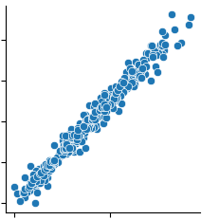
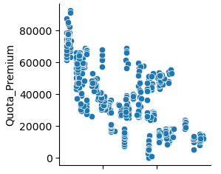


Exploratory Data Analysis

Slide 13
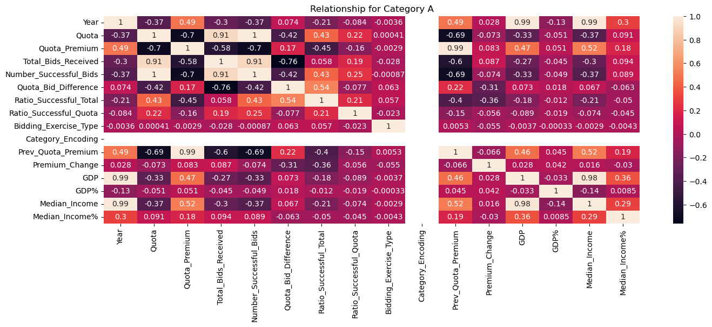
Exploratory Data Analysis

Slide 14
Model Training and Testing
Linear Regression (2002 to 2020 records)
70% (2215 records) Train
30% (120 records) Test
Linear Regression against unseen 2021 data
Linear Regression Cross validation (10 fold)
SARIMAX (2002 to 2021 records)
80% (1870 records) Train
20% (465 records) Test

Slide 15
Model Training and Testing
13 features used to train the Linear Regression model:
Bidding Exercise Type
Category
Difference between quota and bid numbers
GDP per capita (annual % change)
GDP per capita (current SGD)
Median household income per household member (annual % change)
Median household income per household member (current SGD)
Number of Successful Bids
Previous COE
Quota
Ratio of successful bids to quota
Ratio of successful bids to total bids
Total Bids Received

Slide 16
Model Training and Testing
SARIMAX model
Endog = COE price
Exog = Previous COE price

Slide 17
Model Training and Testing
 | RMSE | R2 Score
Linear Regression Model (Training) | 2668 | 0.988
Linear Regression Model (Unseen) | 3033 | 0.980
Linear Regression 10 Fold Cross Validation | 2716 | 0.988
SARIMAX Model (Training) | 2543 | 0.978

Slide 18
Model Training and Testing
 | Jan 2022 First Bidding Forecasted Price | Jan 2022 First Bidding Actual Price | Difference (%)
Category A | 59,910 | 57,599 | -2,311 (3.9%)
Category B | 81,118 | 77,700 | -3,418 (4.2%)
Category C | 44,002 | 42,200 | -1,802 (4.1%)
Category D | 9,603 | 9,689 | 86 (0.9%)
Category E | 83,700 | 82,501 | -1,199 (1.4%)

Slide 19
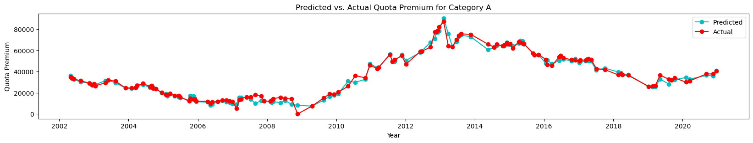
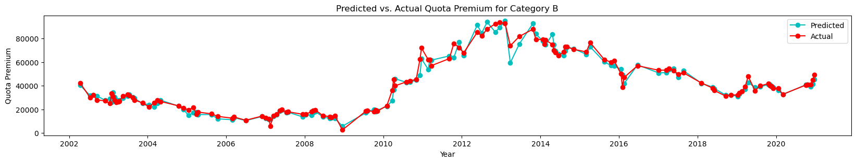
LinReg Predicted vs. Test Data

Slide 20
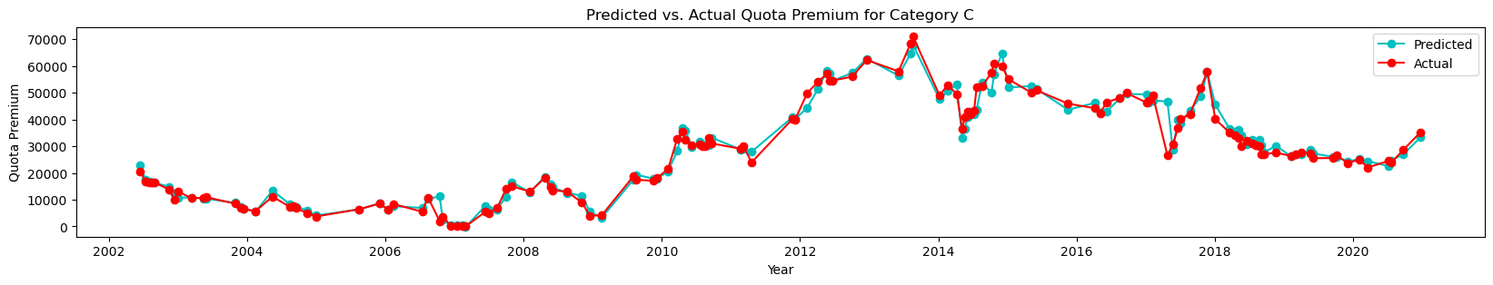
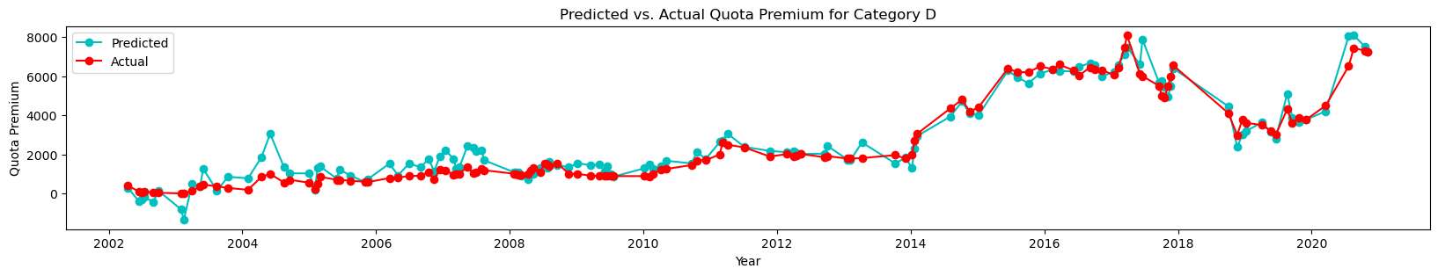
LinReg Predicted vs. Test Data

Slide 21
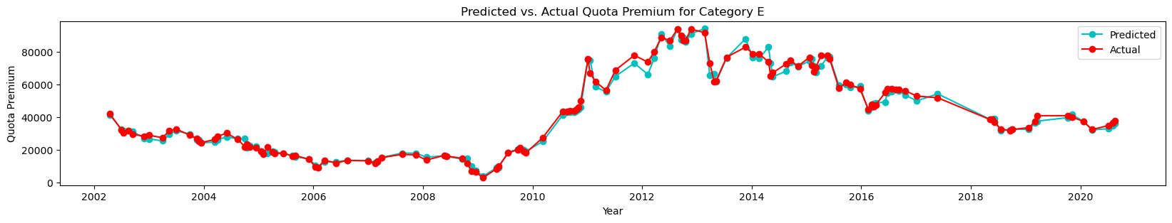
LinReg Predicted vs. Test Data

Slide 22
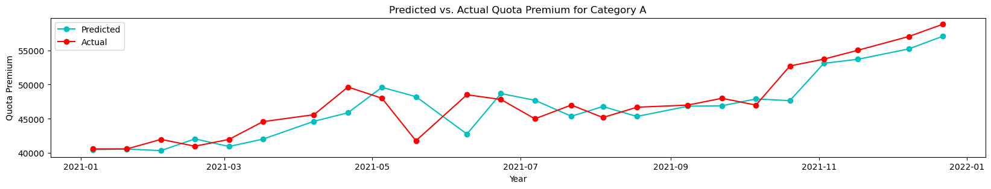
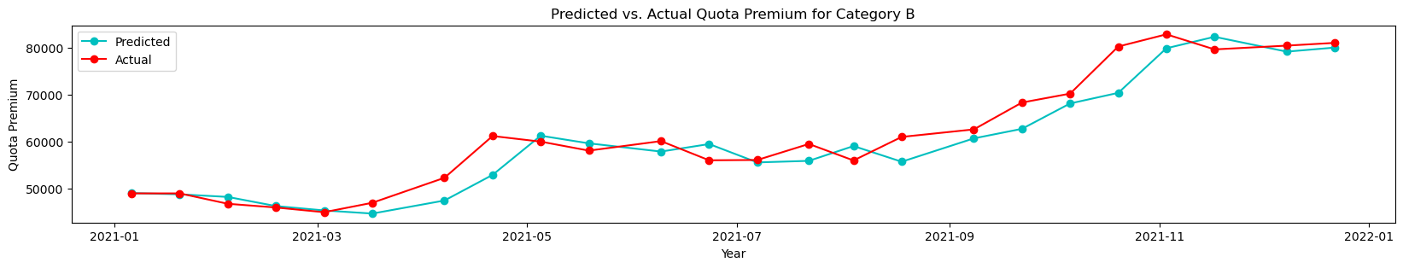
LinReg Predicted vs. Unseen Data

Slide 23
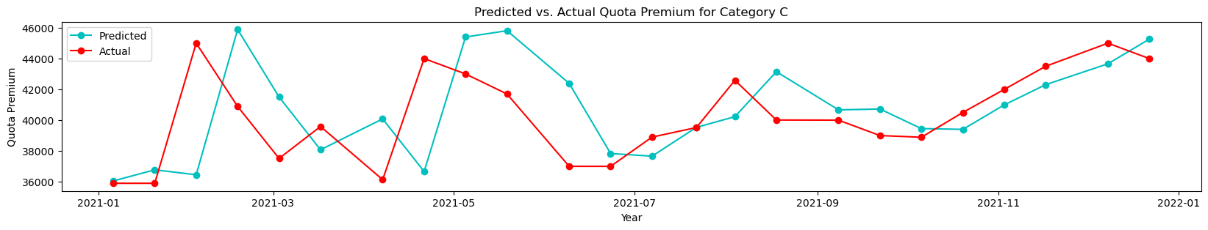
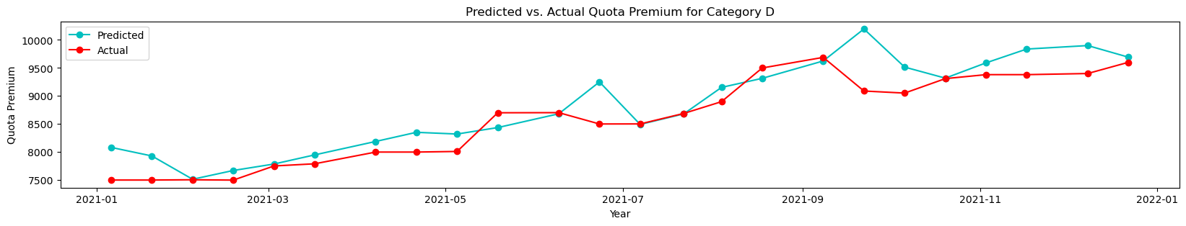
LinReg Predicted vs. Unseen Data

Slide 24
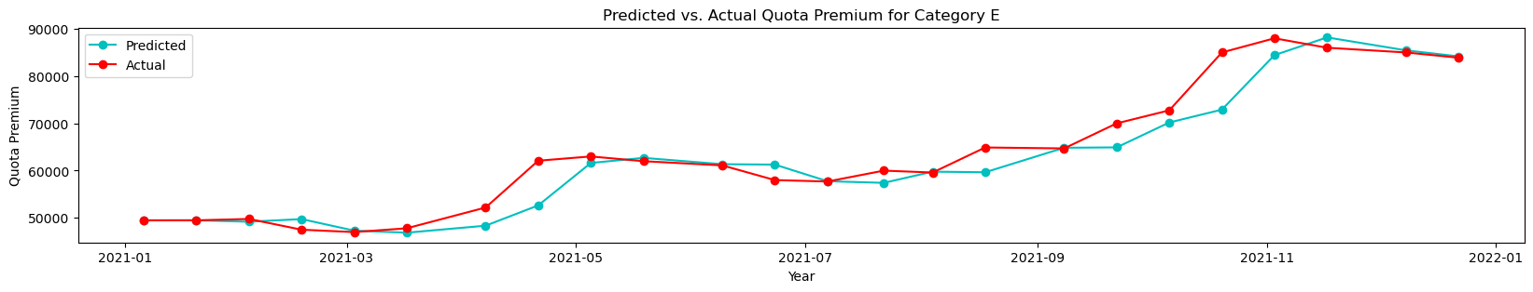
LinReg Predicted vs. Unseen Data

Slide 25
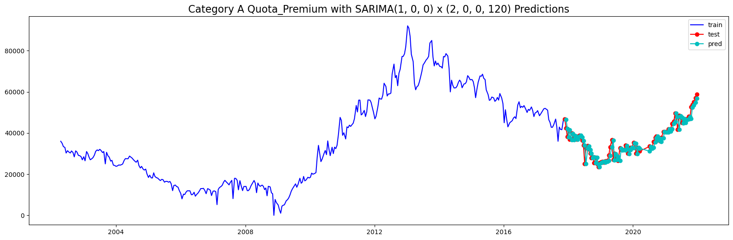
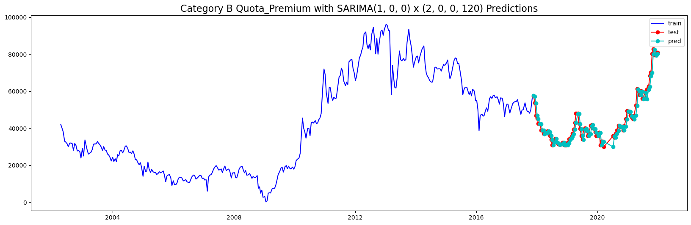
SARIMAX Predicted vs. Unseen Data

Slide 26
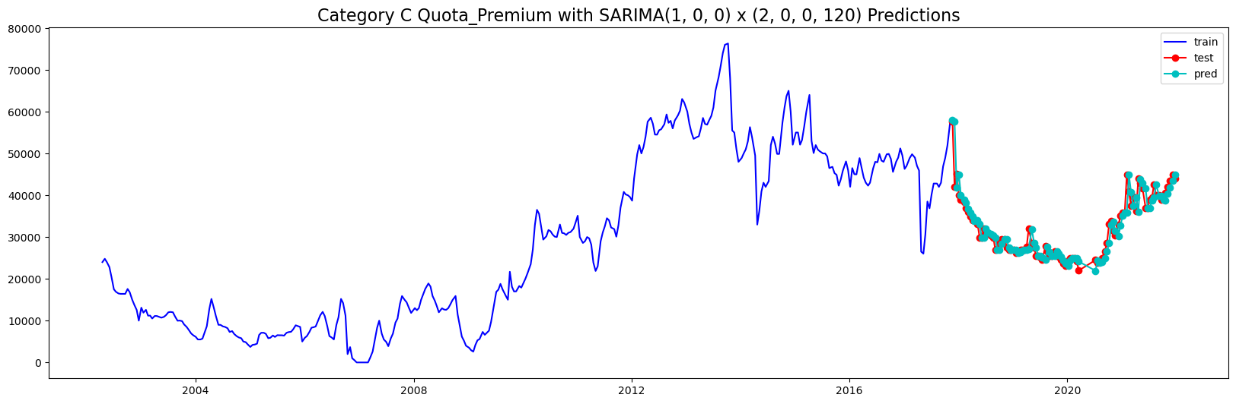
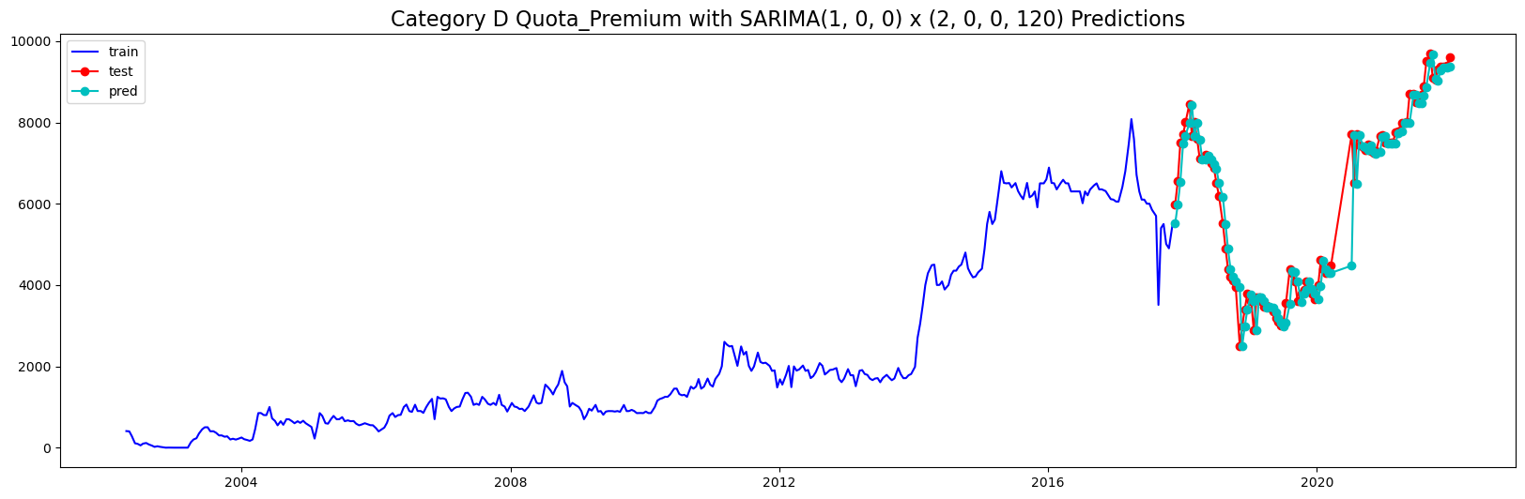
SARIMAX Predicted vs. Unseen Data

Slide 27
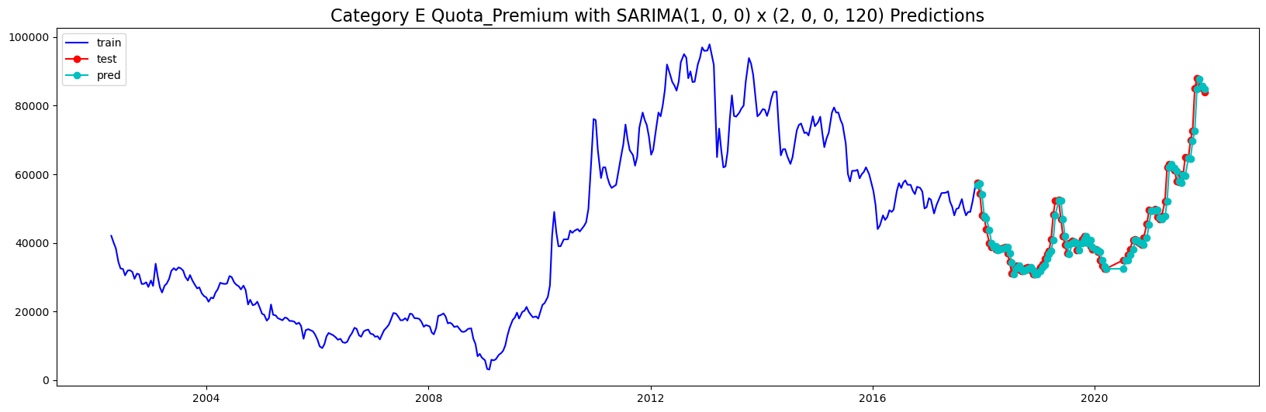
SARIMAX Predicted vs. Unseen Data

