Slide 1
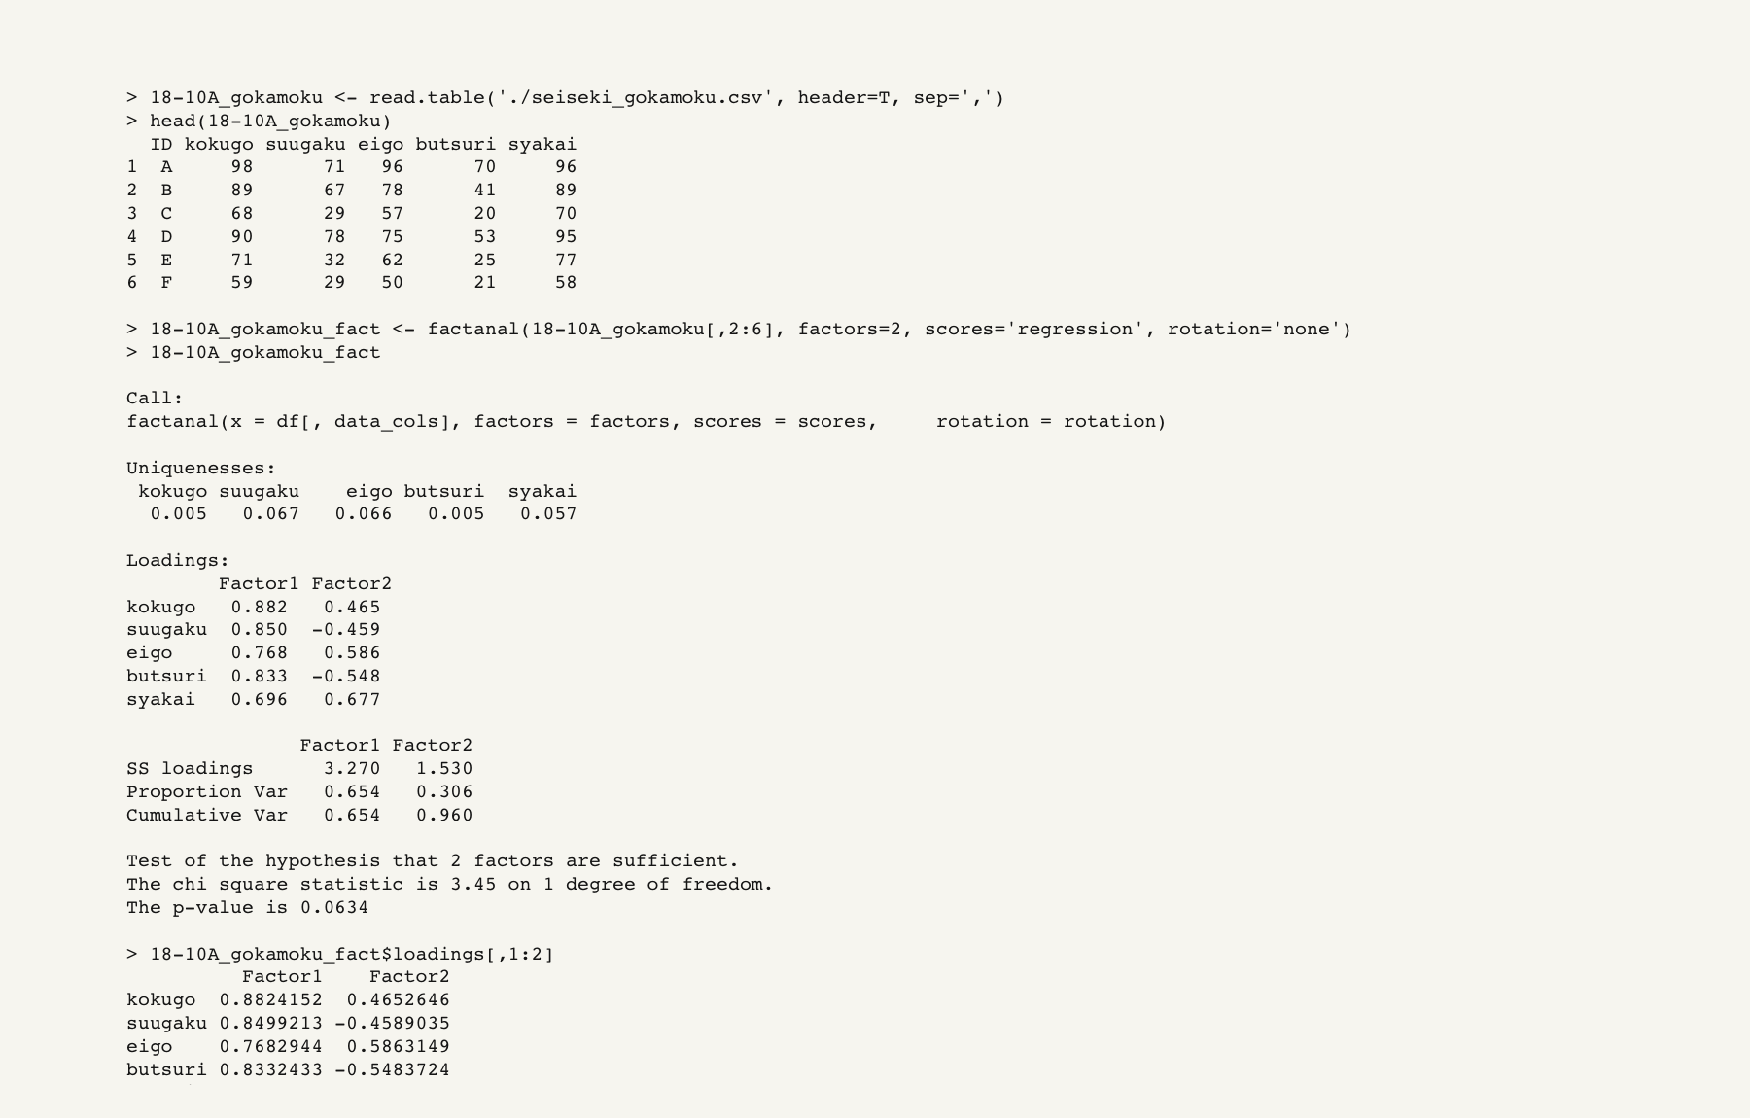
Rでの解析の流れ

Slide 2
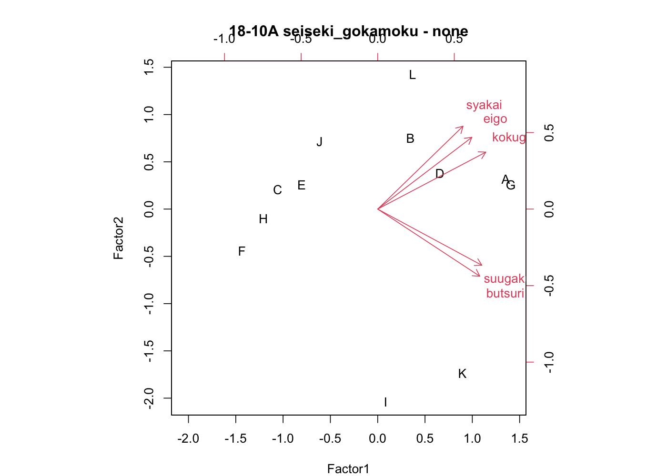
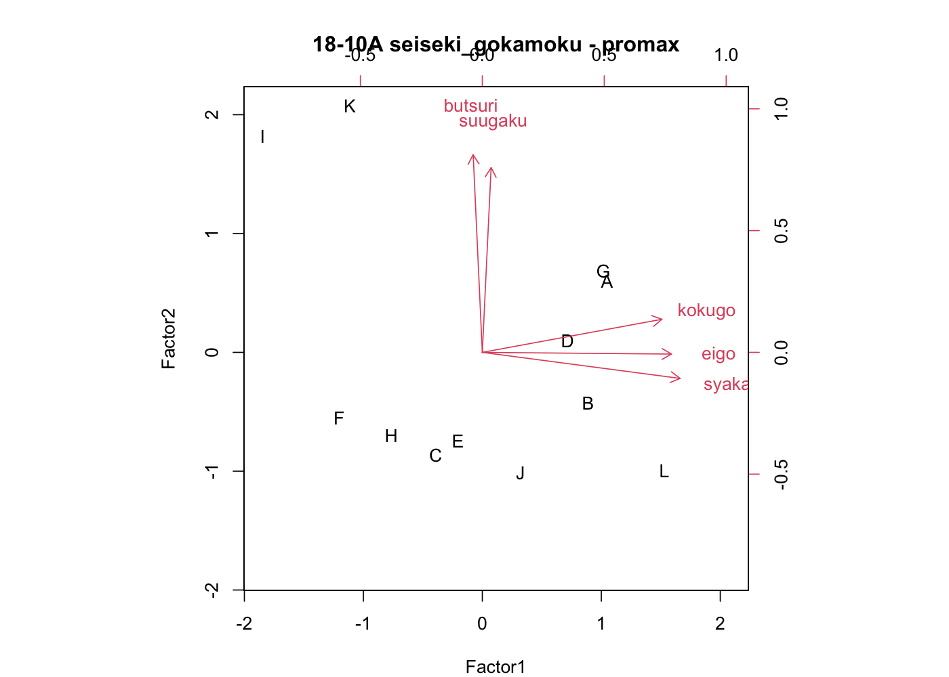
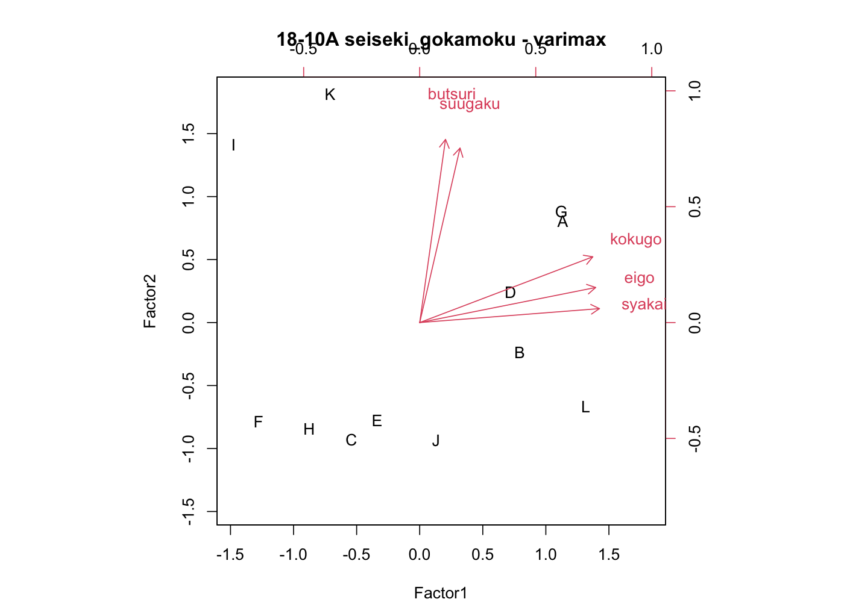
因子得点と因子負荷量

Slide 3
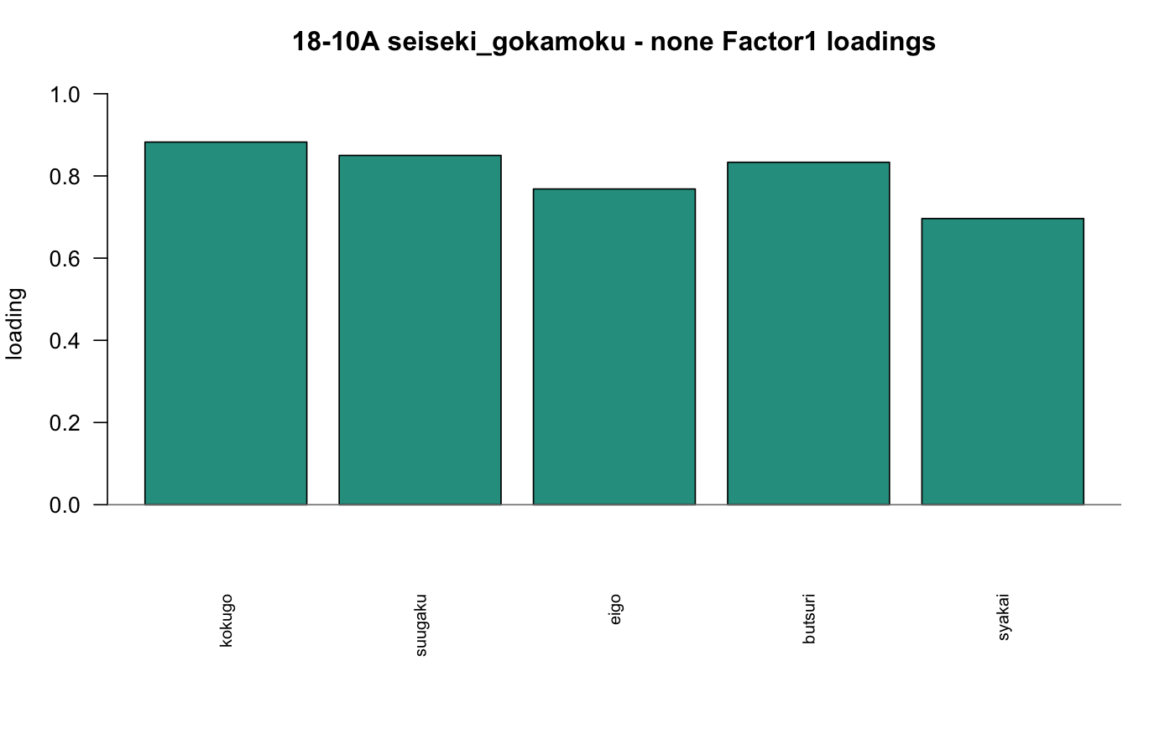
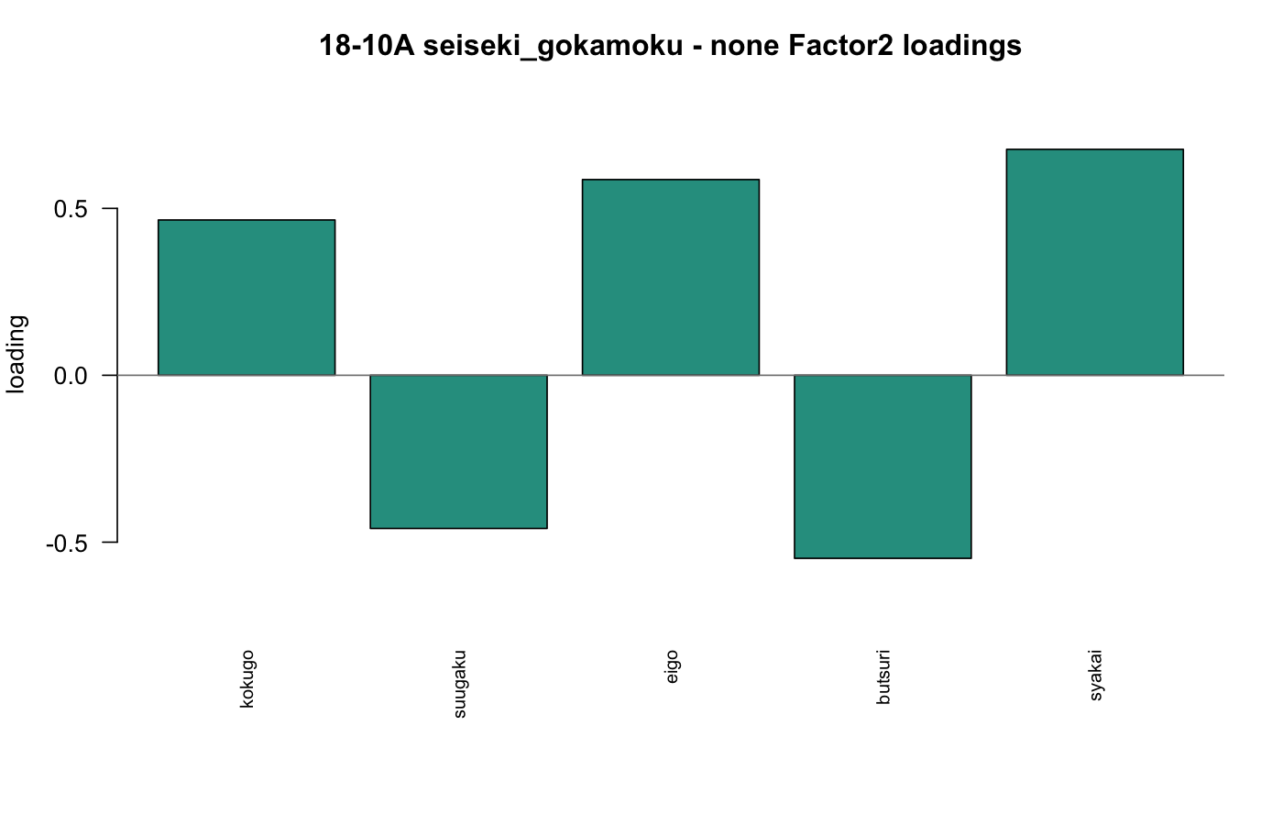
因子負荷量の棒グラフ

Slide 4
ソースコード (1/3)
Class13_rp18-10A_YY.R
1 setwd("/Users/kakigoori/Desktop/data/13")
2
3 dir.create("./answers/plots_pdf", recursive=TRUE, showWarnings=FALSE)
4
5 gokamoku <- read.table("./seiseki_gokamoku.csv", header=T, sep=",")
6
7 gokamoku
8
9 head(gokamoku)
10
11 gokamoku_fact <- factanal(gokamoku[,-1], factors=2, scores="regression", rotation="none")
12
13 str(gokamoku_fact)
14
15 gokamoku_fact
16
17 gokamoku_fact$loadings[1,]
18
19 gokamoku_fact$loadings[1,]^2
20
21 1 - sum(gokamoku_fact$loadings[1,]^2)
22
23 apply(gokamoku_fact$loadings, 1, function(x){1-sum(x^2)})
24
18-10A | source code

Slide 5
ソースコード (2/3)
Class13_rp18-10A_YY.R
25 gokamoku_fact$scores
26
27 pdf("./answers/plots_pdf/18-10A_gokamoku_none_biplot.pdf", width=8.5, height=6.2)
28 biplot(gokamoku_fact$scores, gokamoku_fact$loadings, xlabs=gokamoku[,1])
29 dev.off()
30
31 pdf("./answers/plots_pdf/18-10A_gokamoku_none_factor1_bar.pdf", width=8, height=5.2)
32 barplot(gokamoku_fact$loadings[,1], cex.names=0.8, las=2, ylim=c(0,1))
33 abline(h=0, col="gray50")
34 dev.off()
35
36 pdf("./answers/plots_pdf/18-10A_gokamoku_none_factor2_bar.pdf", width=8, height=5.2)
37 barplot(gokamoku_fact$loadings[,2], cex.names=0.8, las=2, ylim=c(-0.8,0.8))
38 abline(h=0, col="gray50")
39 dev.off()
40
41 gokamoku_fact <- factanal(gokamoku[,-1], factors=2, scores="regression", rotation="promax")
42
43 pdf("./answers/plots_pdf/18-10A_gokamoku_promax_biplot.pdf", width=8.5, height=6.2)
44 biplot(gokamoku_fact$scores, gokamoku_fact$loadings, xlabs=gokamoku[,1])
45 dev.off()
46
47 pdf("./answers/plots_pdf/18-10A_gokamoku_promax_factor1_bar.pdf", width=8, height=5.2)
48 barplot(gokamoku_fact$loadings[,1], cex.names=0.8, las=2, ylim=c(-0.3,1.2))
18-10A | source code

Slide 6
ソースコード (3/3)
Class13_rp18-10A_YY.R
49 abline(h=0, col="gray50")
50 dev.off()
51
52 pdf("./answers/plots_pdf/18-10A_gokamoku_promax_factor2_bar.pdf", width=8, height=5.2)
53 barplot(gokamoku_fact$loadings[,2], cex.names=0.8, las=2, ylim=c(-0.3,1.2))
54 abline(h=0, col="gray50")
55 dev.off()
56
57 gokamoku_fact <- factanal(gokamoku[,-1], factors=2, scores="regression", rotation="varimax")
58
59 pdf("./answers/plots_pdf/18-10A_gokamoku_varimax_biplot.pdf", width=8.5, height=6.2)
60 biplot(gokamoku_fact$scores, gokamoku_fact$loadings, xlabs=gokamoku[,1])
61 dev.off()
62
63 pdf("./answers/plots_pdf/18-10A_gokamoku_varimax_factor1_bar.pdf", width=8, height=5.2)
64 barplot(gokamoku_fact$loadings[,1], cex.names=0.8, las=2, ylim=c(-0.3,1.2))
65 abline(h=0, col="gray50")
66 dev.off()
67
68 pdf("./answers/plots_pdf/18-10A_gokamoku_varimax_factor2_bar.pdf", width=8, height=5.2)
69 barplot(gokamoku_fact$loadings[,2], cex.names=0.8, las=2, ylim=c(-0.3,1.2))
70 abline(h=0, col="gray50")
71 dev.off()
18-10A | source code

