Slide 1
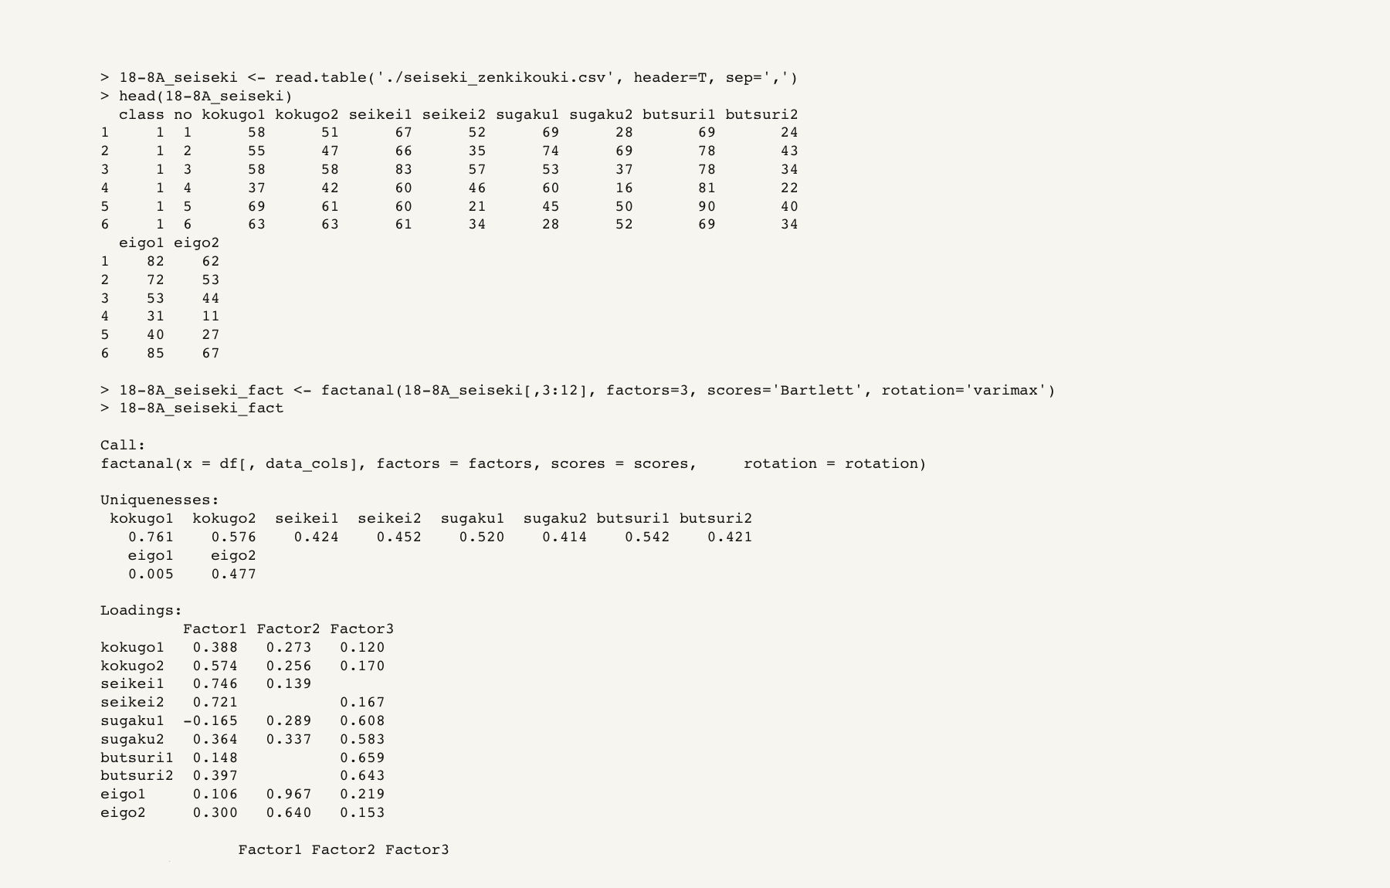
Rでの解析の流れ

Slide 2
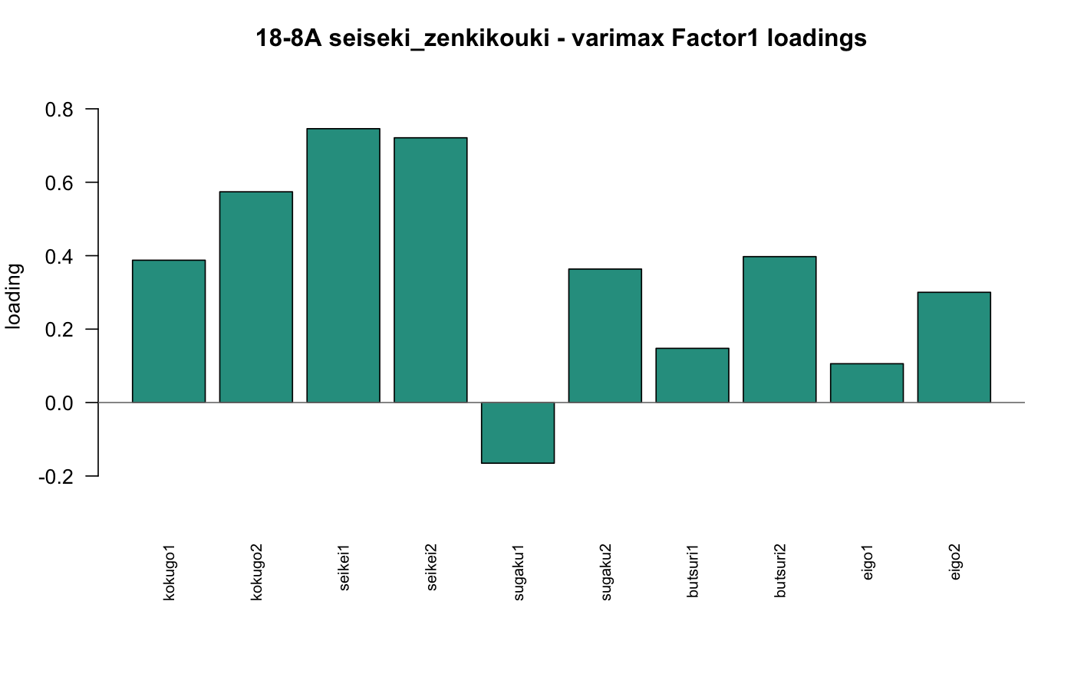
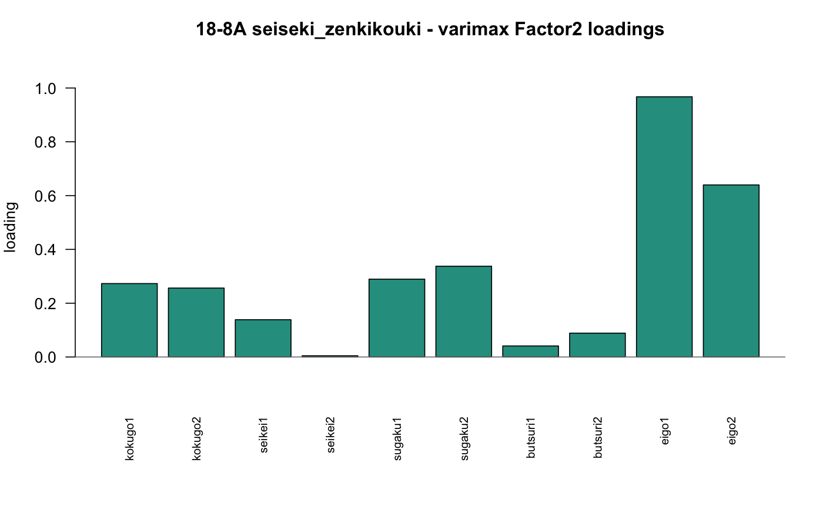
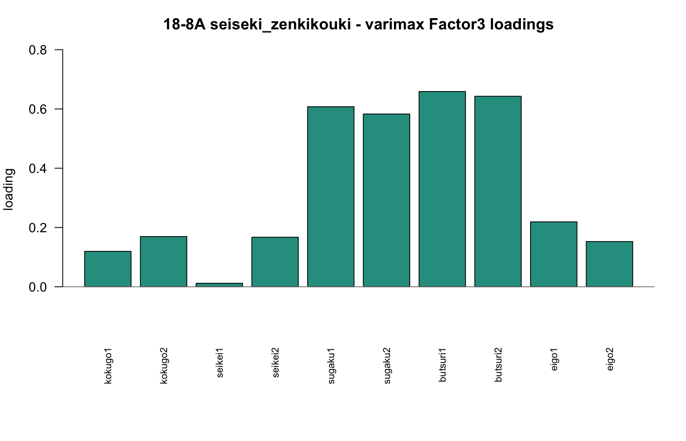
因子負荷量の棒グラフ

Slide 3
ソースコード (1/2)
Class13_rp18-8A_YY.R
1 setwd("/Users/kakigoori/Desktop/data/13")
2
3 dir.create("./answers/plots_pdf", recursive=TRUE, showWarnings=FALSE)
4
5 seiseki <- read.table("./seiseki_zenkikouki.csv", header=T, sep=",")
6
7 seiseki
8
9 head(seiseki, 5)
10
11 seiseki_fact <- factanal(seiseki[,3:12], factors=3)
12
13 seiseki_fact
14
15 names(seiseki_fact)
16
17 seiseki_fact <- factanal(seiseki[,3:12], factors=3, scores="Bartlett")
18
19 names(seiseki_fact)
20
21 head(seiseki_fact$scores, 5)
22
23 tail(seiseki_fact$scores, 5)
24
18-8A | source code

Slide 4
ソースコード (2/2)
Class13_rp18-8A_YY.R
25 seiseki_fact$loadings[,1:3]
26
27 pdf("./answers/plots_pdf/18-8A_seiseki_factor1_bar.pdf", width=8, height=5.2)
28 barplot(seiseki_fact$loadings[,1], cex.names=0.8, las=2, ylim=c(-0.3,1))
29 abline(h=0, col="gray50")
30 dev.off()
31
32 pdf("./answers/plots_pdf/18-8A_seiseki_factor2_bar.pdf", width=8, height=5.2)
33 barplot(seiseki_fact$loadings[,2], cex.names=0.8, las=2, ylim=c(-0.3,1))
34 abline(h=0, col="gray50")
35 dev.off()
36
37 pdf("./answers/plots_pdf/18-8A_seiseki_factor3_bar.pdf", width=8, height=5.2)
38 barplot(seiseki_fact$loadings[,3], cex.names=0.8, las=2, ylim=c(-0.3,1))
39 abline(h=0, col="gray50")
40 dev.off()
18-8A | source code

