Slide 1
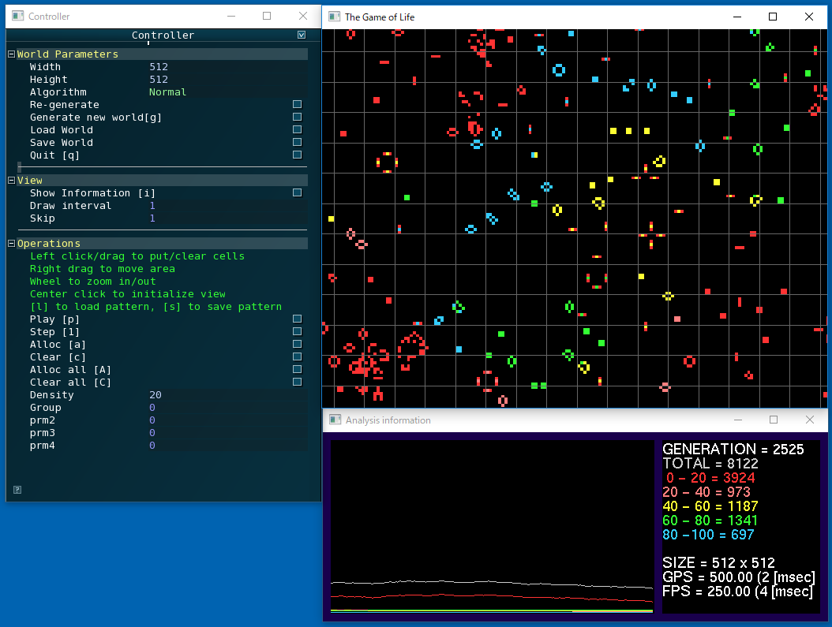
Speeding up Conway’s Game of Life

Slide 2


Step 0
Implementation in HTML5 & JavaScript

Slide 3


Step 1
Implementation in C++, OpenGL

Slide 4
Step 1-1
Implementation in C++, OpenGL
Optimize algorithm
Logic with border check
(Slow)
Logic with border check
(Slow)
Logic without border check
(Fast)

Slide 5

Step 2
Implementation in C++, OpenGL, OpenMP

Slide 6
Step 2
Implementation on C++, OpenGL, OpenMP
CORE 0
CORE 1
CORE 2
CORE 3
Core i7-6700 @3.4GHz
4 cores (8 logical cores)

Slide 7

Step 3
Implementation in C++, OpenGL, CUDA

Slide 8
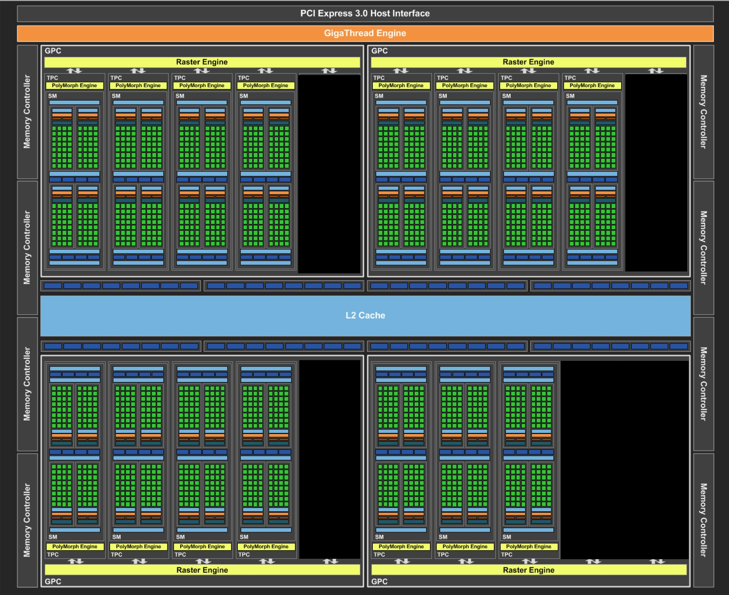
Step 3
Implementation in C++, OpenGL, CUDA
GeForce GTX 1070 @1.531GHz
1920 CUDA Cores
15 SMs
256GByte/s (256bit x 8Gbps)

Slide 9
Step 3-1
Implementation on C++, OpenGL, CUDA
Optimize CUDA Code
pinned memory
Allocate as pinned (non-pageable) memory
Allocate as pinned (non-pageable) memory
DDR on Host
DDR on Host
Pageable memory
Non-Pageable memory
Redundant copy
cudaMemcpy
(h2d)
cudaMemcpy
(d2h)
cudaMemcpy
(h2d)
cudaMemcpy
(d2h)
Calculation
Calculation
DDR on Device
(Global memory)
DDR on Device
(Global memory)

Slide 10
Step 3-2
Implementation in C++, OpenGL, CUDA
Optimize CUDA Code
pinned memory, shared memory
DDR on Device
(Global memory)
read x 9
write x 1
copy x 1
(for 1 cell)
write x 1
slow
Calculation for 1 cell
read x 9
Shared memory
Calculation for 1 cell

Slide 11
Step 3-3
Implementation in C++, OpenGL, CUDA
Optimize CUDA Code
pinned memory, shared memory, stream
DDR on Host
Copy(h2d)
calculation
Copy(d2h)
time
Separate area
Make pipeline
cudaMemcpy
(h2d)
cudaMemcpy
(d2h)
h2d
calc
d2h
stream0
h2d
calc
d2h
stream1
Calculation
DDR on Device
(Global memory)
time

Slide 12
Step 3-4
Implementation in C++, OpenGL, CUDA
Optimize CUDA Code
pinned memory, shared memory, stream
decrease copy operations
DDR on Host
DDR on Host
Copy only at the first frame
No need for copy every frame
cudaMemcpy
(h2d)
cudaMemcpy
(d2h)
cudaMemcpy
(h2d)
cudaMemcpy
(d2h)
Calculation
Calculation
DDR on Device
(Global memory)
DDR on Device
(Global memory)

Slide 13
Result

