Slide 1
Not Talking
Training
Model File
(TensorFlow Lite
for Microcontrollers)
Talking
Training Data (wav files)
Deploy
line
i2c
Mic
Raspberry Pi Pico
Display

Slide 2

NOT TALKING
Quiet
Voice from a distance
Music
Noise, Others
TALKING
Voice
Voice
(more than one person)
Voice + Music
Voice + Noise

Slide 3
pico-pdm
PdmBuffer
AudioProvider
FeatureProvider
PDM
WP
feature_buffer
(40 Byte x 499)
Sampling Rate = 16kHz
local_buffer (2 x 512 Byte)
feature@0ms
RP
feature@20ms
...
max. 64 msec
feature@9940ms
feature@9960ms
Ring Block Buffer
Calculate decibel
Inference
Structure of the Ring Block Buffer
Decibel
- -50 ~ 0 [dB]
Classified sound type
- Talking
- Not Talking
block[0] : data of block_size (512 Byte)
<- WP - 2: valid
block[1] : data of block_size (512 Byte)
<- WP - 1: valid
...
block[2] : data of block_size (512 Byte)
<- WP: ptr to be written
at the next WRITE
Judgement
block[buffer_size - 1] : data of block_size
Final result
- Talking (Loud)
- Not Talking
32 msec x buffer_size

Slide 4
main
AudioProvider
FeatureProvider
tflite:: MicroInterpreter
Oled
use
AudioBuffer
PdmBuffer
AdcBuffer
TestBuffer
RingBlockBuffer

Slide 5
DL Model
line
i2c
Mic
Raspberry Pi Pico
Display

Slide 6
NOT TALKING
Quiet
Voice from a distance
Music
Noise, Others
TALKING
Voice
Voice
(more than one person)
Voice + Music
Voice + Noise

Slide 7
DL Model
Not Talking
line
i2c
Voice from
a distance
Mic
Quiet
Raspberry Pi Pico
Display
Music
Noise, Others

Slide 8
DL Model
Not Talking
line
i2c
Quiet
Mic
Raspberry Pi Pico
Display

Slide 9
DL Model
Not Talking
Voice from
a distance
line
i2c
Mic
Raspberry Pi Pico
Display

Slide 10
DL Model
Not Talking
Music
line
i2c
Mic
Raspberry Pi Pico
Display

Slide 11
DL Model
Not Talking
Noise, Others
line
i2c
Mic
Raspberry Pi Pico
Display

Slide 12
DL Model
Not Talking
line
i2c
Voice from
a distance
Mic
Quiet
Raspberry Pi Pico
Display
Music
Noise, Others

Slide 13
DL Model
Talking
line
i2c
Voice
Mic
Raspberry Pi Pico
Display

Slide 14
DL Model
Talking
line
i2c
Mic
Voice
(more than one person)
Raspberry Pi Pico
Display

Slide 15
DL Model
Talking
line
i2c
Mic
Voice + Music
Raspberry Pi Pico
Display

Slide 16
DL Model
Talking
line
i2c
Mic
Voice + Noise
Raspberry Pi Pico
Display

Slide 17
DL Model
Talking
line
i2c
Voice
Mic
Voice
(more than one)
Raspberry Pi Pico
Display
Voice + Music
Voice + Noise

Slide 18


Slide 20
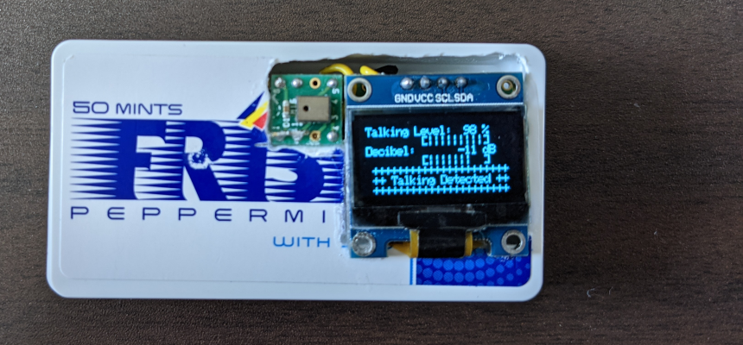
Score of “talking”
Voice level
Result

Slide 22
!
The loud talking detector implemented in an order call system

