Slide 1

Chat With Data
Natural Language Charts and Insights from Spreadsheets
[Mini Project]
[Student Name]
[College Name] | [2025-2026]

Slide 2

The problem
Knowing what to ask isn't the same as knowing how to build it
Answering "what % is male vs female this month" means building the right pivot, formula, or chart manually
That barrier repeats every time the question or the data changes
Generic chatbots can't compute an answer from a spreadsheet they can't actually run code against
“Give me male and female % contribution this month.”
2

Slide 3




Objectives
Upload any spreadsheet
Turn questions into code
CSV or multi-sheet Excel, one or many at once
Let an LLM write pandas + Plotly, not fixed templates
Chart or answer, correctly
Stay safe and self-correcting
Route each question to a visual or a direct answer
Sandbox execution, retry automatically on error
3

Slide 4
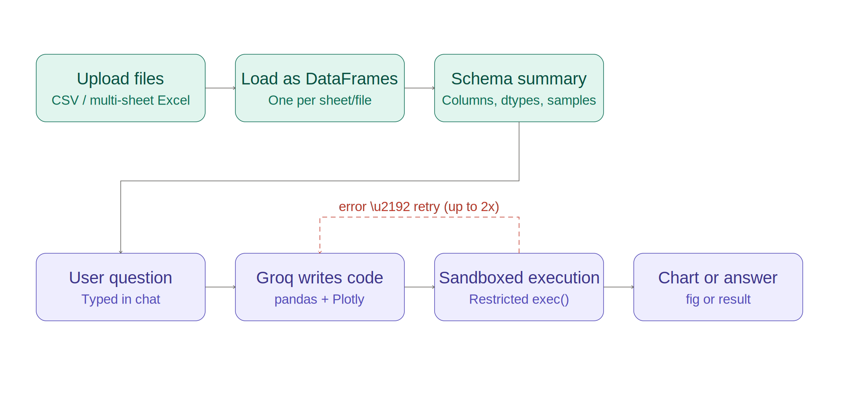
System architecture
Load once, then generate and run fresh code for every question
4

Slide 5
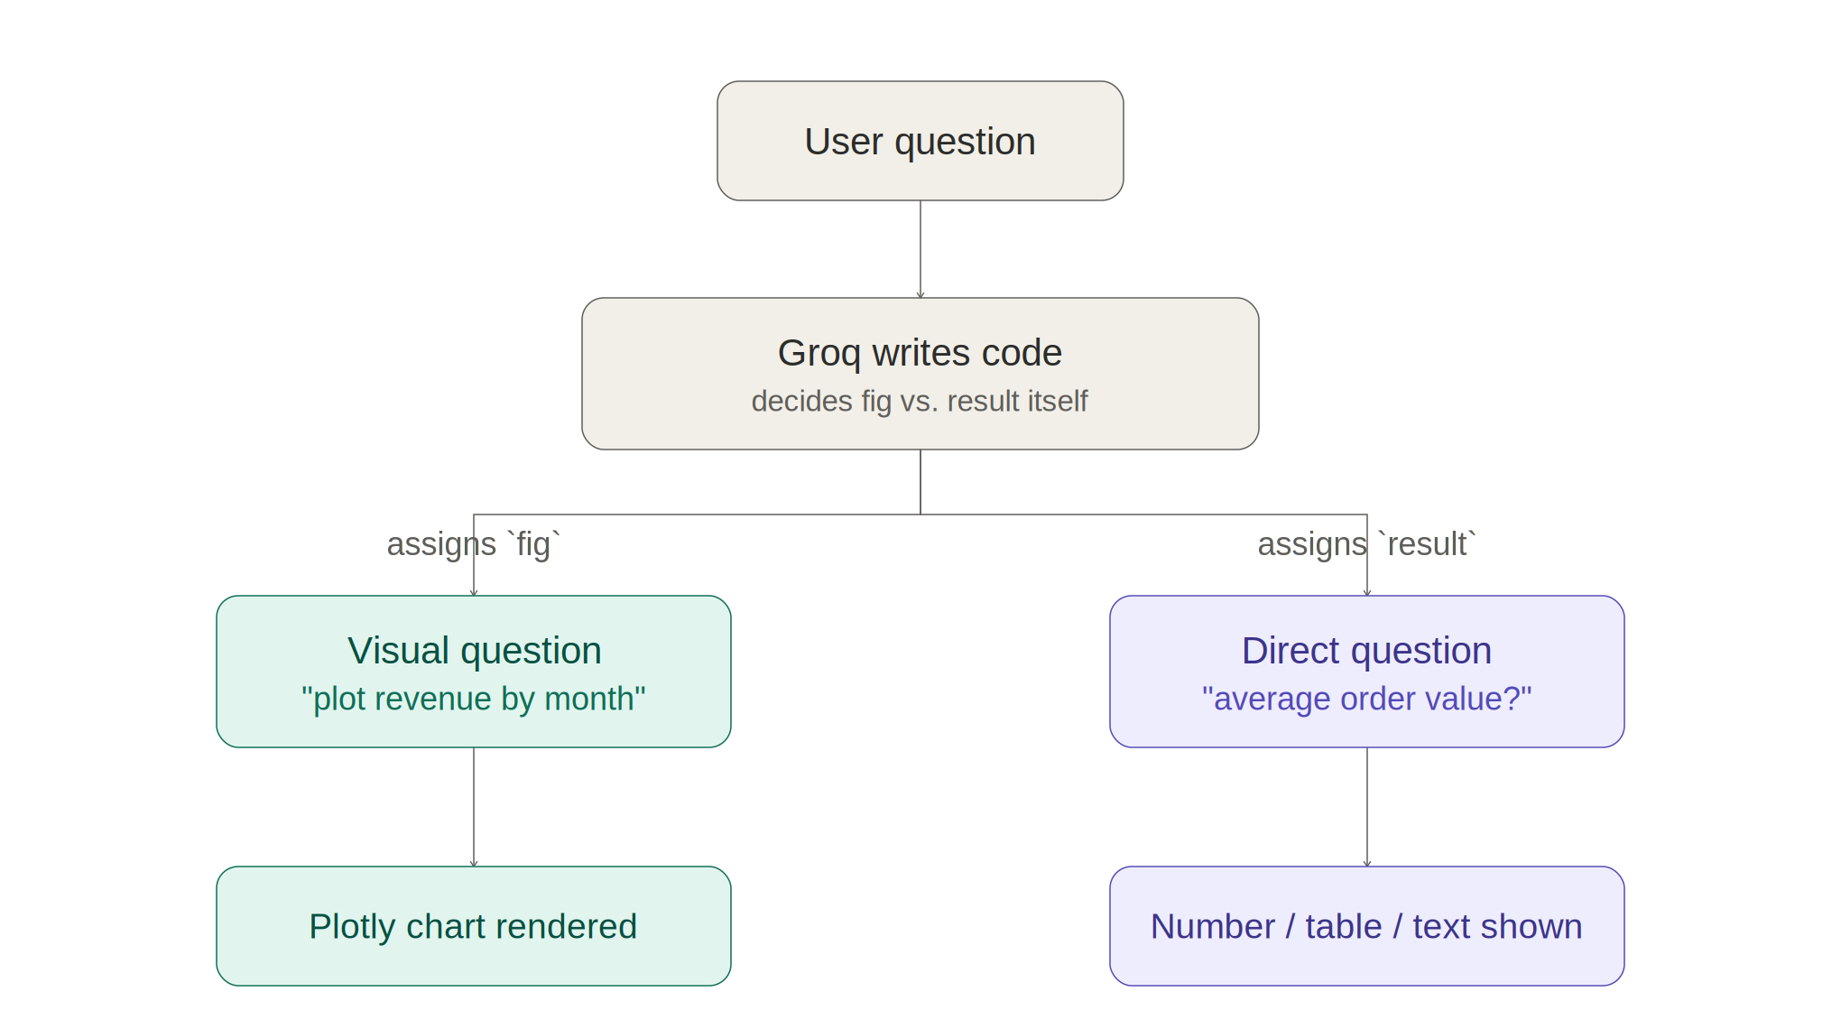
Chart or direct answer?
One code-generation step decides for itself, by which variable it assigns
5

Slide 6




Technology stack
Python 3
Streamlit
pandas
Plotly
Core language
Chat + upload interface
Data loading, joins, aggregation
Interactive charts
Groq API
openpyxl
Sandboxed exec()
Retry loop
Free, fast code generation
Multi-sheet Excel reading
Restricted, safe code execution
Self-corrects on error
6

Slide 7
Why sandbox the generated code
The code is written by a model, not by us — it has to be contained before it runs
Restricted builtins
Approved libraries only
Error-driven retry
No open(), no __import__, no eval/exec — only safe, minimal Python built-ins are exposed
pandas, numpy, and Plotly are in scope — nothing else can be imported
A failed run's error message is fed back to the model for up to 2 corrected attempts
7

Slide 8
Why the retry loop matters
Example: the model guesses a column name slightly wrong on the first try
Without retry
With retry
Code references a column that doesn't quite match the real name
Execution raises a KeyError
User just sees a failure, with no path to a working answer
The KeyError and its message are sent back to the model
Model corrects the column name and rewrites the code
Corrected code runs successfully — user just sees the right answer
8

Slide 9
Answering questions across sheets
Every uploaded sheet becomes its own named table
The model sees every table's schema at once
It writes its own pd.merge() when a question needs more than one table
No manual join configuration required from the user
Q: Male vs female % contribution this month?
merged = pd.merge(contributions, employees, on="employee_id")
...
fig = px.pie(grouped, names="gender", values="percent")
→ Pie chart: Female 59.5% / Male 40.5%
9

Slide 10
Testing & results
10
Multi-sheet Excel and CSV loaded together correctly
/ 10
Chart and direct-answer questions both routed correctly
test cases passed
Cross-sheet joins written correctly by generated code
Retry loop recovers from a column-name error
Sandbox blocks file and import access
10

Slide 11
Demo
[ insert screenshot ]
[ insert screenshot ]
[ insert screenshot ]
Screenshot: file upload and loaded tables
Screenshot: chart question and result
Screenshot: generated code inspection
11

Slide 12

Challenges faced
Executing model-written code safely
Column names the model got slightly wrong
Solved with a restricted exec() sandbox exposing only approved libraries
Solved with the error-driven retry loop, up to 2 corrected attempts
Deciding chart vs. text automatically
Joining tables without manual config
Solved via a fig/result variable convention the model itself follows
Solved by giving the model every table's schema and letting it write its own merge
12

Slide 13


Future scope
Direct database connections, not just uploaded files
Persistent sessions across app restarts
A validation step checking chart labels against the original question
Explicit clarification prompts for genuinely ambiguous questions
13

Slide 14
Thank you
Questions?

