Slide 1

Chat With YouTube
A Retrieval-Augmented Generation System for Video Transcripts
[Mini Project]
[Student Name]
[College Name] | [2025-2026]

Slide 2

The problem
Long videos hide the exact moment you actually need
YouTube's search only matches the title and description, not what's actually said inside
Finding one fact in a two-hour lecture means scrubbing through it manually
Asking an LLM directly about a video it's never seen risks a hallucinated, plausible-sounding but wrong answer
“What did they say about the 2017 result, again?”
2

Slide 3




Objectives
Turn any video into a knowledge base
Retrieve relevant moments accurately
Paste a YouTube link and get an indexed, queryable transcript
Combine semantic and exact-match search for precision
Generate grounded answers
Cite and jump to every answer
Use an LLM to answer strictly from the retrieved transcript
Show the exact timestamp, and seek the player there on click
3

Slide 4
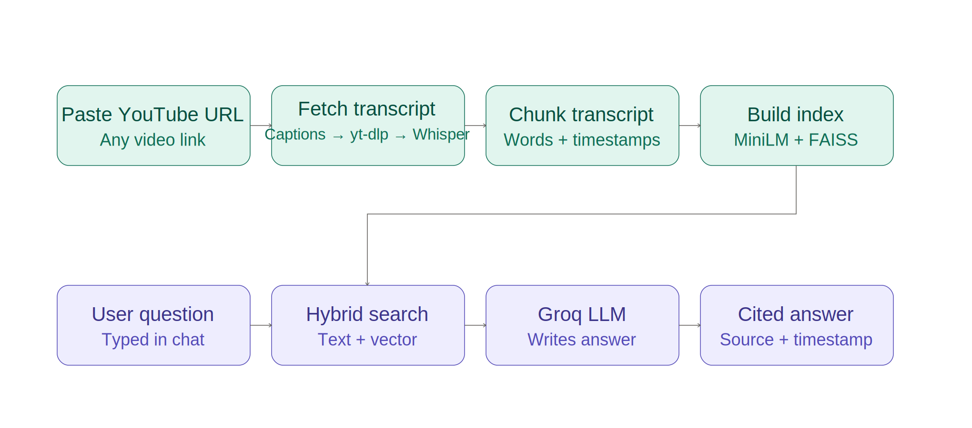
System architecture
Two phases: build the index once, then answer questions against it
Indexing phase — runs once per video
Query phase — runs per question
4
Notes:
Explain: a pasted URL is resolved to a transcript (captions, or yt-dlp/Whisper fallback), then chunked, embedded, and indexed once. Every question then goes through hybrid retrieval against that index, and Groq generates the final answer cited by timestamp.

Slide 5
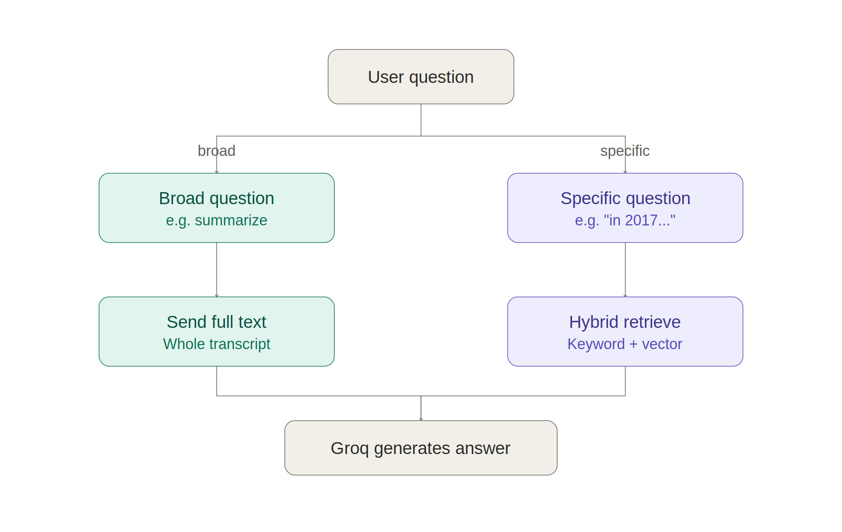
Not all questions are the same
Broad questions (summaries) and specific questions (lookups) need different retrieval strategies
5
Notes:
Vector search alone fails on broad 'summarize this' questions because there's no single matching passage. It also struggles with years and exact quoted phrases, since embeddings capture meaning, not exact digits or wording.

Slide 6







Technology stack
Python 3
Streamlit
youtube-transcript-api
yt-dlp + Whisper
Core language
Chat interface + player
Primary transcript source
Fallback transcript path
sentence-transformers
FAISS
Groq API
Timestamp citations
CPU embeddings
Vector search
Free LLM + Whisper inference
Jumpable player seek
6

Slide 7
Getting a transcript, reliably
Not every video has captions — the pipeline tries three layers before giving up
1. YouTube captions
2. yt-dlp captions
3. Groq Whisper
Fastest path — reads existing manual or auto-generated captions directly, no download needed
Same caption tracks, different code path — used when the first method is rate-limited or blocked
Last resort: downloads audio and transcribes it, for videos with captions disabled entirely
7

Slide 8
Why hybrid retrieval
Example: asking “what happened in 2017” when the transcript also mentions 2016 and 2019
Vector search alone
Hybrid retrieval
Embeddings capture meaning, not exact digits or wording
“2016”, “2017”, and “2019” look almost identical to the model
Result: wrong segment retrieved, or an “I don't have enough information” answer
Detects years and quoted phrases (e.g. “2017”) in the question
Does a literal, exact-match search for that text first
Fills remaining context with vector search results
8

Slide 9
Multi-video support with jumpable citations
Load and query multiple YouTube videos together
Every chunk is tagged with its source video and a timestamp range
Answers cite exactly which video and moment the information came from
Clicking a citation seeks the embedded player to that exact second
Q: What did the speaker say about scaling laws?
They describe how model performance improves predictably as compute, data, and parameters scale up together.
▶ Source: “Scaling Laws Explained”, at 14:22
9

Slide 10
Testing & results
10
All three transcript fallback layers verified (captions, yt-dlp, Whisper)
/ 10
Specific factual questions answered correctly, cited by timestamp
test cases passed
Broad summary questions routed to full-transcript mode
Multi-video queries cite the correct source video
Timestamp citations correctly seek the embedded player
10

Slide 11
Demo
[ insert screenshot ]
[ insert screenshot ]
[ insert screenshot ]
Screenshot: paste-a-URL and indexing screen
Screenshot: chat with a timestamp citation
Screenshot: player after clicking a citation
11

Slide 12


Challenges faced
Not every video has captions
Years and phrases confuse embeddings
Some videos have captions disabled entirely — solved with the yt-dlp and Whisper fallback layers
Vector search alone couldn't reliably distinguish similar years — solved with hybrid retrieval
Keeping citations jump-worthy
Broad vs. specific questions
Chunks needed to stay short in time-span, not just word count, so a citation jumps to a useful moment
A single retrieval strategy didn't work for both summaries and fact lookups — needed explicit routing
12

Slide 13

Future scope
Support additional video platforms, and locally stored video files
Persistent index storage, so videos don't need re-fetching each session
Cross-encoder re-ranking for higher retrieval precision
Speaker diarization, so answers can cite who said what in multi-speaker videos
13

Slide 14
Thank you
Questions?

