Slide 1

Chat With Your PDF
A Retrieval-Augmented Generation System
[Mini Project]
[Student Name]
[College Name] | [2025-2026]

Slide 2

The problem
Large language models are powerful, but they don't know what's inside your PDFs
Keyword search misses matches when a question uses different words than the document
Asking an LLM directly about a private document risks hallucinated, plausible-sounding but wrong answers
There's no easy way to ask natural-language questions and get answers grounded in a specific document
“What does this 40-page PDF actually say about task 3.2.2?”
2

Slide 3




Objectives
Build a searchable knowledge base
Retrieve relevant content accurately
Convert PDF documents into an indexed, queryable form
Combine semantic and exact-match search for precision
Generate grounded answers
Cite every answer
Use an LLM to answer strictly from retrieved content
Show the exact source file and page for verification
3

Slide 4
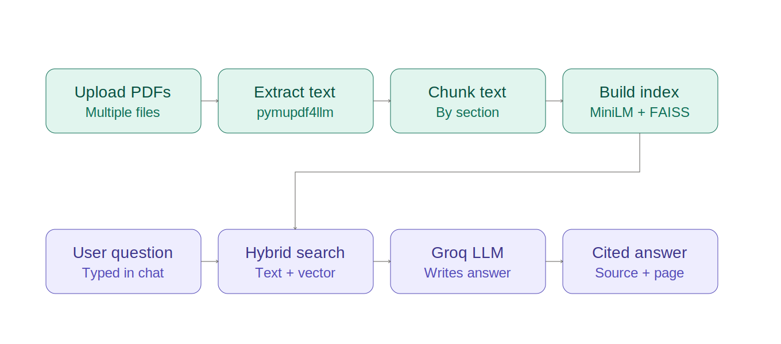
System architecture
Two phases: build the index once, then answer questions against it
Indexing phase — runs once per upload
Query phase — runs per question
4
Notes:
Explain: PDFs are uploaded and indexed once (extract -> chunk -> embed -> FAISS). Every question then goes through hybrid retrieval against that index, and Groq generates the final cited answer.

Slide 5
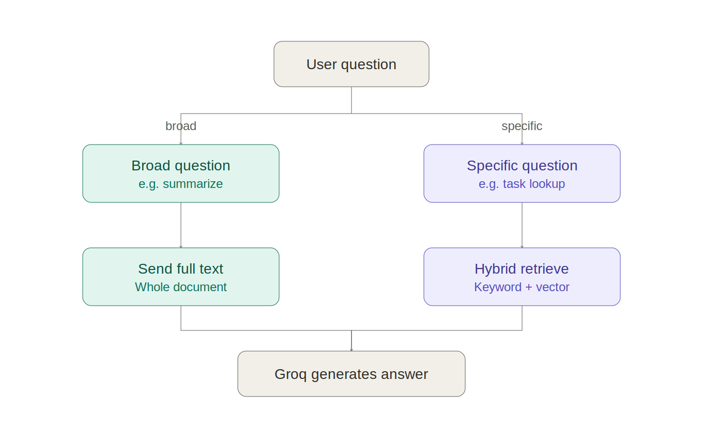
Not all questions are the same
Broad questions (summaries) and specific questions (lookups) need different retrieval strategies
5
Notes:
Vector search alone fails on broad 'summarize this' questions because there's no single matching passage. It also struggles with numeric identifiers like task numbers, since embeddings capture meaning, not exact digits.

Slide 6






Technology stack
Python 3
Streamlit
pymupdf4llm
Core language
Chat interface
PDF to Markdown
sentence-transformers
FAISS
Groq API
CPU embeddings
Vector search
Free LLM inference
6

Slide 7
Why hybrid retrieval
Example: asking about “TASK 3.2.2” when the document also has 3.1.2 and 3.3.1
Vector search alone
Hybrid retrieval
Embeddings capture meaning, not exact digits
“TASK 3.1.2” and “TASK 3.2.2” look almost identical to the model
Result: wrong section retrieved, or an “I don't have enough information” answer
Detects identifier patterns (e.g. “3.2.2”) in the question
Does a literal, exact-match search for that identifier first
Fills remaining context with vector search results
7

Slide 8
Multi-document support with citations
Upload and query multiple PDFs together
Every chunk is tagged with its source file and page number
Answers cite exactly where the information came from
Documents can be removed from the index without restarting
Q: What is the deadline for Task 2.1?
The deadline for Task 2.1 is the end of Sprint 3, as defined in the project schedule.
Source: project_plan.pdf, page 6
8

Slide 9
Testing & results
7
Specific factual questions answered correctly, with citations
/ 7
Broad summary questions routed to full-document mode
test cases passed
Similar numeric identifiers (e.g. task 3.1.2 vs 3.2.2) correctly distinguished
Multi-document queries cite the correct source file
9

Slide 10
Demo
[ insert screenshot ]
[ insert screenshot ]
[ insert screenshot ]
Screenshot: PDF upload and indexing screen
Screenshot: chat with a cited answer
Screenshot: loaded-documents panel
10

Slide 11


Challenges faced
CPU-only constraint
Numeric identifiers confuse embeddings
Chose lightweight models (MiniLM, FAISS flat index) that run efficiently without a GPU
Vector search alone couldn't reliably distinguish similar task numbers — solved with hybrid retrieval
Chunking boundaries
Broad vs. specific questions
Splitting by markdown headers keeps sections coherent, but pages without clear headings need careful handling
A single retrieval strategy didn't work for both summaries and fact lookups — needed explicit routing
11

Slide 12

Future scope
Support additional formats: Word, PowerPoint, scanned documents via OCR
Persistent index storage, so documents don't need re-uploading each session
Cross-encoder re-ranking for higher retrieval precision
Multi-user support with authentication and separate document collections
12

Slide 13
Thank you
Questions?

