Slide 1
thermomec
notes from testing and progress

Slide 2
Test programs
In the folder ‘test’ there are several sub-folders testing individual aspects of the program.
Each sub-folder contains:
  Makefile which should check the dependencies and recompile the program if necessary
  test_something.cpp which is the actual test program(s)
  plot_something.gp which should plot the output using gnuplot
  run_test.sh which is a script to compile, run and plot all test programs in the folder

Slide 3
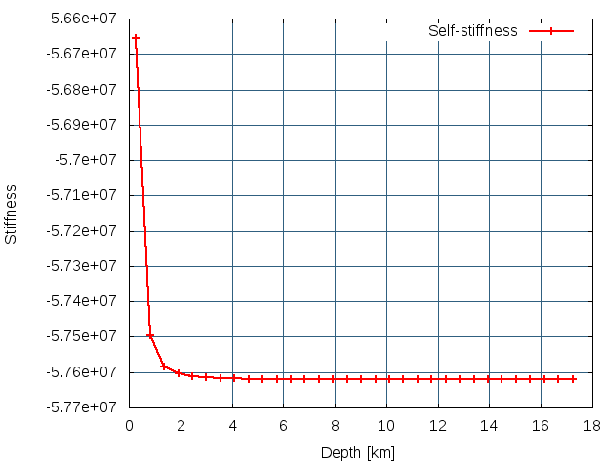
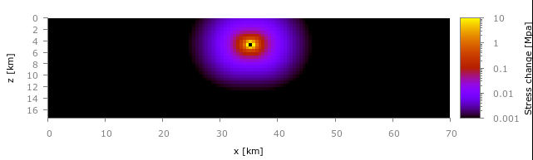
test_selfstiffness/test_stiffness
Tests that the stiffness matrix is set up correctly
Self-stiffness defines the change in stress as a function of slip for that cell. It does not include the change in stress due to slip in other cells. It is influenced by the depth (i.e., distance from free-surface) and rigidity.
Stiffness matrix defines the (instantaneous) change in stress for one slip cell as a function of slip in any other cell. Slip can be seismic or aseismic.
Self-stiffness as a function of depth, checked the same as for 1991 code
Example shows change in stress after 1 m of slip in a cell at the middle, not log scale

Slide 4
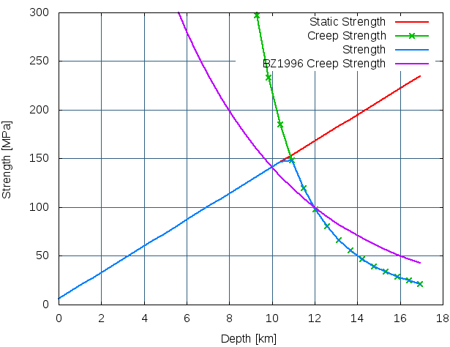
test_strength/test_faultstrength
Note: Arrhenius relation leads to steeper decay than in 1991 paper
tests the static strength with depth
tests the stress required for creep at plate velocity with depth as a function of background temperature
Parameters
Fault width, w = 10 cm
Halfspace Rigidity: 30 GPa
Plate velocity, Vp = 35 mm/yr
Temperature:
T/[K]= 293.15 + 20 z / [km]
Static Strength:
taus/[MPa] = 6 + 0.75 * 18 * z / [km]
Creep Strength:
tauC/[Pa] = { (strainRate/A)*exp( E/RT) }^(⅓)
where
strainRate = Vp/w TODO: check this is correct
A = 6.31 x 10^-20 Pa^3 s
E = 130 kJ / mol
R = gas constant

Slide 5
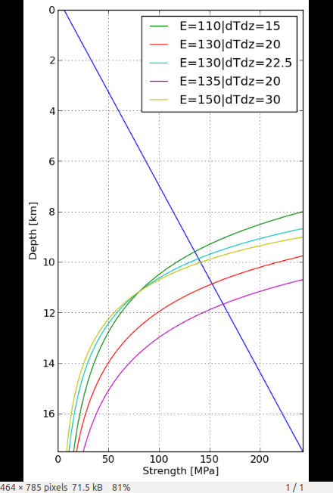
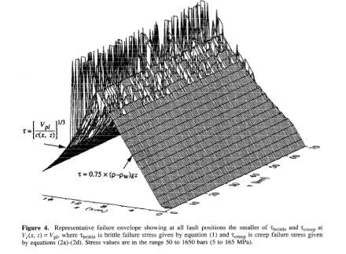
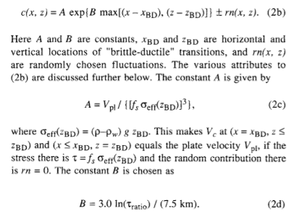
plot_strengthprofile.py
tests how background temperature gradient and activation energy affect the strength profile
Details of BZ1996 model. Note creep decays differently. We cannot choose values of E, T0, dT/dz to reproduce the same shape in our model

Slide 6
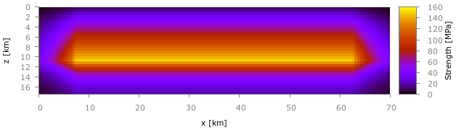
test_strength/test_faultstrength
Parameters
128 x 32 fault (70 x 17.5 km)
Fault width, w = 10 cm
Halfspace Rigidity: 30 GPa
Plate velocity, Vp = 35 mm/yr
Temperature: T/[K]= 293.15 + 20 z / [km]
Static Strength: taus/[MPa] = 6 + 0.75 * 18 * z / [km]
Creep Strength: tauC/[Pa] = { (strainRate/A)*exp( E/RT) }^(⅓)
where
strainRate = Vp/w
A = 6.31 x 10^-20 Pa^3 s
E = 130 kJ / mol
R = gas constant
tests the static strength profile over the entire fault
Tests the implementation of creeping boundaries
Side Creep Mask
Mimic BenZion 1996 creep mask.
In left and right 7.5 km turn off T dependence by E = 0, then set A to be C, as defined in BZ1996
A = [strainRate/min(tauS,tauC)^3] exp(3*ln(4)*(1-x/7.5km) )
Note use strain rate here, not Vpl used in original

Slide 7
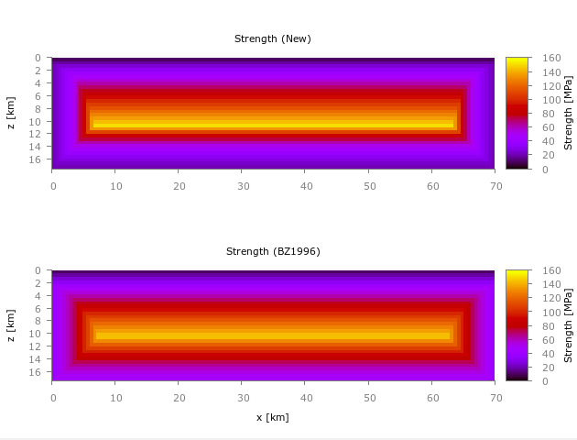
test_strength/test_faultstrength (27-Jul-2014)
Adjusted creep mask behavior after comparison with BZ code (previously misunderstood how it works)
Previous method leads to stress concentrations
New method leads to constant strength with depth in each column
To make like BZ1996...
So creep decreases as fn of x, independent of depth
BZ1996 creep such that lower 10 km and side 10 km have the same increase in strength

Slide 8
test_cooling/test_cardwell (updated 22-Aug-2014)
test that the cooling method works by outputting some numbers to terminal
Fault Cooling Model
initTemp * integrate( erf(X) – erf(-X) )
where X = faultWidth/sqrt( 2*diffusivity*timeSinceSlip )
integrated using Romberg Integration
Three parameters for integration are set at the beginning of any program
e.g.,
int Romberg::JMAX = 20;
int Romberg::K = 5;
double Romberg::EPS = 1.0e-10;
Program: test_cardwell No. Args: 1
Specified Parameters:
dx = 546.875
dz = 546.875
slip = 1
stress = 1e+08
Slip duration time: 10
Time to calc temperature after end of slip: 17990
density = 2600
fault width = 0.01
diffusivity = 1e-06
specific heat capacity = 790
Results:
Heat = 2.990722656250000e+13
Heatrate = 2.990722656250000e+12
dT = 1.023689927761114e+02
i.e. 100 degree temperature change, 6 hours after 1 m slip in 10 s @ 100 MPa

Slide 9
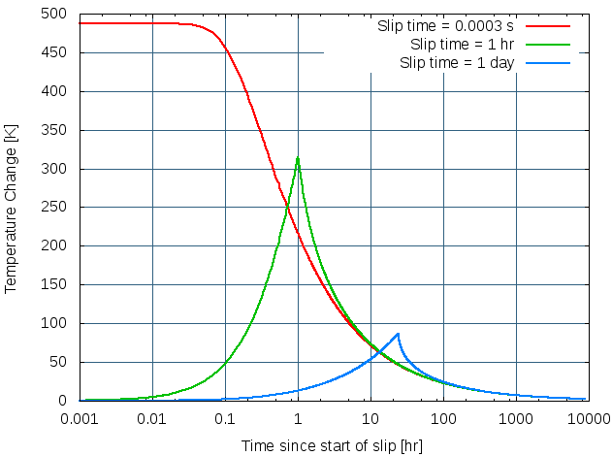
test_cooling (updated 22-Aug-2014)
Single slip cell, 1 m of slip at 100 MPa spread over three different time periods
Parameters:
Density of rock 2.6 g/cm^3
Fault width = 10 cm
Diffusivity = 0.01 cm^2/s
Specific Heat Capacity = 790 J/(kg K)
Note log-scale of time
temperature highest at end of slip
all collapse to common curve at ~10x the end of slip

Slide 10
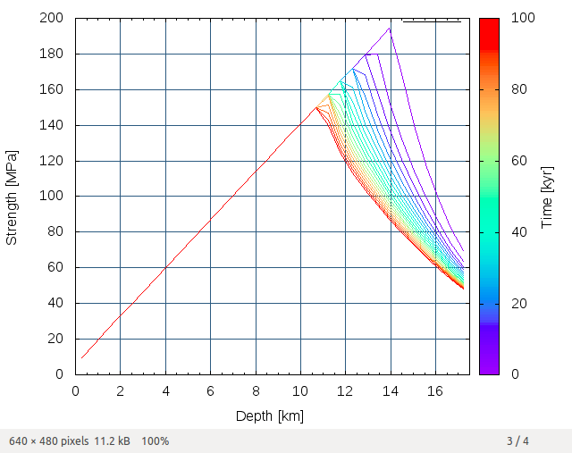
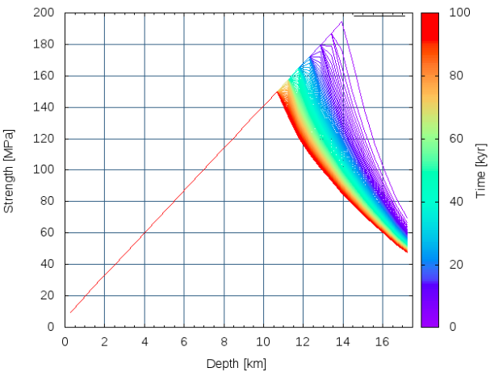
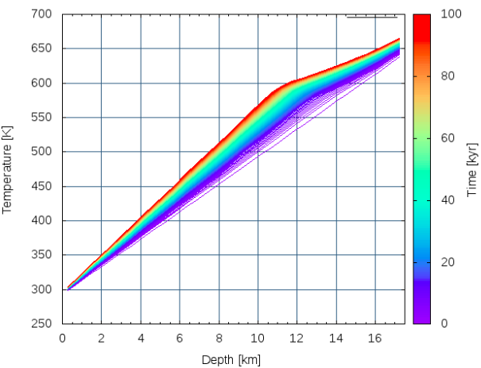
test_strength/test_strength_evol (21-Aug-2014)
Test the how the strength depth-profile changes given temp generated by creep
over a long time with no seismic slip. Each cell is independent and only
changes if it slips due to creep
Initial setup:
staticStrength = 6 + 0.75*1.8*z
Temp = 293.3 + 20*z
Arrhenius
A = 6.31E-20 Pa^3 s
n = 3
E = 150 kJ/mol
Fault width = 10 cm
Creep calc
- Calc current stress min(stress for creep @Vpl, static_strength)
- Calc current temperature
- Calc creep rate
- load fault at 35 mm/yr – creep rate, store the heat generated by this const creep rate and stress over the time step
time step = 100 yr
time step = 10 yr
Can we use this as an initial temperature profile?

Slide 11
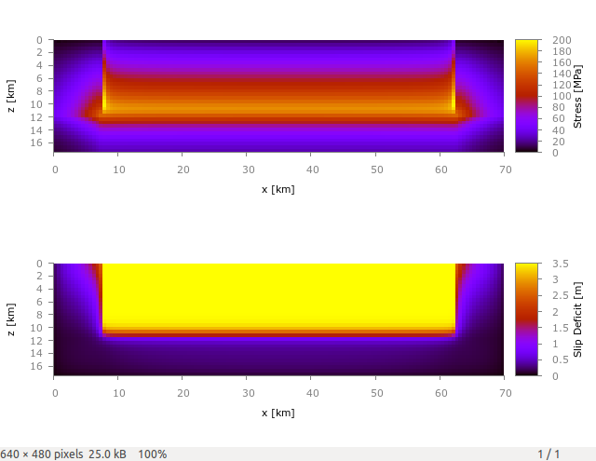
test_loading
Tests that the constant loading produces realistic stress
Loads the fault over N time steps.
Creep computed based on background temperature and stress at each time step
No earthquakes
No heat generation
Outputs the stress, slip deficit and temperature at the end.
Example
128 x 32 fault (70 x 17.5 km)
10 cm width
7.5 km creeping boundary
30 GPa rigidity
Vp = 35 mm/yr
1 yr time step x 100
T = 273.15 + 20 z / [km]
taus = 6 + 0.75 * 18 * z / [km]
vC = 6.31E-20 * exp( -130 )

Slide 12
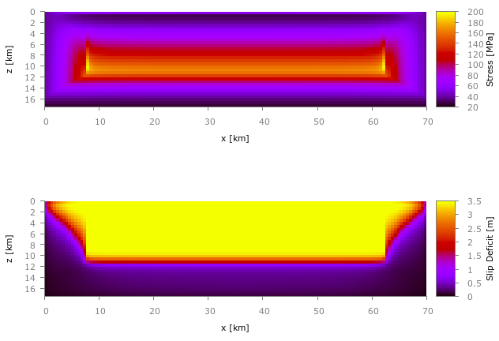
test_loading (21-Aug-2014)
Side creep mask adjusted to be more like Ben-Zion 1996
Tests that the constant loading produces realistic stress
Loads the fault over N time steps.
Creep computed based on background temperature and stress at each time step
No earthquakes
No heat generation
Outputs the stress, slip deficit and temperature at the end.
Example
128 x 32 fault (70 x 17.5 km)
10 cm width
7.5 km creeping boundary
30 GPa rigidity
Vp = 35 mm/yr
1 yr time step x 100
T = 273.15 + 20 z / [km]
taus = 6 + 0.75 * 18 * z / [km]
vC = 6.31E-20 * exp( -130 )

Slide 13
test_noheat
Case where creep parameters vary as a function of stress, no heat generation
… i.e. similar set up to Ben-Zion 1996 but using Arrhenius relation with background temp to define creep
Parameters
70 x 32 cells, 70 x 17.5 km
fault width 10 cm
rigidity 30 GPa
Vpl = 35 mm/yr
Vc = A w tau^3 exp[ -E/RT ]
A = 6.31 x 10^-20 Pa^3 s
E = 130 kJ / mol
R = gas constant
taus = 6 + 0.75 * 18 * z / [km]
Dyn Overshoot Coefficient = 1.25
Slip velocity 6 km/s
Min time step = 1 day
Max time step = 1 yr
Initial stress = min(taus, creep_strength @Vpl)
Time step calculated as time time to failure given creep rate at current stress

Slide 14
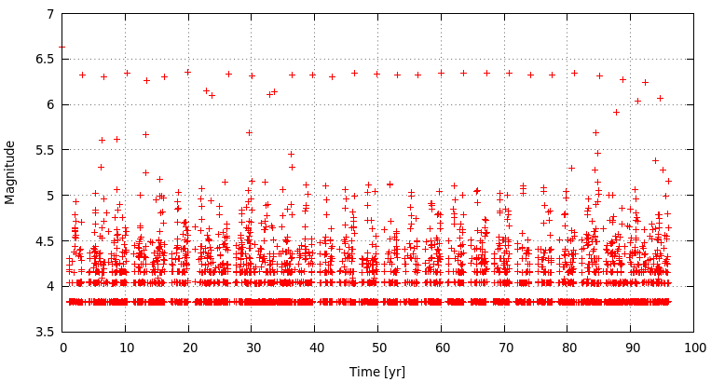
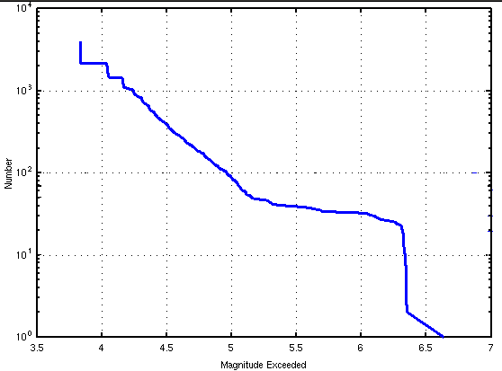
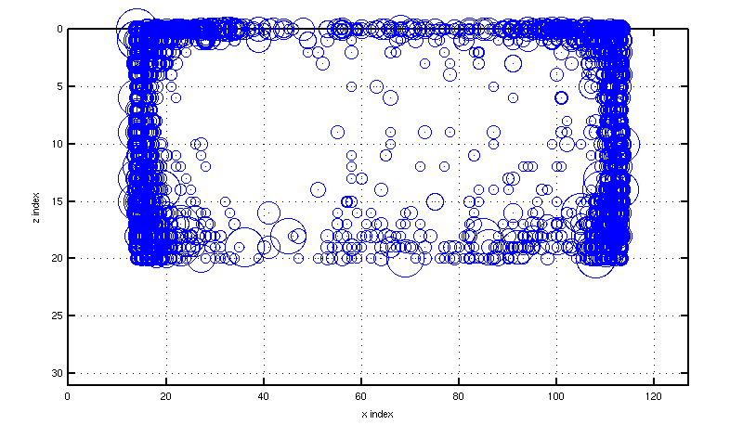
test_noheat
Case where the creep parameters vary only as a function of stress, no heat generation
temporal behavior
Analogous to the BZ1996 model, but with no randomness in the strength parameters. Results look as expected.
hypocenter locations, circle size by magnitude
mag-freq distribution

Slide 15
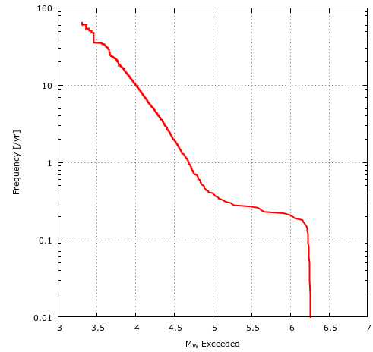
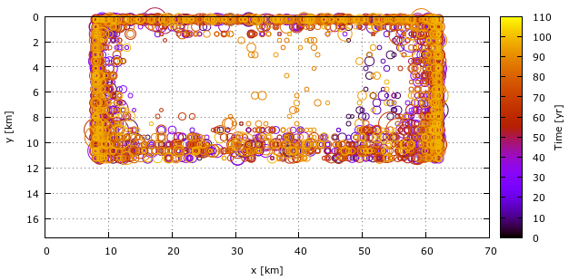
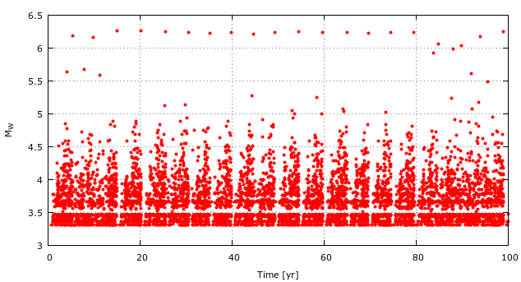
test_noheat
Uniform distribution of taus-taud 12 +/- 6 bar
Magnitude-frequency distribution
Hypocenter locations
time vs. magnitude
m6.25 every 5 years
characteristic distributions
hypocenters concentrated near creeping boundaries and free surface
Note very first (large) earthquake omitted from the catalog

Slide 16
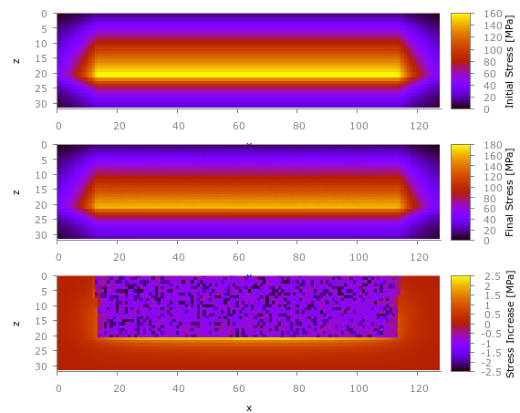
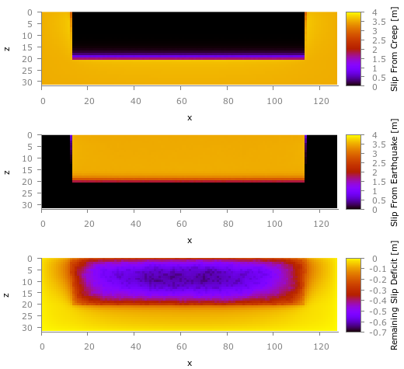
test_noheat
Uniform distribution of taus-taud 12 +/- 6 bar
Stress change after 100 years
Total slip
Initial stress set to the failure envelope
stress decrease in seismogenic part
stress increases at creeping boundaries to seismogenic part
slip from creep and eqk about 4 m
slip deficit mostly negative because initial stress is at static stress

Slide 17
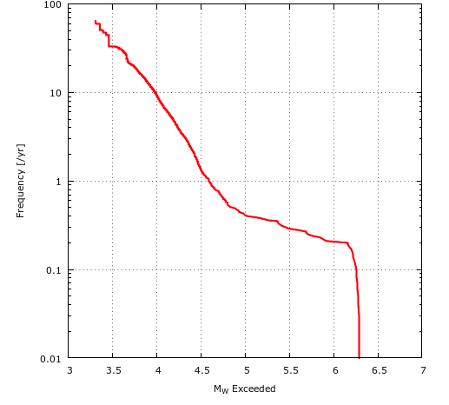
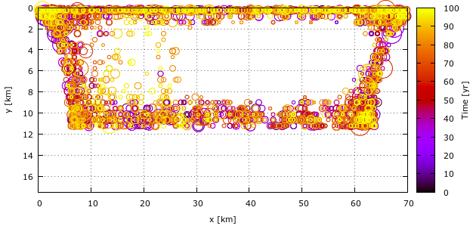
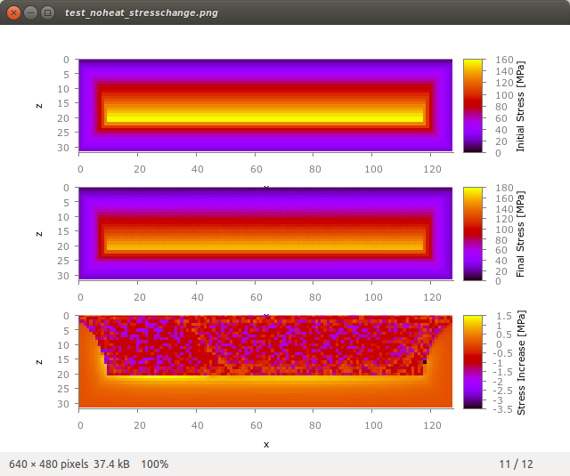
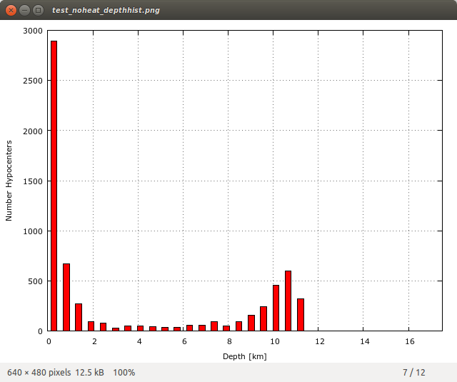
test_noheat (24-Aug-2014)
Update with modification to side creep mask
Earthquakes still clustered at the fault boundaries

Slide 18
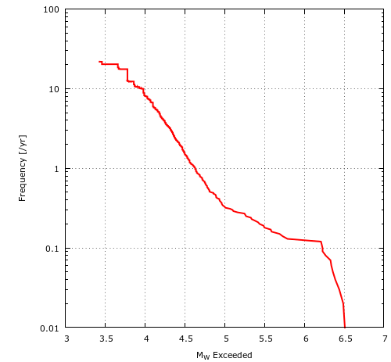
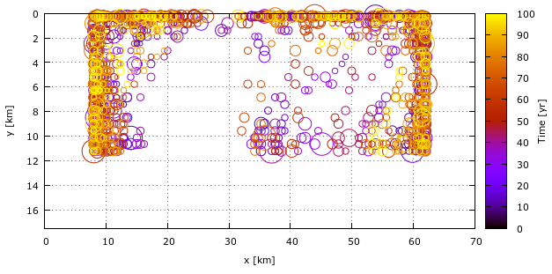
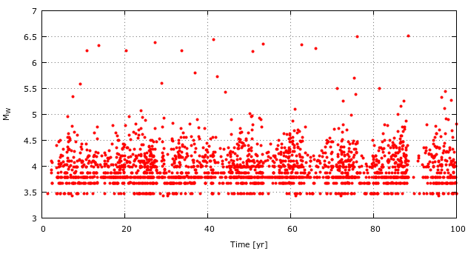
test_noheat
Fractal distribution of taus-taud
Magnitude-frequency distribution
Hypocenter locations
time vs. magnitude
m6.25 every 12 years, more erratic than unif
characteristic distributions
hypocenters concentrated near creeping side boundaries and free surface, not so much along base

Slide 19
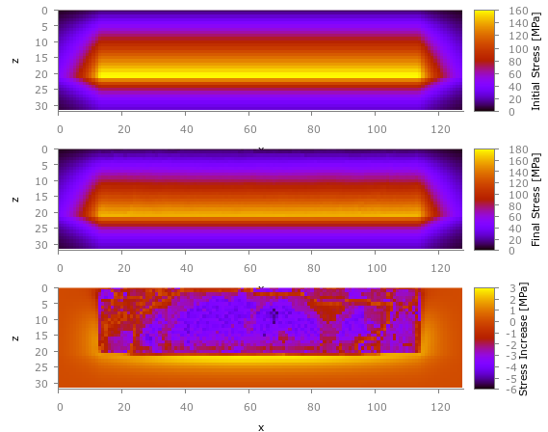
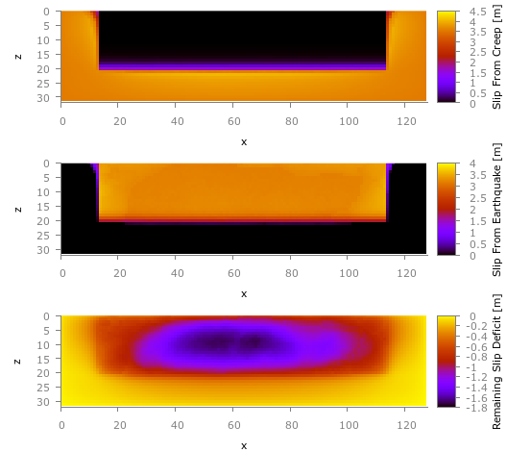
test_noheat
Fractal distribution of taus-taud
Stress change after 100 years
Total slip
Results similar to uniform case
echo of previous ruptures visible in the stress
Results similar to uniform case

Slide 20
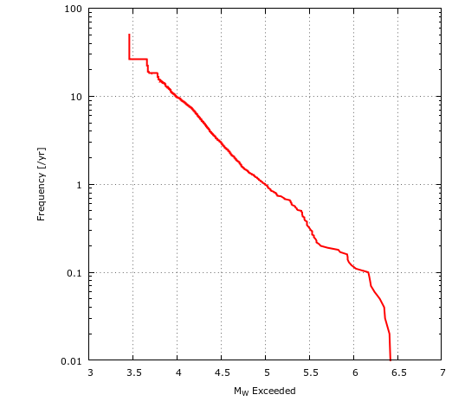
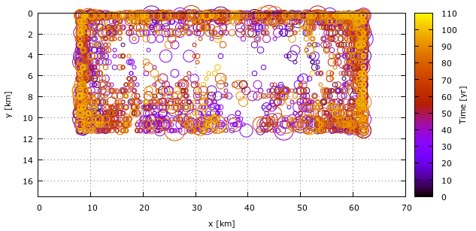
test_noheat
Magnitude-frequency distribution
Random walk distribution of taus-taud, 90 or 10 bar
Hypocenter locations
time vs. magnitude
m6.25 every ~10 years, magnitudes more variable than before
Gutenberg-Richter distributions
hypocenters more distributed within the fault interior

Slide 21
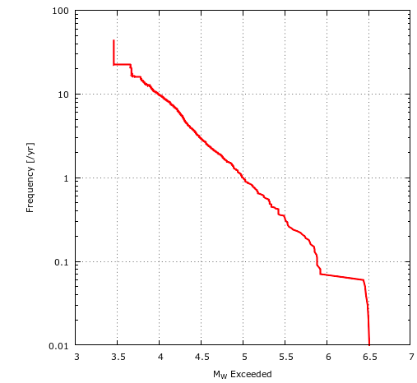
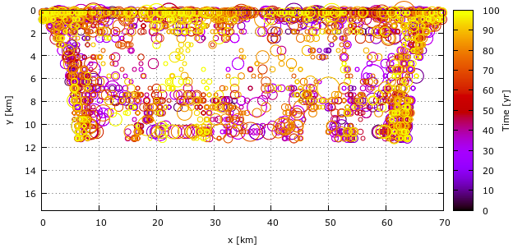
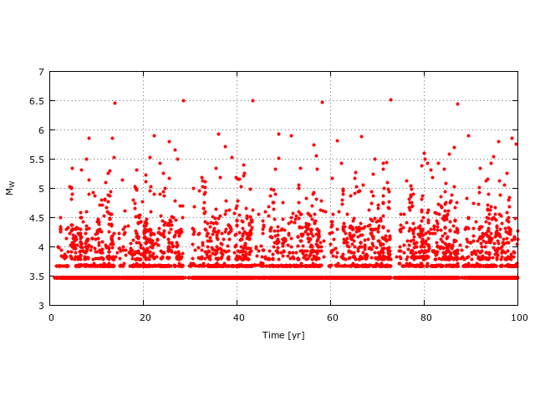
test_noheat (updated 22-Aug-2014)
Updated after changes to the side creep to be more like BZ1996
Magnitude-frequency distribution
Random walk distribution of taus-taud, 90 or 10 bar
Hypocenter locations
a bit more characteristic looking (?)
time vs. magnitude

Slide 22
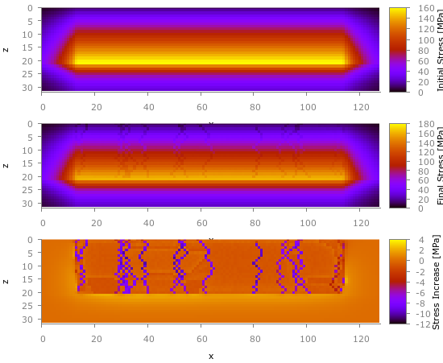
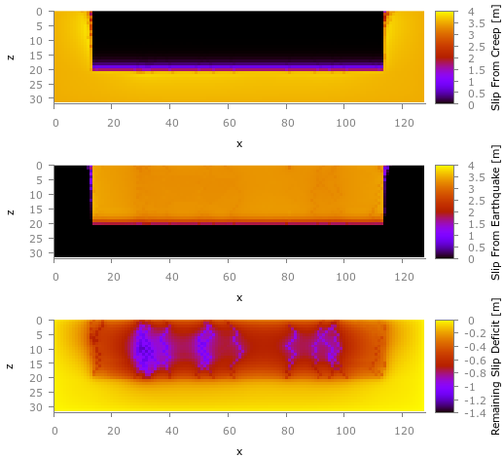
test_noheat
Random walk distribution of taus-taud
Stress change after 100 years
Total slip
Random walk bariers clearly visible
Barriers hold the fault, lower slip deficit

Slide 23
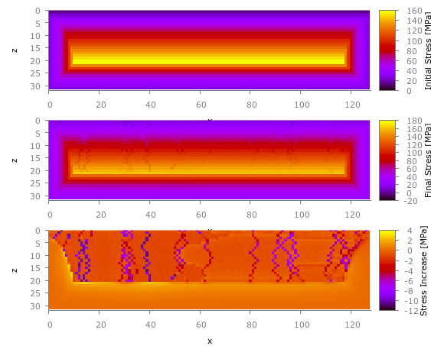
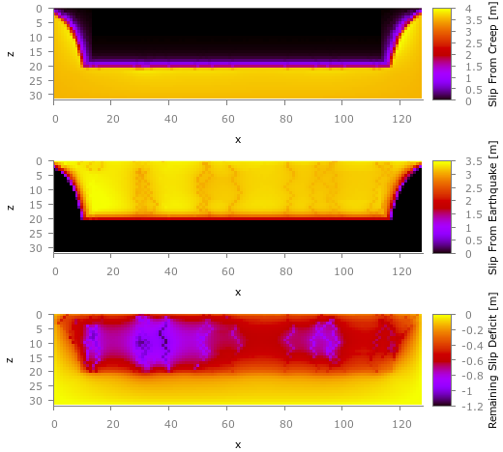
test_noheat (22-Aug-2014)
Updated after changes to the side creep to be more like BZ1996
Random walk distribution of taus-taud
Stress change after 100 years
Total slip
Random walk bariers clearly visible
Barriers hold the fault, lower slip deficit

Slide 24
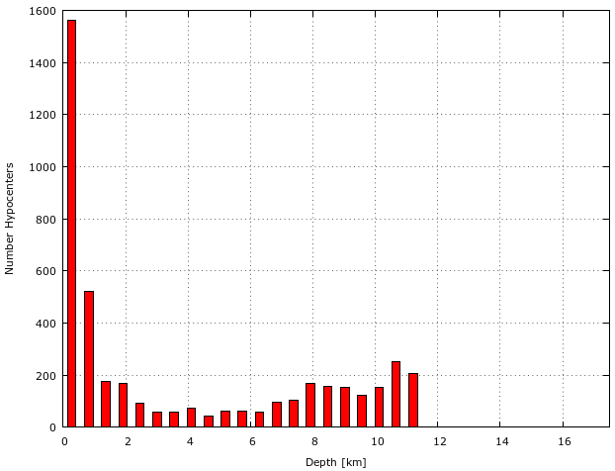
test_noheat (23-Aug-2014)
Depth histogram for the random walk case
Large proportion of hypocenters near surface... due to stress concentration
Why did this not happen in the BZ1996 code?
How to remove that?

Slide 25
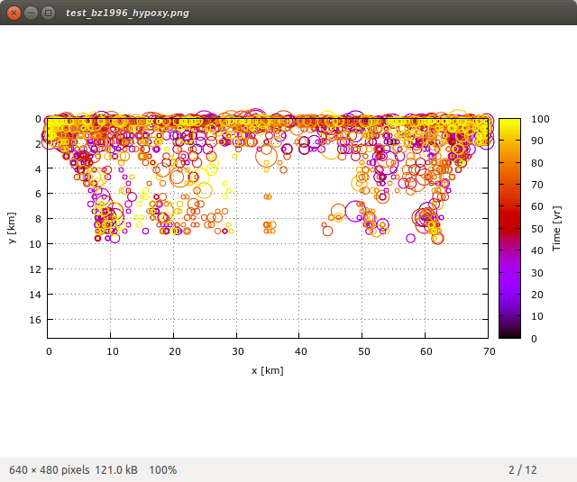
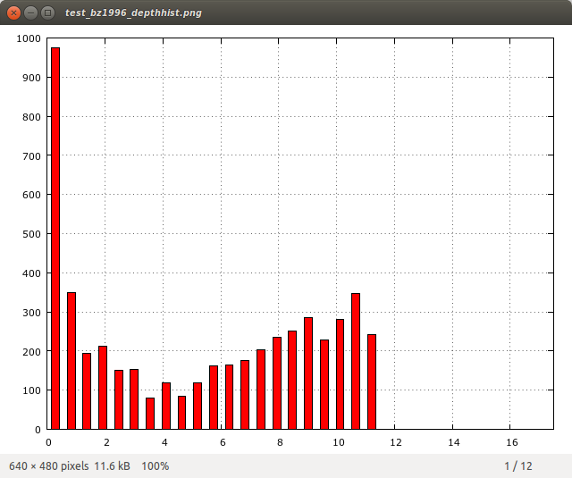
test_bz1996 (updated 24-Aug-2014)
Set up the fault exactly like Ben-Zion (1996) case
Use E=0 and modify the Arrhenius amplitude to mimic C(x,z) in that paper
Differences are...
  No randomness added to the creep parameters
  No imposed earthquakes at the side of the fault (both sides are creeping)
  No initialization of the fault. Start with all stresses near the failure envelope
Random walk case
Earthquakes are less concentrated at ~10 km because creep gradient is more gradual than an Arrhenius relation
Still concentration at top of fault due (?) to the lack of randomness in creep parameters?

Slide 26
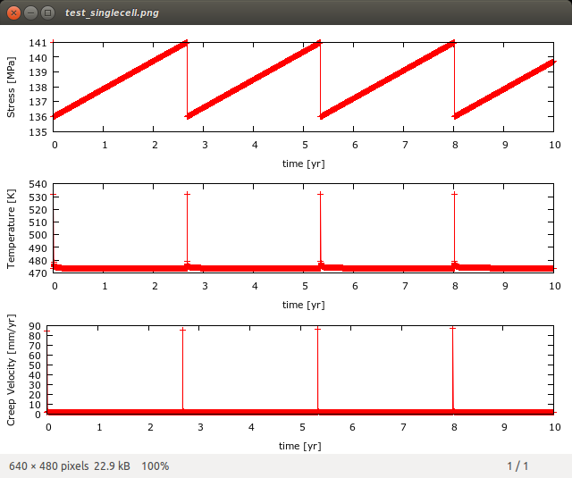
test_singlecell (24-Aug-2014)
Run the slip + heat generated + creep algorithm for a single slip cell
Helps to assess whether temperature changes are realistic and how much that changes the creep velocity
Cell at 10 km depth
Strength drop 4 MPa
Act Energy 130 kJ/mole
Arrhenius amplitude 1.31E-20
Diffusivity 1E-2 cm^2/s
Fault width = 10 cm
TODO: time step constraints and implications of leaving them out

