Slide 1






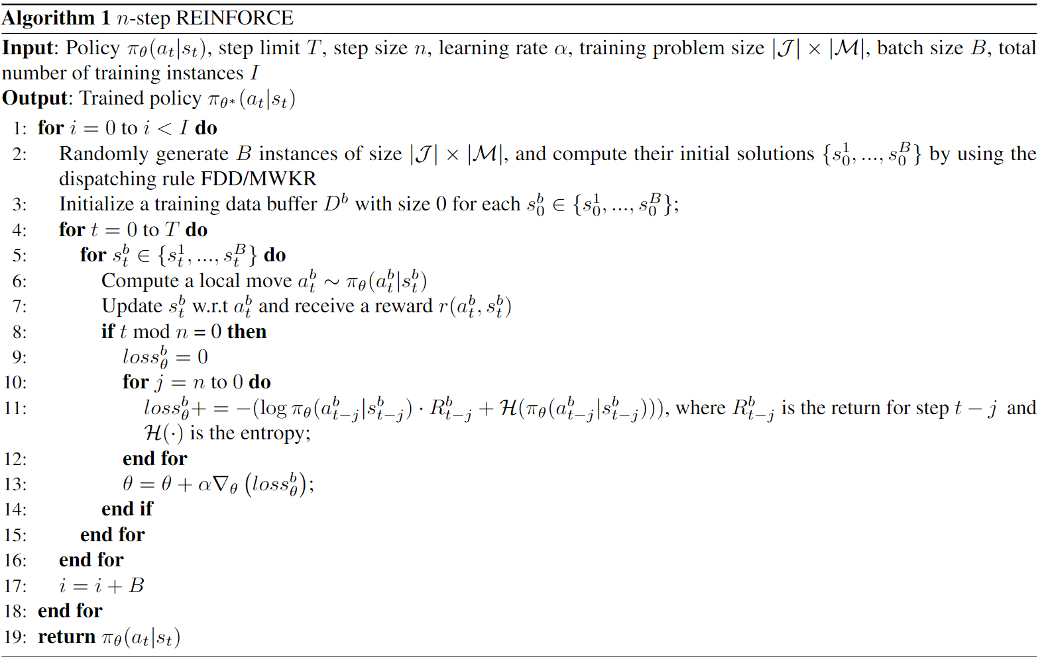
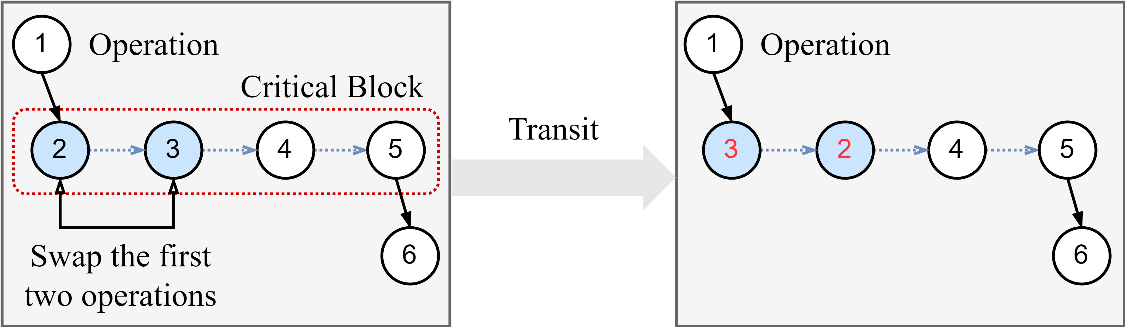
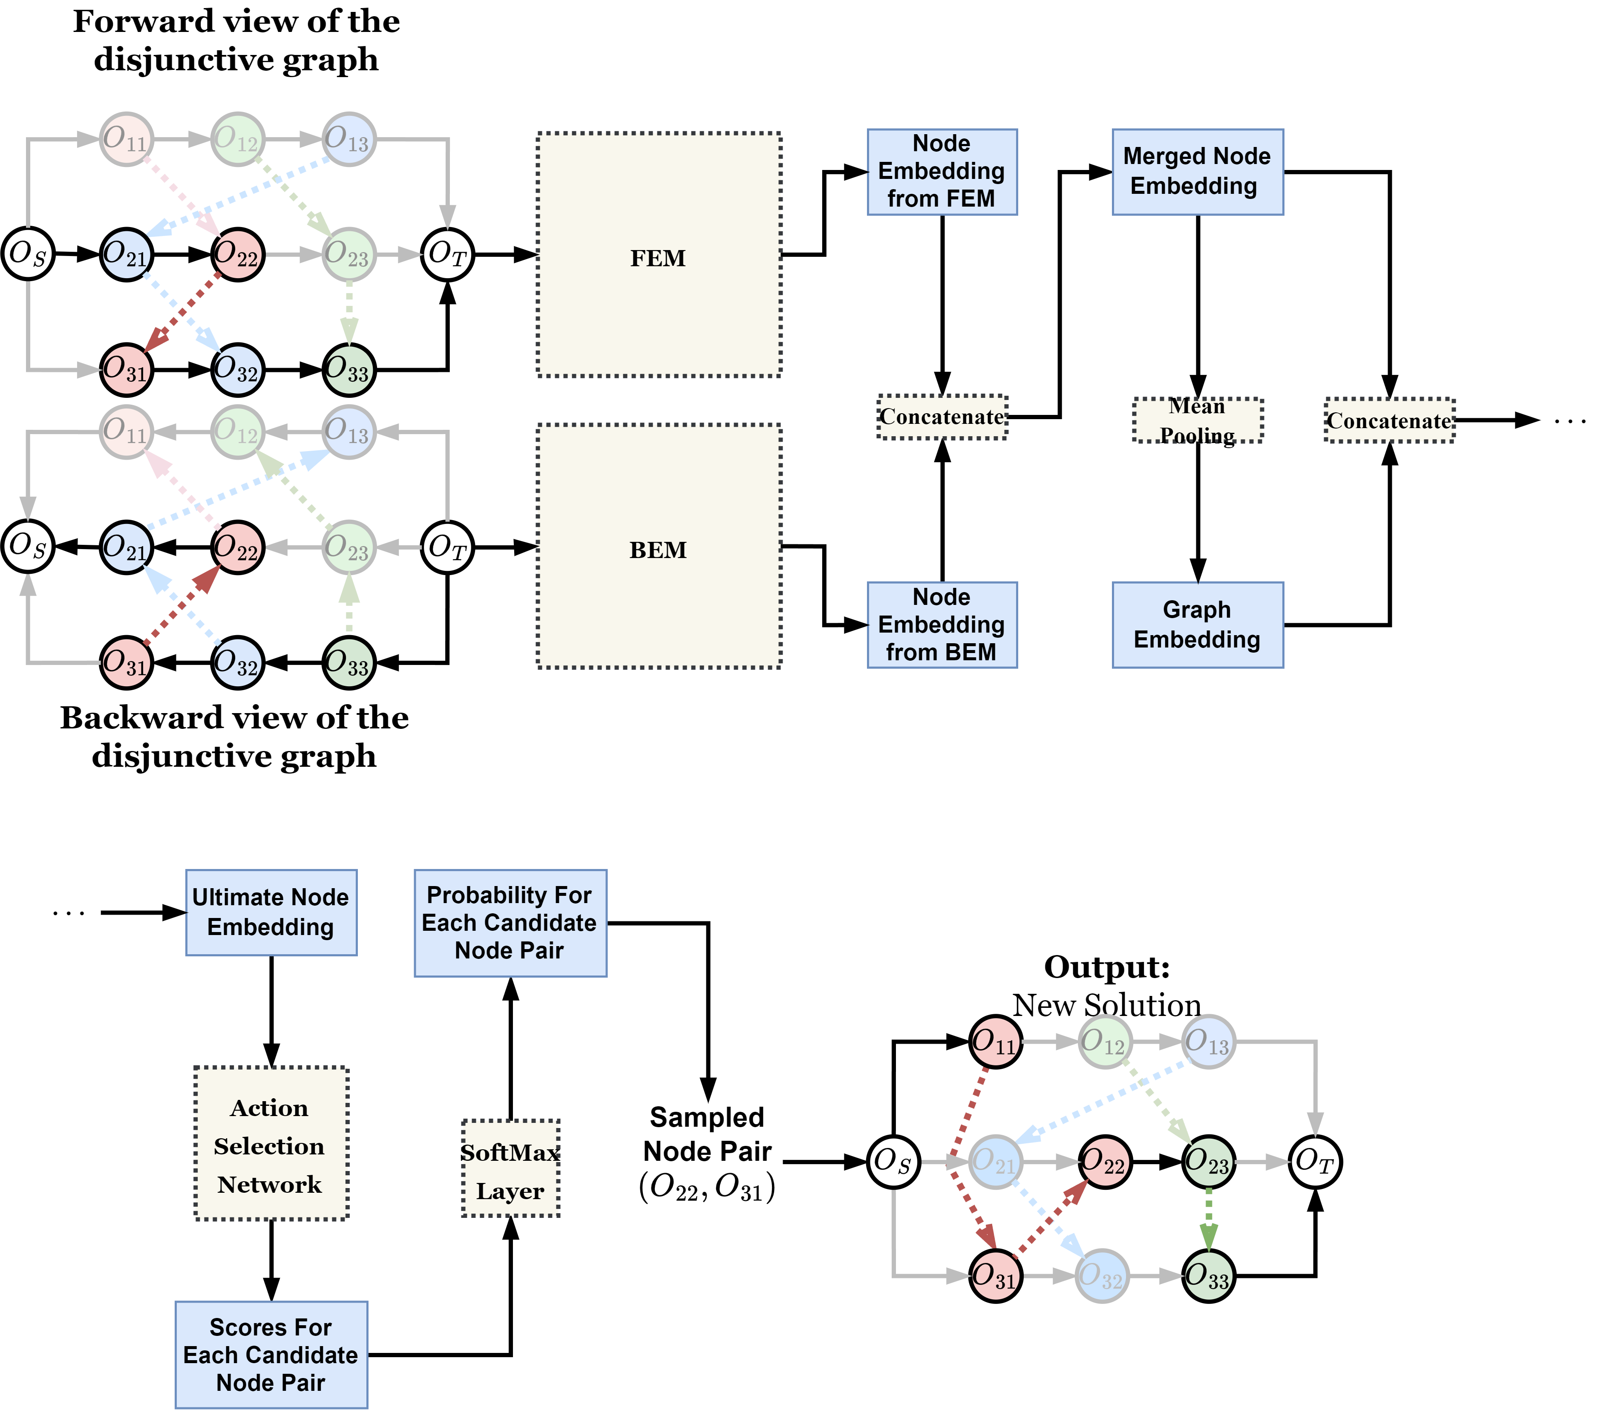
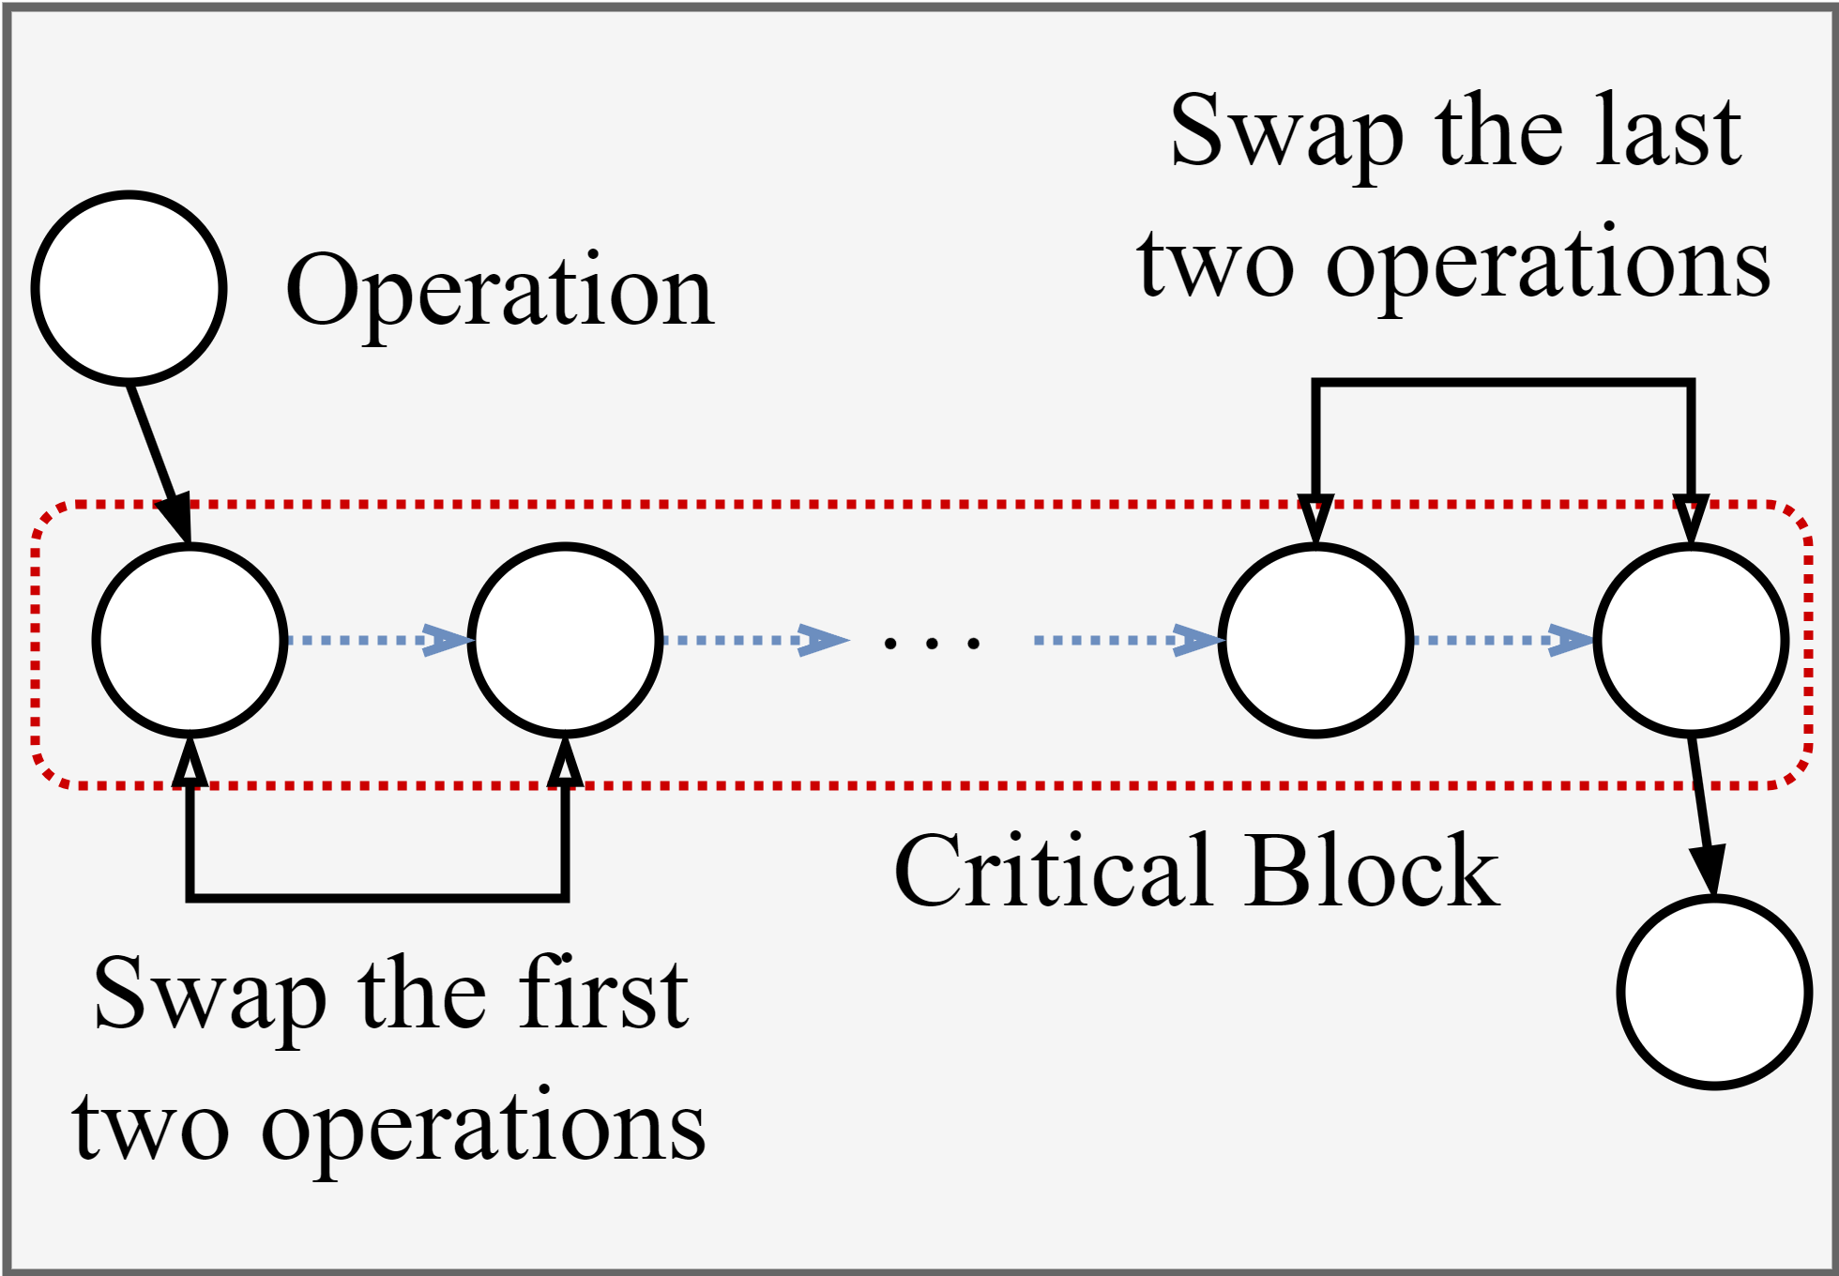
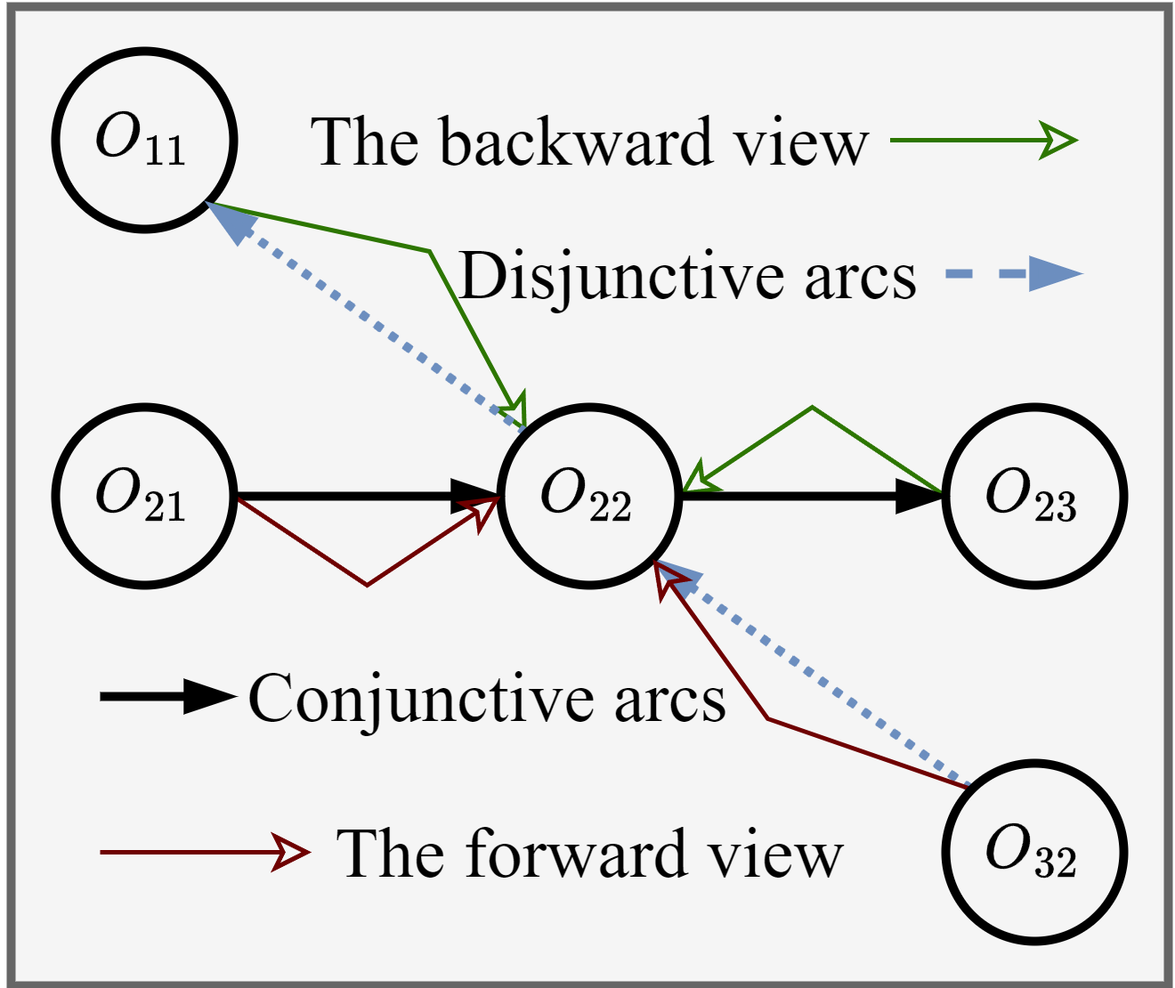
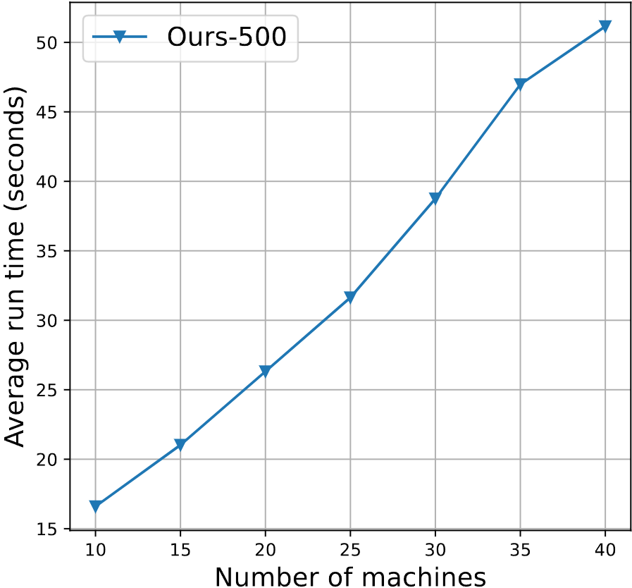
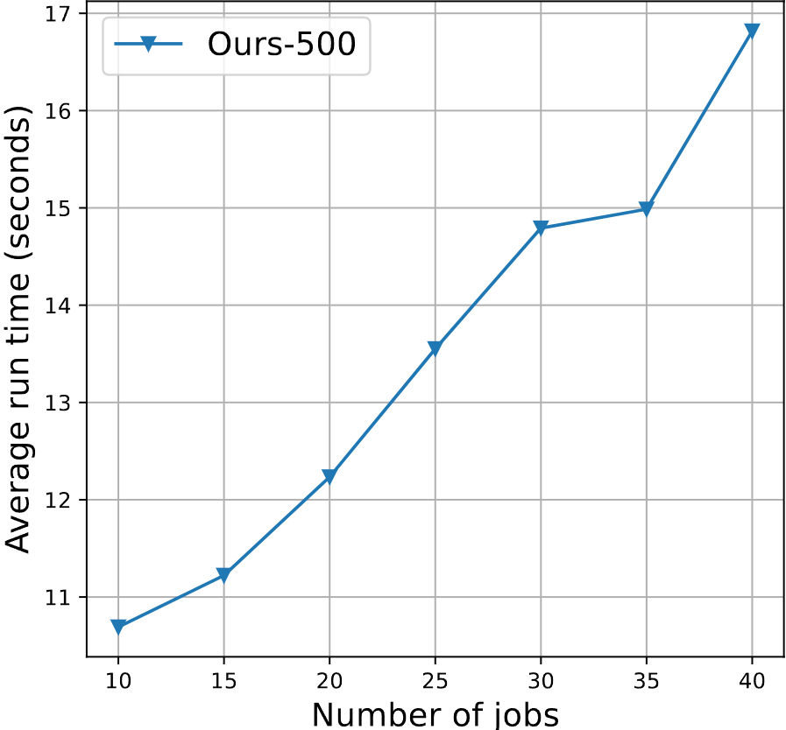
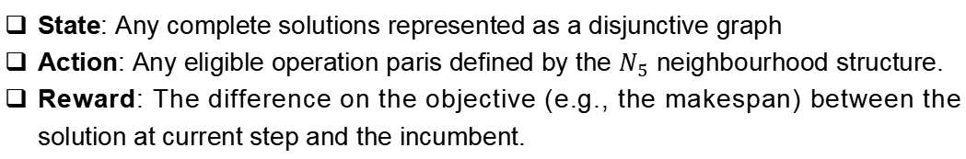
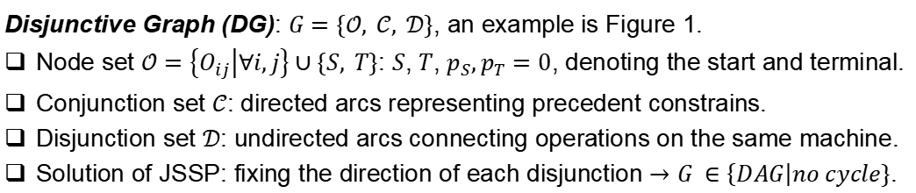
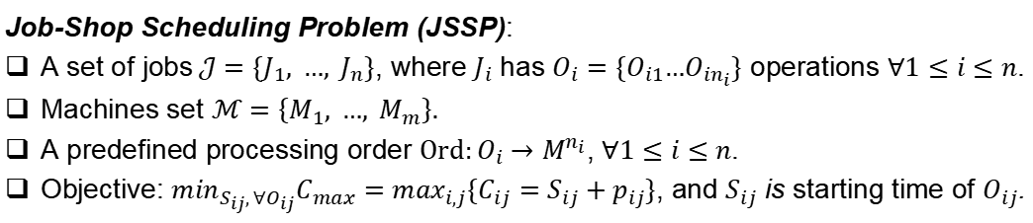
Learning Topological Representations with Bidirectional Graph Attention Network for Solving Job Shop Scheduling Problem
Cong Zhang¹, Zhiguang Cao², Yaoxin Wu³, Wen Song⁴, and Jing Sun¹
¹Nanyang Technological University, ²Singapore Management University,
³Eindhoven University of Technology, ⁴Shandong University
Paper & Code
Contributions
State Transition: The new state is obtained by swapping the pair of operations in current state.
A novel neural network architecture for learning to solve job-shop scheduling (JSSP) based on improvement heuristic.
The proposed methd has linear computational complexity.
Preliminaries
Job-Shop Scheduling Problem (JSSP):
A set of jobs$𝒥=\{J_{1}, …, J_{n}\}$, where $J_{i}$ has $O_{i}=\{O_{i1}…O_{in_{i}}\}$ operations $∀1≤i≤n$.
Machines set $ℳ=\left\{M_{1}, …, M_{m}\right\}.$
A predefined processing order $Ord:O_{i}→M^{n_{i}}$, $∀1≤i≤n$.
Objective: $\min_{S_{ij}, ∀O_{ij}}C_{max}=\max_{i,j}\{C_{ij}=S_{ij}+p_{ij}\}$, and $S_{ij}$ is starting time of $O_{ij}$.
Figure 3: Example of state transition based on $N_{5}$ structure.
Disjunctive Graph (DG): $G=\{𝒪, 𝒞, 𝒟\}$, an example is Figure 1.
Node set $𝒪=\left\{O_{ij} | ∀i,j\right\}∪\{S, T\}$: $S$, $T$, $p_{S},p_{T}=0$, denoting the start and terminal.
Conjunction set $𝒞$: directed arcs representing precedent constrains.
Disjunction set $𝒟$: undirected arcs connecting operations on the same machine.
Solution of JSSP: fixing the direction of each disjunction $→$ $G ∈\left\{DAG\right|no cycle\}$.
TBGAT Network
Theoretical Findings
Theorem 2: The proposed TBGAT network has linear time complexity with respect to both |J | and |M|, where |J| and |M| are the number of jobs and machines, respectively.
Figure 1:$N_{5}$ Neighbourhood structure.
Figure 2: Forward and backward view.
$N_{5}$ Neighbourhood Structure: A widely-used local operator for JSSP.
Motivation
The existing learning based methods for JSSP utilize of-the-shelf GNN, which neglect unique graph structure and information encoded in the disjunctive graph.
Experiment Results
Markov Decision Process (MDP) Formulation
Benhmarks: Taillard, ABZ, FT, LA, SWV, ORB, YN, and Synthetic data.
Baselines:L2D (NeurIPS20), RL-GNN (IJPR21), ScheduleNet (23), conventional improvement operators (e.g., greedy), OR-Tools (Google).
Results:
Average optimality gap: ~3%.
Outperforms the exsisting learning-based methods by a large margin.
State: Any complete solutions represented as a disjunctive graph
Action: Any eligible operation paris defined by the $N_{5}$ neighbourhood structure.
Reward: The difference on the objective (e.g., the makespan) between the solution at current step and the incumbent.
Figure 4. The TBGAT Network.

