Slide 1

Unveiling Next.js: A Comprehensive Guide
Mastering Key Concepts for Modern Web Development
Assignment 4 Made by Sumera Imran(106741)

Slide 2
Table of Contents
01 What is the Page.tsx File?
02 Understanding the Layout.tsx File
03 The Power of the Link Tag
04 Creating Nested Pages with Ease
05 Mastering CSS and Tailwind CSS

Slide 3
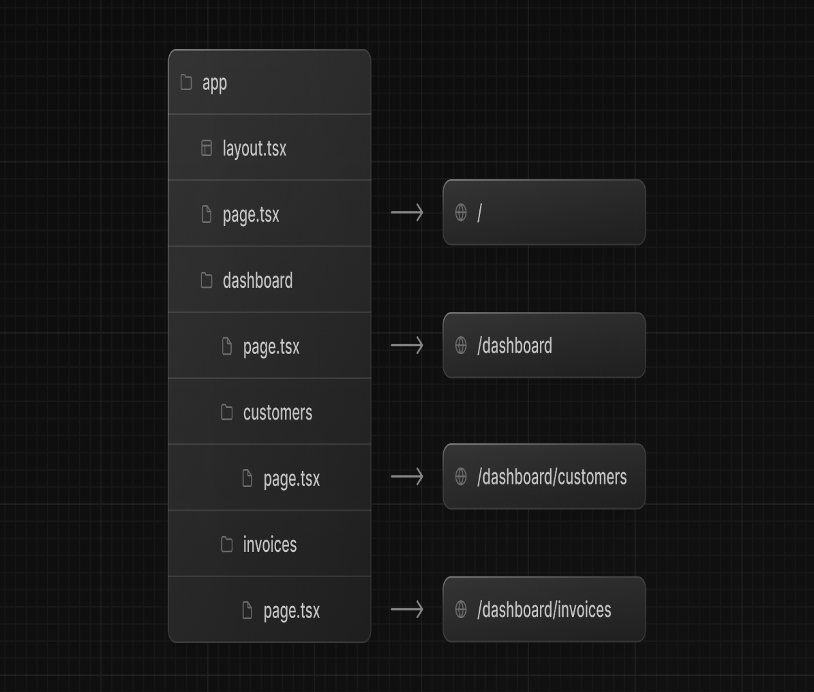
What is the Page.tsx File?
.The Page.tsx file acts as the main entry point for your application's pages. It defines how content is rendered on a given path.
• In Next.js, every component in the pages directory corresponds to a unique route based on its file name.
• It enhances SEO by enabling server-side rendering, ensuring users and search engines get fully rendered HTML on first load.
• Dynamic routes can also be created within this structure, catering to various use cases seamlessly.
• In essence, Page.tsx is pivotal in defining routes and rendering views efficiently.

Slide 4
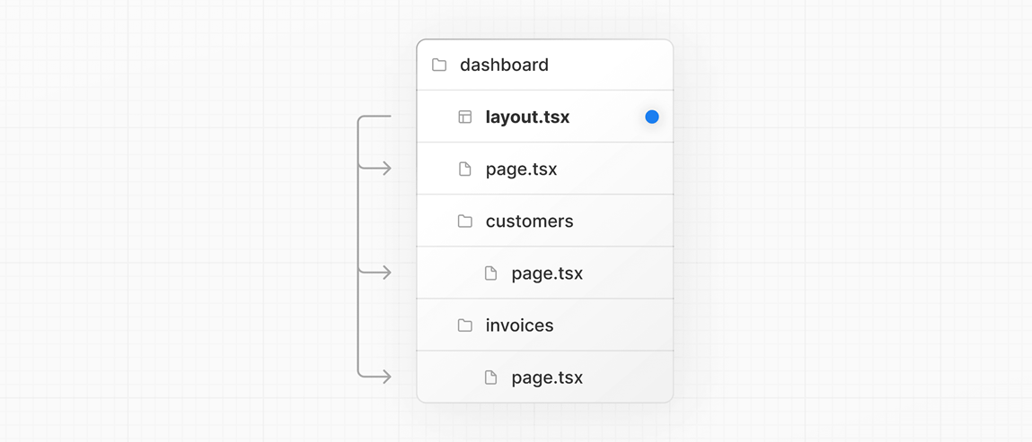
What is the Layout.tsx file ?
• The Layout.tsx file provides a consistent structure across multiple pages. It can include headers, footers, and navigation.
• Using layout components allows developers to avoid code duplication, ensuring a uniform look and feel throughout the app.
• Layouts enhance user experience by providing context and navigation options without overwriting page content.
• They enable better organization of components and help maintain clean, modular code.
• Ultimately, Layout.tsx promotes reusability and consistency in UI design.

Slide 5
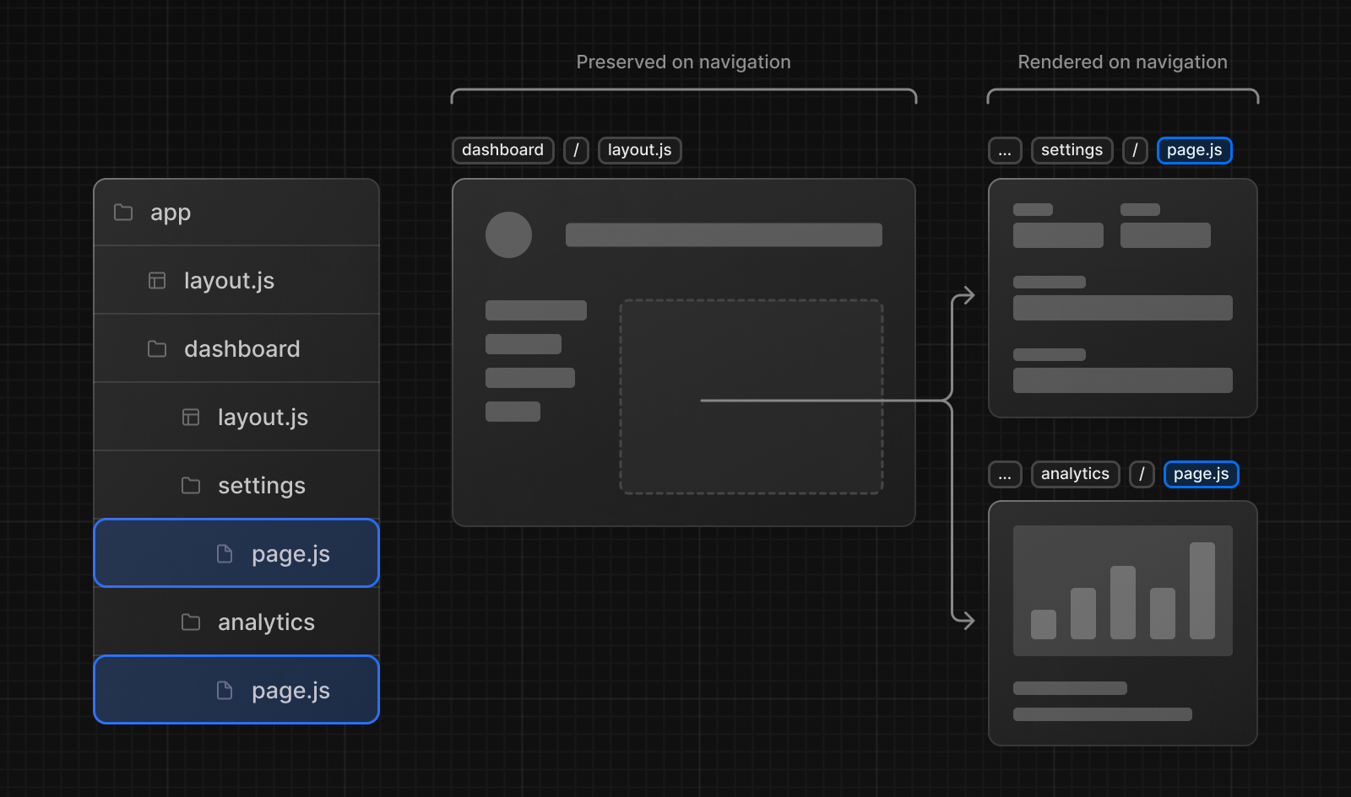
What is the link tag,why do we use this tag,and what is its purpose ?
The Link tag in Next.js is essential for client-side navigation, enabling faster page transitions without full reloads.
By using the Link tag, you can prefetch pages in the background for an instant experience when users navigate.
It supports dynamic routing, allowing developers to create links to other pages or nested structures effortlessly.
The Link tag also plays a crucial role in SEO by ensuring the right structure for crawlers. • In essence, the Link tag enhances both performance and user experience

Slide 6
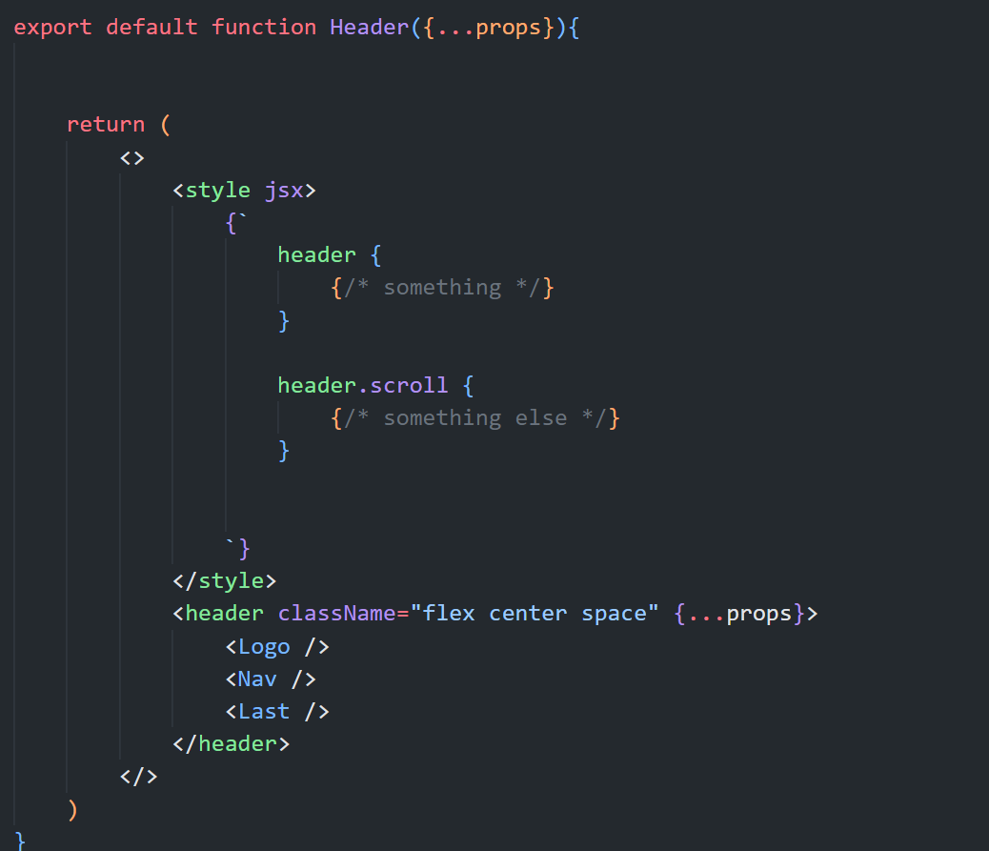
How can we apply CSS in Next.js
Add global styles to your application by navigating to /app/layout.tsx and importing the global.css file:
/app/layout.tsx. import '@/app/ui/global.css'; export default function RootLayout({ children, }: { children: React. ...
/app/page.tsx. ...
/app/page.tsx. ...
/app/ui/invoices/status.tsx.

Slide 7
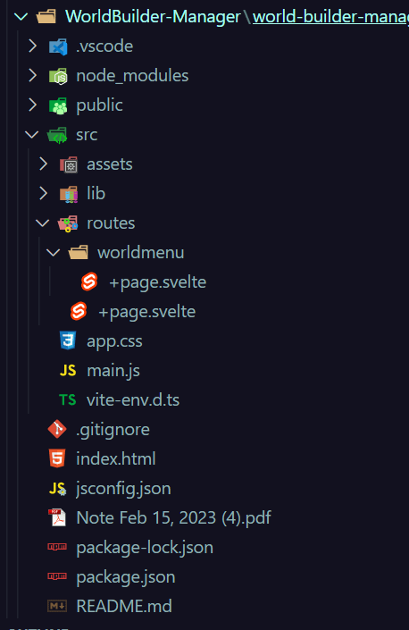
What are Components,and why do we use them
Components allow you to build self-contained, reusable snippets of code. If you think of components as LEGO bricks, you can take these individual bricks and combine them together to form larger structures. If you need to update a piece of the UI, you can update the specific component or brick.

Slide 8
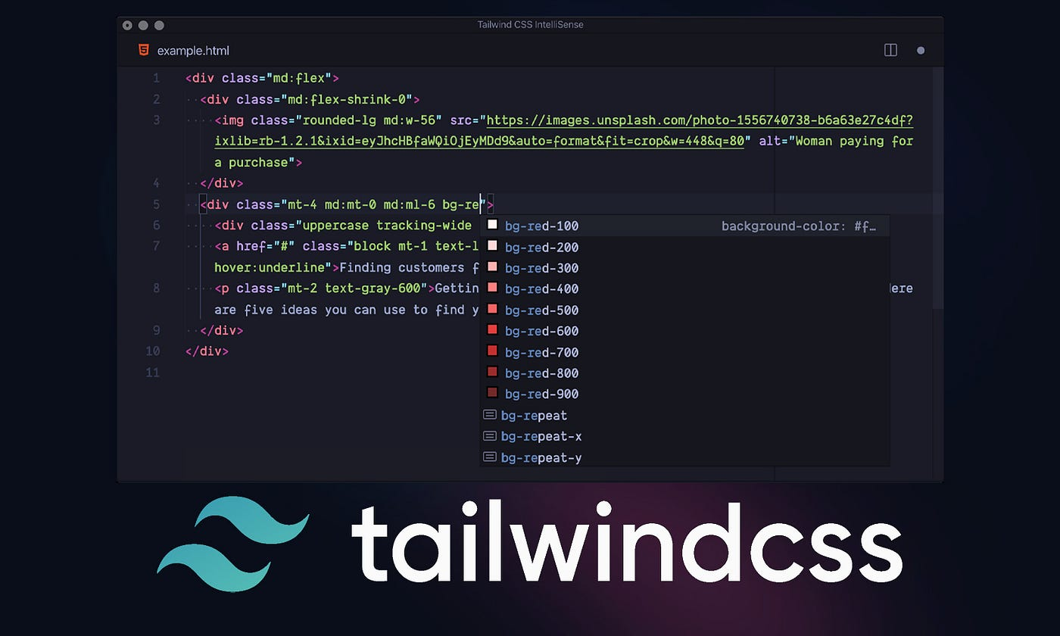

What is Taliwind css Difference between Taliwind css and standard css
Applying CSS in Next.js can be done using traditional stylesheets, CSS modules, or styled-components for scoped styling. • Tailwind CSS, on the other hand, is a utility-first framework that enables rapid UI design with reusable classes. • The main difference lies in Tailwind's approach, focusing on utility classes rather than traditional CSS rules, promoting a different workflow. • Tailwind encourages rapid prototyping while ensuring maintainability by avoiding the specificity issues of standard CSS. • Integrating either approach depends on your project needs and personal preferences, each serving unique purposes.

Slide 9
Thank You!

