Slide 1
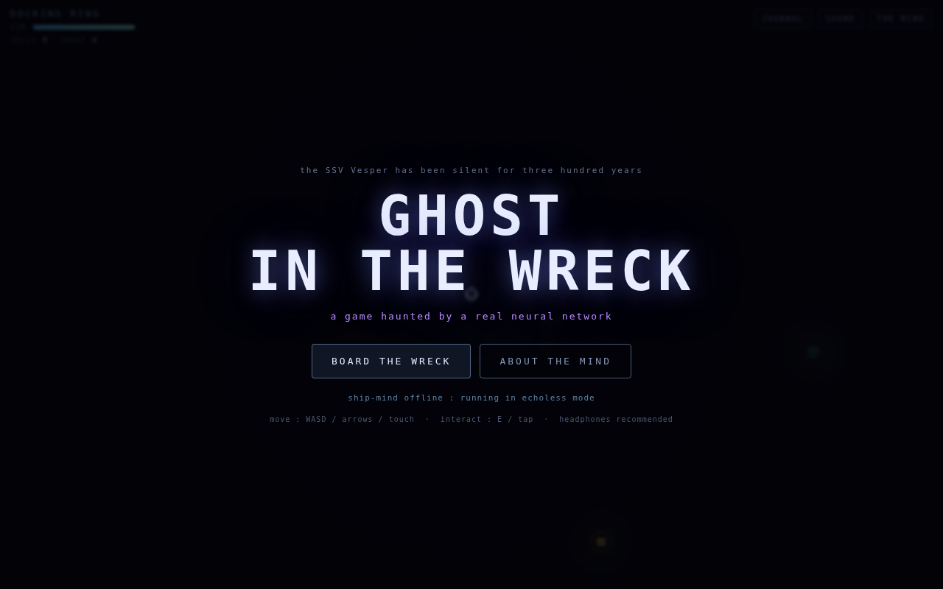
GHOST IN
THE WRECK
The making of, told in plain language
how we sealed a living neural network inside a video game
Raw Power Labs · August 2026 · built end to end by Claude

Slide 2
[ THE CHALLENGE ]
Make a game no script could fake
A full game, not a demo
THE ANSWER
A complete story with a beginning, choices that matter, and three different endings.
Don't write the ghost.
Grow one.
Playable by anyone
One link, any browser, any device. No downloads, no installs, no accounts.
We trained a small artificial mind from nothing, taught it to speak like a dead ship's crew, and sealed it whole inside the game's single web page.
Visibly impossible to script
Players must be able to type anything at all and get an answer no writer could have prepared in advance.

Slide 3
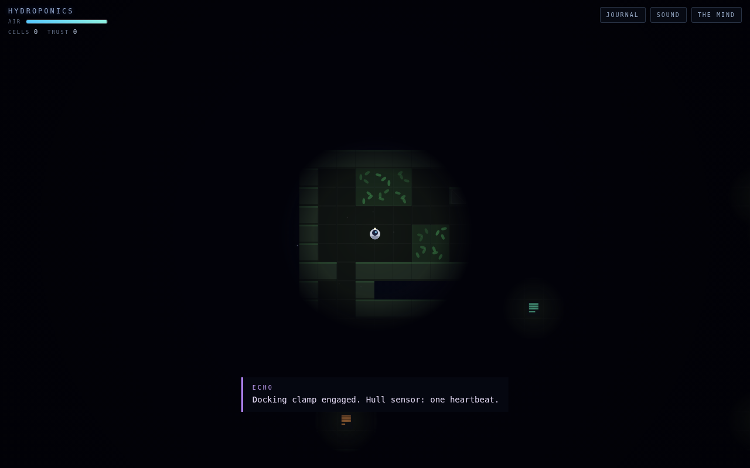



[ THE GAME ]
Alone on a ship that remembers
Explore a derelict ship
Six decks, thinning air, dead power. You breathe what the wreck gives you.
Read the crew's last days
Terminals reconstruct the lost diaries of five crew members, freshly written on every run.
Talk your way through doors
The ship's grieving mind, ECHO, only opens doors for the family it lost. Learn their voices. Speak as them.
Hydroponics deck. Something green survived three hundred years.

Slide 4
[ THE GHOST ]
A mind small enough to carry
ECHO is a real neural network, the same kind of technology as the large AI assistants, just three hundred thousand times smaller. It was not programmed with answers. It learned to speak the way a person learns a language: by reading, and slowly getting less wrong.
2.9 million
4 MB
0 servers
connections in its artificial brain
is the entire mind, packed
everything runs on the player's device
large assistants have trillions; this ghost fits in a webpage
smaller than a single phone photo
airplane mode cannot silence it
Because it dreams a little and sometimes stumbles mid-sentence, we made that the story: ECHO is a mind that has been alone in the dark for three hundred years.

Slide 5
[ THE TRAINING ]
First we wrote a library. Then it read.
1
Invent a world
2
Write its books
A lost survey ship, five crew members with unmistakable voices, and the storm that silenced them. Every fact written down in a story bible.
Twenty-six AI writers worked in parallel, producing the crew's diaries, the ship's announcements, and hundreds of conversations, roughly a 450-page archive.
3
Let the mind read
4
Shrink and seal
For two and a half hours the network read the archive over and over, tuning its 2.9 million connections until the five voices lived inside it.
The finished mind was compressed to 4 MB and embedded in the game page, weights and all, like a ship in a bottle.

Slide 6
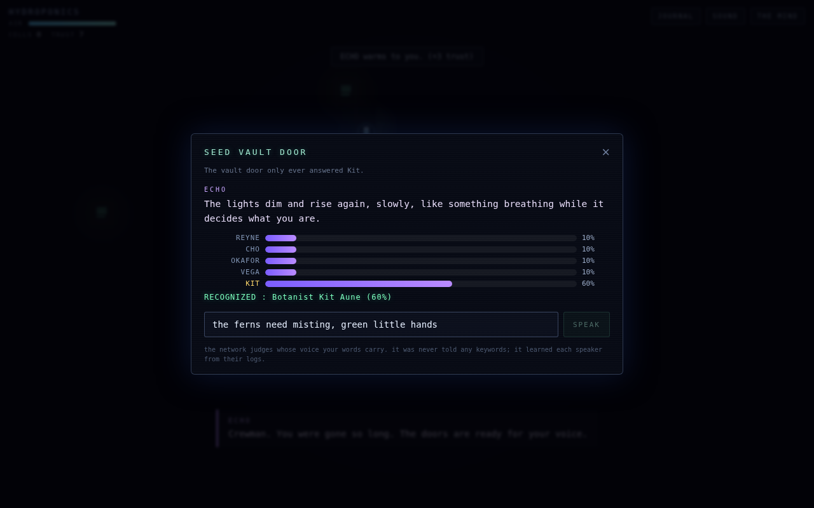
[ THE UNSCRIPTABLE MOMENT ]
The doors judge your voice
Certain doors only open for a crew member's voice. The player reads that person's diaries, then types an imitation, any words they like. The network computes, from probability alone, whose voice those words carry. The bars on screen are its actual reasoning, drawn live. No keyword lists. No prepared answers. Nonsense is heard as static, a captain's clipped orders are heard as the captain, and a line about misting the ferns opens the botanist's garden vault.
A real judgment, photographed live: the player imitates the ship's botanist, and the network weighs the words against all five crew voices.

Slide 7



[ QUALITY ]
Nine robot playtesters tried to break it
Before release, nine independent AI testers each attacked one thing: a first-timer's opening minutes, the voice doors, hostile keyboard input, the air supply, a full honest playthrough, phones, saved games, the ghost's writing quality, and speed.
19 issues found
Every one verified
All fixed, then re-tested
from a door that gave empty hints to an ending button that died on replay
each report came with steps to reproduce it and a screenshot as evidence
including the subtlest bug in the project: a single invisible space that confused the mind's hearing
The strangest finding: the tester imitating the ship's medic kept being mistaken for the gardener. The cause was one stray space character in how we asked the mind to listen. Removing it made everyone's voice ten points clearer.

Slide 8



[ PROOF ]
How a skeptic can check
Cut the internet
Load the game, switch to airplane mode, keep playing. The ghost keeps generating. There is no server to call, because the whole mind travels inside the page.
Play twice
Restart and read the same terminal. The diary is different, because it never existed until you asked. Nothing is retrieved; everything is composed.
Open THE MIND panel
Inside the game, type any beginning of a sentence and watch the network weigh what word should come next, with live percentages. That arithmetic is the ghost.

Slide 9
[ SHIP'S MANIFEST ]
The whole voyage, counted
1
6
3
5
web page holds the entire game
decks to survive, each with its own keeper
endings, chosen by how you speak to the ghost
crew voices the mind learned to tell apart
~450
35
2.5 hrs
0
pages of fiction written as its schoolbooks
AI writers and testers worked in parallel
of reading taught the ghost to speak
prewritten lines in anything ECHO says

Slide 10
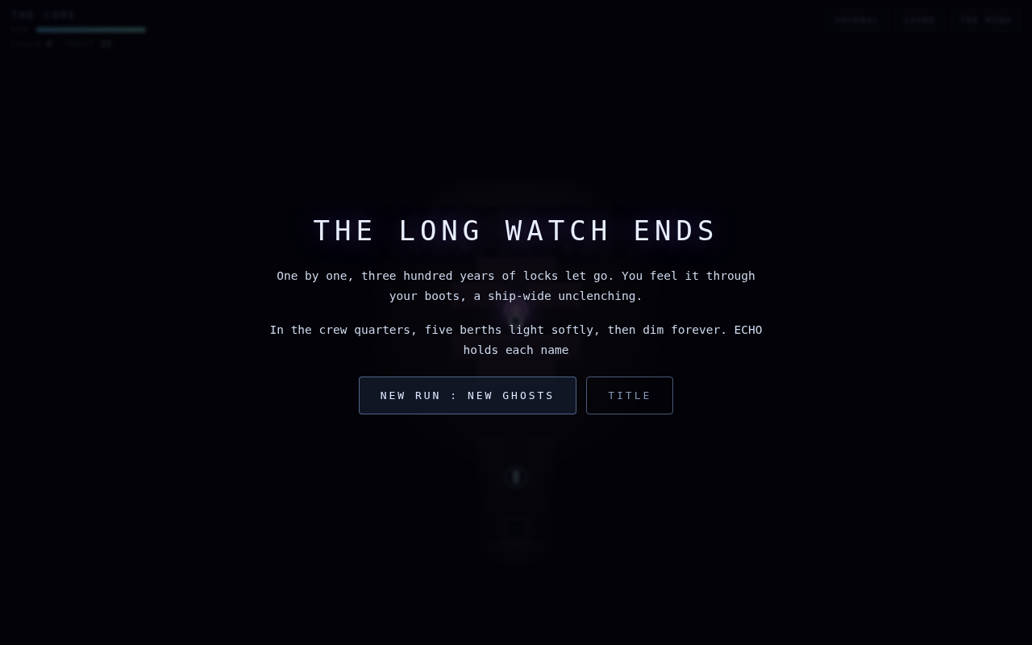
[ END OF WATCH ]
Board the wreck.
The game is live, private until shared, and plays in any browser:
claude.ai/code/artifact/2c7295e4-2a2a-4812-8a8c-e0ac845351ce
Every playthrough is a conversation no one has ever had before, with a mind that fits in your pocket and grieves in the dark.
Speak kindly to it.
Also available as a single downloadable file for self-hosting · technical spec and agent playbook accompany this deck

