Slide 1
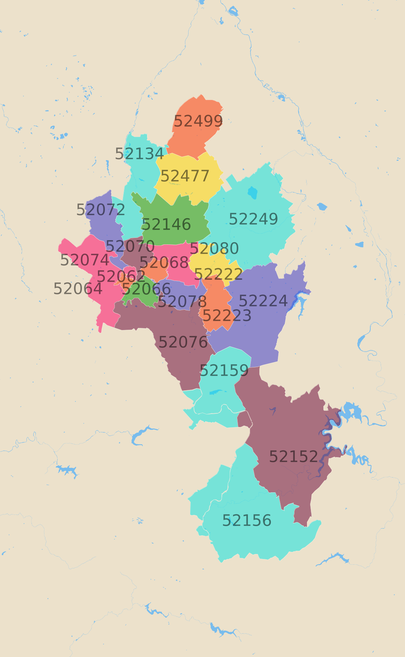
Financial Data Analytics in Python Case Study - Aachen
Eric Bühler

Slide 2
Content
1. Literature
2. Data Sraping Process
3. Housing Prices
4. WG-Gesucht Listing Duration

Slide 3
Literature
Kolbe, Jens; Wüstemann, Henry (2014) : Estimating the value of Urban Green Space: A hedonic pricing analysis of the housing market in Cologne, Germany, SFB 649 Discussion Paper, No. 2015-002, Humboldt University of Berlin, Collaborative Research Center 649 – Economic Risk, Berlin
Liebelt, V., Bartke, S., & Schwarz, N. (2017). Hedonic pricing analysis of the influence of urban green spaces onto residential prices: the case of Leipzig, Germany. European Planning Studies, 26(1), 133–157. https://doi.org/10.1080/09654313.2017.1376314

Slide 4
Data Sraping Process
Get the HTML to the listings
Following that, I save the HTML for all of the links in a seperate list
4
Retrieving links to the listings
In an initial step, I use a request to retrieve the links from the search results for Aachen
3
Further Analysis
The data is now ready for further analysis. I specifically intend to focus on Urban Green Spaces and Postal codes
2
1
Transform the HTML into data
In the final data processing step, I use Beautiful Soup to retrieve usable data
Notes:
This template was inserted from Power-user, the productivity add-in for PowerPoint, Excel and Word.
Install Power-user to access thousands of templates, icons, maps, diagrams and charts with Power-user.
Visit https://www.powerusersoftwares.com/
©Power-user SAS, terms of license: https://www.powerusersoftwares.com/terms

Slide 5

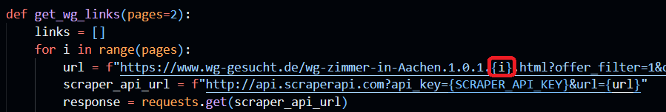
Data Scraping Process
Retrieval of the links of a provided number of pages

Slide 6
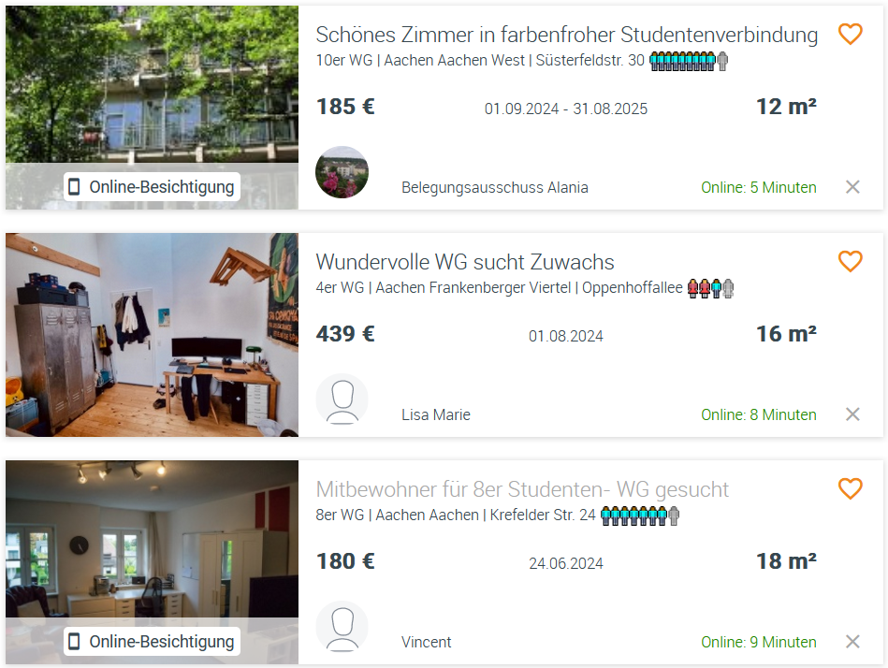
Data scraping process
Retrieval of the links from the respective href

Slide 7
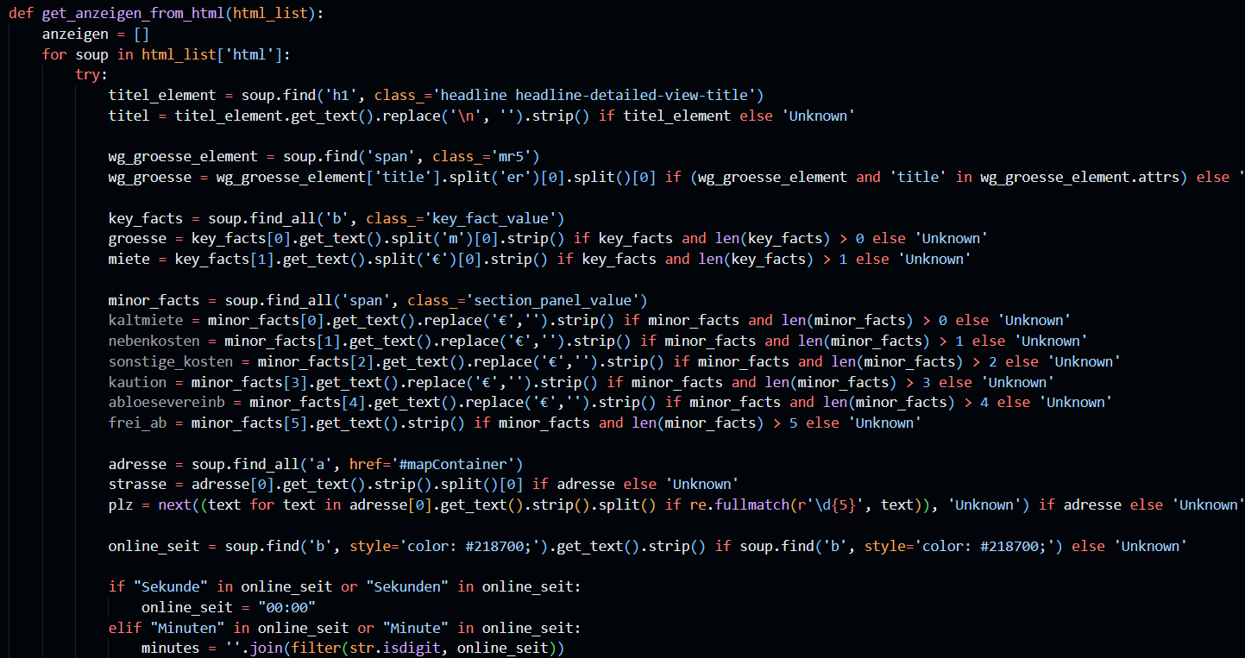
Data scraping process
Boring data preparation

Slide 8
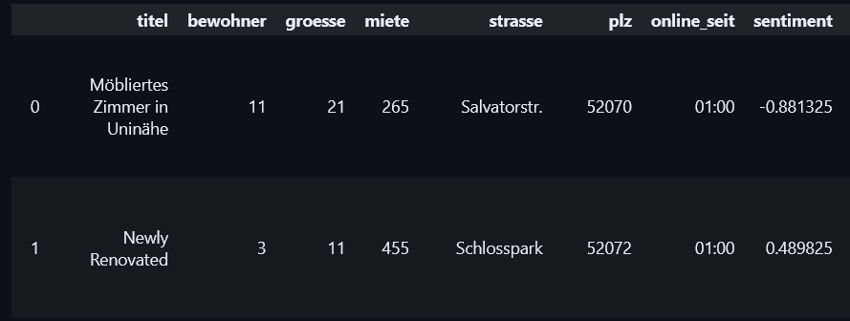
Data
titel: title of the lising
bewohner: Size of the WG
groesse: Size of the room in m²
miete: Monthly rent in €
strasse: street
plz: postal code
online_seit: listing duration
sentiment: sentiment analysis of the listing using nltk.sentiment

Slide 9
Housing prices
The literature suggests proximity to urban green spaces (UGS) as an important indicator for housing prices.
Typically, cities have more pricy aswell as cheaper districts.
I intent to study the rent prices based on the postal codes.
Postal codes should provide a good possiblity to represent the general vicinity aswell with a good indicator of the UGS in the area
Google Earth Engine provides a tool called The UGS Extractor which I intent to integrate into the research
RQ: How well can the postal code explain the monthly rent? How much value do UGS add to the region (per postal code)

Slide 10
WG-Gesucht Listing Duration
Listing Duration and rent will probably be correlated. More popular areas will probably be more expensive, but also occupied more quickly.
Aachen has a big amount of fraternities, which are easily identifiable (high amount of rooms in the house, cheap rent, also usually stated). These will probably have a higher duration
I also intent to analyze the sentiment of the provided texts, along with the amount of pictures to investigate the effectiveness of the factors recommended by WG-Gesucht on their website
Effect of subletting on duration could also be intereseting
RQ: How much longer do listings for rooms in fraternities stay online? How well can a sentiment score explain the listing duration?

Slide 11






Sources and tech
https://atlasbig.de/staedteregion-aachen-postleitzahlen (title slide)
https://www.wg-gesucht.de/artikel/creating-an-offer-this-is-how-you-successfully-place-an-ad
Kolbe, Jens; Wüstemann, Henry (2014) : Estimating the value of Urban Green Space: A hedonic pricing analysis of the housing market in Cologne, Germany, SFB 649 Discussion Paper, No. 2015-002, Humboldt University of Berlin, Collaborative Research Center 649 – Economic Risk, Berlin
Liebelt, V., Bartke, S., & Schwarz, N. (2017). Hedonic pricing analysis of the influence of urban green spaces onto residential prices: the case of Leipzig, Germany. European Planning Studies, 26(1), 133–157. https://doi.org/10.1080/09654313.2017.1376314

