Slide 1
Determinants of shared apartment prices in Cologne (Germany)
Notes:
- Cologne is also a city in Minnesota

Slide 2
Table of Contents
Motivation and Literature
Research question
Scraping
Data analysis
Ongoing tasks
Sources
Feedback and Discussion

Slide 3
1. Motivation and Literature
Motivation:
Rising rental prices¹
Colognes Popularity
net influx of approx. 3,000 people in 2023²
104.242 Students at University or University of Applied Science in 2021³
Why wg-gesucht.de?
One of the most popular platforms
Often used by students
Literature – Determinants of real estate prices⁴
Fundamental factors
Population density
Mortgage
Income equality
Unemployment
Hedonic factors
Area (proximity to Hospitals, shopping malls, city center …)
Number of rooms
Other structural characteristics
Presence of balcony
⁴ (Toan Ngoc Bui, 2020); (Konstantin A. Kholodilin, Dirk Ulbricht 2015)
Notes:
Rising rental prices in cologne: increased by 6%
Cologne experienced a net influx of 5,000 people, with more people moving to the city than leaving it.
One University and 7 University of applied science in cologne

Slide 4
2. Research Question
What are the key determinants that influence shared apartment (WG) prices in Cologne as listed on WG-Gesucht.de?
What factors affect the length of time shared apartment (WG) listings remain online in Cologne on WG-Gesucht.de?

Slide 5

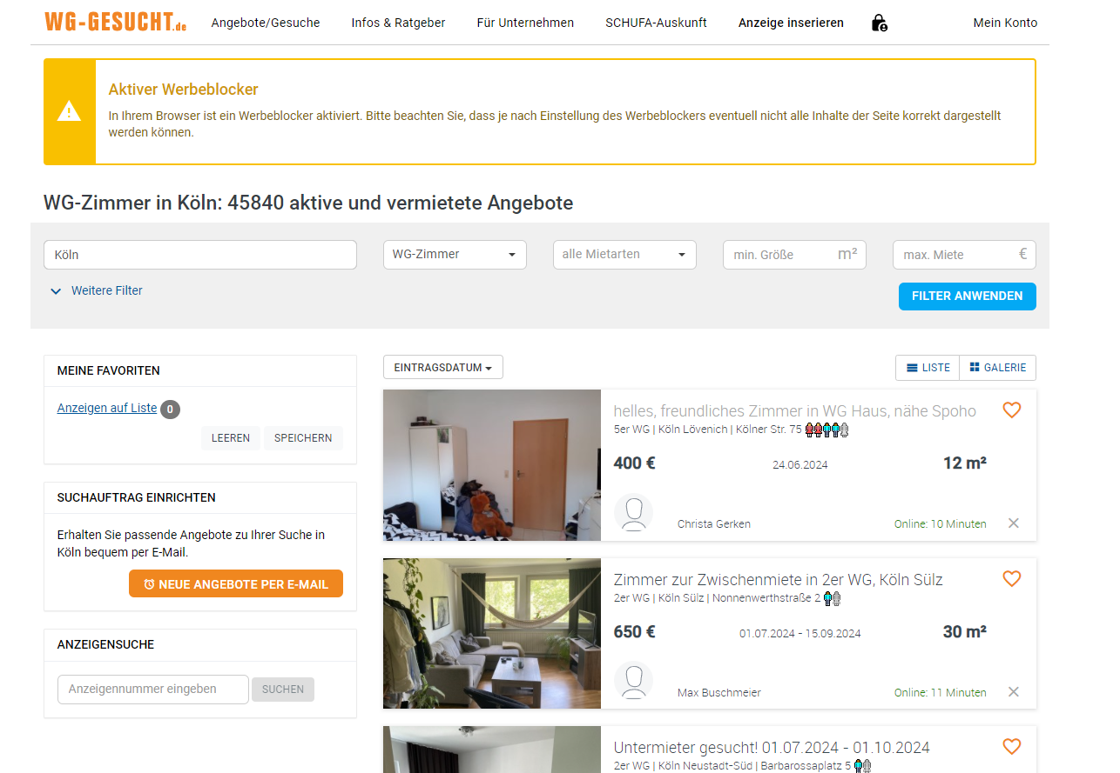
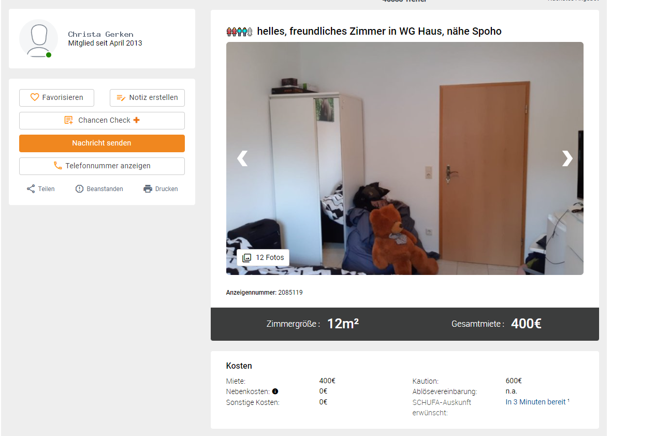
3. Scraping and Data
JSON with URLS of Apartments
JSON with Info about Apartments
WgController.py
Requested URL
Response
Soup of Overview
URLs of Listed Apartments
Soup of a Apartment
Info about Apartment
Scraper.py
LinkScraper.py
LinkScraper.py

Slide 6
3. Scraping and Data
JSON with URLS of Apartments
JSON with Info about Apartments
WgController.py
Requested URL
Response
Soup of Overview
URLs of Listed Apartments
Soup of a Apartment
Info about Apartment
Scraper.py
LinkScraper.py
LinkScraper.py

Slide 7
3. Scraping and Data
JSON with URLS of Apartments
JSON with Info about Apartments
WgController.py
Requested URL
Response
Soup of Overview
URLs of Listed Apartments
Soup of a Apartment
Info about Apartment
Scraper.py
LinkScraper.py
LinkScraper.py

Slide 8
3. Scraping and Data
JSON with URLS of Apartments
JSON with Info about Apartments
WgController.py
Requested URL
Response
Soup of Overview
URLs of Listed Apartments
Soup of a Apartment
Info about Apartment
Scraper.py
LinkScraper.py
LinkScraper.py

Slide 9
3. Scraping and Data
JSON with URLS of Apartments
JSON with Info about Apartments
WgController.py
Requested URL
Response
Soup of Overview
URLs of Listed Apartments
Soup of a Apartment
Info about Apartment
Scraper.py
LinkScraper.py
AppartScraper.py

Slide 10
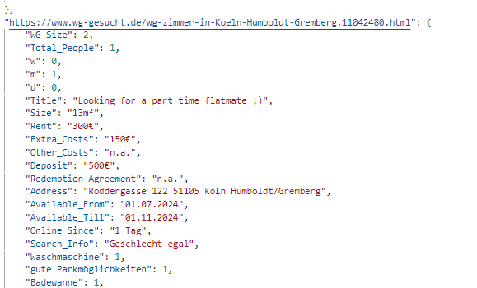
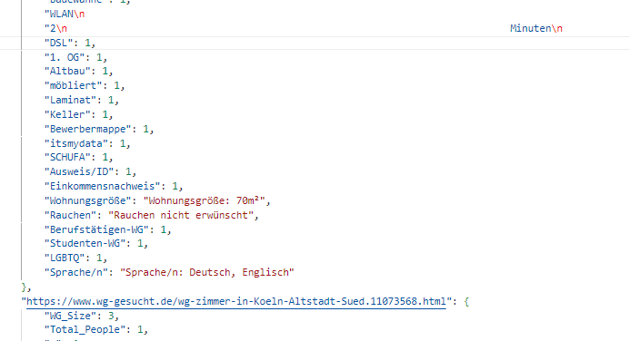
3. JSON-Data

Slide 11
3. JSON-Data

Slide 12
3. JSON-Data

Slide 13
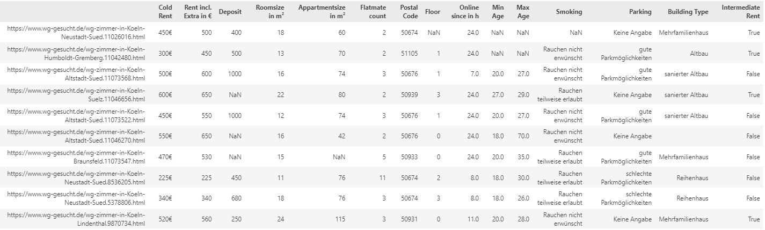
3. Restructured Data
Notes:
120 different columns
First attempt to define the most important → 15

Slide 14
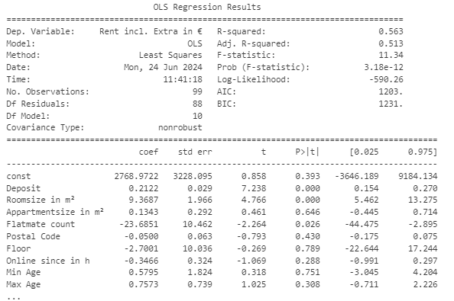
4. Data analysis
Results:
R-squared: 0.563
Very small P-value of F-statistic
Significant predictors:
Deposit
Room size
Flat mate count
Problems:
No significant const
Maybe perfect dependency between depended variable and deposit
Maybe multicollinearity

Slide 15
5. Ongoing Tasks
Adding information about Demographic and Crime Statistics
information on migration (inflow and outflow) across different city districts
the population density (number of people per square kilometer)
crime rates by police precinct
the distance of apartments from the city center
Improving the Regression Model
Further checking literature for important factors
Validate the Model
Create Regression model for research question part 2:
What factors affect the length of time shared apartment (WG) listings remain online in Cologne on WG-Gesucht.de?
Notes:
Model Assumptions:
No perfect linearity
No multicollinearity
expected value of the error is zero
The variance of the error is constant
no correlation between the independent variables
Errors are uncorrelated
Errors are normally distributed

Slide 16
6. Sources
Immowelt 2024, Entwicklung der Quadratmeterpreise https://www.immowelt.de/immobilienpreise/koeln/wohnungspreise#:~:text=Was%20kostet%20eine%20Wohnung%20in,teuersten%20Wohnungen%208.960%20%E2%82%AC%2Fm%C2%B2.
Konstantin A. Kholodilin and Dirk Ulbricht 2015, Urban House Prices: A Tale of 48 Cities, http://dx.doi.org/10.5018/ economics-ejournal.ja.2015-28
Stadt Köln 2024, Bevölkerung und Haushalte – Bevölkerungsentwicklung 2023, https://www.stadt-koeln.de/politik-und-verwaltung/statistik/bevoelkerung-und-haushalte
Statista 2024, Anzahl der Studierenden an der Universität und den Hochschulen in Köln im Jahr 2021, https://de.statista.com/statistik/daten/studie/1198036/umfrage/studierende-nach-hochschule-koeln/
Toan Ngoc Bui 2020, A study of factors influencing the price of apartments: Evidence from Vietnam, 10.5267/j.msl.2020.3.007

Slide 17

7. Feedback and Discussion

