Slide 1
Clustering CDC Data - Nutrition, Physical Activity, & Obesity using Unsupervised and Supervised Learning

Slide 2
CSML1000 Project #2, by Group 8
Tamer Hanna tamerh@my.yorku.ca Pete Gray ptgray@my.yorku.ca Xiaohai Lu yu271637@my.yorku.ca Haofeng Zhou zhf85@my.yorku.ca
Problem Statement
Obesity is a big problem in North American society, and contributes to increased rates of diabetes, heart disease, stroke, depression, suicide, disability, death, and many other serious problems that I’ll look up later.
Using this dataset, we can identify groups at highest risk based on age, gender, race, education, income, etc. Using supervised and unsupervised learning, we can look for unexpected combinations of features that lead to an increased rate of obesity. Using decision trees, we can divine the most critical factors correlated with high rates of obesity. We can do this in general, or within those clusters.
This dataset includes data on adult’s diet, physical activity, and weight status from Behavioral Risk Factor Surveillance System. This data is used for DNPAO’s Data, Trends, and Maps database, which provides national and state specific data on obesity, nutrition, physical activity, and breastfeeding. The dataset provider is particularly curious on whether socioeconomic status has an impact on obesity. In her analysis, she compares the obesity rate in each state, and then perform a linear regression on the obesity rate for each educational status and the income bracket. (spittman1248 2015)
Business Objectives
For any given sample, we can determine the impact of changing different factors on a given group’s predicted obesity rate.
Approach
Supervised Learning - build a regression/random forse model
Import the source file - Nutrition__Physical_Activity__and_Obesity_-_Behavioral_Risk_Factor_Surveillance_System.csv:
The source file has 53,392 rows and 33 columns
Describe Data
* *The data describe 9 different questions and each one has a corresponding precentage which is Data_Value column* + 1. Percent of adults aged 18 years and older who have an overweight classification + 2. Percent of adults aged 18 years and older who have obesity + 3. Percent of adults who achieve at least 150 minutes a week of moderate-intensity aerobic physical activity or 75 minutes a week of vigorous-intensity aerobic activity + 4. Percent of adults who achieve at least 150 minutes a week of moderate-intensity aerobic physical activity or 75 minutes a week of vigorous-intensity aerobic physical + 5. Percent of adults who achieve at least 300 minutes a week of moderate-intensity aerobic physical activity or 150 minutes a week of vigorous-intensity aerobic activity + 6. Percent of adults who engage in muscle-strengthening activities on 2 or more days a week + 7. Percent of adults who engage in no leisure-time physical activity + 8. Percent of adults who report consuming fruit less than one time daily + 9. Percent of adults who report consuming vegetables less than one time daily * *For each of there questions, there are 6 different categories* 1. Age (years) 2. Education 3. Gender 4. Income 5. Race/Ethnicity 6. Total * *For each of there categories, which has different values* 1. *Age (years)* * 18 - 24 * 25 - 34 * 35 - 44 * 45 - 54 * 55 - 64 * 65 or older 2. *Education* * Less than high school * High school graduate * Some college or technical school * College graduate 3. *Gender* * Male * Female 4. *Income* * Less than $15,000 * $15,000 - $24,999 * $25,000 - $34,999 * $35,000 - $49,999 * $50,000 - $74,999 * $75,000 or greater * Data not reported 5. *Race/Ethnicity* * 2 or more races * American Indian/Alaska Native * Asian * Hawaiian/Pacific Islander * Hispanic * Non-Hispanic Black * Non-Hispanic White * Other 6. *Total* * Total
Clean dataset
Column Correlation:
LocationAbbr and LocationDesc:
Column Datasource
Class and Topic columns are correlated:
Data_Value is the mean of Low_Confidence_Limit and High_Confidence_Limit
Clean the columns:

Slide 3
colName | action
YearStart | change to int
YearEnd | remove, corelate with YearStart
LocationAbbr | pass
LocationDesc | remove, correlate with LocationAbbr
Datasource | remove, may not relate to the problem
Class | remove, correlate with TopicID
Topic | remove, because corelate to Class
Question | remove, correlate with QuestionID
Data_Value_Unit | remove, contain only NA
Data_Value_Type | remove, contains only value ‘Value’
Data_Value | remove ‘NA’ observations
Data_Value_Alt | remove, corelate to Data_Value
Data_Value_Footnote_Symbol | remove, correlate to Data_Value_Footnote
Data_Value_Footnote | remove, contain only NA after removing Data_Value NA obs
Low_Confidence_Limit | remove, Data_Value = mean(Low_confidence_Limit, High_Confidence_Limit)
High_Confidence_Limit | remove, Data_Value = mean(Low_confidence_Limit, High_Confidence_Limit)
Sample_Size | pass
Total | update NA -> ‘Unknown’
Age(years) | update colname -> Age, update NA-> ‘Unknown’
Education | update NA -> ’Unknown
Gender | update NA -> ’Unknown
Income | update NA -> ‘Unknown’
Race/Ethnicity | update colname -> ‘Race’ and update NA -> ‘Unknown’
GeoLocation | remove, correlate to LocationAbbr
ClassID | remove, correlate with col: TopicID
TopicID | pass
QuestionID | pass
DataValueTypeID | remove, contain only one value ‘VALUE’
LocationID | remove, corelated with column GeoLocation
StratificationCategory1 | remove, corelation with StratificationCategoryId1
Stratification1 | remove, corelation with Income, Race/Ethnicity, Gender, Education, Age, Total, sub catigory under spread StratificationCategoryId1
StratificationCategoryId1 | remove, gathered columns from OVR,GEN,EDU,AGEYR,INC,RACE
StratificationID1 | remove, combined col: StratificationCategoryId1 + Stratification1
column list

Slide 4
Visulization - Building Models
apply for single feature:
exploreFeature(Age )

Slide 5
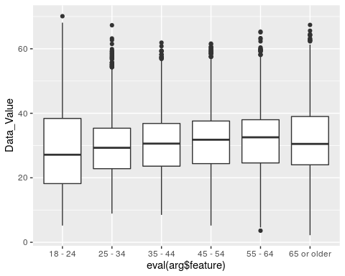

Slide 6
mod <- buildingModel(Age) exploreModel(mod = mod, Age)

Slide 7
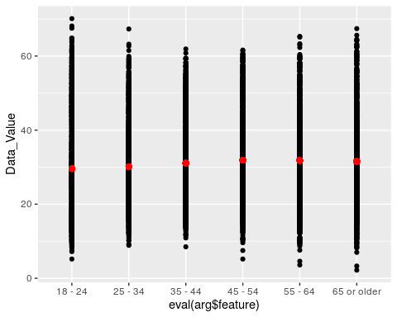

Slide 8
exploreResidual(Age)

Slide 9
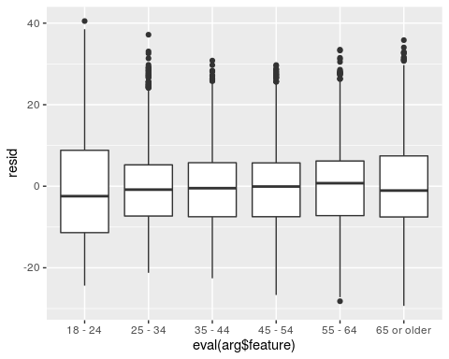

Slide 10
exploreFeature(YearStart )
## Warning: Continuous x aesthetic -- did you forget aes(group=...)?

Slide 11
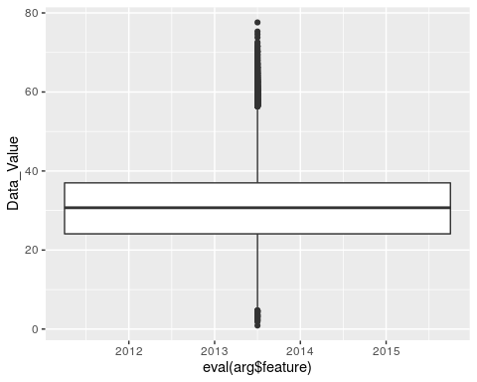

Slide 12
mod <- buildingModel(YearStart) exploreModel(mod = mod, YearStart)

Slide 13
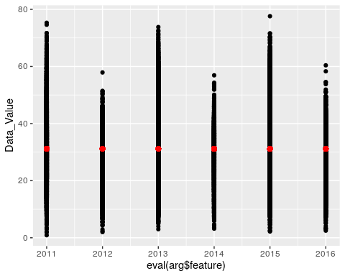

Slide 14
exploreResidual(YearStart)
## Warning: Continuous x aesthetic -- did you forget aes(group=...)?

Slide 15
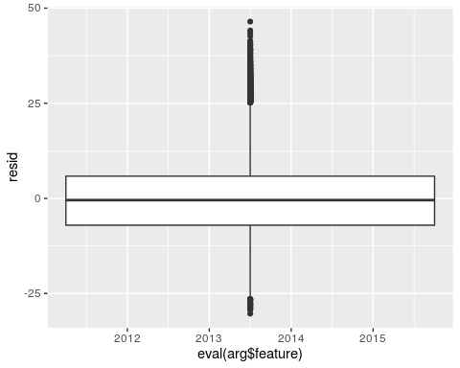

Slide 16
exploreFeature(LocationAbbr )

Slide 17
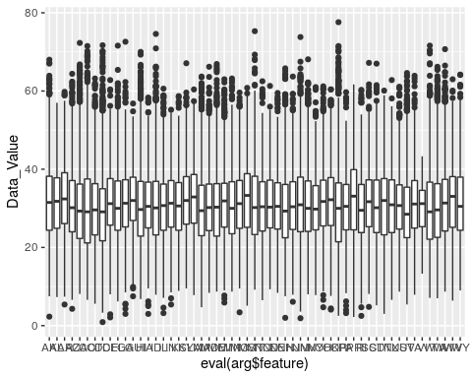

Slide 18
mod <- buildingModel(LocationAbbr) exploreModel(mod = mod, LocationAbbr)

Slide 19
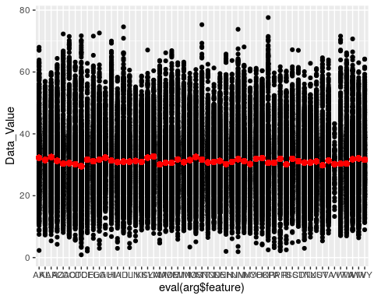

Slide 20
exploreResidual(LocationAbbr)

Slide 21


Slide 22
exploreFeature( Sample_Size )
## Warning: Continuous x aesthetic -- did you forget aes(group=...)?

Slide 23


Slide 24
mod <- buildingModel(Sample_Size) exploreModel(mod = mod, Sample_Size)

Slide 25
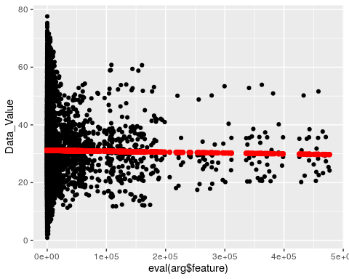

Slide 26
exploreResidual(Sample_Size)
## Warning: Continuous x aesthetic -- did you forget aes(group=...)?

Slide 27
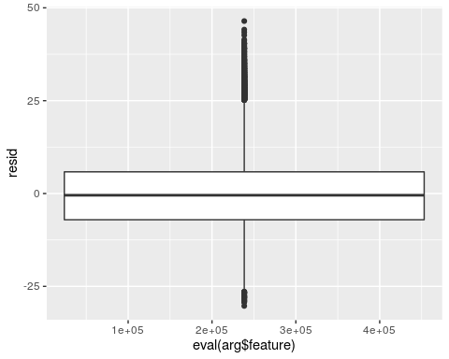

Slide 28
exploreFeature(Education )

Slide 29
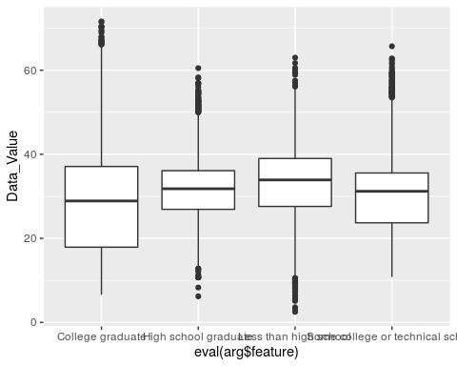

Slide 30
mod <- buildingModel(Education) exploreModel(mod = mod, Education)

Slide 31
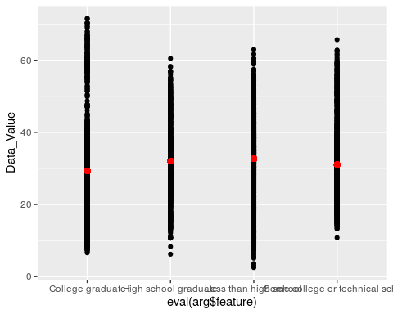

Slide 32
exploreResidual(Education )

Slide 33
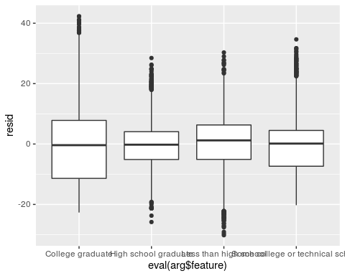

Slide 34
exploreFeature(Gender )

Slide 35
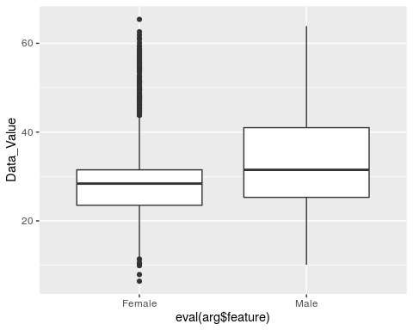

Slide 36
mod <- buildingModel(Gender) exploreModel(mod = mod, Gender)

Slide 37
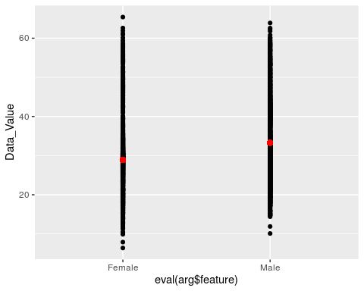

Slide 38
exploreResidual(Gender)

Slide 39
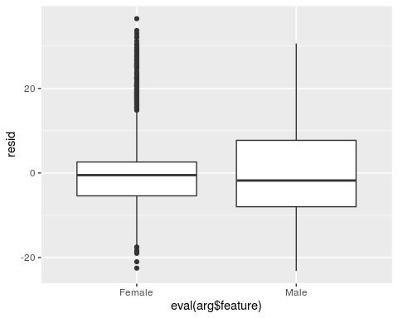

Slide 40
exploreFeature( Income )

Slide 41
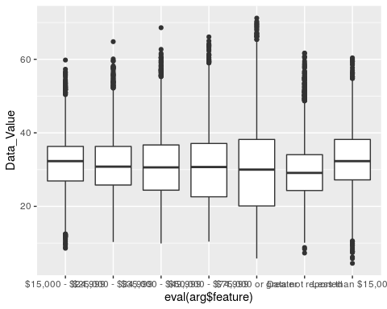

Slide 42
mod <- buildingModel(Income ) exploreModel(mod = mod, Income)

Slide 43
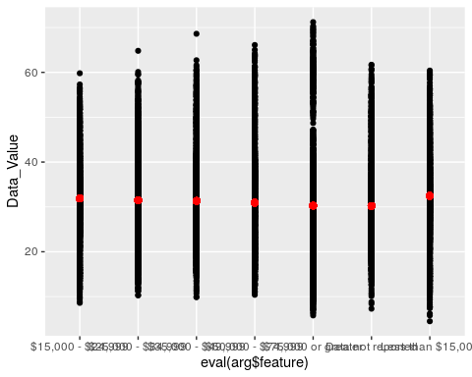

Slide 44
exploreResidual(Income )

Slide 45
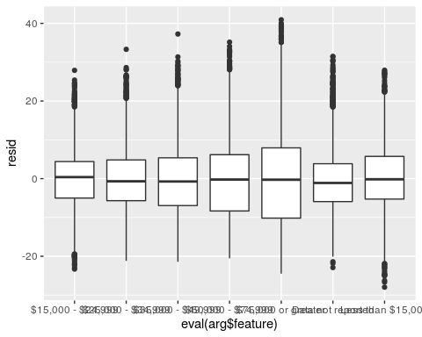

Slide 46
exploreFeature( Race )

Slide 47
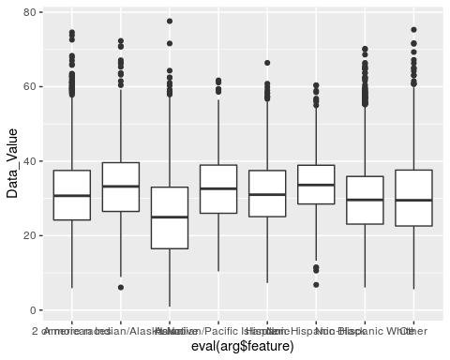

Slide 48
mod <- buildingModel(Race) exploreModel(mod = mod, Race)

Slide 49
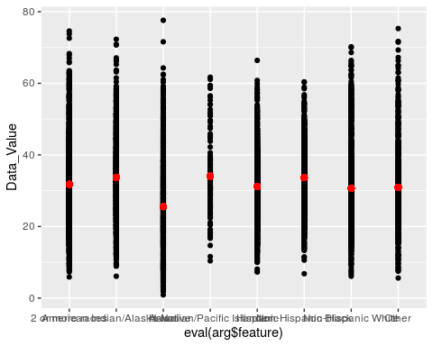

Slide 50
exploreResidual(Race)

Slide 51
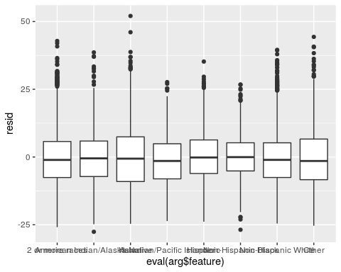

Slide 52
exploreFeature( TopicID)

Slide 53
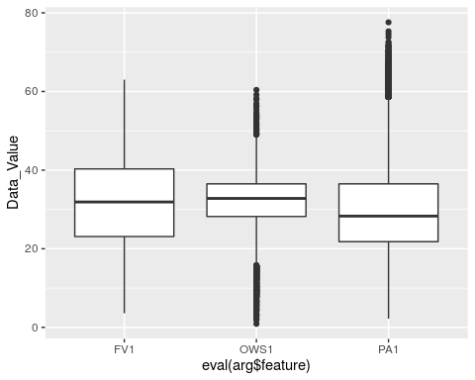

Slide 54
mod <- buildingModel(TopicID) exploreModel(mod = mod, TopicID)

Slide 55
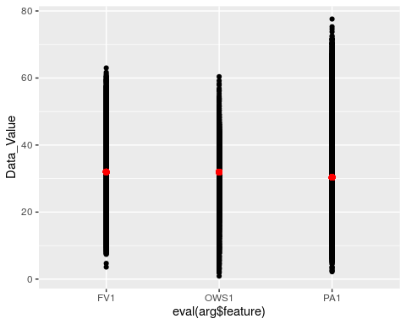

Slide 56
exploreResidual(TopicID)

Slide 57
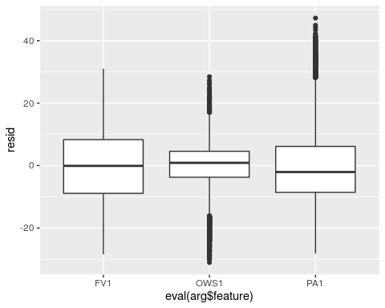

Slide 58
exploreFeature( QuestionID )

Slide 59
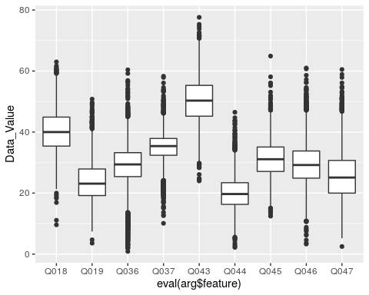

Slide 60
mod <- buildingModel(QuestionID) exploreModel(mod = mod, QuestionID)

Slide 61
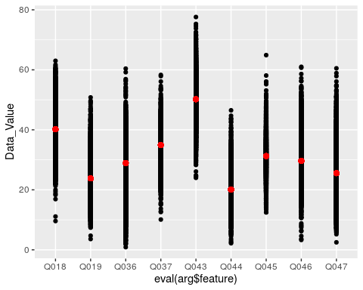

Slide 62
exploreResidual(QuestionID)

Slide 63
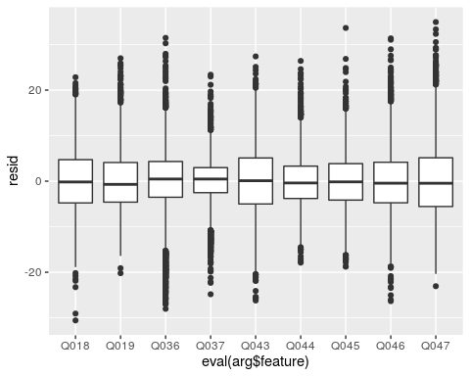

Slide 64
* **Apply for two features**

Slide 65
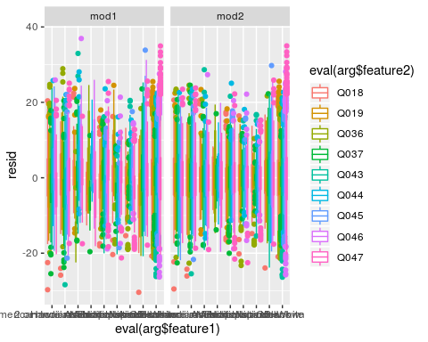

Slide 66
* **generate models** The general wide range model has Root-Mean-Squared-Error(RMSE) on its training set is 6.509817 which is very close to its test set RMSE: 6.5251302, while the simplified model with only considering Gender, Race and QuestionID has RMSE as 6.588039. There is only 0.0629089 different or 0.009641 percentage difference, which indicate we can use Gender, Race and QuestionID to represent the model with no significant sacrifice of the accuracy of the model generated. Just curiosity, when we use Age/Education/Income combination, we got the RMSE 10.2503121, which is 0.5708977 percentage decrease in model accuracy.
Model / Code: Now we save the model file into disk:
summary of findings/recommendation When we look at the residuals, which verifies that we’ve successfully removed the strong linear pattern. We can now redo our plots using those residuals instead of Data_Value (our dependent variable). Now we see the relationships: There are strong correlation between Data_Value and Gender, Race and Question; and there are less correlation between Data_Value and Age, Location and Education. There is no relationships between Data_Value and Year and SampleSize. The probably explanation on this may suggest obesity risk may higher among male, but less possible among female. Also, if you are Asian, then the chance to get Obesity is less. Of course, the way you address your questions about Obesity will lead you to different results. The supervised research also suggests that some obvious factors such as age, income, education has little effect on obesity. While with getting older, we may still keep the habits, life styles, food preferences. Those personal habits and preferences are most likely not change much with time, social status, educational background.
output Output has been saved to disk: /cloud/project/project - project.html
References
spittman1248. 2015. “CDC Data: Nutrition, Physical Activity, & Obesity.” Computer Program. https://www.kaggle.com/spittman1248/cdc-data-nutrition-physical-activity-obesity.

