Slide 1


Be A Scout Unit Information Quality
Council-wide Round Table
October 13, 2025
Ira Wolf (irawolf81@gmail.com)

Slide 2
How Families Find Your Unit
BeAScout.org is the destination for National and Council recruitment campaigns.
When we advertise Scouting, we send families to BeAScout.org.
Your unit listing in BeAScout.org is your recruitment tool.
Be A Scout Unit Information Quality

Slide 3
Crucial Unit Information
Meeting Day
Meeting Time
“Does this unit’s meeting schedule fit into my family’s schedule?”
Meeting Location
“Is the unit’s meeting location convenient to my family?”
Contact Email
“Whom do I contact for more information?”
Be A Scout Unit Information Quality

Slide 4
Helpful Unit Information
Description
This is your marketing to prospective Scouting families.
It answers: “What makes your unit special, and why should we join it?”
Social Media / Website
Shows an active unit that make a family say: “I want to be part of that unit!”
Contact Person and Phone Number
An optional contact point for families.
Be A Scout Unit Information Quality

Slide 5
The “More Information” Button Problem
The “More Information” button is present for every unit in BeAScout.org.
It does NOT provide immediate answers to basic unit information questions.
The input form requires user to enter personal information about the youth and parent/guardian.
This form can be viewed as an unnecessary invasion of privacy and turn families away from the unit.
Be A Scout Unit Information Quality

Slide 6
Unit Information Quality Scoring
An application was created to analyze the quality for each HNE unit in BeAScout.org. The following scoring system was applied:
Meeting Day 25% of score
Meeting Time 25% of score
Meeting Location 25% of score
½ credit if location in Description field instead of Address field
½ credit if location is only a PO Box
Contact Email 25% of score
½ credit if a personal email (e.g., irawolf81@gmail.com) instead of a unit-specific email (e.g., troop32-information@actonscouts.org) that multiple leaders can monitor as they rotate through unit.
Be A Scout Unit Information Quality

Slide 7
Council-wide Unit Information Scores
Total Units: 167 units
Average Quality Score: 57.1%
Quality Grade Distribution:
Grade A (90%+): 17 units (10% of units)
Grade B (80-89%): 40 units (24% of units)
Grade C (70-79%): 17 units (10% of units)
Grade D (60-69%): 7 units (4% of units)
Grade F (<60%): 84 units (50% units)
Grade N/A (Missing): 2 units (1% of units)
Only 1/3 of units have minimal required information (Grades A, B).
1/2 of units have at most 1/2 of minimal required information (Grades F, N/A).
Be A Scout Unit Information Quality

Slide 8
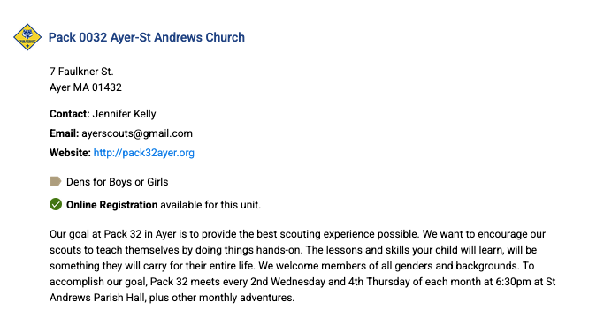
A Great Example
Be A Scout Unit Information Quality

Slide 9
Example Location and Contact Email
Meeting Location
Andrew’s Parish Hall 7 Faulkner St. Ayer, MA 01432
Correct address for Google Maps, Waze, etc.
Contact Email
ayerscouts@gmail.com
Three leaders should have access to the unit-specific email account.
Helps ensure a quick response to inquiries.
Maintains continuity as leaders and responsibilities transition over time.
Be A Scout Unit Information Quality

Slide 10
Example Descriptions
Meeting Wednesday nights from 6pm - 7pm during the school year.
Useful meeting schedule but not welcoming,
We are a welcoming and fun group of youth-led adventurers who enjoy the outdoors. Our Scouts learn valuable leadership skills and build resilience and self-confidence in a safe, supportive learning environment. We host weekly events and monthly trips throughout the year including canoeing, kayaking, whitewater rafting, hiking, camping, and urban exploration. Join us!
Welcoming but no useful meeting schedule.
Be A Scout Unit Information Quality

Slide 11
A Better Example Description
We are a welcoming and fun group of youth-led adventurers who enjoy the outdoors. Our Scouts learn valuable leadership skills and build resilience and self-confidence in a safe, supportive learning environment. We meet Wednesdays 6pm-7pm during the school year and host monthly trips throughout the year including canoeing, kayaking, whitewater rafting, hiking, camping, and urban exploration. Join us any time!
Useful meeting schedule and welcoming.
Be A Scout Unit Information Quality

Slide 12
Next Steps
Spend 15 minutes updating your unit’s information in BeAScout.org.
Only your unit’s Key Three and the District Executives can update this information.
Refer to your individual unit handout for guidance to improve your unit’s information in BeAScout.org.
See BeAScout.org update instructions at:
https://www.scouting.org/wp-content/uploads/2020/05/Be-A-Scout-Pin-Set-up.pdf
Contact District Executives for technical assistance, if needed.
Be A Scout Unit Information Quality

Slide 13
Thank you for all you do! Questions?

