Slide 1
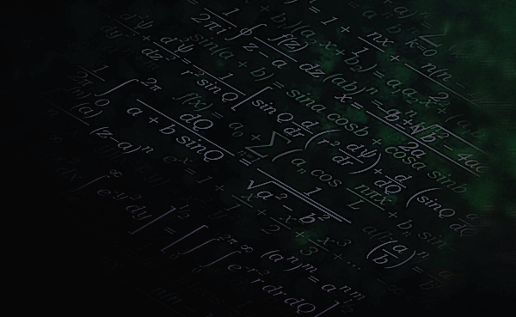

MACHINE
LEARNING

Slide 2
What is
LEARNING?

Slide 3
Learning is the acquisition of knowledge or skills through study, experience, or being taught.

Slide 4
What is
MACHINE LEARNING?

Slide 5
Machine Learning is a type of artificial intelligence that allows machines to learn from data without being explicitly programmed.

Slide 6
Importance of
MACHINE LEARNING?

Slide 7
Importance of machine learning
Uncover patterns in large dataset
Automate decision making
Other applications across industries

Slide 8
types of
MACHINE LEARNING
Supervised learning
Unsupervised learning
Reinforcement learning

Slide 9
This is a type of machine learning in which a model is trained to learn from labeled data
It’s goal is to predict outcomes for new data
😊 Matthew 25:
Supervised learning
Unsupervised learning
Reinforcement learning

Slide 10
This is a type of machine learning in which a model is trained to identify patterns unlabeled data
It’s goal is to get insight from large volume of data
😊 genesis 11:
Supervised learning
Unsupervised learning
Reinforcement learning

Slide 11
This is a type of machine learning in which a model is trained to learn by receiving reward or penalty for actions
It’s goal is to minimize penalties and maximize rewards
😊
Supervised learning
Unsupervised learning
Reinforcement learning

Slide 12
MACHINE LEARNING
workflow

Slide 13
Data Collection: Gather relevant data from various sources.
Data Preprocessing: Clean and format data for analysis.
Model Selection: Choose appropriate algorithms based on the problem.
Training: Feed data into the model to learn patterns.
Evaluation: Assess model performance using metrics.
Deployment: Implement the model in a real-world environment.

Slide 14
MACHINE LEARNING
problems

Slide 15
Classification : Predicting discrete output values using input variables .
Clustering : Creating subgroups based of common shared features .
Regression : Predicting continues output using input variables .
For casting : This is a time – indexed prediction .
Recommendation : making an offer based on receiver’s preference.

Slide 16
Assign the above ML problems into either supervised or unsupervised ML problem
_____

Slide 17
MACHINE LEARNING
Algorithms
Linear Regression
Logistic Regression
Decision Tree
Random forest
Support Vector Machine
K-Nearest Neighbors
Naïve Bayes
K-Means Clustering
Hierarchical Clustering
Principal Component Analysis
DBSCAN
Q-Learning
Deep Q-learning
Policy Gradient Method

Slide 18
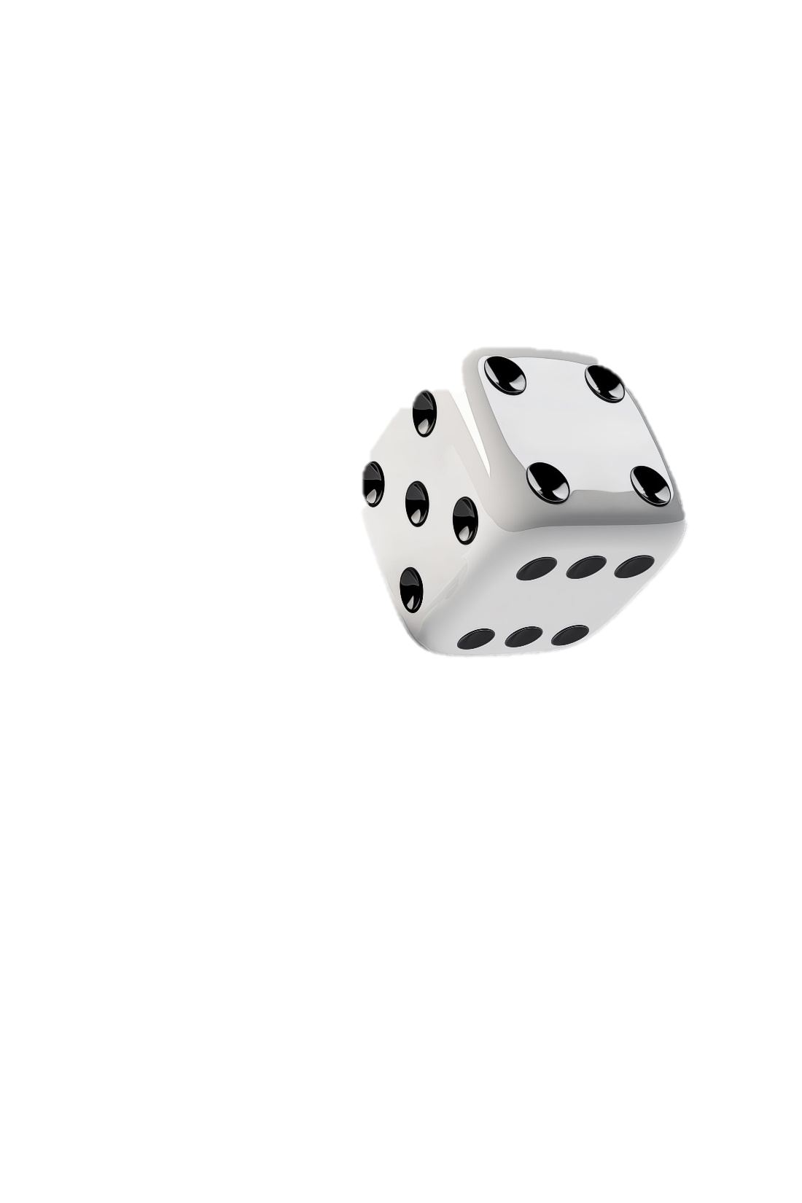
Linear Regression
Logistic Regression
Decision Tree
Random forest
Support Vector Machine
K-Nearest Neighbors
Naïve Bayes
K-Means Clustering
Hierarchical Clustering
Principal Component Analysis
DBSCAN
Q-Learning
Deep Q-learning
Policy Gradient Method
Logistic regression

Slide 19
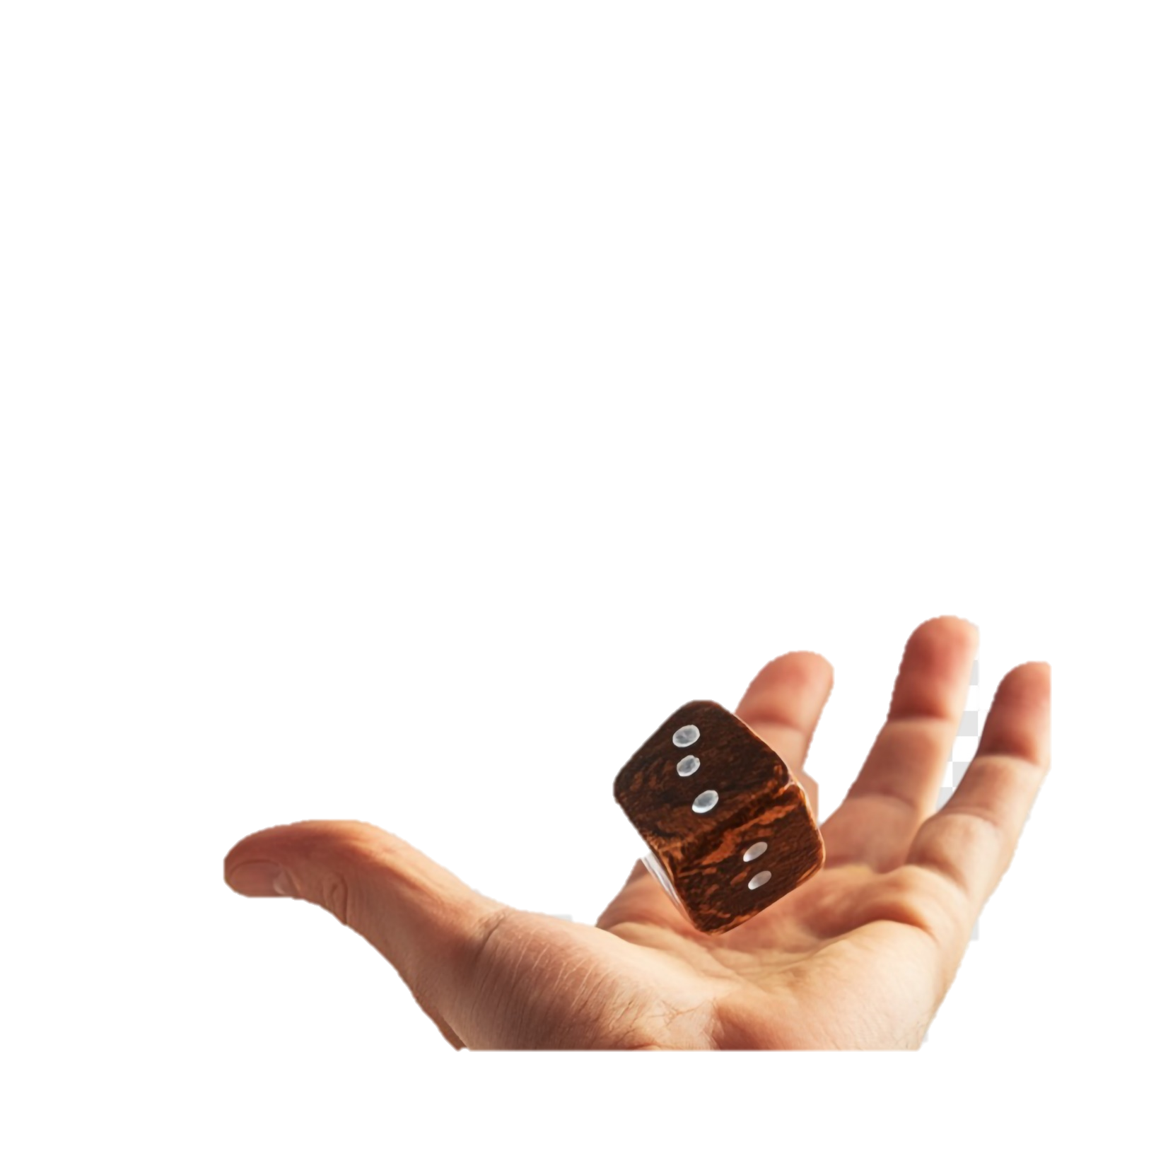
Linear Regression
Logistic Regression
Decision Tree
Random forest
Support Vector Machine
K-Nearest Neighbors
Naïve Bayes
K-Means Clustering
Hierarchical Clustering
Principal Component Analysis
DBSCAN
Q-Learning
Deep Q-learning
Policy Gradient Method
A number from 0 to infinity
odds
Quantifying certainty for the occurrence of an event

Slide 20
Linear Regression
Logistic Regression
Decision Tree
Random forest
Support Vector Machine
K-Nearest Neighbors
Naïve Bayes
K-Means Clustering
Hierarchical Clustering
Principal Component Analysis
DBSCAN
Q-Learning
Deep Q-learning
Policy Gradient Method
A number from 0 to infinity
odds
Represents the ratio of success to failure(odds for) or the ratio of failure to success(odds against)

Slide 21
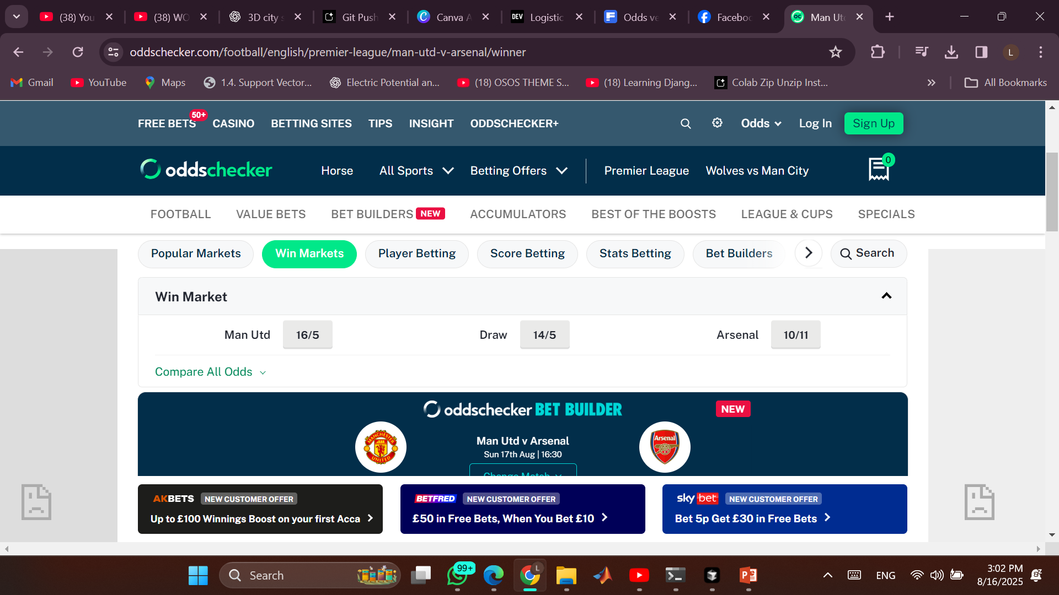
Example from sports and betting
Linear Regression
Logistic Regression
Decision Tree
Random forest
Support Vector Machine
K-Nearest Neighbors
Naïve Bayes
K-Means Clustering
Hierarchical Clustering
Principal Component Analysis
DBSCAN
Q-Learning
Deep Q-learning
Policy Gradient Method
odds

Slide 22
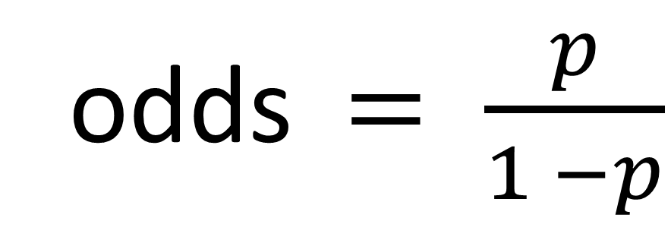
Linear Regression
Logistic Regression
Decision Tree
Random forest
Support Vector Machine
K-Nearest Neighbors
Naïve Bayes
K-Means Clustering
Hierarchical Clustering
Principal Component Analysis
DBSCAN
Q-Learning
Deep Q-learning
Policy Gradient Method
This is odds for
odds$= \frac{p}{1 −p}$
Odds > 1 : success is more likely
Odds <1 : failure is more likely
Odds = 1 : means 50-50
This has one limitation which is odds donot know anything about negative numbers

Slide 23
Linear Regression
Logistic Regression
Decision Tree
Random forest
Support Vector Machine
K-Nearest Neighbors
Naïve Bayes
K-Means Clustering
Hierarchical Clustering
Principal Component Analysis
DBSCAN
Q-Learning
Deep Q-learning
Policy Gradient Method
A number from -infinty to +infinity
logit
Rescaling odds values by computing the logarithm of the odds values

Slide 24
Linear Regression
Logistic Regression
Decision Tree
Random forest
Support Vector Machine
K-Nearest Neighbors
Naïve Bayes
K-Means Clustering
Hierarchical Clustering
Principal Component Analysis
DBSCAN
Q-Learning
Deep Q-learning
Policy Gradient Method
How does this help ?
You fit data to our model
It performs a computation on the features and their weights and ouput a number
This number should tells us the how likely our input belongs to a certain category (success or failure)
We can assign that number to the logit function

Slide 25
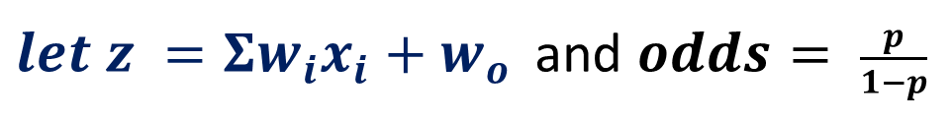
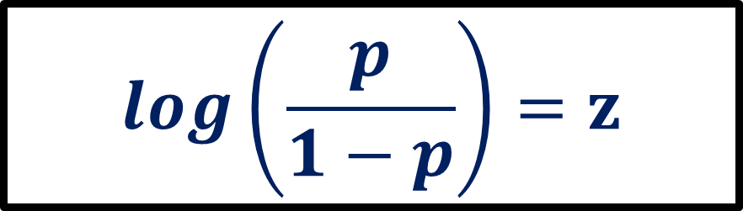


Logistic regression model
Linear Regression
Logistic Regression
Decision Tree
Random forest
Support Vector Machine
K-Nearest Neighbors
Naïve Bayes
K-Means Clustering
Hierarchical Clustering
Principal Component Analysis
DBSCAN
Q-Learning
Deep Q-learning
Policy Gradient Method
$$log\left(odds\right)= Σw_{i}x_{i}+w_{o}$$
$let z =Σw_{i}x_{i}+w_{o }$ and $odds= \frac{p}{1−p}$
We can get the sigmoid function
$$log\left(\frac{p}{1−p}\right)=z$$
$$p = \frac{1}{1+ e^{−z}}$$

Slide 26
Linear Regression
Logistic Regression
Decision Tree
Random forest
Support Vector Machine
K-Nearest Neighbors
Naïve Bayes
K-Means Clustering
Hierarchical Clustering
Principal Component Analysis
DBSCAN
Q-Learning
Deep Q-learning
Policy Gradient Method
Decision boundary
This is a number,a line,a plane that we use to assign each input record to it’s output category
For 1 feature it is a number x = a
For 2 features it is a line (y = mx + c)
For 3 features it is a plane(ax +by +cz = d)
…….

Slide 27
Linear Regression
Logistic Regression
Decision Tree
Random forest
Support Vector Machine
K-Nearest Neighbors
Naïve Bayes
K-Means Clustering
Hierarchical Clustering
Principal Component Analysis
DBSCAN
Q-Learning
Deep Q-learning
Policy Gradient Method
Cost function
Encouraging good prediction and non tolerant to mistakes
It’s either you make it or you mare it

Slide 28
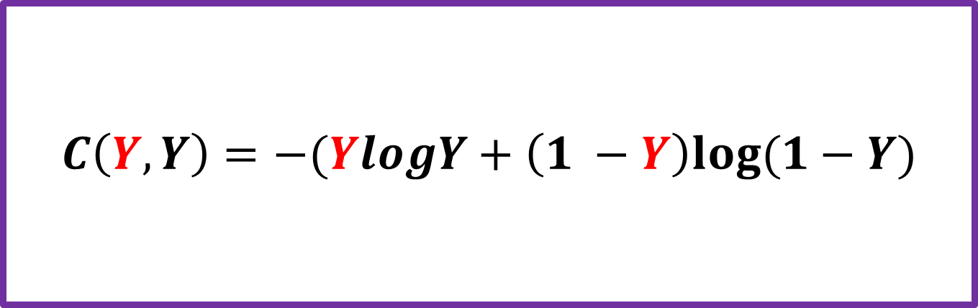
Cost function
Linear Regression
Logistic Regression
Decision Tree
Random forest
Support Vector Machine
K-Nearest Neighbors
Naïve Bayes
K-Means Clustering
Hierarchical Clustering
Principal Component Analysis
DBSCAN
Q-Learning
Deep Q-learning
Policy Gradient Method
Y : predicted value Y: actual value
$$C\left(Y,Y\right)=−(YlogY+\left(1 −Y\right)log⁡(1−Y)$$

Slide 29
Optimization
Linear Regression
Logistic Regression
Decision Tree
Random forest
Support Vector Machine
K-Nearest Neighbors
Naïve Bayes
K-Means Clustering
Hierarchical Clustering
Principal Component Analysis
DBSCAN
Q-Learning
Deep Q-learning
Policy Gradient Method
Finding the best value for the weight and bias that will produce minimum cost
$$C\left(Y,Y\right)=−(YlogY+\left(1 −Y\right)log⁡(1−Y)$$

Slide 30


Optimization
Linear Regression
Logistic Regression
Decision Tree
Random forest
Support Vector Machine
K-Nearest Neighbors
Naïve Bayes
K-Means Clustering
Hierarchical Clustering
Principal Component Analysis
DBSCAN
Q-Learning
Deep Q-learning
Policy Gradient Method
$$α is called the learning rate$$
Commute how each feature’s weight contributes to the cost $\left(\frac{∂C}{∂w_{i}}\right)$
Compute how the bias contributes to the cost $\left(\frac{∂C}{∂w_{o}}\right)$
Update weight and bias as
$w_{t+1}= w_{t} − α\left(\frac{∂C}{∂w_{i}}\right)$

Slide 31
Linear Regression
Logistic Regression
Decision Tree
Random forest
Support Vector Machine
K-Nearest Neighbors
Naïve Bayes
K-Means Clustering
Hierarchical Clustering
Principal Component Analysis
DBSCAN
Q-Learning
Deep Q-learning
Policy Gradient Method
The
Sigmoid function
Is further genaralized by the SOFTMAX to handle multi-class classification

Slide 32
Linear Regression
Logistic Regression
Decision Tree
Random forest
Support Vector Machine
K-Nearest Neighbors
Naïve Bayes
K-Means Clustering
Hierarchical Clustering
Principal Component Analysis
DBSCAN
Q-Learning
Deep Q-learning
Policy Gradient Method
Code implementation
https://colab.research.google.com/drive/1o2OH-ohslAur0R565W63bwGCLLzo12A7?usp=sharing

Slide 33
Linear Regression
Logistic Regression
Decision Tree
Random forest
Support Vector Machine
K-Nearest Neighbors
Naïve Bayes
K-Means Clustering
Hierarchical Clustering
Principal Component Analysis
DBSCAN
Q-Learning
Deep Q-learning
Policy Gradient Method
Thank you !

