Slide 1


MACHINE
LEARNING

Slide 2
Label encoding
One Hot Encoding
Term Doc Incidence Matrix
Bag Of Words
TF-IDF
Word Embeddings
K-Nearest Neighbors
Naïve Bayes
K-Means Clustering
Hierarchical Clustering
Principal Component Analysis
DBSCAN
Q-Learning
Deep Q-learning
Policy Gradient Method
Natural Language
Process!ng

Slide 3
Label encoding
One Hot Encoding
Term Doc Incidence Matrix
Bag Of Words
TF-IDF
Word Embeddings
K-Nearest Neighbors
Naïve Bayes
K-Means Clustering
Hierarchical Clustering
Principal Component Analysis
DBSCAN
Q-Learning
Deep Q-learning
Policy Gradient Method
ML models take only numbers as their inputs and output only numbers

Slide 4
Label encoding
One Hot Encoding
Term Doc Incidence Matrix
Bag Of Words
TF-IDF
Word Embeddings
K-Nearest Neighbors
Naïve Bayes
K-Means Clustering
Hierarchical Clustering
Principal Component Analysis
DBSCAN
Q-Learning
Deep Q-learning
Policy Gradient Method
Label Encod!ng

Slide 5
Label encoding
One Hot Encoding
Term Doc Incidence Matrix
Bag Of Words
TF-IDF
Word Embeddings
K-Nearest Neighbors
Naïve Bayes
K-Means Clustering
Hierarchical Clustering
Principal Component Analysis
DBSCAN
Q-Learning
Deep Q-learning
Policy Gradient Method
What is label Encoding
A Data processing technique used to convert categorical values into labels.

Slide 6
How does it work
Label encoding
One Hot Encoding
Term Doc Incidence Matrix
Bag Of Words
TF-IDF
Word Embeddings
K-Nearest Neighbors
Naïve Bayes
K-Means Clustering
Hierarchical Clustering
Principal Component Analysis
DBSCAN
Q-Learning
Deep Q-learning
Policy Gradient Method
weather
sunny
normal
cloudy
rainy
weather
0
1
2
3

Slide 7
Label encoding
One Hot Encoding
Term Doc Incidence Matrix
Bag Of Words
TF-IDF
Word Embeddings
K-Nearest Neighbors
Naïve Bayes
K-Means Clustering
Hierarchical Clustering
Principal Component Analysis
DBSCAN
Q-Learning
Deep Q-learning
Policy Gradient Method
One Weak Point
Label encoder will enforce
un-necessery order to nominal data
Think about jersey numbers on players

Slide 8
Label encoding
One Hot Encoding
Term Doc Incidence Matrix
Bag Of Words
TF-IDF
Word Embeddings
K-Nearest Neighbors
Naïve Bayes
K-Means Clustering
Hierarchical Clustering
Principal Component Analysis
DBSCAN
Q-Learning
Deep Q-learning
Policy Gradient Method
When to avoid
When trying to convert nominal data to numbers.
They will think that categories with higher values are actually above others beneath it in the real-world

Slide 9
Label encoding
One Hot Encoding
Term Doc Incidence Matrix
Bag Of Words
TF-IDF
Word Embeddings
K-Nearest Neighbors
Naïve Bayes
K-Means Clustering
Hierarchical Clustering
Principal Component Analysis
DBSCAN
Q-Learning
Deep Q-learning
Policy Gradient Method
Implementation
Label_encoder.py
import pandas as pd
from sklearn.preprocessing import LabelEncoder
# 1. Sample dataset
df = pd.DataFrame({'Target_Class': ['Low', 'High', 'Medium', 'Low', 'High']})
# 2. Initialize the LabelEncoder
le = LabelEncoder()
# 3. Fit to the column and transform text to integers
df['Encoded_Class']=le.fit_transform(df['Target_Class'])
print(df)

Slide 10
Label encoding
One Hot Encoding
Term Doc Incidence Matrix
Bag Of Words
TF-IDF
Word Embeddings
K-Nearest Neighbors
Naïve Bayes
K-Means Clustering
Hierarchical Clustering
Principal Component Analysis
DBSCAN
Q-Learning
Deep Q-learning
Policy Gradient Method
One-hot Encod!ng

Slide 11
Label encoding
One Hot Encoding
Term Doc Incidence Matrix
Bag Of Words
TF-IDF
Word Embeddings
K-Nearest Neighbors
Naïve Bayes
K-Means Clustering
Hierarchical Clustering
Principal Component Analysis
DBSCAN
Q-Learning
Deep Q-learning
Policy Gradient Method
What is one hot encoding
A Data processing technique used to convert categorical values into numerical vectors

Slide 12
How does it work
Label encoding
One Hot Encoding
Term Doc Incidence Matrix
Bag Of Words
TF-IDF
Word Embeddings
K-Nearest Neighbors
Naïve Bayes
K-Means Clustering
Hierarchical Clustering
Principal Component Analysis
DBSCAN
Q-Learning
Deep Q-learning
Policy Gradient Method
weather
sunny
normal
cloudy
rainy
Am I sunny | Am I normal | Am I cloudy | Am I rainy
1 | 0 | 0 | 0
0 | 1 | 0 | 0
0 | 0 | 1 | 0
0 | 0 | 0 | 1
Number of new columns = number of unique categories

Slide 13
Label encoding
One Hot Encoding
Term Doc Incidence Matrix
Bag Of Words
TF-IDF
Word Embeddings
K-Nearest Neighbors
Naïve Bayes
K-Means Clustering
Hierarchical Clustering
Principal Component Analysis
DBSCAN
Q-Learning
Deep Q-learning
Policy Gradient Method
Discussion Point
Can you point
out one weakness of this approach?

Slide 14
Label encoding
One Hot Encoding
Term Doc Incidence Matrix
Bag Of Words
TF-IDF
Word Embeddings
K-Nearest Neighbors
Naïve Bayes
K-Means Clustering
Hierarchical Clustering
Principal Component Analysis
DBSCAN
Q-Learning
Deep Q-learning
Policy Gradient Method
One-hot_encoder.py
import pandas as pd
# 1. Create a sample dataset with a nominal categorical columndata = {'City': ['Paris', 'New York', 'Tokyo', 'Paris', 'Tokyo']}
df = pd.DataFrame(data)
# 2. Apply one-hot encoding and fix the dummy variable trap
# 'drop_first=True' removes the very first category column (alphabetically)
# 'dtype=int' changes the output from True/False booleans to 1/0 integers
df_encoded = pd.get_dummies(df, columns=['City'], drop_first=True, dtype=int)
# Print the resulting dataframe
print(df_encoded)
Implementation

Slide 15
Label encoding
One Hot Encoding
Term Doc Incidence Matrix
Bag Of Words
TF-IDF
Word Embeddings
K-Nearest Neighbors
Naïve Bayes
K-Means Clustering
Hierarchical Clustering
Principal Component Analysis
DBSCAN
Q-Learning
Deep Q-learning
Policy Gradient Method
Limitations of one-hot-encoding
Uses vectors that store more zeros than 1 i.e sparcity
It does not scale with number of categories
It adds dimensions to our model >☺

Slide 16
Label encoding
One Hot Encoding
Term Doc Incidence Matrix
Bag Of Words
TF-IDF
Word Embeddings
K-Nearest Neighbors
Naïve Bayes
K-Means Clustering
Hierarchical Clustering
Principal Component Analysis
DBSCAN
Q-Learning
Deep Q-learning
Policy Gradient Method
Discussion Point
How can we apply
one-hot encoding to a message ?

Slide 17
Label encoding
One Hot Encoding
Term Doc Incidence Matrix
Bag Of Words
TF-IDF
Word Embeddings
K-Nearest Neighbors
Naïve Bayes
K-Means Clustering
Hierarchical Clustering
Principal Component Analysis
DBSCAN
Q-Learning
Deep Q-learning
Policy Gradient Method
Term document incidence matr!x

Slide 18
How does it work
Label encoding
One Hot Encoding
Term Doc Incidence Matrix
Bag Of Words
TF-IDF
Word Embeddings
K-Nearest Neighbors
Naïve Bayes
K-Means Clustering
Hierarchical Clustering
Principal Component Analysis
DBSCAN
Q-Learning
Deep Q-learning
Policy Gradient Method
I am happy
He is not happy
I see happiness
Is present in | Doc 1 | Doc 2 | Doc 3
am | 1 | 0 | 0
happiness | 0 | 0 | 1
happy | 1 | 1 | 0
he | 0 | 1 | 0
… | … | …
see | 0 | 0 | 1

Slide 19
Label encoding
One Hot Encoding
Term Doc Incidence Matrix
Bag Of Words
TF-IDF
Word Embeddings
K-Nearest Neighbors
Naïve Bayes
K-Means Clustering
Hierarchical Clustering
Principal Component Analysis
DBSCAN
Q-Learning
Deep Q-learning
Policy Gradient Method
Discussion Point
Can you point
out one weakness of this approach?

Slide 20
Label encoding
One Hot Encoding
Term Doc Incidence Matrix
Bag Of Words
TF-IDF
Word Embeddings
K-Nearest Neighbors
Naïve Bayes
K-Means Clustering
Hierarchical Clustering
Principal Component Analysis
DBSCAN
Q-Learning
Deep Q-learning
Policy Gradient Method
Bag-of-Words

Slide 21
Label encoding
One Hot Encoding
Term Doc Incidence Matrix
Bag Of Words
TF-IDF
Word Embeddings
K-Nearest Neighbors
Naïve Bayes
K-Means Clustering
Hierarchical Clustering
Principal Component Analysis
DBSCAN
Q-Learning
Deep Q-learning
Policy Gradient Method
How it works
Converts text into collection of words and count how often a word appear in text
Focuses on word frequency only

Slide 22
How does it work
Label encoding
One Hot Encoding
Term Doc Incidence Matrix
Bag Of Words
TF-IDF
Word Embeddings
K-Nearest Neighbors
Naïve Bayes
K-Means Clustering
Hierarchical Clustering
Principal Component Analysis
DBSCAN
Q-Learning
Deep Q-learning
Policy Gradient Method
I am happy if everyone is happy
He is not happy and he is hungry
I see happiness ,then happiness
Is present in | Doc 1 | Doc 2 | Doc 3
am | 1 | 0 | 0
and | 0 | 1 | 0
happiness | 0 | 0 | 2
happy | 2 | 1 | 0
he | 0 | 2 | 0
… | … | …
see | 0 | 0 | 1

Slide 23
Label encoding
One Hot Encoding
Term Doc Incidence Matrix
Bag Of Words
TF-IDF
Word Embeddings
K-Nearest Neighbors
Naïve Bayes
K-Means Clustering
Hierarchical Clustering
Principal Component Analysis
DBSCAN
Q-Learning
Deep Q-learning
Policy Gradient Method
Discussion Point
Can you point
out one weakness of this approach?

Slide 24
Label encoding
One Hot Encoding
Term Doc Incidence Matrix
Bag Of Words
TF-IDF
Word Embeddings
K-Nearest Neighbors
Naïve Bayes
K-Means Clustering
Hierarchical Clustering
Principal Component Analysis
DBSCAN
Q-Learning
Deep Q-learning
Policy Gradient Method
Bag-Of-Words.py
import pandas as pd
from sklearn.feature_extraction.text import CountVectorizer
# 1. Create a sample dataset with text reviews
data = {‘reviews': [‘the food is good',
'New food is terrible',
‘good food and good services']
}
df = pd.DataFrame(data)
# 2. Initialize the CountVectorizer
# stop_words='english' removes useless words like 'the' and 'and' to save memory
vectorizer = CountVectorizer(stop_words='english')
# 3. Fit and transform the text column
# This learns the unique vocabulary and counts the word occurrences
bow_matrix = vectorizer.fit_transform(df['Text_Reviews'])
# 4. Convert the matrix into a clean Pandas DataFrame
# vectorizer.get_feature_names_out() extracts the learned vocabulary as column names
df_bow = pd.DataFrame(bow_matrix.toarray(), columns=vectorizer.get_feature_names_out()) print(df_bow)
Implementation

Slide 25
Label encoding
One Hot Encoding
Term Doc Incidence Matrix
Bag Of Words
TF-IDF
Word Embeddings
K-Nearest Neighbors
Naïve Bayes
K-Means Clustering
Hierarchical Clustering
Principal Component Analysis
DBSCAN
Q-Learning
Deep Q-learning
Policy Gradient Method
Limitations of BOW model
Does not capture semantic distance between words
Does not preserve word order
Inefficient when it has mores zeros in the object(vector) .ie sparcity

Slide 26
Label encoding
One Hot Encoding
Term Doc Incidence Matrix
Bag Of Words
TF-IDF
Word Embeddings
K-Nearest Neighbors
Naïve Bayes
K-Means Clustering
Hierarchical Clustering
Principal Component Analysis
DBSCAN
Q-Learning
Deep Q-learning
Policy Gradient Method
TF-IDF
TERM FREQUENCY-INVERSE DOCUMENT FREQUENCY

Slide 27

KEY DEFINATIONS
Label encoding
One Hot Encoding
Term Doc Incidence Matrix
Bag Of Words
TF-IDF
Word Embeddings
K-Nearest Neighbors
Naïve Bayes
K-Means Clustering
Hierarchical Clustering
Principal Component Analysis
DBSCAN
Q-Learning
Deep Q-learning
Policy Gradient Method
Document frequency(df) : number of documents that contain a give word i.e df(w)
Inverse document frequency(idf) : number of docs ÷ df i.e
Term frequency(td(w,d) : fraction of (w) in document (d)
idf(w) = $\log{( \frac{num of docs}{df\left(w\right)} )}$

Slide 28
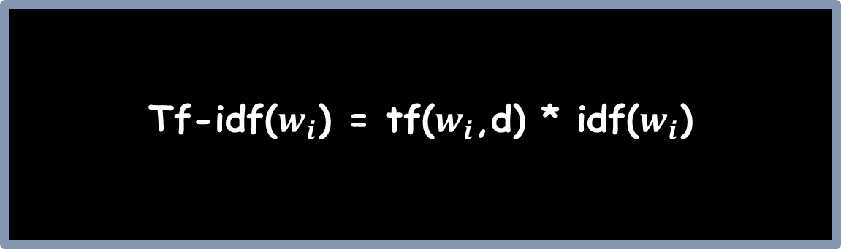
Label encoding
One Hot Encoding
Term Doc Incidence Matrix
Bag Of Words
TF-IDF
Word Embeddings
K-Nearest Neighbors
Naïve Bayes
K-Means Clustering
Hierarchical Clustering
Principal Component Analysis
DBSCAN
Q-Learning
Deep Q-learning
Policy Gradient Method
Obtain tf-idf
Tf-idf($w_{i}$) = tf($w_{i}$,d) * idf($w_{i}$)

Slide 29
Label encoding
One Hot Encoding
Term Doc Incidence Matrix
Bag Of Words
TF-IDF
Word Embeddings
K-Nearest Neighbors
Naïve Bayes
K-Means Clustering
Hierarchical Clustering
Principal Component Analysis
DBSCAN
Q-Learning
Deep Q-learning
Policy Gradient Method
Tf-idf.py
import pandas as pd
from sklearn.feature_extraction.text import CountVectorizer
# 1. Create a sample dataset with text reviews
data = {‘reviews': [‘the food is good',
'New food is terrible',
‘good food and good services']
}
df = pd.DataFrame(data)
# 2. Initialize the tf-idf vectorizer
# stop_words='english' removes useless words like 'the' and 'and' to save memory
vectorizer = tfidf_vectorizer = TfidfVectorizer(stop_words='english')
# 3. Fit and transform the text data
# This calculates the TF (term frequency) and multiplies it by IDF (inverse document frequency)
tfidf_matrix = vectorizer.fit_transform(df[‘reviews'])
# 4. Convert the resulting numerical matrix into a Pandas DataFrame
# vectorizer.get_feature_names_out() extracts the unique vocabulary for column headers
df_tfidf = pd.DataFrame(tfidf_matrix.toarray(),columns=tfidf_vectorizer.get_feature_names_out())
Implementation

Slide 30
Label encoding
One Hot Encoding
Term Doc Incidence Matrix
Bag Of Words
TF-IDF
Word Embeddings
K-Nearest Neighbors
Naïve Bayes
K-Means Clustering
Hierarchical Clustering
Principal Component Analysis
DBSCAN
Q-Learning
Deep Q-learning
Policy Gradient Method
Word Embedd!ngs
CAPTURING MEANING IN NUMBERS

Slide 31
Label encoding
One Hot Encoding
Term Doc Incidence Matrix
Bag Of Words
TF-IDF
Word Embeddings
K-Nearest Neighbors
Naïve Bayes
K-Means Clustering
Hierarchical Clustering
Principal Component Analysis
DBSCAN
Q-Learning
Deep Q-learning
Policy Gradient Method
DISCUSSION POINT
BOY – HUT + PALACE = ?

Slide 32
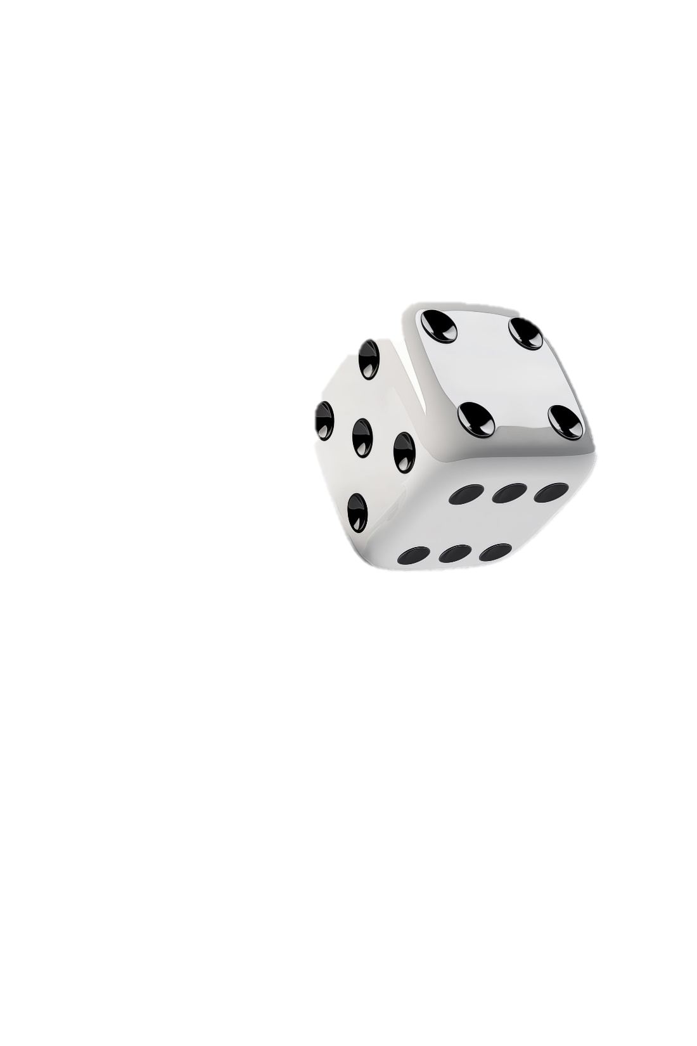
Label encoding
One Hot Encoding
Term Doc Incidence Matrix
Bag Of Words
TF-IDF
Word Embeddings
K-Nearest Neighbors
Naïve Bayes
K-Means Clustering
Hierarchical Clustering
Principal Component Analysis
DBSCAN
Q-Learning
Deep Q-learning
Policy Gradient Method
What is a word embedding
It is A vector representation of a word in a set of vectors(space)

Slide 33
Label encoding
One Hot Encoding
Term Doc Incidence Matrix
Bag Of Words
TF-IDF
Word Embeddings
K-Nearest Neighbors
Naïve Bayes
K-Means Clustering
Hierarchical Clustering
Principal Component Analysis
DBSCAN
Q-Learning
Deep Q-learning
Policy Gradient Method
What is an embedding model
It is A model responsible for generating word embeddings(space)

Slide 34
Linear Regression
Logistic Regression
Decision Tree
Random forest
Support Vector Machine
K-Nearest Neighbors
Naïve Bayes
K-Means Clustering
Hierarchical Clustering
Principal Component Analysis
DBSCAN
Q-Learning
Deep Q-learning
Policy Gradient Method
Thank you !

