Slide 1
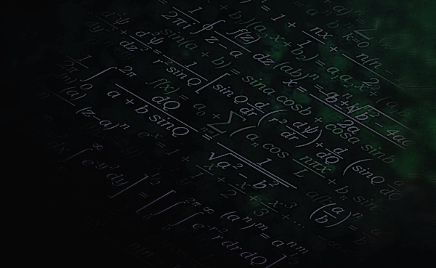

MACHINE
LEARNING

Slide 2
What is
LEARNING?

Slide 3
Learning is the acquisition of knowledge or skills through study, experience, or being taught.

Slide 4
What is
MACHINE LEARNING?

Slide 5
Machine Learning is a type of artificial intelligence that allows machines to learn from data without being explicitly programmed.

Slide 6
Importance of
MACHINE LEARNING?

Slide 7
Importance of machine learning
Uncover patterns in large dataset
Automate decision making
Other applications across industries

Slide 8
types of
MACHINE LEARNING
Supervised learning
Unsupervised learning
Reinforcement learning

Slide 9
This is a type of machine learning in which a model is trained to learn from labeled data
It’s goal is to predict outcomes for new data
😊 Matthew 25:
Supervised learning
Unsupervised learning
Reinforcement learning

Slide 10
This is a type of machine learning in which a model is trained to identify patterns unlabeled data
It’s goal is to get insight from large volume of data
😊 genesis 11:
Supervised learning
Unsupervised learning
Reinforcement learning

Slide 11
This is a type of machine learning in which a model is trained to learn by receiving reward or penalty for actions
It’s goal is to minimize penalties and maximize rewards
😊
Supervised learning
Unsupervised learning
Reinforcement learning

Slide 12
MACHINE LEARNING
workflow

Slide 13
Data Collection: Gather relevant data from various sources.
Data Preprocessing: Clean and format data for analysis.
Model Selection: Choose appropriate algorithms based on the problem.
Training: Feed data into the model to learn patterns.
Evaluation: Assess model performance using metrics.
Deployment: Implement the model in a real-world environment.

Slide 14
MACHINE LEARNING
problems

Slide 15
Classification : Predicting discrete output values using input variables .
Clustering : Creating subgroups based of common shared features .
Regression : Predicting continues output using input variables .
For casting : This is a time – indexed prediction .
Recommendation : making an offer based on receiver’s preference.

Slide 16
Assign the above ML problems into either supervised or unsupervised ML problem
_____

Slide 17
MACHINE LEARNING
Algorithms
Linear Regression
Logistic Regression
Decision Tree
Random forest
Support Vector Machine
K-Nearest Neighbors
Naïve Bayes
K-Means Clustering
Hierarchical Clustering
Principal Component Analysis
DBSCAN
Q-Learning
Deep Q-learning
Policy Gradient Method

Slide 18
Linear Regression
Logistic Regression
Decision Tree
Random forest
Support Vector Machine
K-Nearest Neighbors
Naïve Bayes
K-Means Clustering
Hierarchical Clustering
Principal Component Analysis
DBSCAN
Q-Learning
Deep Q-learning
Policy Gradient Method
Principal
Component
Analysis

Slide 19
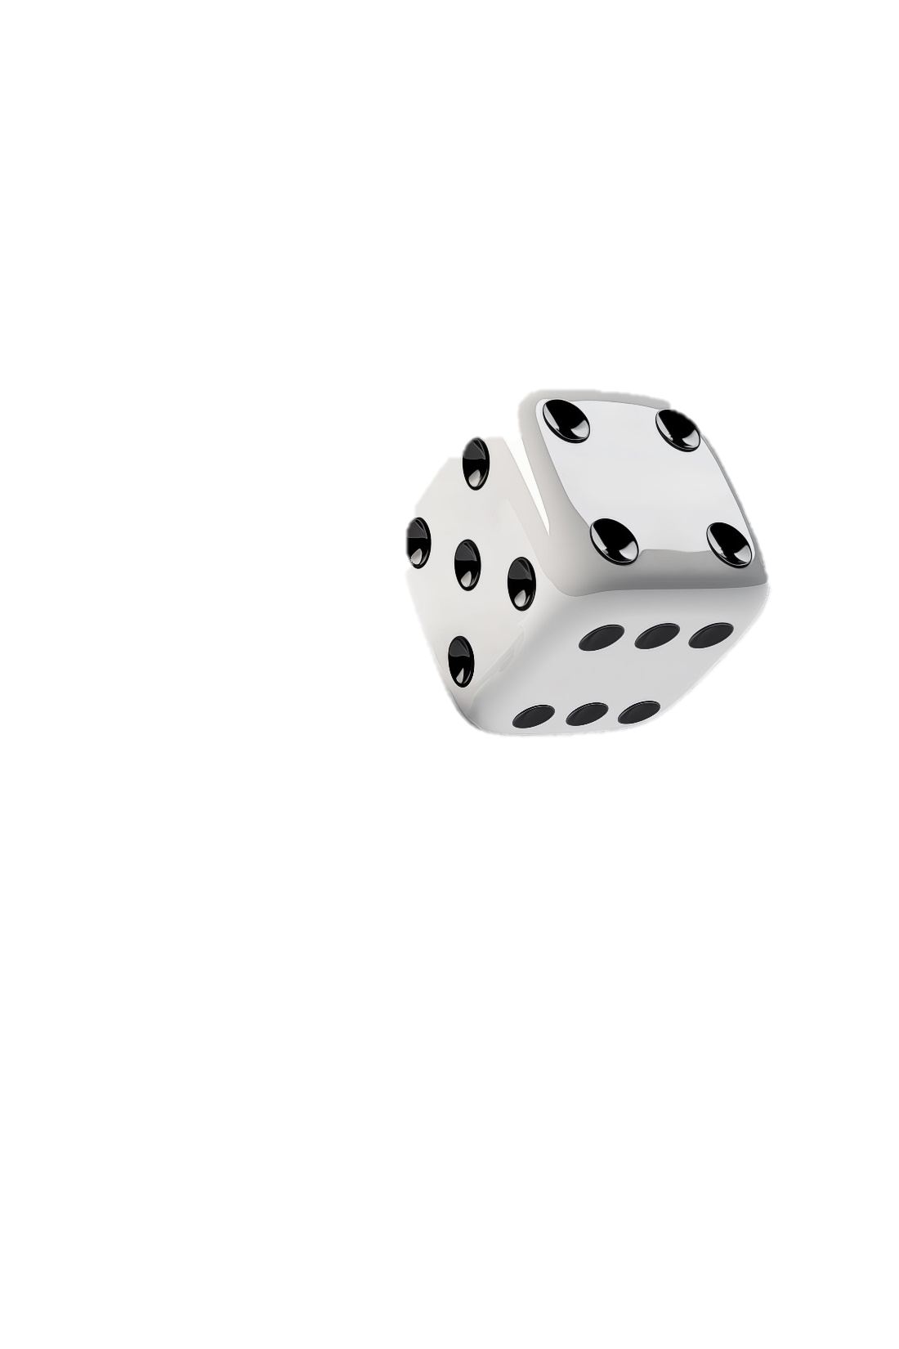
Linear Regression
Logistic Regression
Decision Tree
Random forest
Support Vector Machine
K-Nearest Neighbors
Naïve Bayes
K-Means Clustering
Hierarchical Clustering
Principal Component Analysis
DBSCAN
Q-Learning
Deep Q-learning
Policy Gradient Method
Visualization becomes impossible beyond 3D
Many features increase computation cost
Curse of
dimensionality
Many features NOT EQUAL TO better performance
Many features CAN confuse a ML model

Slide 20
Linear Regression
Logistic Regression
Decision Tree
Random forest
Support Vector Machine
K-Nearest Neighbors
Naïve Bayes
K-Means Clustering
Hierarchical Clustering
Principal Component Analysis
DBSCAN
Q-Learning
Deep Q-learning
Policy Gradient Method
The solutions
Feature engineering
Feature extraction
Selecting the right features from a set of features and discarding the irrelevant features
Performing transformation on the available features to form new features but in a lesser dimensions

Slide 21
Linear Regression
Logistic Regression
Decision Tree
Random forest
Support Vector Machine
K-Nearest Neighbors
Naïve Bayes
K-Means Clustering
Hierarchical Clustering
Principal Component Analysis
DBSCAN
Q-Learning
Deep Q-learning
Policy Gradient Method
feature
Extract!n
Derriving new set of features in a lesser dimension to capture essence of data in higher dimensions

Slide 22

Linear Regression
Logistic Regression
Decision Tree
Random forest
Support Vector Machine
K-Nearest Neighbors
Naïve Bayes
K-Means Clustering
Hierarchical Clustering
Principal Component Analysis
DBSCAN
Q-Learning
Deep Q-learning
Policy Gradient Method

Slide 23

Linear Regression
Logistic Regression
Decision Tree
Random forest
Support Vector Machine
K-Nearest Neighbors
Naïve Bayes
K-Means Clustering
Hierarchical Clustering
Principal Component Analysis
DBSCAN
Q-Learning
Deep Q-learning
Policy Gradient Method
$$cov(x,y) =\frac{\sum_{i=1}^{n}{(x−\overline{x})(y−\overline{y})}}{n−1}$$
We can use the correlation coefficient (r) for
Feature selection
$$r =\frac{cov(x,y)}{σ_{x}σ_{y}}$$
We only permit features whose r value is close to zero else we need to remove one of the features

Slide 24
We can also call feature extraction as Dimensionality Reduction
Linear Regression
Logistic Regression
Decision Tree
Random forest
Support Vector Machine
K-Nearest Neighbors
Naïve Bayes
K-Means Clustering
Hierarchical Clustering
Principal Component Analysis
DBSCAN
Q-Learning
Deep Q-learning
Policy Gradient Method
PCA
Is one amongs many dimensionality reduction techniques

Slide 25
Linear Regression
Logistic Regression
Decision Tree
Random forest
Support Vector Machine
K-Nearest Neighbors
Naïve Bayes
K-Means Clustering
Hierarchical Clustering
Principal Component Analysis
DBSCAN
Q-Learning
Deep Q-learning
Policy Gradient Method
What do we want to achieve with PCA ?

Slide 26
Linear Regression
Logistic Regression
Decision Tree
Random forest
Support Vector Machine
K-Nearest Neighbors
Naïve Bayes
K-Means Clustering
Hierarchical Clustering
Principal Component Analysis
DBSCAN
Q-Learning
Deep Q-learning
Policy Gradient Method
What IN the world is project!on ?
How much can you know about a given shape just from it’s shadow
A Shadow is a simplified flat representation of a 3D object on a flat wall
We can adjust the tilt of our wall to get the best shadow that captures our object

Slide 27
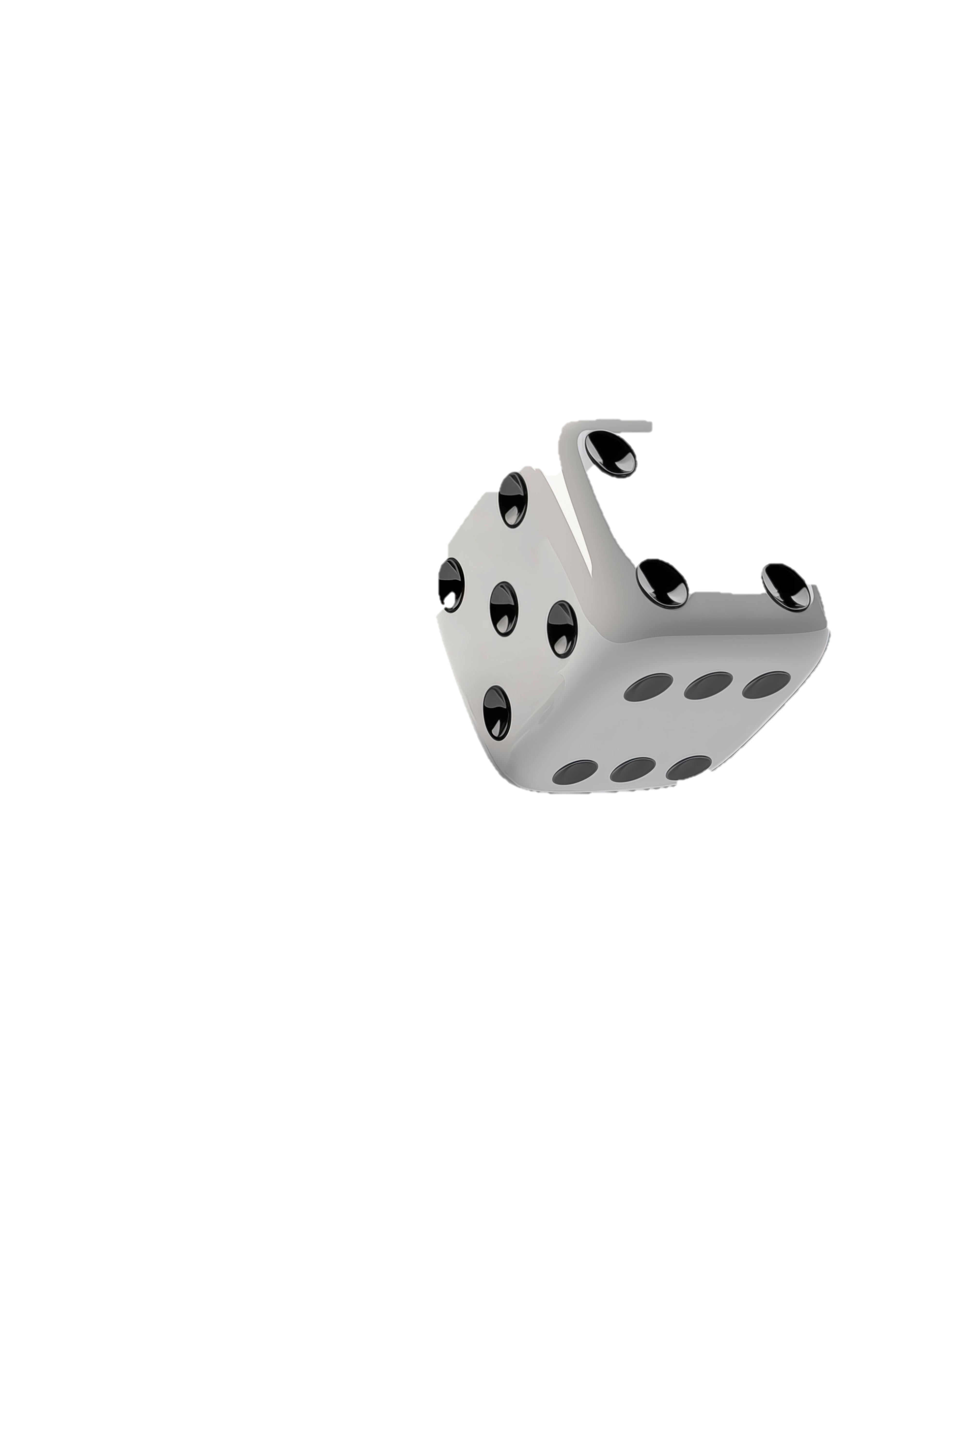
Linear Regression
Logistic Regression
Decision Tree
Random forest
Support Vector Machine
K-Nearest Neighbors
Naïve Bayes
K-Means Clustering
Hierarchical Clustering
Principal Component Analysis
DBSCAN
Q-Learning
Deep Q-learning
Policy Gradient Method
What IN the world is project!on ?
By looking at just the shadow of an object we loss information about it’s Color
Meaning we have trade-off some info to keeps things simple

Slide 28
Linear Regression
Logistic Regression
Decision Tree
Random forest
Support Vector Machine
K-Nearest Neighbors
Naïve Bayes
K-Means Clustering
Hierarchical Clustering
Principal Component Analysis
DBSCAN
Q-Learning
Deep Q-learning
Policy Gradient Method
Goal of PCA ?
Look for the best way to tilt our wall so that it’s shadow captures fully all the most relevant details of our image on our flat wall
Have you ever seen people adjusting projector before ☺

Slide 29
Linear Regression
Logistic Regression
Decision Tree
Random forest
Support Vector Machine
K-Nearest Neighbors
Naïve Bayes
K-Means Clustering
Hierarchical Clustering
Principal Component Analysis
DBSCAN
Q-Learning
Deep Q-learning
Policy Gradient Method
In machine learning we use vectors and matrices to represent data records
Vector : a single record (a row) or all the values of a given feature(column)
Matrix : a stack of many vectors (the whole dataset

Slide 30
What we are doing!
Linear Regression
Logistic Regression
Decision Tree
Random forest
Support Vector Machine
K-Nearest Neighbors
Naïve Bayes
K-Means Clustering
Hierarchical Clustering
Principal Component Analysis
DBSCAN
Q-Learning
Deep Q-learning
Policy Gradient Method
We want to find a unit vector (wall tilt) that still best explain the varieties our data(3d object) in a lesser dimensions(flat wall)

Slide 31



projection
Linear Regression
Logistic Regression
Decision Tree
Random forest
Support Vector Machine
K-Nearest Neighbors
Naïve Bayes
K-Means Clustering
Hierarchical Clustering
Principal Component Analysis
DBSCAN
Q-Learning
Deep Q-learning
Policy Gradient Method
$Z_{i}$:shadow w: wall tilt $X_{i}$:3D object
$$Z_{i}=w^{T}X_{i}$$
$$w^{T}:Transpose of w$$

Slide 32
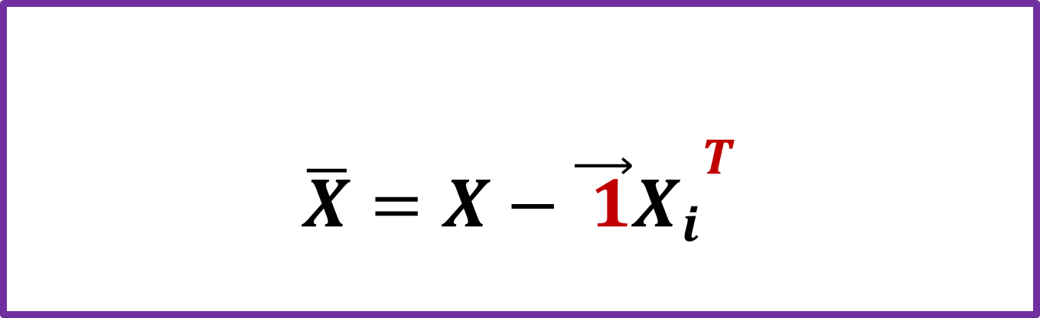
projection
Linear Regression
Logistic Regression
Decision Tree
Random forest
Support Vector Machine
K-Nearest Neighbors
Naïve Bayes
K-Means Clustering
Hierarchical Clustering
Principal Component Analysis
DBSCAN
Q-Learning
Deep Q-learning
Policy Gradient Method
Step1 : center the data : this will ensure everything is about the origin
$$\overline{X}=X−{{\vec{ 1}X}_{i}}^{T}$$
$$\vec{1}:a vector of 1^{′}s(NOT unit vector eh$$

Slide 33

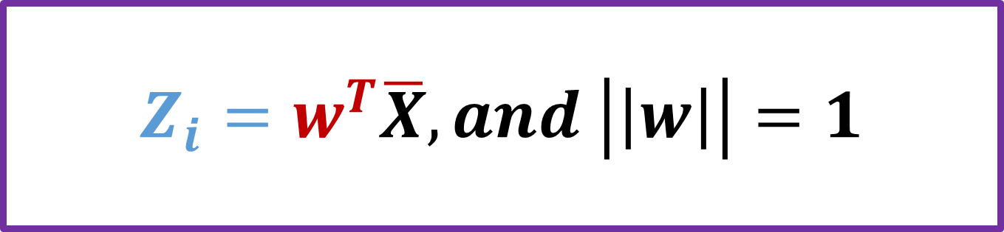
projection
Linear Regression
Logistic Regression
Decision Tree
Random forest
Support Vector Machine
K-Nearest Neighbors
Naïve Bayes
K-Means Clustering
Hierarchical Clustering
Principal Component Analysis
DBSCAN
Q-Learning
Deep Q-learning
Policy Gradient Method
Step2 : give a name to our projected data called Z
$$Z_{i}=w^{T}\overline{X}, and \left|\left|w\right|\right|=1$$
||w||$:size of the w vector$

Slide 34

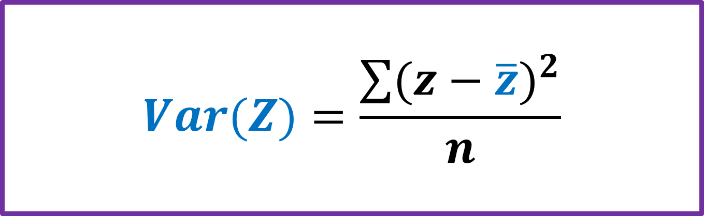
projection
Linear Regression
Logistic Regression
Decision Tree
Random forest
Support Vector Machine
K-Nearest Neighbors
Naïve Bayes
K-Means Clustering
Hierarchical Clustering
Principal Component Analysis
DBSCAN
Q-Learning
Deep Q-learning
Policy Gradient Method
Step3 : calculate the variance of our shadow ( Z )
$$Var(Z)=\frac{\sum{{(z−\overline{z})}^{2}}}{n}$$
$$\overline{z}=0 :our data is centered at zero$$
Z =${(z_{1 }z_{2}{ z}_{3 }{ z}_{n})}^{T}$

Slide 35
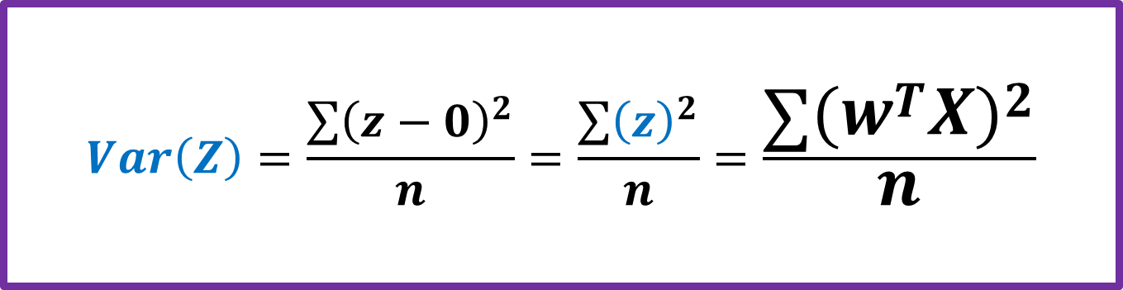
projection
Linear Regression
Logistic Regression
Decision Tree
Random forest
Support Vector Machine
K-Nearest Neighbors
Naïve Bayes
K-Means Clustering
Hierarchical Clustering
Principal Component Analysis
DBSCAN
Q-Learning
Deep Q-learning
Policy Gradient Method
Step3 : calculate the variance of our shadow ( Z )
$$Var\left(Z\right)=\frac{\sum{{\left(z−0\right)}^{2}}}{n}=\frac{\sum{{\left(z\right)}^{2}}}{n}=\frac{\sum{{{(w}^{T}X)}^{2}}}{n}$$
$$\overline{z}=0 :our data is centered at zero$$

Slide 36

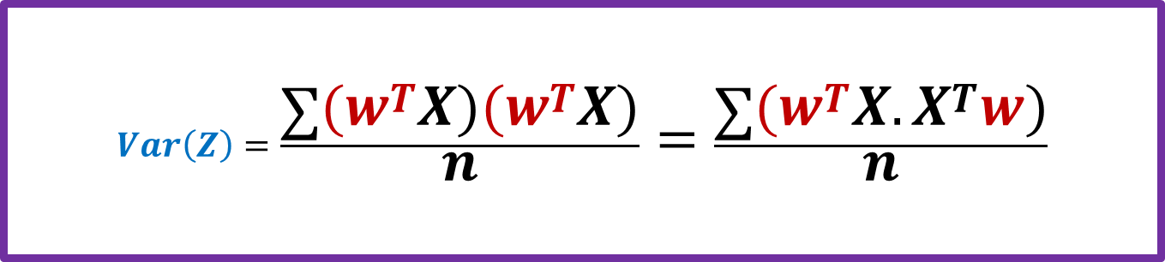
projection
Linear Regression
Logistic Regression
Decision Tree
Random forest
Support Vector Machine
K-Nearest Neighbors
Naïve Bayes
K-Means Clustering
Hierarchical Clustering
Principal Component Analysis
DBSCAN
Q-Learning
Deep Q-learning
Policy Gradient Method
Step3 : calculate the variance of our shadow ( Z )
$$Var\left(Z\right)=\frac{\sum{{(w}^{T}X){(w}^{T}X)}}{n}=\frac{\sum{{(w}^{T}X.X^{T}w)}}{n}$$
$$w^{T}and w Can be isolated from the summation$$
$$Var\left(Z\right)=w^{T}\left(\frac{\sum{X.X^{T}}}{n} \right)w=w^{T}Sw$$
What you see in the bracket is called the covariance matrix

Slide 37
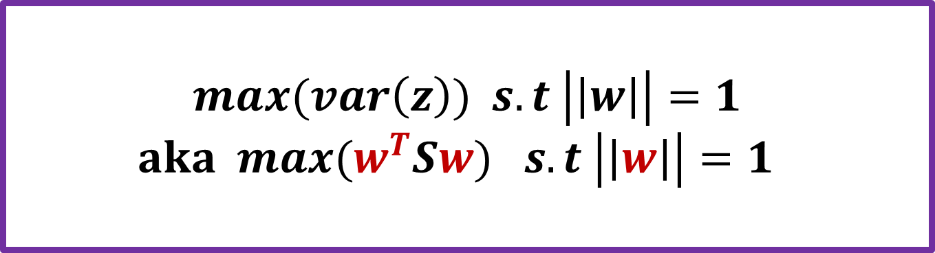
OBJECTIVE FUNCTION
Linear Regression
Logistic Regression
Decision Tree
Random forest
Support Vector Machine
K-Nearest Neighbors
Naïve Bayes
K-Means Clustering
Hierarchical Clustering
Principal Component Analysis
DBSCAN
Q-Learning
Deep Q-learning
Policy Gradient Method
QUESTION : HOW DO WE GET w
$$max(var\left(z\right)) s.t \left|\left|w\right|\right|=1$$
$aka max(w^{T}Sw) s.t \left|\left|w\right|\right|=1$
Tutor can take chalk and solve this optimization problem using Lagrange multipliers

Slide 38
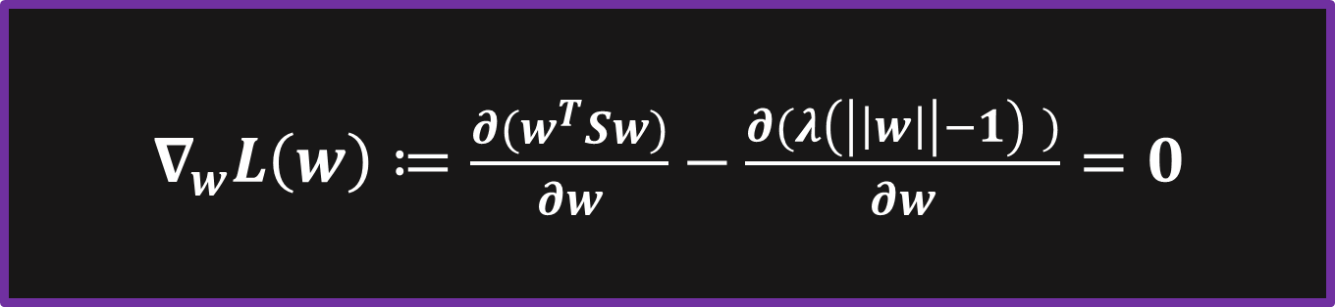
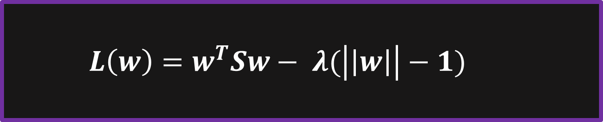
OBJECTIVE FUNCTION
Linear Regression
Logistic Regression
Decision Tree
Random forest
Support Vector Machine
K-Nearest Neighbors
Naïve Bayes
K-Means Clustering
Hierarchical Clustering
Principal Component Analysis
DBSCAN
Q-Learning
Deep Q-learning
Policy Gradient Method
We simply optimize
$L\left(w\right)=w^{T}Sw− λ(\left|\left|w\right|\right|−1)$
$∇_{w}L\left(w\right)≔\frac{∂(w^{T}Sw)}{∂w}−\frac{∂(λ\left(\left|\left|w\right|\right|−1\right) )}{∂w}=0$

Slide 39
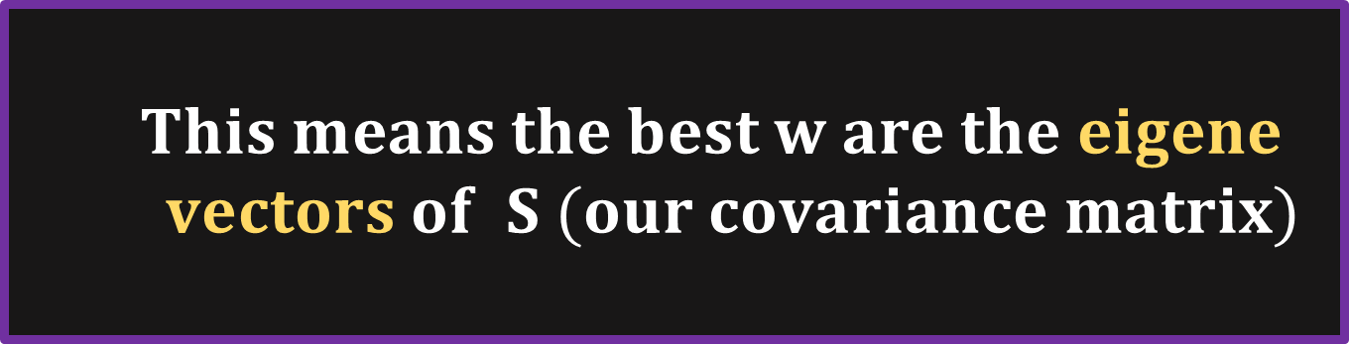

OBJECTIVE FUNCTION
Linear Regression
Logistic Regression
Decision Tree
Random forest
Support Vector Machine
K-Nearest Neighbors
Naïve Bayes
K-Means Clustering
Hierarchical Clustering
Principal Component Analysis
DBSCAN
Q-Learning
Deep Q-learning
Policy Gradient Method
After 3 hours of solving
$2Sw −2λw=0 ⟹Sw= λw$
$This means the best w are the eigene$
$$vectors of S (our covariance matrix)$$

Slide 40
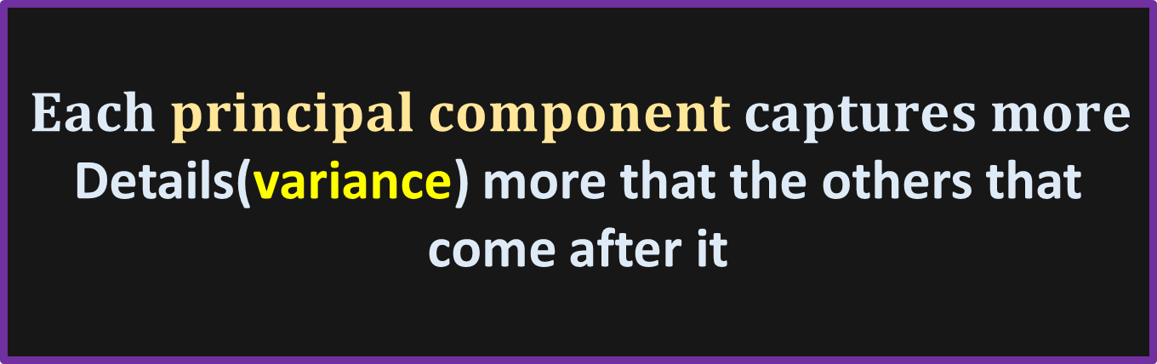

Linear Regression
Logistic Regression
Decision Tree
Random forest
Support Vector Machine
K-Nearest Neighbors
Naïve Bayes
K-Means Clustering
Hierarchical Clustering
Principal Component Analysis
DBSCAN
Q-Learning
Deep Q-learning
Policy Gradient Method
T$hese w vectors are called principal$
components and are orthogonal
$Each principal component captures more$
Details(variance) more that the others that come after it

Slide 41
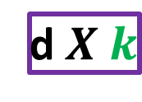

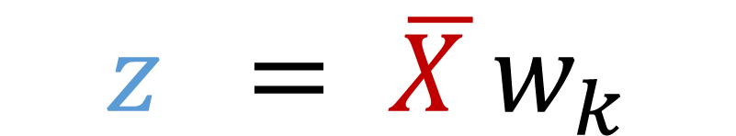
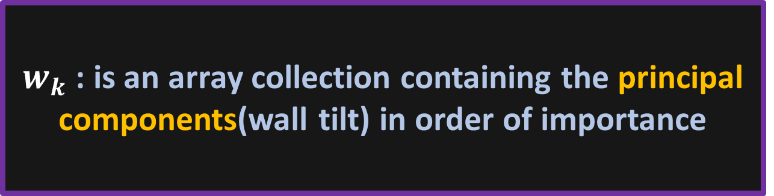

EXAMPLE
Linear Regression
Logistic Regression
Decision Tree
Random forest
Support Vector Machine
K-Nearest Neighbors
Naïve Bayes
K-Means Clustering
Hierarchical Clustering
Principal Component Analysis
DBSCAN
Q-Learning
Deep Q-learning
Policy Gradient Method
$w_{k}$ : is an array collection containing the principal components(wall tilt) in order of importance
$k<d : that is why we call it dimensionality reduction$
$$z = \overline{X }w_{k}$$
$$n X k$$
$$n X d$$
d$X k$
$Z∈ℝ^{nXk}$ $\overline{X}∈ℝ^{nXd}$ $w_{k}∈ℝ^{dXk}$

Slide 42
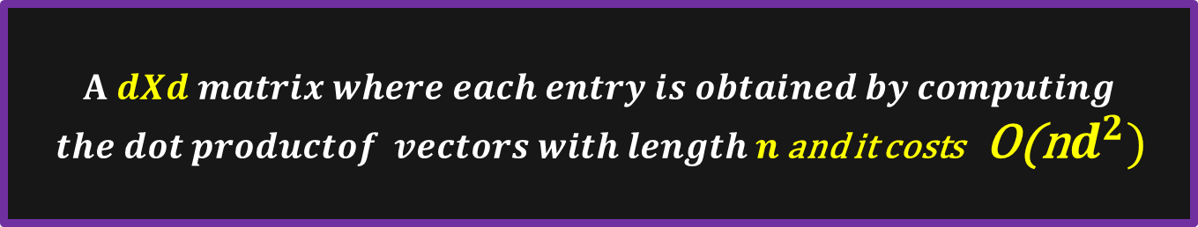
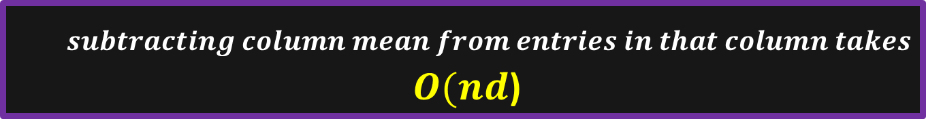
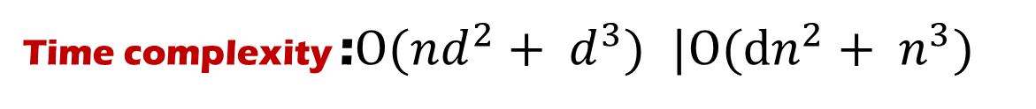

Time complexity :$O(nd^{2}+ d^{3})$ $|O(dn^{2}+ n^{3})$
Linear Regression
Logistic Regression
Decision Tree
Random forest
Support Vector Machine
K-Nearest Neighbors
Naïve Bayes
K-Means Clustering
Hierarchical Clustering
Principal Component Analysis
DBSCAN
Q-Learning
Deep Q-learning
Policy Gradient Method
Data centering
$subtracting column mean from entries in that column takes$
$O(nd$)
Computing the covariance matrix
$$A dXd matrix where each entry is obtained by computing$$
$the dot productof vectors with length n$ and it costs O(n$d^{2})$
Eigene decomposition
$This is a dxd operation done d−times$ THEREFORE
O($d^{3})$

Slide 43
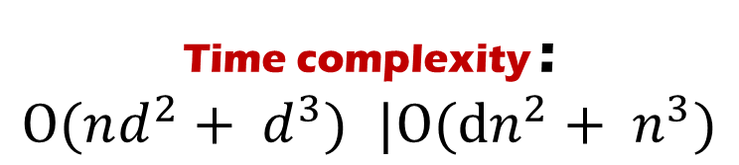
Linear Regression
Logistic Regression
Decision Tree
Random forest
Support Vector Machine
K-Nearest Neighbors
Naïve Bayes
K-Means Clustering
Hierarchical Clustering
Principal Component Analysis
DBSCAN
Q-Learning
Deep Q-learning
Policy Gradient Method
Time complexity :
$O(nd^{2}+ d^{3})$ $|O(dn^{2}+ n^{3})$
CAN WE DO BETTER ?
UP_NEXT:SVD

Slide 44
Linear Regression
Logistic Regression
Decision Tree
Random forest
Support Vector Machine
K-Nearest Neighbors
Naïve Bayes
K-Means Clustering
Hierarchical Clustering
Principal Component Analysis
DBSCAN
Q-Learning
Deep Q-learning
Policy Gradient Method
Thank you !

