Slide 1


MACHINE
LEARNING

Slide 2
What is
LEARNING?

Slide 3
Learning is the acquisition of knowledge or skills through study, experience, or being taught.

Slide 4
Machine Learning is a type of artificial intelligence that allows machines to learn from data without being explicitly programmed.

Slide 5
Linear Regression
Logistic Regression
Decision Tree
Random forest
Support Vector Machine
K-Nearest Neighbors
Naïve Bayes
K-Means Clustering
Hierarchical Clustering
Principal Component Analysis
DBSCAN
Q-Learning
Deep Q-learning
Policy Gradient Method
S!ngular Value
Decompostion

Slide 6
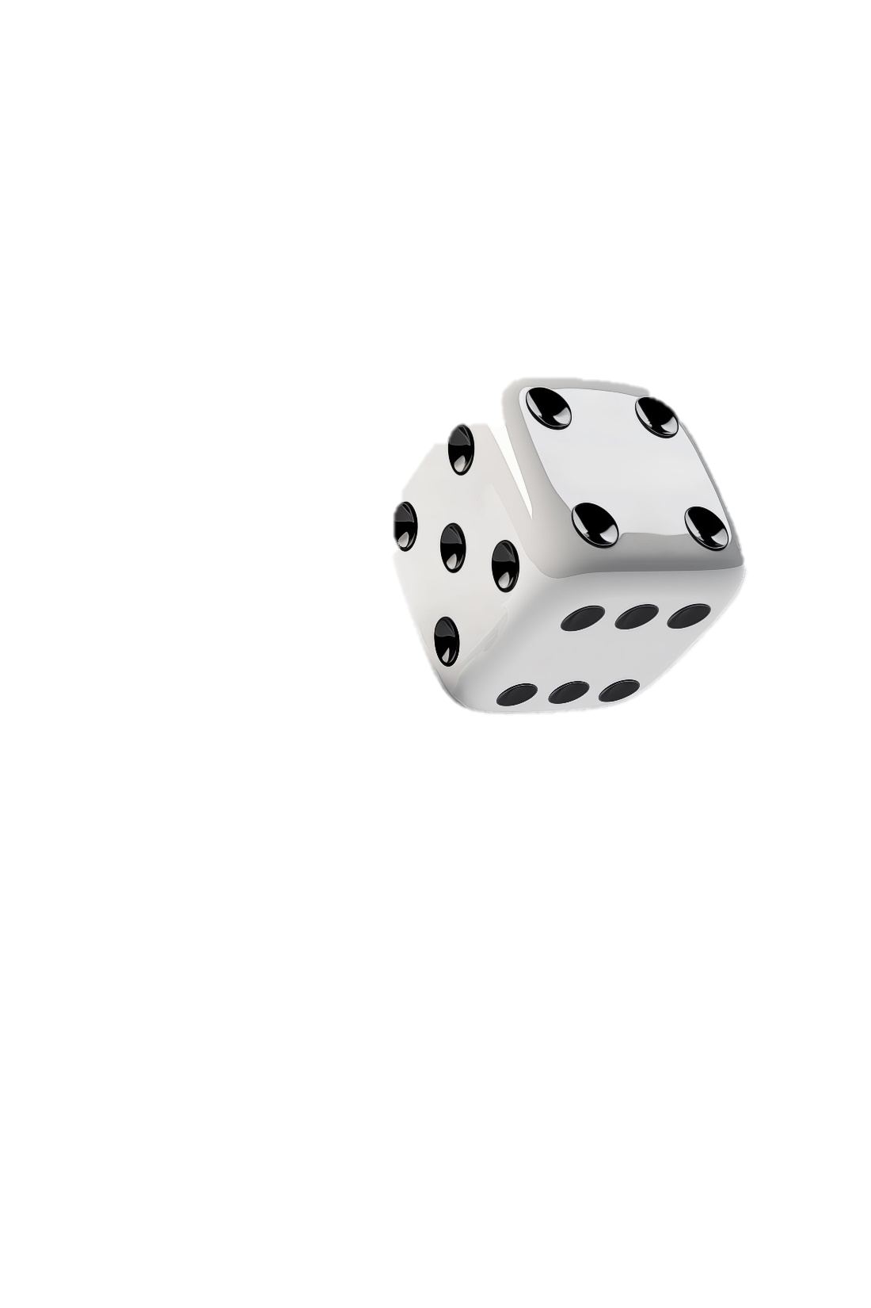
Linear Regression
Logistic Regression
Decision Tree
Random forest
Support Vector Machine
K-Nearest Neighbors
Naïve Bayes
K-Means Clustering
Hierarchical Clustering
Principal Component Analysis
DBSCAN
Q-Learning
Deep Q-learning
Policy Gradient Method
How points change location when an object rotate in space
How the points in an object move when we apply stress on the object
Matrices as
descriptions
Behavior of point during a flip
If we compress,rotate,stretch,flip object , can you give a function to assign old points to new points

Slide 7

Matr!ces
Linear Regression
Logistic Regression
Decision Tree
Random forest
Support Vector Machine
K-Nearest Neighbors
Naïve Bayes
K-Means Clustering
Hierarchical Clustering
Principal Component Analysis
DBSCAN
Q-Learning
Deep Q-learning
Policy Gradient Method
The best framework to model functions that output more than 1 value
$$\begin{matrix}2 & −1 \\ −5 & 3\end{matrix}$$
2a - b
a
-5a + 3b
b

Slide 8
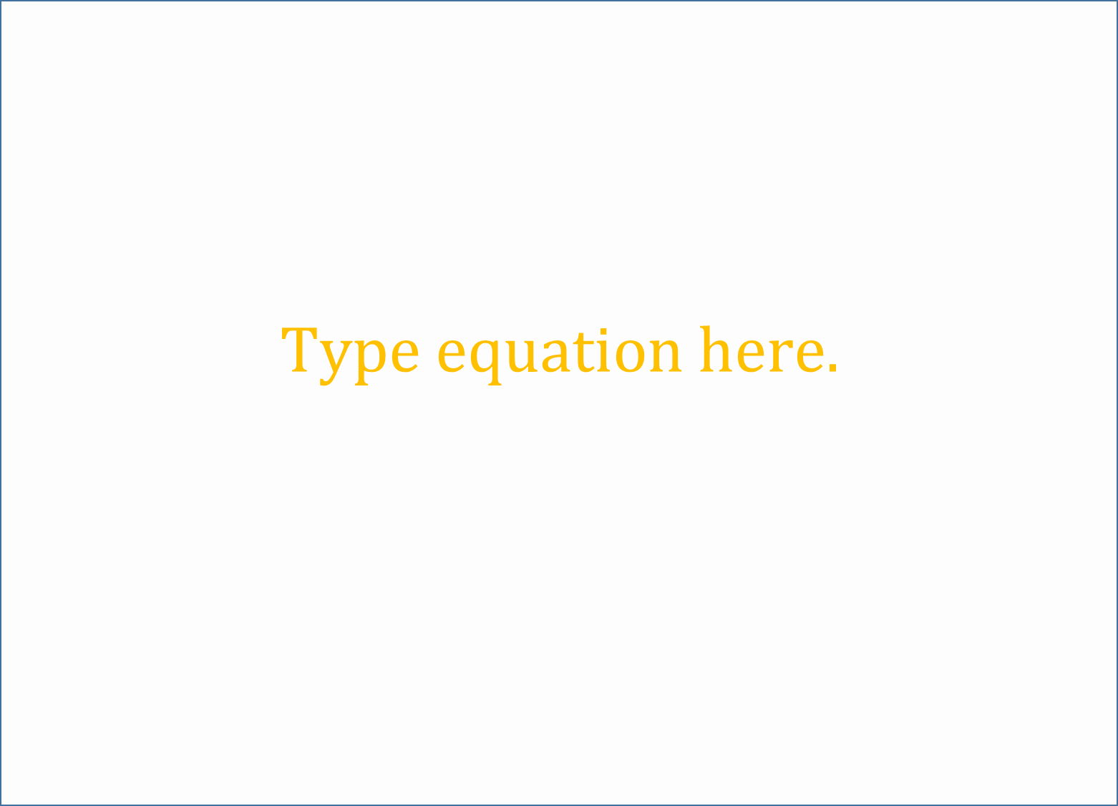
 | apples | oranges | banana
Monday | 90 | 48 | 56
Tuesday | 89 | 80 | 0
Wednesday | 45 | 7 | 90
Thursday | 100 | 88 | 55
Friday | 02 | 66 | 87
Saturday | 111 | 0 | 77
 | Profit/XAF
apple | 75
orange | 100
banana | 125
Linear Regression
Logistic Regression
Decision Tree
Random forest
Support Vector Machine
K-Nearest Neighbors
Naïve Bayes
K-Means Clustering
Hierarchical Clustering
Principal Component Analysis
DBSCAN
Q-Learning
Deep Q-learning
Policy Gradient Method
WHAT IS THE PROFIT MADE EACH DAY FROM MON-SAT

Slide 9

Linear Regression
Logistic Regression
Decision Tree
Random forest
Support Vector Machine
K-Nearest Neighbors
Naïve Bayes
K-Means Clustering
Hierarchical Clustering
Principal Component Analysis
DBSCAN
Q-Learning
Deep Q-learning
Policy Gradient Method

Slide 10
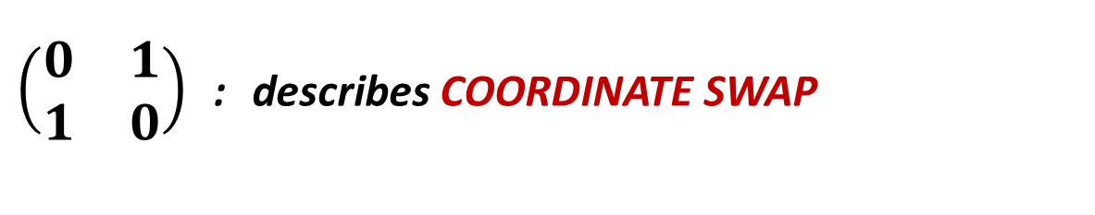
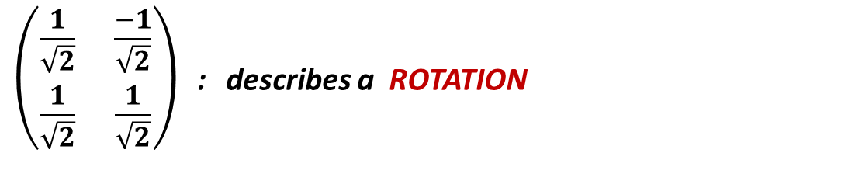
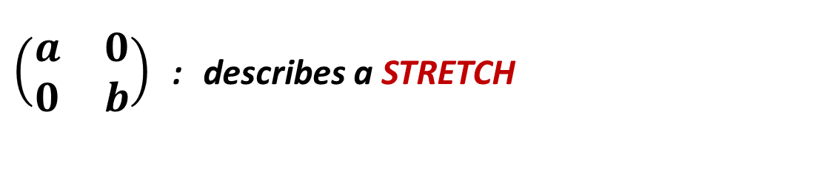
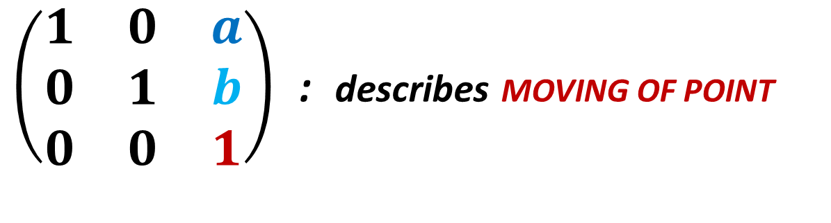
Linear Regression
Logistic Regression
Decision Tree
Random forest
Support Vector Machine
K-Nearest Neighbors
Naïve Bayes
K-Means Clustering
Hierarchical Clustering
Principal Component Analysis
DBSCAN
Q-Learning
Deep Q-learning
Policy Gradient Method
$\left(\begin{matrix}a & 0 \\ 0 & b\end{matrix}\right)$ : describes a STRETCH
$\left(\begin{matrix}\frac{1}{\sqrt{2}} & \frac{−1}{\sqrt{2}} \\ \frac{1}{\sqrt{2}} & \frac{1}{\sqrt{2}}\end{matrix}\right)$ : describes a ROTATION
$\left(\begin{matrix}0 & 1 \\ 1 & 0\end{matrix}\right)$ : describes COORDINATE SWAP
$\left(\begin{matrix}1 & 0 & a \\ 0 & 1 & b \\ 0 & 0 & 1\end{matrix}\right)$ : describes MOVING OF POINT

Slide 11
BUT NOT ALL MATRICES ARE EASY TO DESCRIBE THE KIND OF TRANSFORMATION THEY MODEL
Linear Regression
Logistic Regression
Decision Tree
Random forest
Support Vector Machine
K-Nearest Neighbors
Naïve Bayes
K-Means Clustering
Hierarchical Clustering
Principal Component Analysis
DBSCAN
Q-Learning
Deep Q-learning
Policy Gradient Method
SVD
Breaks down any linear transformation to just a sequence of rotate, stretch, rotate

Slide 12

Linear Regression
Logistic Regression
Decision Tree
Random forest
Support Vector Machine
K-Nearest Neighbors
Naïve Bayes
K-Means Clustering
Hierarchical Clustering
Principal Component Analysis
DBSCAN
Q-Learning
Deep Q-learning
Policy Gradient Method
FOR ANY MATRIX A IRRESPECTIVE OF IT’S SHAPE
$$A=UΣV^{T}$$

Slide 13
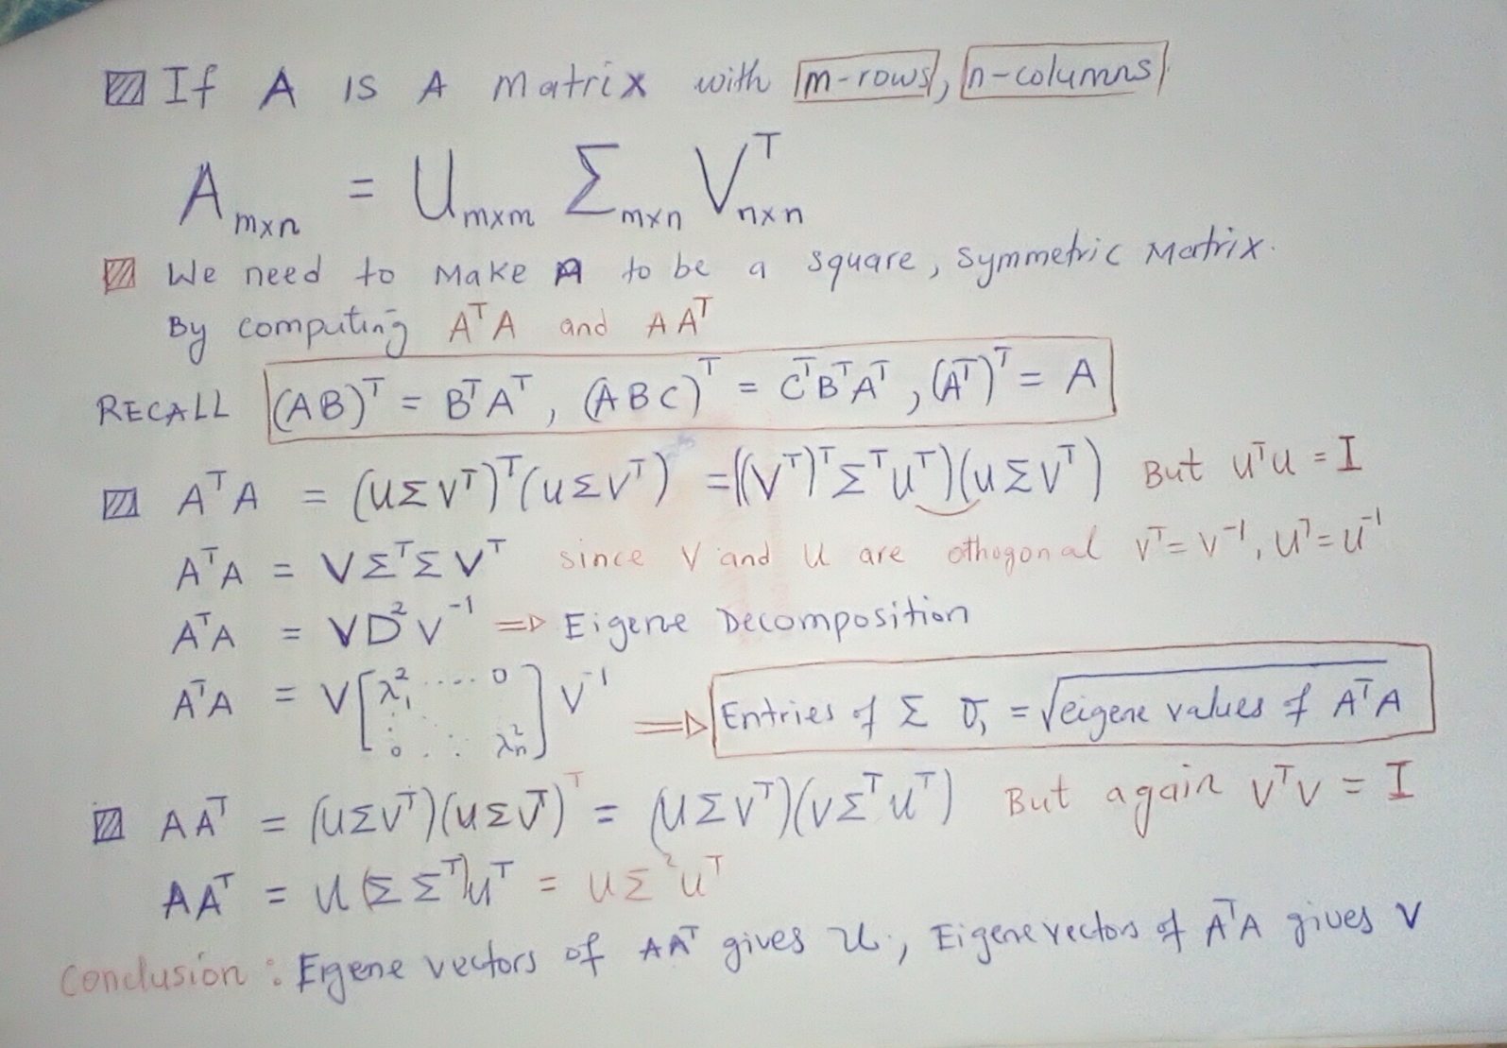
Linear Regression
Logistic Regression
Decision Tree
Random forest
Support Vector Machine
K-Nearest Neighbors
Naïve Bayes
K-Means Clustering
Hierarchical Clustering
Principal Component Analysis
DBSCAN
Q-Learning
Deep Q-learning
Policy Gradient Method

Slide 14
Linear Regression
Logistic Regression
Decision Tree
Random forest
Support Vector Machine
K-Nearest Neighbors
Naïve Bayes
K-Means Clustering
Hierarchical Clustering
Principal Component Analysis
DBSCAN
Q-Learning
Deep Q-learning
Policy Gradient Method
Let’s talk about matrix rank ?
It tells us How much real, non-redundant information is inside this matrix
SVD decomposes your matrix into layers of importance. And rank is the number of useful patterns SVD can extract

Slide 15

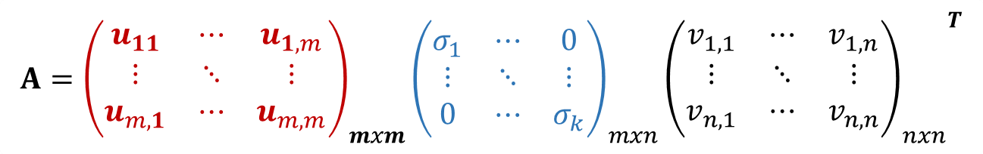
Linear Regression
Logistic Regression
Decision Tree
Random forest
Support Vector Machine
K-Nearest Neighbors
Naïve Bayes
K-Means Clustering
Hierarchical Clustering
Principal Component Analysis
DBSCAN
Q-Learning
Deep Q-learning
Policy Gradient Method
FOR ANY MATRIX A IRRESPECTIVE OF IT’S SHAPE
$$A={\left(\begin{matrix}u_{11} & ⋯ & u_{1,m} \\ ⋮ & ⋱ & ⋮ \\ u_{m,1} & ⋯ & u_{m,m}\end{matrix}\right)}_{mxm}{\left(\begin{matrix}σ_{1} & ⋯ & 0 \\ ⋮ & ⋱ & ⋮ \\ 0 & ⋯ & σ_{k}\end{matrix}\right)}_{mxn}{{\left(\begin{matrix}v_{1,1} & ⋯ & v_{1,n} \\ ⋮ & ⋱ & ⋮ \\ v_{n,1} & ⋯ & v_{n,n}\end{matrix}\right)}_{nxn}}^{T}$$
The $σ_{i}$are the singular values

Slide 16


Linear Regression
Logistic Regression
Decision Tree
Random forest
Support Vector Machine
K-Nearest Neighbors
Naïve Bayes
K-Means Clustering
Hierarchical Clustering
Principal Component Analysis
DBSCAN
Q-Learning
Deep Q-learning
Policy Gradient Method
A
mxn
=
u
mxm
$$Σ$$
mxn
$$V^{T}$$
nxn
For a rank of r | r < m, n
a
=
mxr
rxr
rxn

Slide 17
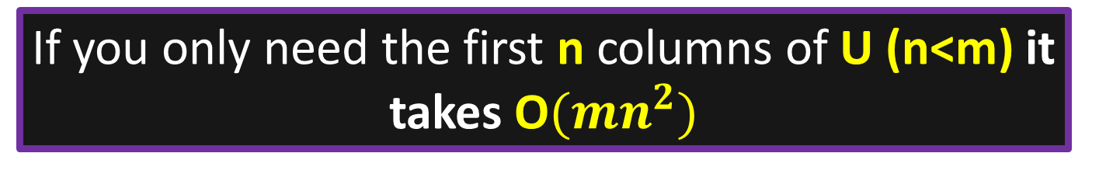
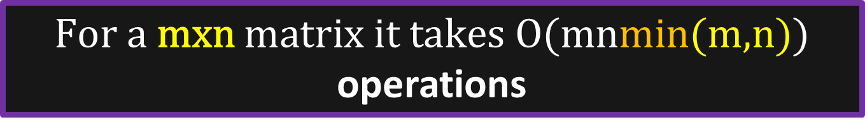
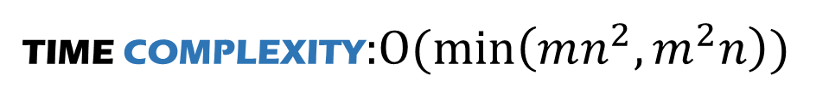

TIME COMPLEXITY:$O(\min\left(mn^{2},m^{2}n\right))$
Linear Regression
Logistic Regression
Decision Tree
Random forest
Support Vector Machine
K-Nearest Neighbors
Naïve Bayes
K-Means Clustering
Hierarchical Clustering
Principal Component Analysis
DBSCAN
Q-Learning
Deep Q-learning
Policy Gradient Method
Let’s break it down
$\text{F}\text{or} \text{a} \text{mxn} \text{matrix} \text{it} \text{takes} \text{O}\text{(}\text{mnmin}\text{(}\text{m}\text{,}\text{n}\text{))}$ operations
If you only need the first n columns of U (n<m) it takes O${(mn}^{2})$
When calculating only the top k singular values (k<<min(m,n)) it takes O$(mnk)$

Slide 18
Linear Regression
Logistic Regression
Decision Tree
Random forest
Support Vector Machine
K-Nearest Neighbors
Naïve Bayes
K-Means Clustering
Hierarchical Clustering
Principal Component Analysis
DBSCAN
Q-Learning
Deep Q-learning
Policy Gradient Method
Thank you !

