Slide 1
Expectation Visualization
Ian Wesley-Smith, Lovenoor Aulck, Yea-Seul Kim

Slide 2
A good way to assess the strengths and weaknesses of your project is to present your ideas to your classmates for feedback. Thus, each group will be expected to present their project idea and current status to a subset of the class. The presentation should expand on the the project proposal and include the following material.
Your presentation to the class should include:
A description of the problem you will address and motivation explaining why it is worth addressing.
In your description you should mention 1-2 pieces of the most relevant prior work, and discuss how your project is different.
Your current progress. Use sketches, storyboards, and/or prototype images to communicate your ideas. It is a good idea to highlight issues of design or implementation for which you would like to get feedback from the class. End your talk with a single slide containing questions you'd like feedback on.
Keep your presentation concise – no more than a few (3-4) minutes. Use at least half of that time to discuss your design ideas and completion plan. It is difficult to communicate effectively in such a short time span: carefully revise your materials and practice your talk to avoid rambling and unnecessary description.
You should also submit a progress report, which include:
Literature Review. A background survey of related work and a full list of references.
Project Plan. A list of milestones breaking the project into smaller chunks and a description of what each person in the group will work on.

Slide 3
“What if visualizations allowed people to draw their expectations of the data prior to viewing? “

Slide 4
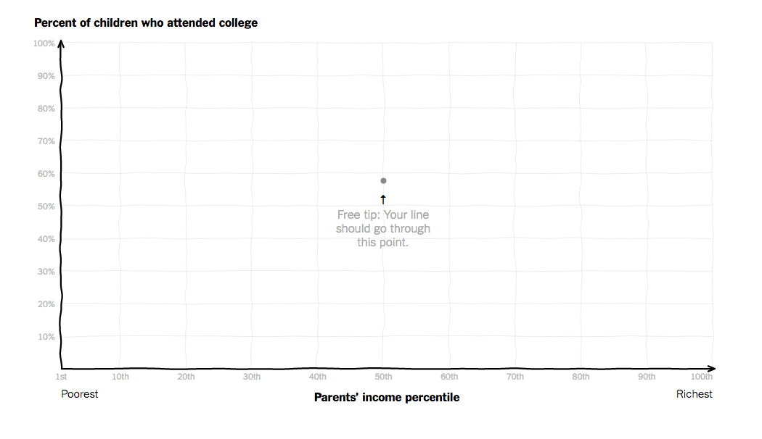

Slide 5
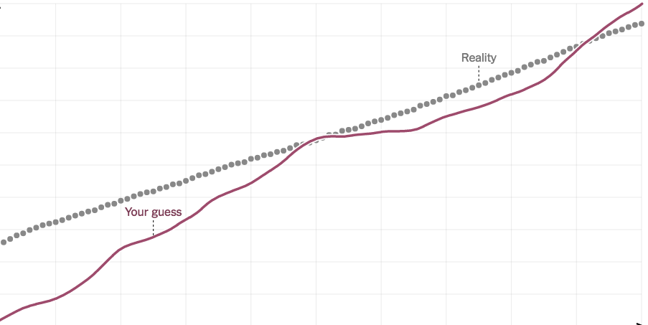

Slide 6
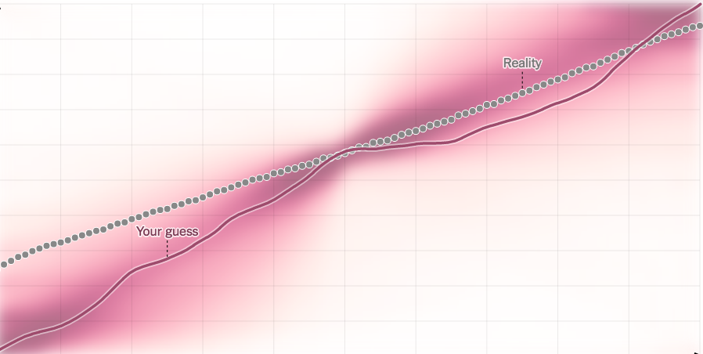

Slide 7
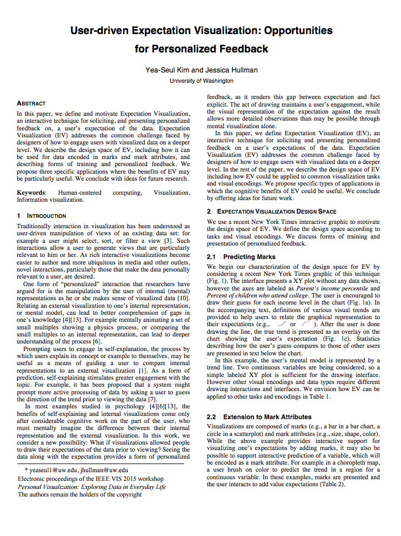
INFOVIS 15 Workshop Paper
Described the design space of EV
Proposed applications
Suggested ideas for future research.

Slide 8
Plugging data
Drawing interaction
Visualizing true data
Visualizing aggregated data
Annotating personalized feedback
Define design space
Identify application
Validate effects
Building Tools

Slide 9
Your current progress. Use sketches, storyboards, and/or prototype images to communicate your ideas.

Slide 10
Option listed
Feedback on feedback
Display aggregate

Slide 11
Thanks

