Slide 1
Expectation Visualization
Ian Wesley-Smith, Lovenoor Aulck, Yea-Seul Kim

Slide 2
“What if visualizations allowed people to draw their expectations of the data prior to viewing?“

Slide 3
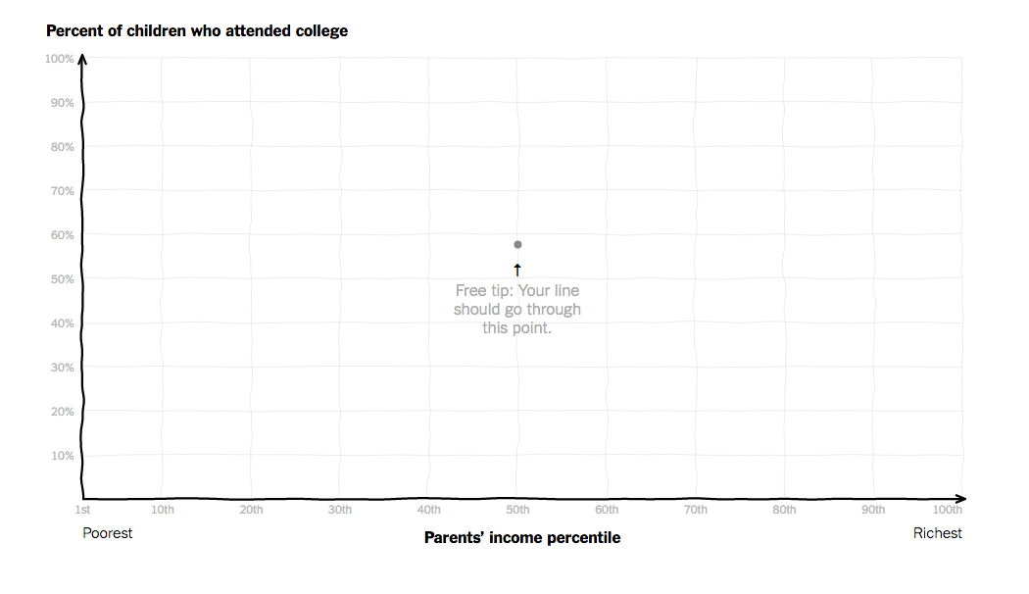

Slide 4
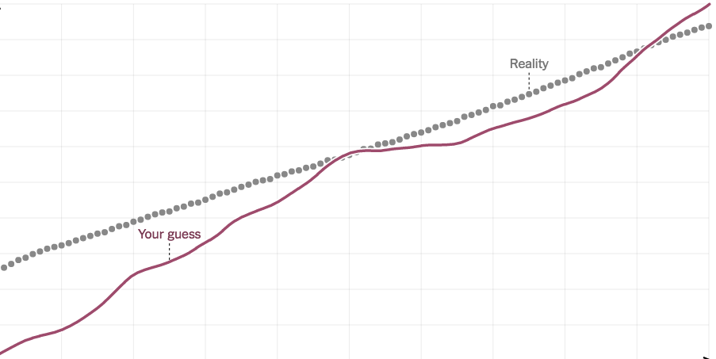

Slide 5
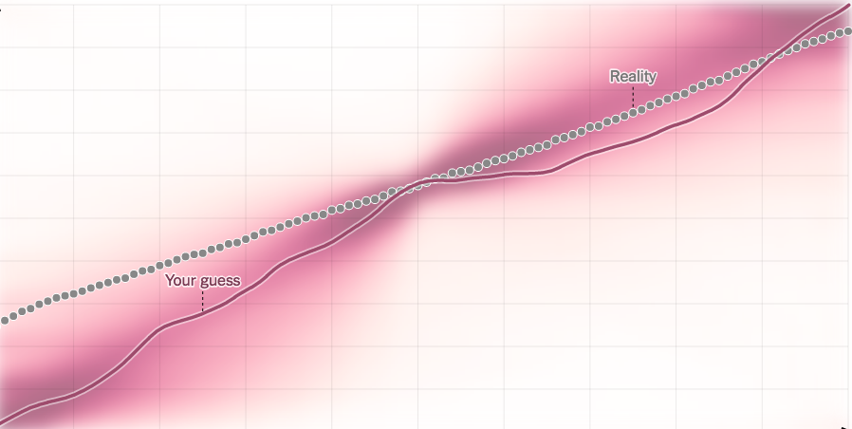

Slide 6
Process
Define design space
Identify application
Building Tools
Validate effects

Slide 7
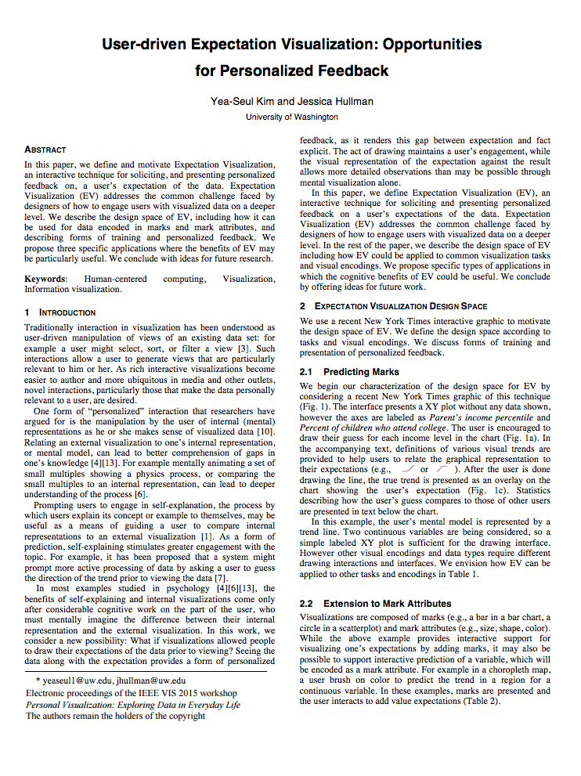
INFOVIS 15 Workshop Paper
Described the design space of EV
Proposed applications
Suggested ideas for future research.

Slide 8
Scope
Plugging data
Drawing interaction
Visualizing true data
Visualizing aggregated data
Annotating personalized feedback
Define design space
Identify application
Building Tools
Validate effects

Slide 9
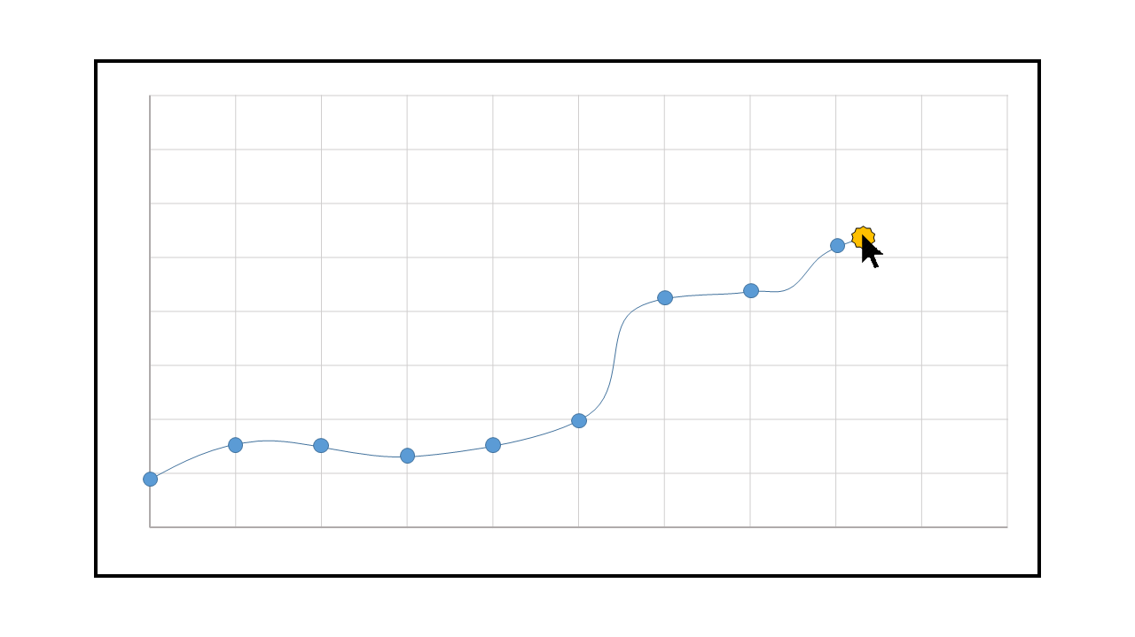
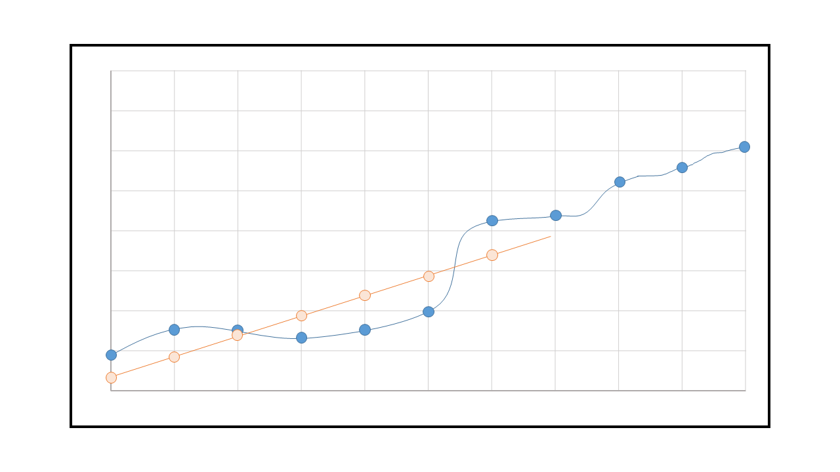
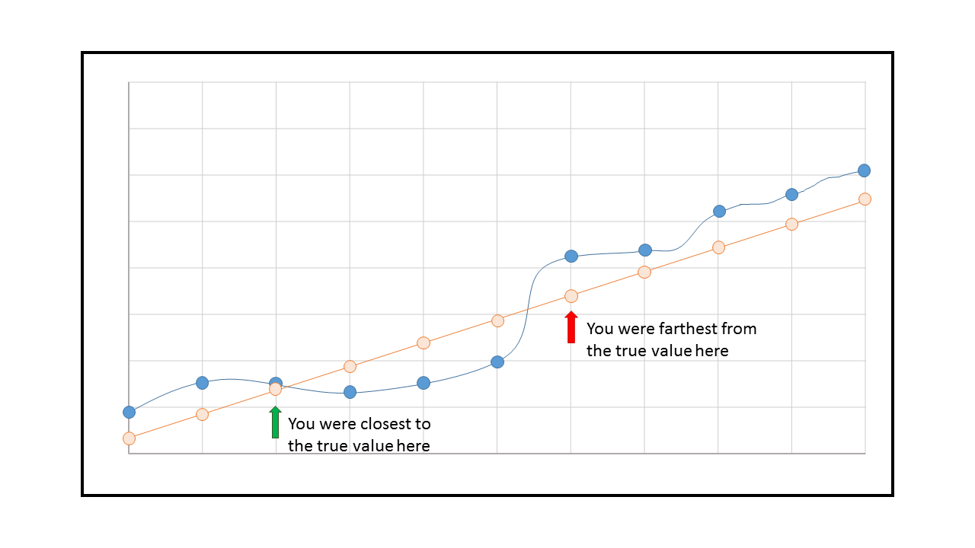
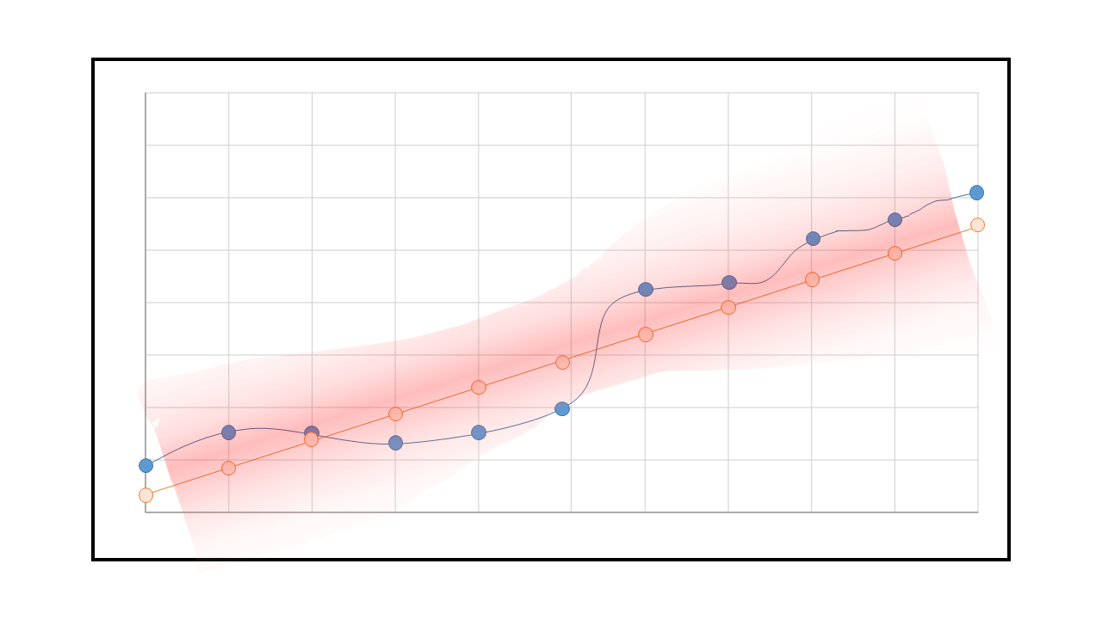
Storyboard – Line Chart
1
2
3
4

Slide 10
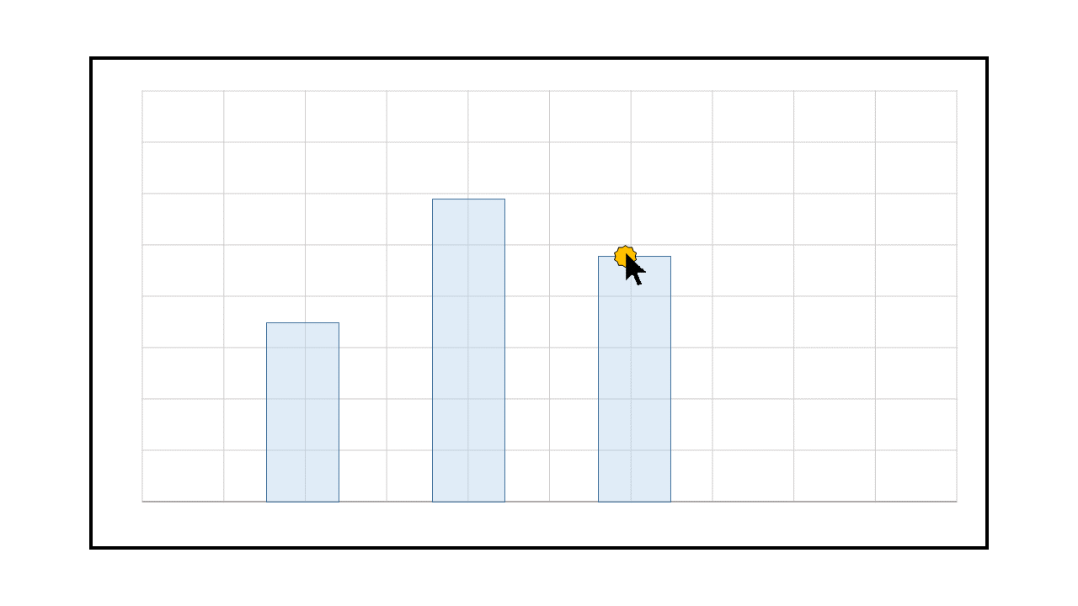
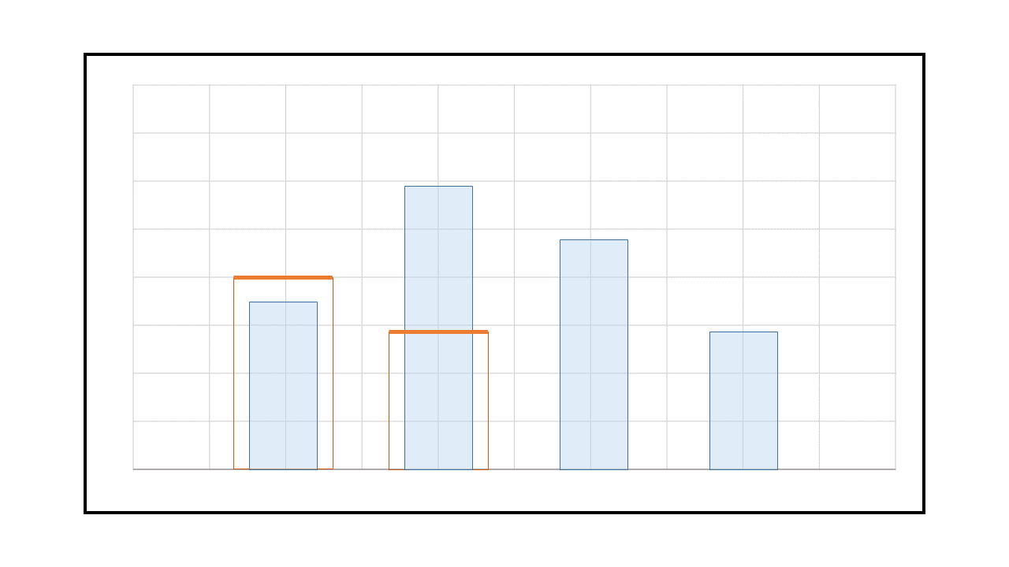
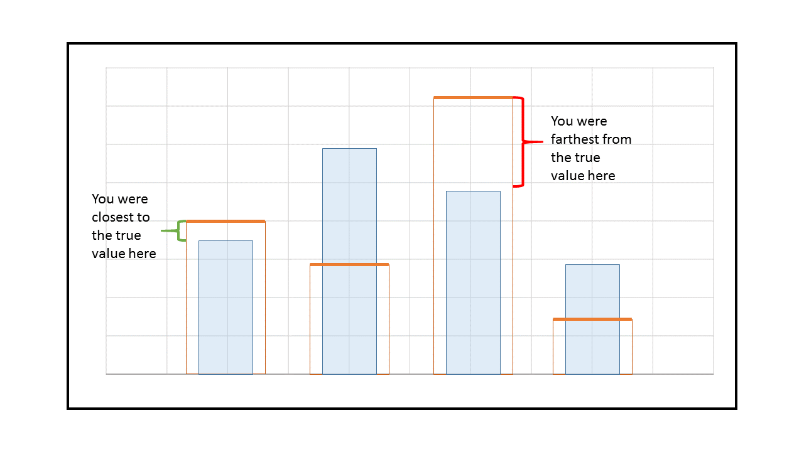
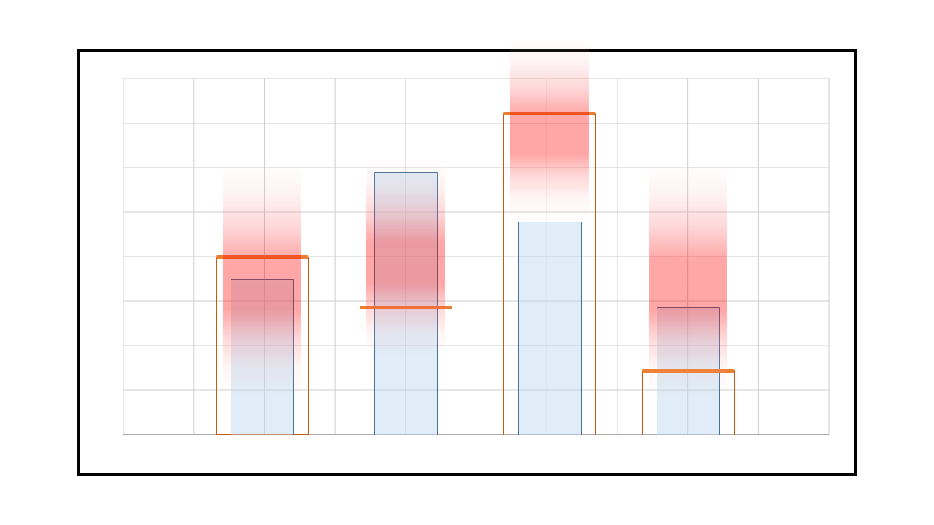
Storyboard – Bar Chart
1
2
3
4

Slide 11
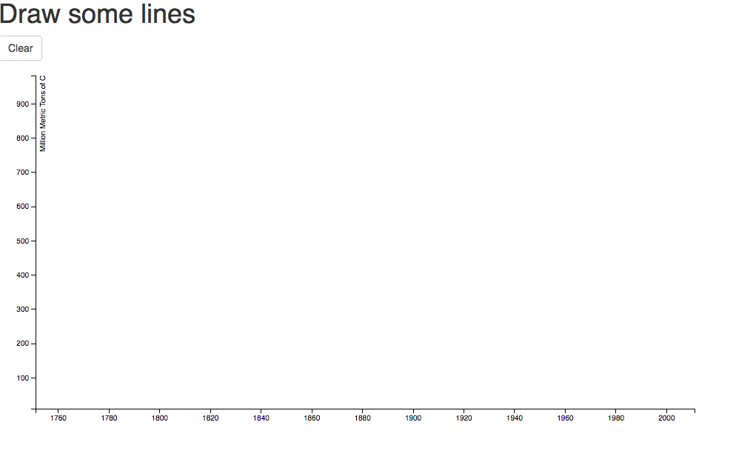
Prototype

Slide 12
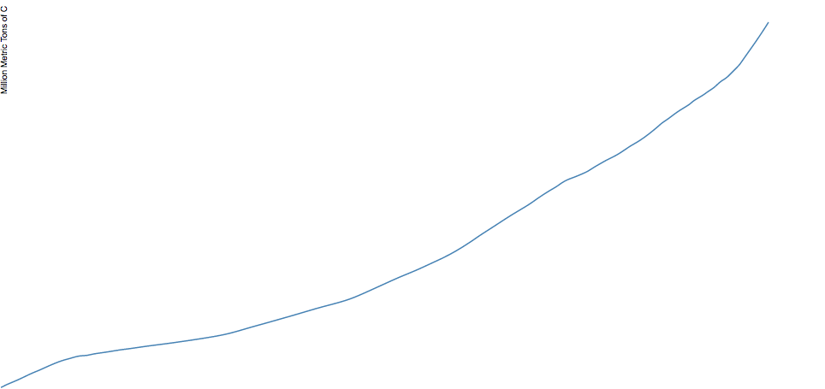
Prototype

Slide 13
Questions
How to visualize aggregated data?
How to annotate personalized feedback?

Slide 14
Thank you!

