Slide 1
Web Components
Craig West
Repo with course files, accompanying YouTube videos as well as these slides:
https://wpjs.co.uk/ndc

Slide 2






My start in computing at school in 1979 Still find tech hard!
58 in human years – 243 in tech years
Where/what were you in 1979?
Brighton, UK
Source:Wikimedia Commons
Source:Wikimedia Commons
1980: At University, I studied Chemistry and used MS-DOS, client/server main frame systems.
ZX-Spectrum computer and Jupiter Ace.
15 min walk
The English Channel
Source:Wikimedia Commons
Source:Wikimedia Commons

Slide 3
In this talk…
What is a Web Component?
How do we use them?
How do we make them:
- Vanilla JS
- with build tools (not frameworks).
- using frameworks.
Using Web Components as interconnected MicroApps/MicroServices.
Use them as business widgets for not-tech users.

Slide 4
Two Business Applications
Case One:
Disassemble a very monolithic PHP/MySQL into a set of HTML/JS/CSS Web Components that can be used in the app or as a Microapp in any HTML site.
This will be WordPress as it is very monolithic, PHP and very popular.
Case Two:
Entrepreneur wants to create a ONE-STOP tech conference site that uses a number of other businesses to provide information on events, booking, flights, hotels and tour guides.
Each MicroApp is a separate concern and all needed to be orchestrated together with minimal coding.

Slide 5

1
WordPress
HTML
WEB COMPONENTS
Web Components
WP PHP PAGES
Gutenberg Blocks
Framework 1
Framework 2
Framework ...n

Slide 6
2
A website that enables a user to find all tech conferences, book, get flight, hotel, travel guides etc…
Conferences
Booking Service
Flights
Places to see
MicroApps

Slide 7

International JS Conference London 2018 – Key Note Speech
https://www.youtube.com/watch?v=1KJQurclLdw

Slide 8
Micro Apps/Services
Micro App:
A microapp is an interactive software module designed to perform like a full coded application or website. (Wikipedia)
Micro Service:
A self-contained piece of business functionality with clear interfaces - "Do one thing and do it well". (Paraphrased from Wikipedia) or…

Slide 9
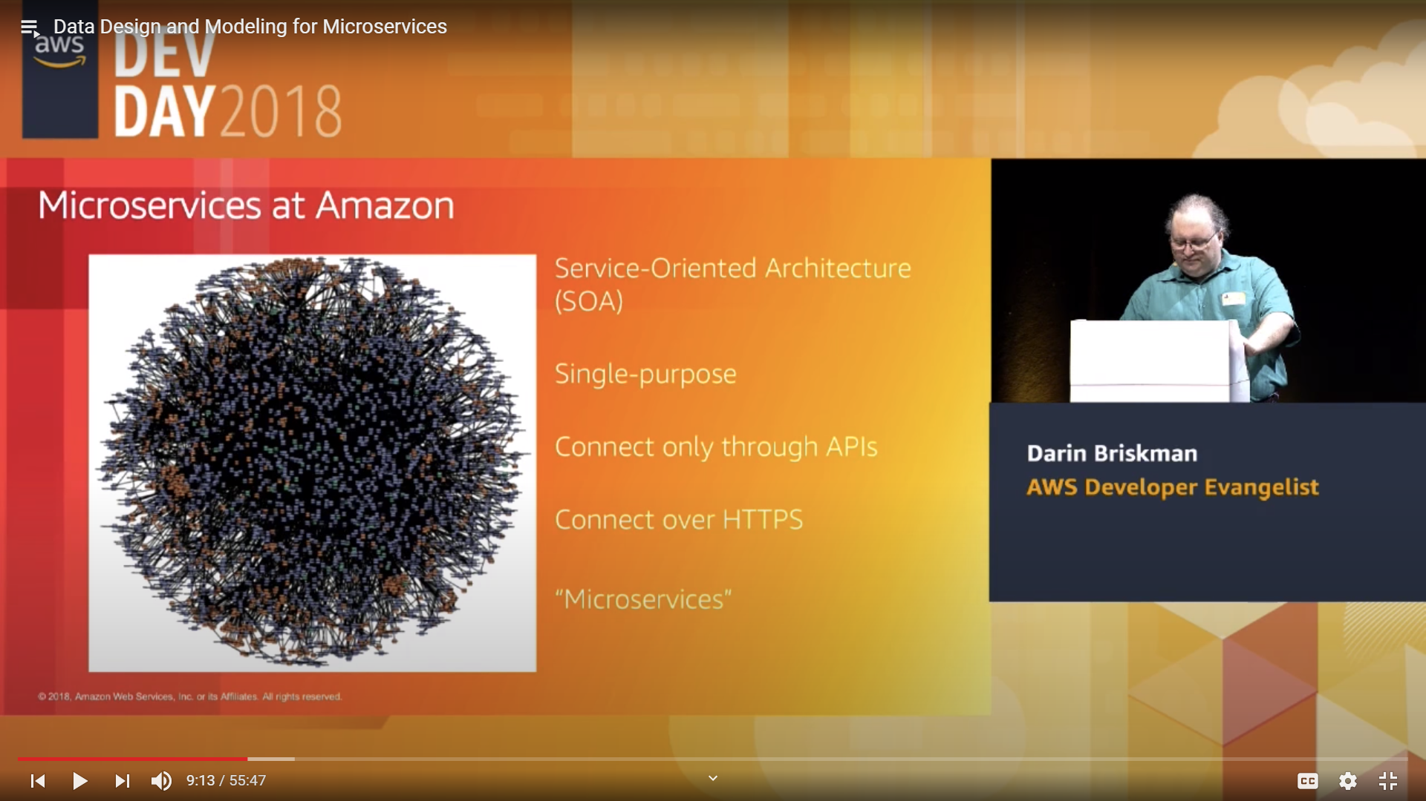
Micro Apps/Services
Docs for all their Microservices
Single Purpose
Connect only through APIs
Connect over HTTPS
= “MICROSERVICES”

Slide 10
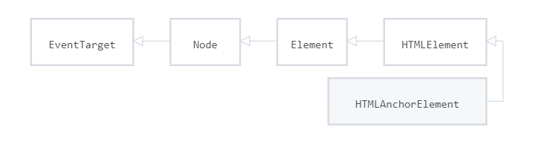
What is HTML?
<a href=“#” target=“_blank>CLICK EVENT</a>
props
built-in click method slot api
https://developer.mozilla.org/en-US/docs/Web/API/HTMLAnchorElement

Slide 11
<video>
<video width="320" height="240"
controls
loop
muted
autoplay
> <source src="movie.mp4" type="video/mp4"> Your browser does not support the video tag. </video>

Slide 12
What is a Web Component?
<my-component></my-component>
<script src=“file.js”></script>
Must contain at least one hyphen.
Use just like any HTML tag.
They extend HTMLElement class.
Hybrids is a non-class based library - https://hybrids.js.org/
https://www.webcomponents.org/ - main reference site
https://custom-elements-everywhere.com/
(Making sure frameworks and custom elements can be BFFs )
https://webcomponents.dev/ - over 40 libraries and compilers.
Like <div id=“app”></div> - one element can contain a whole app.

Slide 13
Who uses Web Components?
Google 20,000+.
Google Accelerated Mobile Pages.
Ionic and Ionic/ReactJS/Angular (Ionic Apps with Capacitor can run on IOS, Android, Web and Electron). ‘Write once, run anywhere…’
Salesforce – Lightning Web Components
Google video about Web Components and Salesforce: https://www.youtube.com/watch?v=YBwgkr_Sbx0

Slide 14
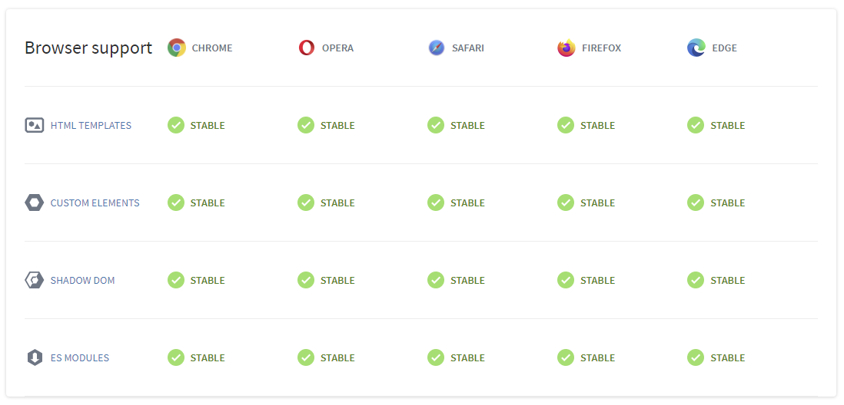
Browser Support
<template></template>
customElements.define('my-component', MyClass);
Polyfills available

Slide 15
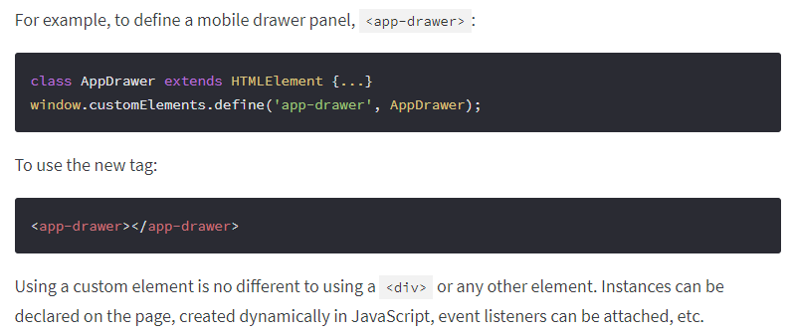
How to use
https://www.webcomponents.org/introduction

Slide 16
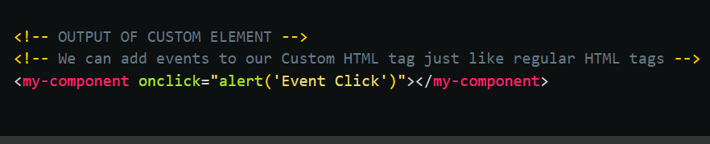
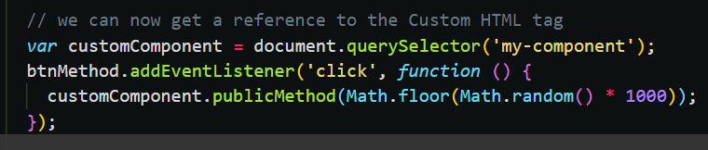
How to use
05: 01-light-events-NDC.html

Slide 17
COMMUNICATION
PROPS DOWN
Demo: 06-library/01-ndc-show-post
EVENTS UP
Demo: 05-events/15-child-to-parent
We use JS Custom Events to send event and data.
NB Methods and properties on components can be directly accessed. This would be a design choice as components tend to use props down events up, rather than sibling to sibling.

Slide 18
Framework: <div id=“app”></div>
<web-component id=“app” custom=“{}” …></web-component>
HTML attributes (props)
Attribute can be string, number, array, object
Emit custom event with payload
Listen to custom event with payload
A
Public Methods/Properties called by COMPONENT C etc…
1. Public method/property on component B
2. Set attributes on component B
Slot API (Children)

Slide 19



Deployment of Web Components
ndc-stencil Github repo
Vercel template to ndc-stencil.vercel.app
WWW folder manual drop to
netlify ndc-stencil.netlify.app
File storage
Use components in
iwswordpress-ionic UNPKG CDN
Also use a vanilla JS coimponent of login.
unpkg-ndc-stencil.netlify.app
Red NPM package
Blue UNPKG CDN
Green vanilla JS

Slide 20
www.JSconf.demo
Create an app that finds all conferences, enables booking place, booking flight and hotel along with a travel blog of that city.
Finally, does some very heavy calculations on which attendees one will have things in common:
<show-all-conferences /> ‘Angular’
<select-book-place /> ‘Vue’
<book-flight-hotel /> ‘React’
<show-blog-for-city /> ‘WordPress’
<show-people-connections /> ‘Web Assembly’
Business has some web dev skills to configure and connect them.

Slide 21
Types of components
These are only limited by JS.
We will look at couple of UI components and many more highly functional components that have built in:
Fetch requests.
Lazy loading and dynamic loading (scripts/components).
Storing JSON in IndexedDB and rendering it via templates.
Authentication and storage of JSON Web Tokens.
Added offline capability and ‘instant’ pages.
Let’s see an example: https://49plus.co.uk/udemy-webcomponents/
(Vanilla JS)

Slide 22
Build tools
JS compilers (not frameworks):
Stencil JS (Part of Ionic)
Lit Element/Lit HTML
Svelte
Open WC
Wrappers:
Vue, Angular, React etc have builds that add a web component wrapper.

Slide 23
Deployment
How to deploy Web Components as a third party:
In HTML pages as we have seen.
NPM
In Angular, Vue, React etc. There are well documented procedures. (https://stenciljs.com/docs/framework-bindings)

Slide 24
Framework integration…
Your thoughts…

Slide 25
SUMMARY
Craig West
wpjs.co.uk
craig@wpjs.co.uk

