Slide 1
Web Components
Craig West
Repo with course files, accompanying YouTube videos as well as these slides:
https://github.com/iwswordpress/

Slide 2






My start in computing at school in 1979 Still find tech hard!
58 in human years – 243 in tech years
Where/what were you in 1979?
Brighton, UK
Source:Wikimedia Commons
Source:Wikimedia Commons
1980: At University, I studied Chemistry and used MS-DOS, client/server main frame systems.
ZX-Spectrum computer and Jupiter Ace.
15 min walk
The English Channel
Source:Wikimedia Commons
Source:Wikimedia Commons

Slide 3
In this talk…
What is a Web Component?
How do we use them?
How we make them:
- with build tools (not frameworks).
- using frameworks.
Using Web Components as interconnected micro apps/services.
Use them as business widgets for not-tech users.
Open a conversation about state of JS world…

Slide 4
Who uses Web Components?
Google 20,000+.
Google Accelerated Mobile Pages.
Salesforce.
Onsen UI library.
Ionic and Ionic/ReactJS/Angular (Ionic Apps with Capacitor can run on IOS, Android, Web and Electron). ‘Write once, run anywhere…’

Slide 5

International JS Conference London 2018 – Key Note Speech
https://www.youtube.com/watch?v=1KJQurclLdw

Slide 6
Micro Apps/Services
Micro App:
A microapp is an interactive software module designed to perform like a full coded application or website. (Wikipedia)
Micro Service:
A self-contained piece of business functionality with clear interfaces - "Do one thing and do it well". (Paraphrased from Wikipedia)
or…

Slide 7
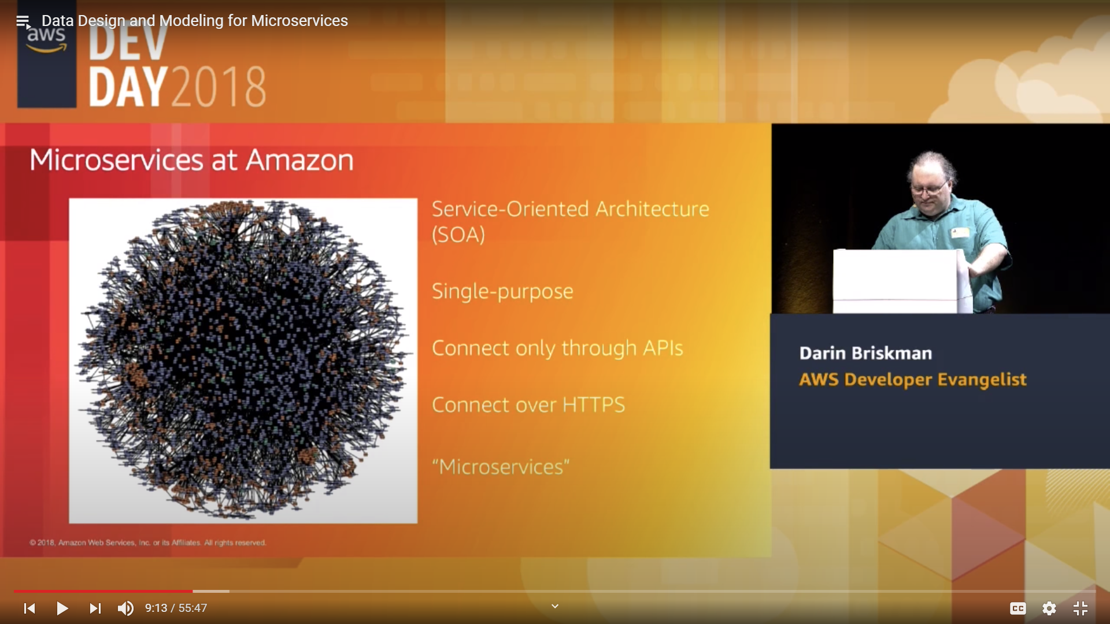
Micro Apps/Services
Docs for all their Microservices
Single Purpose
Connect only through APIs
Connect over HTTPS
= “MICROSERVICES”

Slide 8
www.JSconf.demo
Create an app that finds all conferences, enables booking place, booking flight and hotel along with a travel blog of that city.
Finally, does some very heavy calculations on which attendees one will have things in common:
<show-all-conferences /> ‘Angular’
<select-book-place /> ‘Vue’
<book-flight-hotel /> ‘React’
<show-blog-for-city /> ‘WordPress’
<show-people-connections /> ‘Web Assembly’
Business has some web dev skills to configure and connect them.

Slide 9
What is HTML?
<a href=“#” target=“_blank>CLICK EVENT</a>
props
built-in click method slot api
MY FRAME:
It is like <a> is syntax to create an instance of a class, HTMLAnchorElement, which can then have its methods and properties used:
<a></a> === objA = new HTMLAnchorElement
Thus with web components in index.html we can do the following:
document.querySelector(‘my-webcomponent’).method()
https://developer.mozilla.org/en-US/docs/Web/API/HTMLAnchorElement

Slide 10
What is a Web Component?
<my-component></my-component>
<script src=“file.js”></script>
Must contain at least one hyphen.
Use just like any HTML tag.
They extend HTMLElement class.
Hybrids is a non-class based library - https://hybrids.js.org/
https://www.webcomponents.org/
https://custom-elements-everywhere.com/
(Making sure frameworks and custom elements can be BFFs )

Slide 11
COMMUNICATION
PROPS DOWN
Demo: 06-library/01-ndc-show-post
EVENTS UP
Demo: 05-events/15-child-to-parent
We use JS Custom Events to send event and data.
NB Methods and properties on components can be directly accessed. This would be a design choice as components tend to use props down events up, rather than sibling to sibling.

Slide 12

<script src=“bundle.js”></script>
<div id=“app”>
HTML
WordPress
Framework 1
Framework 2
Framework ...n

Slide 13

WordPress
HTML
WEB COMPONENTS
Web Components
WP PHP PAGES
Gutenberg Blocks
Framework 1
Framework 2
Framework ...n

Slide 14
Types of components
These are only limited by JS.
We will look at couple of UI components and many more highly functional components that have built in:
Fetch requests.
Lazy loading and dynamic loading (scripts/components).
Storing JSON in IndexedDB and rendering it via templates.
Authentication and storage of JSON Web Tokens.
Added offline capability and ‘instant’ pages.
Let’s see an example: https://49plus.co.uk/udemy-webcomponents/
(Vanilla JS)

Slide 15
Build tools
JS compilers (not frameworks):
Stencil JS (Part of Ionic)
Lit Element/Lit HTML
Svelte
Open WC
Wrappers:
Vue, Angular, React etc have builds that add a web component wrapper.

Slide 16
Deployment
How to deploy Web Components as a third party:
In HTML pages as we have seen.
NPM
In Angular, Vue, React etc. There are well documented procedures. (https://stenciljs.com/docs/framework-bindings)

Slide 17
Framework integration…
Your thoughts…

Slide 18
SUMMARY
Craig West
wpjs.co.uk
craig@wpjs.co.uk

