Slide 1
Offline and ‘instant’ websites
Using HTML5 APIs to create fast, robust websites.
Collectively known as Progressive Web Apps.
Craig West
Trainer and Developer
https://github.com/iwswordpress
craig@wpjs.co.uk

Slide 2
Demo site and resources
wpjs.co.uk/asyncjs
(PWAs require httpS)

Slide 3
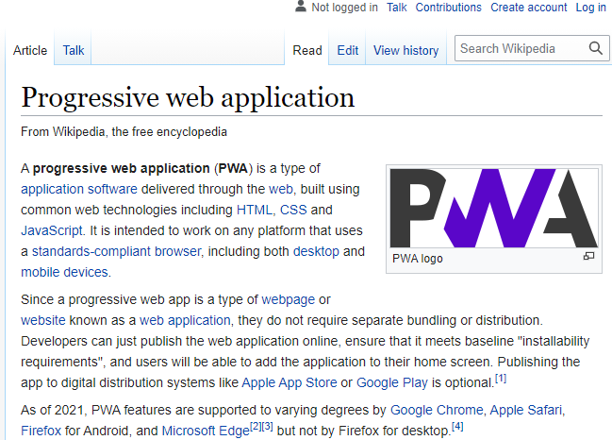
Progressive = one can use just a few features as needed.
Brain interprets instant if < 100ms

Slide 4

Why do I find tech so hard at times?
Brain shapes…
It is a if I have to change the shape of parts of my brain from one shape to another and that can create a lot of friction (discomfort).

Slide 5



Device – Browser -Page
WEB SERVER
All requests go through browser cache and we can specify rules as to how the browser cache responds.
Thus the ‘network’ response could just be the browser cache.
Browser’s HTTP Cache

Slide 6



Message API
Fetch API
Device – Browser -Page
Service Worker
WEB SERVER
Cache API
IndexedDB
o/s
Cache API
Cache API
Stores resources
Browser’s HTTP Cache

Slide 7
Service Workers
Essentially event listeners from page/device services – ‘fetch’ being the most used.
NB: AJAX/Axios etc do NOT trigger ‘fetch’ event. Only the Fetch API They can be triggered by events from page/device services – ‘fetch’ being the most used.

Slide 8
Service Workers
Service Workers are the powerhouse of PWAs.
JavaScript files but a wrapper to OS.
Runs in own thread so does not block JS. Async APIs only.
They operate even if the browser or tab is closed.
Must use https unless localhost.
Cannot access DOM – event messaging to and from web pages.

Slide 9
Service Workers
They may go to sleep but are awoken by events.
SW Lifecycle, Push notifications, Notifications and BackgroundSync are other events.
Has a SCOPE over which it has dominion – based on where it is located or its SCOPE option (later).

Slide 10

10s - Installability
The ability to add an icon to the Homescreen or save link on mobile device.
Each browser has its own implementation – Chrome offers the ability to offer a custom install.
‘whatwebcando.today’

Slide 11
SW and Cache API
The CACHE API is an HTML API not a SW feature.
Essentially, folders that stores a dictionary of REQUEST: RESPONSE key value pairs. Cached pages.
Regular web pages can add pages to CACHE and we will see how this can be used for fast, intelligent web pages.

Slide 12
IndexedDB
Key points are:
IndexedDB is asynchronous, transactional and a JS object key/value pair that can store JSON, files, images, videos.
We will see how versioning enables schema changes.
We can create Primary Keys and indexes.

Slide 13
IndexedDB
Key points are:
It is quite a clunky implementation based on events and callbacks but there are a variety of libraries that provide ease of use.
Please refer to the manual where we will have more information and we will then see IndexedDB in action via code and drills.

Slide 14
Messaging and Notifications
MESSAGING
These are regular HTML5 APIs which we can use.
The postMessage API enables messaging between pages, web workers, service workers.
In the SW we can send messages to a particular client or a range of clients.

Slide 15
Messaging and Notifications
NOTIFICATIONS
An HTML5 API but it will use the underlying OS.
We must have user permission so the first thing we do is ask for permission as we saw in the demo.
Some browsers are starting to block apps from making requests and have an icon in URL bar indicating user intervention.

Slide 16
HTML Messaging API
Web Page e.g. form.html
Service Worker
postMessage(msg)
self.addEventListener(‘message’)
postMessage API
document.addEventListener(‘message’)
postMessage(msg)

Slide 17
Notifications API – HTML API
PWA/Web Page
Operating System
Get permission from user to display notifications - a Web API
GRANTED/DENIED/DEFAULT
Once denied we cannot ask again, so ask at the right time.
showNotification(title, options) is the most basic of notifications.
We have seen a demo of this previously but we can see it again.
There is a great site with examples and code for a great range of notifications…
https://web-push-book.gauntface.com/demos/notification-examples/
Notifications API

Slide 18
Offline Form Submission
If ONLINE process it immediately, otherwise wait until ONLINE.
Get data from IndexedDB.
POST and get response.
If OK, delete data from IndexedDB.
Send message to page and send Notification.

Slide 19

Offline Form Submission
PAGE
SW
animation
ONLINE
Capture and store data in IDB
Register a SYNC event TAG
Listen for TAG and save in event queue
Get data from IDB
Send data
Do any clean up
SEND NOTIFICATION and MESSAGES for success of failure
When back online the SW will try 3 times to send data before cancelling the task. It will emit a lastChance event for app to handle.
Tested on my Samsung 02SEP2021 Notification came through when form submitted with FLIGHT MODE ON and then back ONLINE.

Slide 20
Offline and ‘instant’ websites
Using HTML5 APIs to create fast, robust websites.
Collectively known as Progressive Web Apps.
Craig West
Trainer and Developer
https://github.com/iwswordpress
craig@wpjs.co.uk

