Slide 1
PWA - Caching
Strategies for caching files

Slide 2
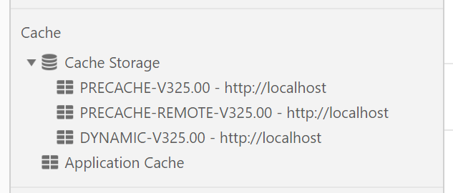
Service Worker Caching
The service worker holds the code for caching files.
In our demo app we create three caches:

Slide 3
SW Caching APP SHELL
During the installation of the SW, we can cache just the essential files for the APP SHELL.
This will be core images and CSS.
Loading is SYNCHRONOUS so we can’t add whole site as this would tie up CPU but depends on how many cores we have.
We can split this into local resources and remote resources.
We use two cache operations for our own and third party assets
We do this because the cache.AddAll is promise-based and if one fails all fail. (Ensure you have no missing files or mis-spelling as this will cause all files NOT to be cached.

Slide 4
SW Caching DYNAMIC
We can intercept every URL request in the SW.
We do this by writing some code for the FETCH event.
If we make a network request, we can make a copy (clone) and store it in our DYNAMIC_CACHE that we have set up.
Then we can if we want check the local cache before going to the network.
We thus have 3 caches →

Slide 5
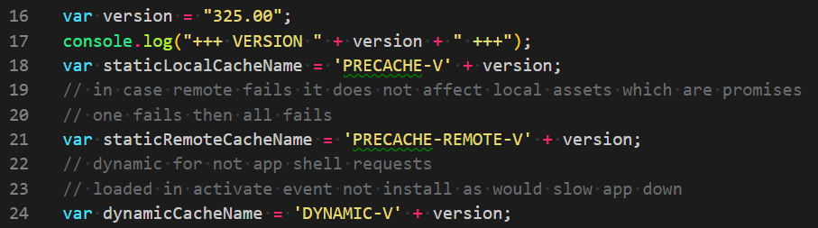
SW Caching DYNAMIC

Slide 6
Caching Strategies
Cache Only. Network Only.
Cache then Network. Network then Cache.
Cache/Network then Fallback.
Cache and Network race.
Stale while revalidate – cache but go to network and cache and inform user a newer version is available. https://web.dev/offline-cookbook/#generic-fallback
In our APP we use cacheThenNetworkAddStoreThenFallback – we look in the cache first, then network, clone a copy and add to cache and if we can do none of these we give a graceful FALLBACK page →

Slide 7
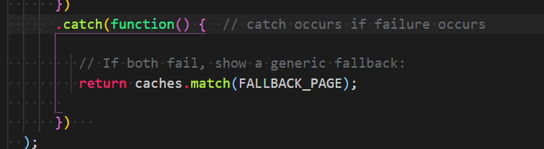
Caching Strategies
FALLBACK_PAGE is a variable defined at top of SW file.
We can determine the type of request and have a switch block to give a different FALLBAK_PAGE or IMAGE accordingly.

