Slide 1
WP REST API & AJAX
WORKSHOP: REST API and AJAX
Craig West
Feel free to contact me: craig@wpjs.co.uk
RESOURCE PACK:
https://www.wpjs.co.uk/london.zip
https://github.com/iwswordpress/LONDON
Course files
Slides
Handbook
FREE coupon to my Udemy course

Slide 2

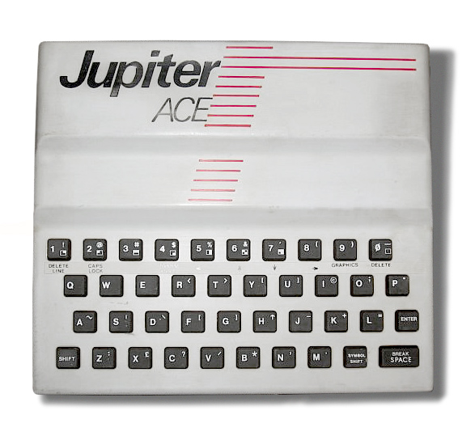
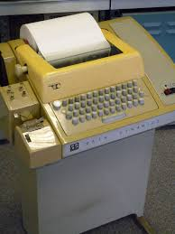



My start in computing at school in 1979
58 in human years – 243 in tech years
Where/what were you in 1979?
Brighton, UK
Source:Wikimedia Commons
Source:Wikimedia Commons
At University
The English Channel
Source:Wikimedia Commons
Source:Wikimedia Commons

Slide 3
WP REST API & AJAX
Microsoft Certified Systems Engineer (2000-2003)
Microsoft Certified Database Administrator (SQL2000)
Business Information Architect at a UK Recycling Company
WordPress 2017
Currently PWAs(offline/instant websites), Web Components, WP-HTML, Google AMP and Web Optimisation.
Developing 1-2 hour training seminars for companies
Still just as ‘student’!

Slide 4
WP REST API & AJAX
IT IS YOUR WORKSHOP!
Please feel free to ask questions
Aim is to understand what we are doing
No shaming
We are all developers and know the road is rocky with many silly mistakes and frustrations

Slide 5
WP REST API & AJAX
DESIRED OUTCOMES:
Understand WP REST API, AJAX, JSON
Know how to create custom WP REST API Endpoints
Create REST APIs via page-slug.php (regular WP page)
Use them for GET/POST requests
Create forms that use these Endpoints
Secure forms with WP NONCE
DEMO=>

Slide 6
WP REST API & AJAX
API:
Application Programming Interface
‘one bit of software communicating with another’

Slide 7
WP REST API & AJAX
What is REST?
This was formulated by Roy Fielding for his thesis in 2000.
An architectural style not a protocol.
HTTP by its nature is implicitly RESTful.
https://www.ics.uci.edu/~fielding/pubs/dissertation/rest_arch_style.htm

Slide 8
WP REST API & AJAX
ENDPOINTS:
HTTP VERB + URL = ENDPOINT
GET/POST + same URL = 2 ENDPOINTS
https://wpjs.co.uk/wpb/wp-json/wp/v2/posts GET/POST/DELTE

Slide 9
WP REST API & AJAX
AJAX:
AJAX = Asynchronous JavaScript And XML.
Read data from a web server without reloading the page
Update a web page
Send data to a web server - in the background

Slide 10
WP REST API & AJAX
JSON: JavaScript Object Notation
JSON is a lightweight format for storing and transporting data
JSON is often used when data is sent from a server to a web page
JSON is "self-describing" and easy to understand
Data is in name/value pairs (types on next slide)
A multi-dimensional array
Data is separated by commas
Curly braces hold objects
Square brackets hold arrays
data.id === data[“id”] – JS uses dot notation for shorthand

Slide 11
WP REST API & AJAX
JSON Data Types
Strings
Booleans
Numbers
Null
Object
Array
https://wpjs.co.uk/wpb/wp-json/wp/v2/posts

Slide 12
WP REST API & AJAX
WORKSHOP: REST API and AJAX
Craig West
Feel free to contact me: craig@wpjs.co.uk
RESOURCE PACK:
https://www.wpjs.co.uk/london.zip
https://github.com/iwswordpress/LONDON
Course files
Slides
Handbook
FREE coupon to my Udemy course

