Slide 1
WP REST API & AJAX
Craig West
Feel free to contact me: craig@wpjs.co.uk
RESOURCE PACK with course files, handbook, slides:
https://github.com/iwswordpress/rest
https://wpjs.co.uk/rest.zip
Live site: https://49plus.co.uk/udemy/
https://49plus.co.uk/udemy/login
user: demo pwd: demo

Slide 2
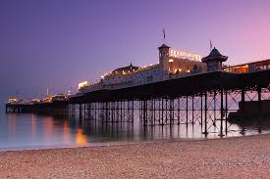
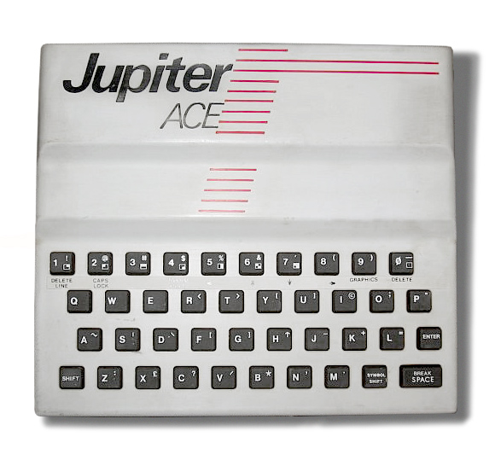
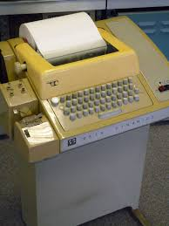

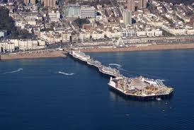

My start in computing at school in 1979
58 in human years – 243 in tech years
Where/what were you in 1979?
Brighton, UK
Source:Wikimedia Commons
Source:Wikimedia Commons
At University
15 min walk
The English Channel
Source:Wikimedia Commons
Source:Wikimedia Commons

Slide 3
WP REST API & AJAX
Microsoft Certified Systems Engineer (2000-2003)
Microsoft Certified Database Administrator (SQL2000)
Business Information Architect at a UK Recycling Company
WordPress 2017
Currently PWAs(offline/instant websites), Web Components, WP-HTML and Web Optimisation.
Volounteer coach at Codebar.io
Developing 1-2 hour training seminars for companies
Still just as ‘student’!

Slide 4
WP REST API & AJAX
IT IS YOUR WORKSHOP!
Please feel free to ask questions
Aim is to understand what we are doing
No shaming
We are all developers and know the road is rocky with many silly mistakes and frustrations

Slide 5
WP REST API & AJAX
DESIRED OUTCOMES:
Understand WP REST API, AJAX, JSON
Know how to create custom WP REST API Endpoints
Use them for GET/POST requests
Create forms that use these Endpoints
Secure forms with WP NONCE
OPTIONAL: DECOUPLED WP

Slide 6
WP REST API & AJAX
REALISTIC OUTCOMES:
Have an overview of how non-refreshed pages work.
Have sample code so that it works. You can then break it and learn more.
Have links to the resources I found very useful
Have ready made AJAX pages and forms to edit and amend.
This is a lot to understand in a short talk…allow yourself not to fully understand it at this present time…there is time afterward…
Please contact me for follow up Zooms etc…

Slide 7
WP REST API & AJAX
What is REST?
Representational State Transfer
This was formulated by Roy Fielding for his thesis in 2000 to create an alternative to the SOAP method.
An architectural style not a protocol.
HTTP by its nature is implicitly RESTful.
https://www.ics.uci.edu/~fielding/pubs/dissertation/rest_arch_style.htm

Slide 8
WP REST API & AJAX
API:
Application Programming Interface
‘one bit of software communicating with another’

Slide 9
WP REST API & AJAX
ENDPOINTS:
HTTP VERB + URL = ENDPOINT
GET/POST + same URL = 2 ENDPOINTS
https://wpjs.co.uk/wpb/wp-json/wp/v2/posts GET/POST/DELETE

Slide 10
WP REST API & AJAX
AJAX:
AJAX = Asynchronous JavaScript And XML.
Read data from a web server without reloading the page
Update a web page
Send data to a web server - in the background
Many libraries like jQuery, Axios etc
I use browser API: fetch()

Slide 11
WP REST API & AJAX
Think of JSON data as an associative array
json_encode([php associative array]) gives JSON
json_decode (JSON) gives an assoc array
Strings
Booleans
Numbers
Null
Object
Array
https://wpjs.co.uk/wpb/wp-json/wp/v2/posts

Slide 12
WP REST API & AJAX
WordPress Hooks
Hooks are a way for one piece of code to interact/modify another piece of code at specific, pre-defined spots.
We can add our own endpoints using the 'rest_api_init’ hook.

Slide 13
WP REST API & AJAX
SITE SETUP…
Please refer to REST-AJAX.docx and the source code

Slide 14
WP REST API & AJAX
DECOUPLED WP
As we are using JS blocks in our PHP pages this can lead to using these scripts in HTML pages or PHP outside of the WP ecosystem.
This means we can have DECOUPLED or HEADLESS WP sites
HEADLESS means formatting preconfigured in a ready made block for example.
DECOUPLED means raw data is sent and page formats data.
Using JSON WEB TOKENS (JWT) we can also authenticate…
Example: https://wp-html.co.uk/semantic

Slide 15

<script src=“bundle.js”></script>
<div id=“app”>
HTML
WordPress
Framework 1
Framework 2
Framework ...n

Slide 16

HTML
WEB COMPONENTS
Web Components
WP PHP PAGES
Gutenberg Blocks
Framework 1
Framework 2
Framework ...n

Slide 17
WP REST API & AJAX
WP REST API + Web Components
=> 100% INTERNET
Web Components are custom HTML elements/tags that we can create.
We define a tag and associate with a JS Class.
They are regular HTML so can be used wherever HTML is used and also be wired into JS Framework builds.
The example of DECOUPLED WP is in fact built entirely with Web Components…let’s look at the source code…

Slide 18
WP REST API & AJAX
What are the implications?
These Web Components can be thought of as HTML Plugins.
Other sites can use these highly functional HTML Plugins to render out WP site’s content and functionality.
This has opportunities for increased agency work for our clients.
It can also create extended exposure, SEO and business partnerships…our WP provides content/service for another site.

Slide 19
WP REST API & AJAX
Craig West
craig@wpjs.co.uk
I offer regular no fee online workshops on Progressive Web Apps, Web Components, WP-HTML, JavaScript for WP developers and High Performance Websites.
Please email me for more details.

