Slide 1
Serious Game for Management of IT-Projects
Ixhen Hasani
21.02.2019
Kickoff: Bachelor Business Information Systems
Supervisor(s): Christian Eichhorn & Adnane Jadid

Slide 2

Introduction / Motivation
Hi all!
I am Ixhen Hasani
Born on 05.08.1994 in Tirana, Albania
Student on the 5.Semester B.Sc,
Field of study: Business Information Systems
Software developer working student at Sulzer GmbH

Slide 3
“If you do what you love, you'll never work a day in your life.” -Steve Jobs What do I love to do ?
Code
From an idea, a requirements list is elicited. From that a plan is derived, and after a whole lot of hours of typing and even more bugs, a product comes to life, of which you can be proud. What‘s not to love about it ?
Business
The point system of life has $ as its measuring unit. The more of this points collected, the more people you can reach a helping hand to, which is one of the biggest goals of my life.

Slide 4
Professional Goal
Programer
I
Business Manager

Slide 5
What is my project about?
A lot of IT projects fail
The Project Management Institute’s 2017 Pulse of the Profession report found that “due to poor project performance, organizations waste an average of $97 million for every $1 billion invested.”

Slide 6
What is my project about?
A lot of IT projects fail
AND Management is the main factor
According to IBM “only 40% of projects meet schedule, budget and quality goals. Further, they found that the biggest barriers to success are people factors.”

Slide 7

What would a solution be?
Develop a Serious Game!

Slide 8
What is a Serious Game ?
as defined by Chen & Michael (2005), Serious Games are “Games that do not have entertainment, enjoyment or fun as their primary purpose” ¹
Oposed to Gamificiation, which is defined from Gartner as “the use of game mechanics and experience design to digitally engage and motivate people to achieve their goals”²

Slide 9
Why a serious game ?
More Engagement
“...The results we obtained so far lead us to believe that serious game design has a direct and indirect effect over student’s perceived acquired competency, which is mediated by student's engagement”
Bonazzi, R (2011). Analysis of Serious Games Implementation for Project Management Courses. ³
Better Management
“...the Gamification of the educational part of project management actually leads to better managed projects in the real business environment.
Briers, B. (2013). The gamification of project management. ⁴

Slide 10

Where do we get the content/theory from?
PMBOK-Guide(Software Extension)
Set of standard terminology and guidelines (a body of knowledge) for (software) project management.
Collection of best practices and approaches for Management of IT-Projects

Slide 11
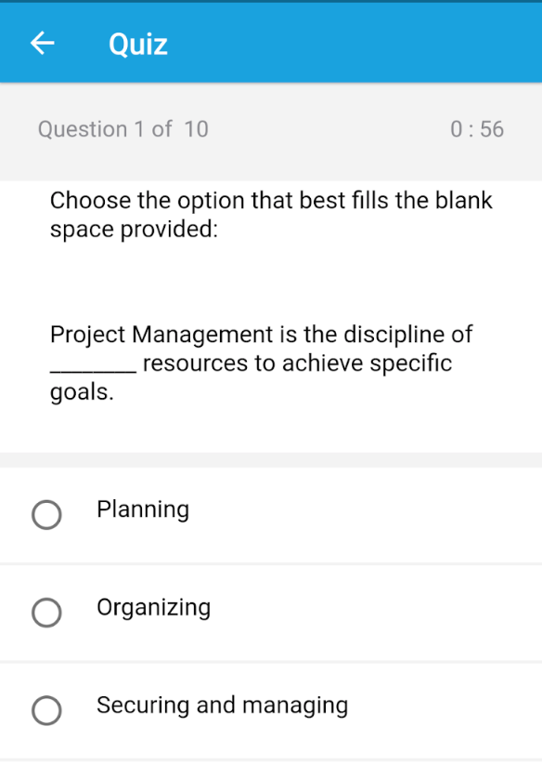
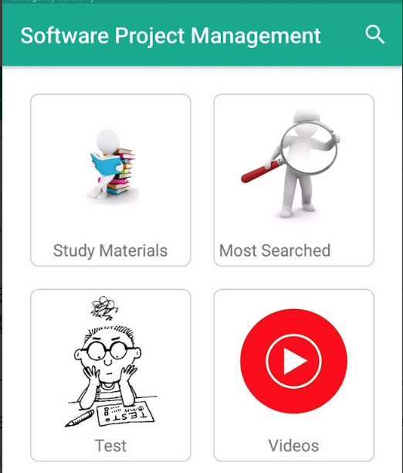
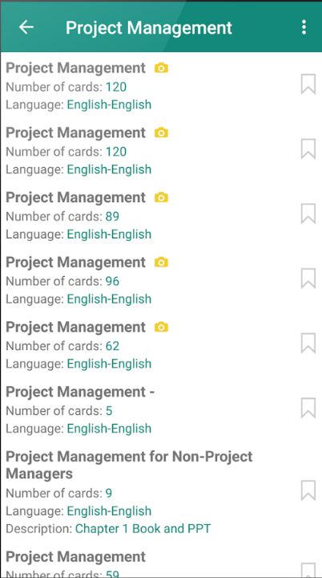
Existing Solutions / Related Work
A few Apps on the market, that teach concepts of software project management...
But they have incorporated gamification elements like points, badges, timers etc. and they teach through:
Quizzes
Video Tutorials
Flashcards

Slide 12
Existing Solutions / Related Work
A similar tool is used on the lecture CIO-Planspiel from the chair for business information systems at the TUM.
On it the user takes the role of a project manager, who has to make decisions between alternatives. The processes are interconnected so that each choice has to be taken carefully, because it will ignite a chain reaction.
My project will use some characteristics of this simulation but will also inject serious game elements in it, like a 2D field, and one of the main goals will be to put the user on flow state.

Slide 13
Goals of this Thesis
The goal is to create a game, in which the user learns the concepts of software project management and also finds himself in flow state during the interaction with the simulation.

Slide 14
Proposed Work / Approach
Take the content of chapters from PMBOK(Software Extension) like: Introduction to Project Managemet, Time Management, Human Resource Management etc.
Create a 2D simulation where the player learns the concepts with minimalistic effort.

Slide 15
Time Line
Android Studio Tutorials (15.12-07.01)
Introduction Section & Research( 07.01-21.01)
Related Work und Theory(21.01-06.02)
Coding & Development Section(21.02-08.04)
Evaluation/Future Work/ Summary(08.04-14.05)

Slide 16
Thank you for the attention!

Slide 17
List of References
http://www.ludoscience.com/files/ressources/classifying_serious_games.pdf
https://blogs.gartner.com/brian_burke/2014/04/04/gartner-redefines-gamification/
Bonazzi, Riccardo & Missonier, Stéphanie & Jaccard, Dominique & Bienz, Pius & Fritscher, Boris & Fernandes, Emmanuel. (2011). Analysis of Serious Games Implementation for Project Management Courses. 10.1007/978-3-7908-2789-7_53.
Briers, B. (2013). The gamification of project management. Paper presented at PMI® Global Congress 2013—North America, New Orleans, LA. Newtown Square, PA: Project Management Institute.

