Slide 1

Incident Response Ticketing System

Slide 2
Incident Management
Purpose
To identify, contain, remediate and restore normal operations as quickly as possible and minimize adverse impact to network operations.

Slide 3
Objectives
Ensure standardized method/procedures used for efficient/prompt response and analysis
Increase visibility and communication of incidents to network owner and response team

Slide 4
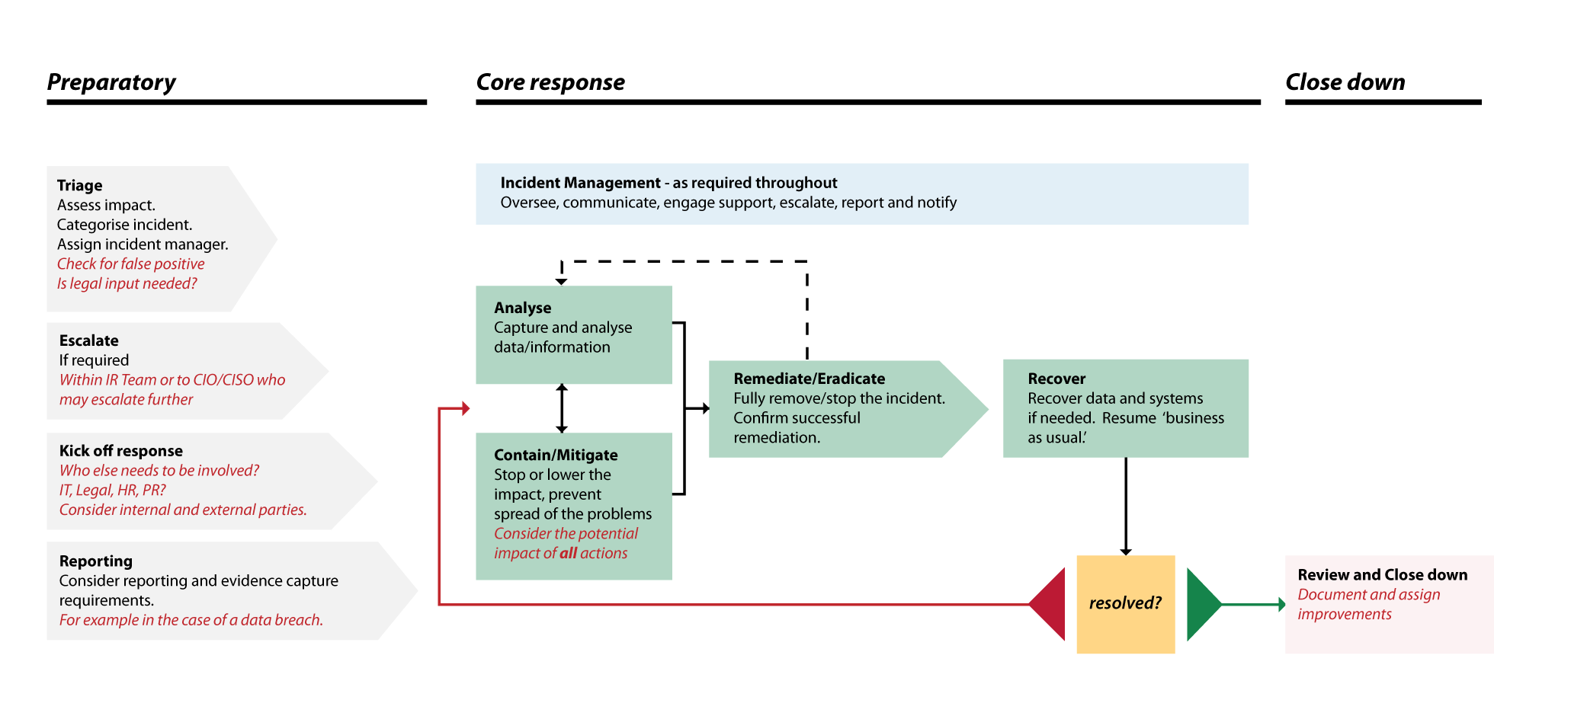

Slide 5
Incident ticket system requirements
Easy ticket creation
Multiple methods for creating – email, website portal
Auto Assign to team/members
Route incident to the respective team/member utilizing templates
Timely notifications
Keep members informed of updates via email or other notification.
Integration with monitoring tools
Automatically convert alerts from network monitoring tools to tickets
Open-Source Intelligence
Business rules
API accessibility
Collaboration
OPEN CTI/MISP integration to allow for updated threat information
Automate preset actions on incoming tickets based on criteria
Allowing for multiple users to simultaneously work on the same case
Attachment/artifact functionality
Allow for upload into case and margining of tickets or artifacts to reduce redundant data
Pull data via API to pull into other systems

Slide 6
Test Process
1. Theoretical evaluation, beginning with a review of a well-documented response plan. Helpful in reviewing small process changes and other updates. Not feasible for an initial test of incident management software.
2. Evaluate cybersecurity tools and strategies collaboratively with all stakeholders using a drill/rehearsal. Intended to assess how cross-functional teams can respond to an incident. Tests preparedness, planning and policy for participants.
3. Conduct real-time simulated attacks to test the efficacy of existing incident management processes and tools. Deploy known threat to effectively analyze effectiveness of incident tracking software.
1. Paper Test
2. Table-top
3. Simulated Attacks

Slide 7
Software Options
The HIVE
SECURITY ONION CASES
Scalable 3-1 open source
Exportable results
Collaboration possible with multiple analysts on same case simultaneously
Create case from scratch or from MISP and SIEM alerts
Multiple Authentication methods and RBAC
Sec Onion integration
Allows escalation logs from Alerts, Dashboards, and Hunt
Assign analyst, add comments and attachments, and track observables
Free

Slide 8
Notable Mentions
FIR
CYBER CPR
SPLUNK SOAR
SERVICE NOW

Slide 9
Observed Results: The Hive
Pros:
Easy ticket (Case) creation from alerts with fields and evidence attached, great UI, clean and mature
Cases create observables that will be linked across cases as they appear
OSINT enrichment integrated automation (MISP)
Non-repudiation and auditing through authenticated users (LDAP on DDSM, OAuth/Keycloak)
Backup / restore of database is an organic function, able to be automated
Cons:
Division by group not intuitive
New version requires paid subscription (Hive 5 and later) **** (Hive 4 end of life in 2022)

Slide 10
Observed Results: FIR
Pros:
Easy standup, open source (Dev access to modify/update), able to automate stand-up, cost is free
Quick to make a case, easy to deal with tickets; parses observables automatically
Django plugins, easy to extend; built on Python, hackable
Quick report generation for events/cases
Cons:
No organic backup/export option; no enterprise support or guarantee of continued developer support
Needs polish; requires dev work to be functional for team needs, ex: filtering by category is manual
As tickets increase in number, ticket management is more challenging
Data is hand-jammed, opportunities for mistakes to happen

Slide 11
Observed Results: SecOnion Cases
Brand new product; may be open to changes in features by the devs, but immature tech
Pros:
Case creation based upon alerts, links directly to events
Adding outside attachments easy (pcaps, intel enrichment)
Easy setup, built into DDSM (may also be a con)
Cons:
Clunky UI, not polished; missing essential functions such as import/export, report generation
Integration with servers/sensors can cause restrictions in network layout/security
LDAP support missing/not advised

Slide 12
The Path Forward
Bottom Line Up Front:
The Hive was the clear winner in terms of integration, quality, and features. However, the Hive is going to cost money after 2022 if we want a product that has support. If we begin looking at paid systems, a number of other options become contenders.
Notes:
The initial wave at three of the options for ticketing systems needs more time to provide serious evaluation.
All three systems were stood up and operators had some time to play with each; the DDSM kit was partially inop so the systems had to be run locally for The Hive and FIR. Nailing down deployment automation and backup/restore/report functionality for each option is still a requirement.
Recommend further testing and hands-on evaluation in February/March, and a discussion on paid systems in terms of their viability and proposed cost models.

