Slide 1
On-nara BPS System & Innovation way to national archives management

Slide 2
E-Government, on-nara BPS system and, government innovation.
On-nara BPS system
Document management system
On-nara BPS system and innovation way to Document management

Slide 3
1. E-Government, on-nara BPS System and, government innovation.

Slide 4
E-government and government innovation
Final goal of IT investment is to improve the way of working
E-government is more about government than about “e”
[OECD,2003]
Improve the competitiveness of government, by way of working innovation
Beyond IT, Putting Government at Center of National Competitiveness Putting Citizen at the Heart of Government
[Cisco, 2004]

Slide 5
On-nara system & government innovation
Core support system that innovate the government
Provide the shortest way to innovate the working process.
Making a connection with other systems.
Leading elements of other systems innovation
Revitalizing using other systems.
Can not handle the Business without On-nara system
→ Coexistence between e-gov system and creation of synergy effect

Slide 6
On-nara BSP is basic system of administrative work.
E-Support(Easy-one) System
National Affairs Management System
Digital budget
& accounting
e-Human (PPSS) System
cabinet meeting instruction
private assessment
Budget/accounting
On-nara BPS
Public relation management system
Record management system
promote
record
knowledge
Institution
assessment
knowledge management system
(government department)
e-Integration Evaluation System

Slide 7
Changing the document management paradigm and government innovation
E-government
paper records → electronic records
Knowledge-government
preserving records →“knowledge resource-izatation” of records(make records to knowledge resource)
participative government
Undisclosed practice → open to public and let them read actively
Records management innovation → government innovation

Slide 8
On-nara BPS & Record management system
On-nara BPS system
Register takeover
Administration of preservation
Transfer
Take over Elctronic / non-electornic
convert preservation formats, preserve the authenticity
transfer permanent records
E-Approval System
Search application
making public management
Nonelectronic- records
search/reading/statistics
reclassification / reading online

Slide 9
2.On-nara BPS System

Slide 10
On-nara BPS is a steppingstone that recovers original values of e-government
Causes of negative evaluation in e-government
Only pursuing IT application without business process improvement
Inadequacy of practical effects on productivity and convenience.
On-nara BPS
Reengineering all decision-making processes and connecting with BRM
Improving accountability of civil servants and governmental organizations and enhancing transparency of administration through recording all the decision-making processes.
→ representative systems that successfully implement the purpose of e-government.

Slide 11
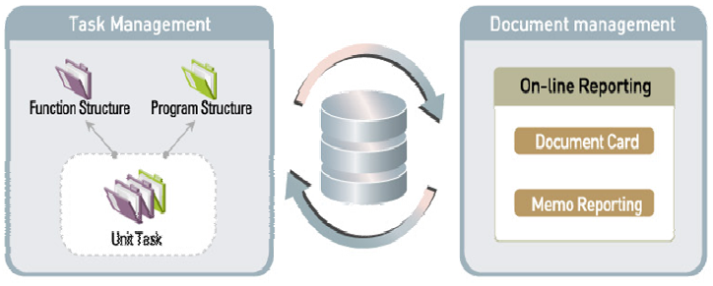
Task management and document management is the key point
Business handling
Daily schedule,
Daily record
automatically accumulated
Clarifying each job assignment
Performance management
Systematical management of decision-making process

Slide 12
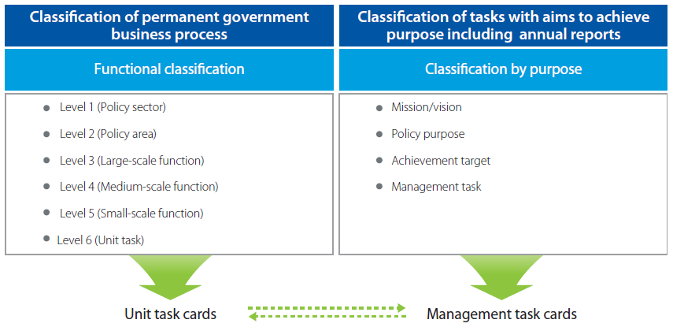
Task management

Slide 13
Example of BRM
Functional classification → drawing the work-relatedness from related organizations.
BRM | Ministry of the Interior | Ministry of Information and Communication | Ministry of Agriculture, Food and Rural Affaris | Organization
Level1 (Policy sector) | Government Resource Management | Telecommunication | agriculture, Forestry, Maritime, Affairs and Fisheries | Ministry, administration
Level 2 (Policy area) | Information resource management | information and communication | Agriculture and Rural Community
Level 3 (Large-scale function) | Electronic-government | Utilization of information | Information Agriculture | Bureau, headquarter
Level 4 (Medium-scale function) | service informatization | informatization promotion | informationization | team., department
Level 5 (Small-scale function) | overcoming the digital divide between regions | establishment of a plan for informatization promotrion | Operation and Management of informationization | Smallest unit of government organization
Level 6 (Unit task) | Expanding the creation scale of information network village | Establishment of information Super Highway on farming and fishing village | IT education for farmers | Person in charge

Slide 14
Unit task
Functional classication
Unit task
Managing the personal business performance based on organizational regulation
file forder in offline
Integrating and managing processes like establishment of plans – execution – evaluation etc.
can create, change and finish in case of need
Managing connected informations(laws, organizations and regulations)
unit task
Unit task card
All the business performances(daily log, memo…)are automatically accumulated in the unit task cards.
Accumulated work performance is a base data for personal achievement and government performance evaluation
Making a good use to document management and business transition is important

Slide 15
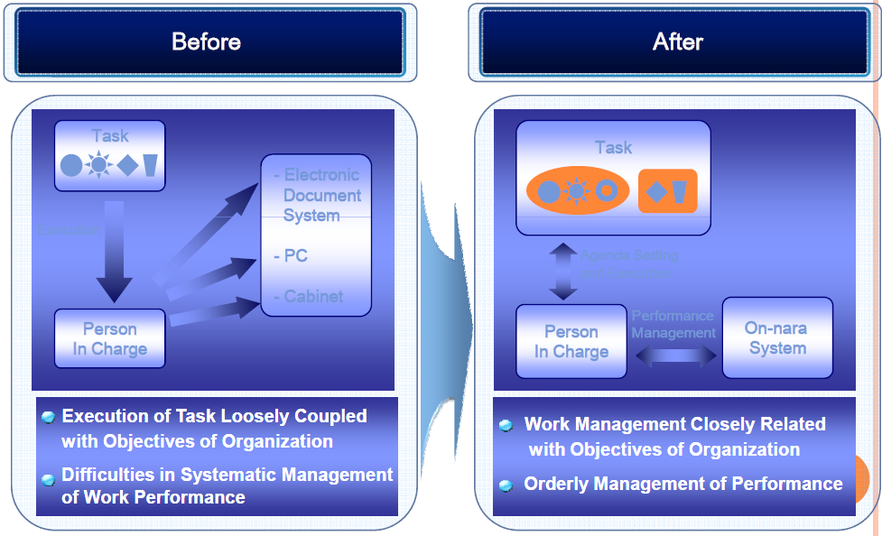
Before and after of task management system

Slide 16
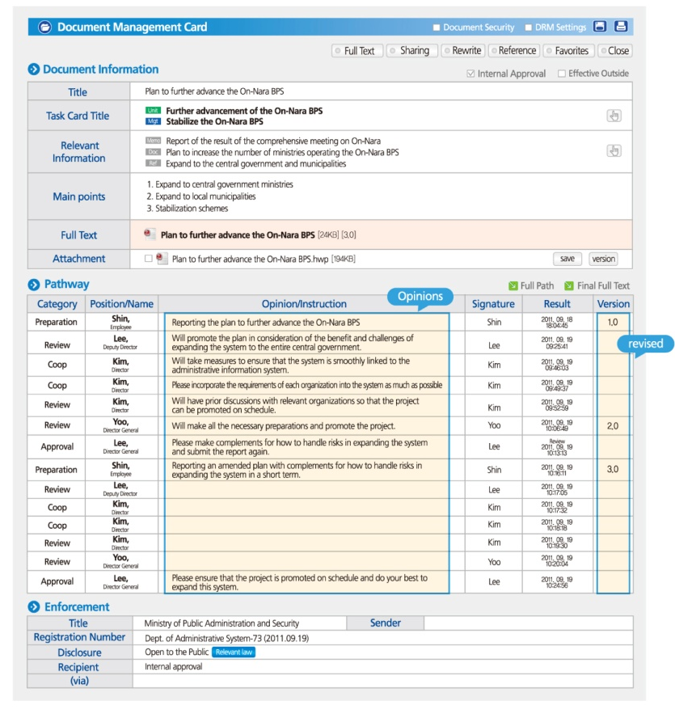
Document management

Slide 17
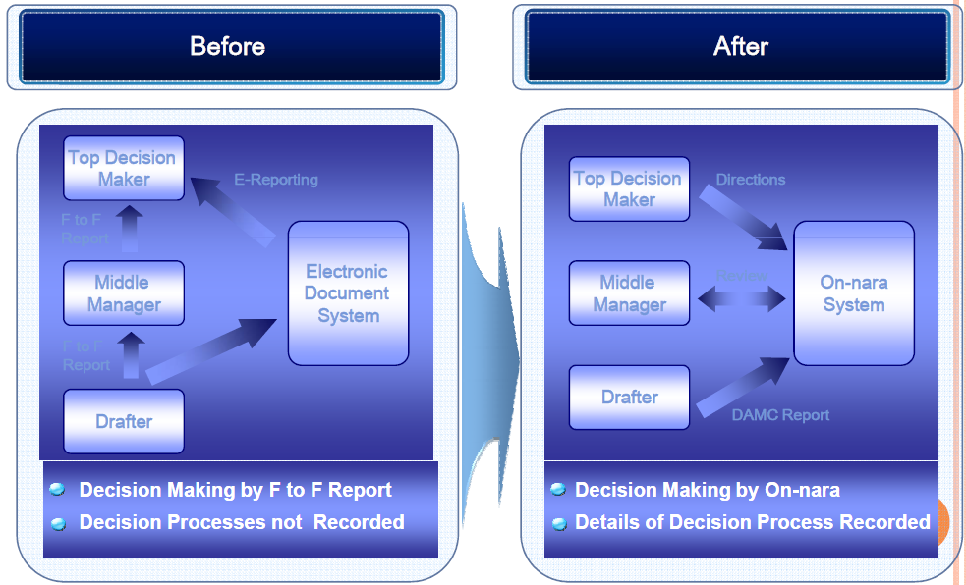
Before and after of document management system

