Slide 1

Internet of Things Project using Python (CSE 4110) End-Term Project Presentation on Topic
Presented by
Mr. Sohan Kumar Sahoo
Mr. Subham Jena
Mr. V Sourav Rahu
Mr.Harishankar Rout
Supervisor
Dr. Hara Prasad Tripathy
Dr. Siddharth Sahany
Department of Computer Science and Engineering
Institute of Technical Education & Research (FET)
Siksha ‘O’ Anusandhan Deemed to be University, Bhubaneswar
January, 2023

Slide 2
Contents
Introduction
Literature Survey
Design Scheme
Testing, Analysis, And Evaluation
Socio-economic Issues Associated With The Project
Engineering Tools And Standards
Conclusion

Slide 3
Introduction
There is an increasing demand for smart homes, where appliances react automatically to changing environmental conditions and can be easily controlled through one common device.
This project presents a possible solution whereby the user controls devices by using their existing mobile phone,where control is communicated to the Microcontroller from a mobile phone through its Bluetooth interface.
This project helps us to save energy by switching off the appliances when there is no human presence in the home and it is also helpful for disable people as every thing can be controlled using smart phone.

Slide 4
Literature Survey
In Bluetooth based home automation system the home appliances are connected to the Raspberry pi pico board at input output ports . The program of Raspberry pi pico board is based on high level interactive python language of microcontrollers; the connection is made via Bluetooth. The Bluetooth connection is established between Raspberry pi pico board and phone for wireless communication. In this system the python script is used and it can install on any of the Symbian OS environment, it is portable. One circuit is designed and implemented for receiving the feedback from the phone, which indicate the status of the device.

Slide 5
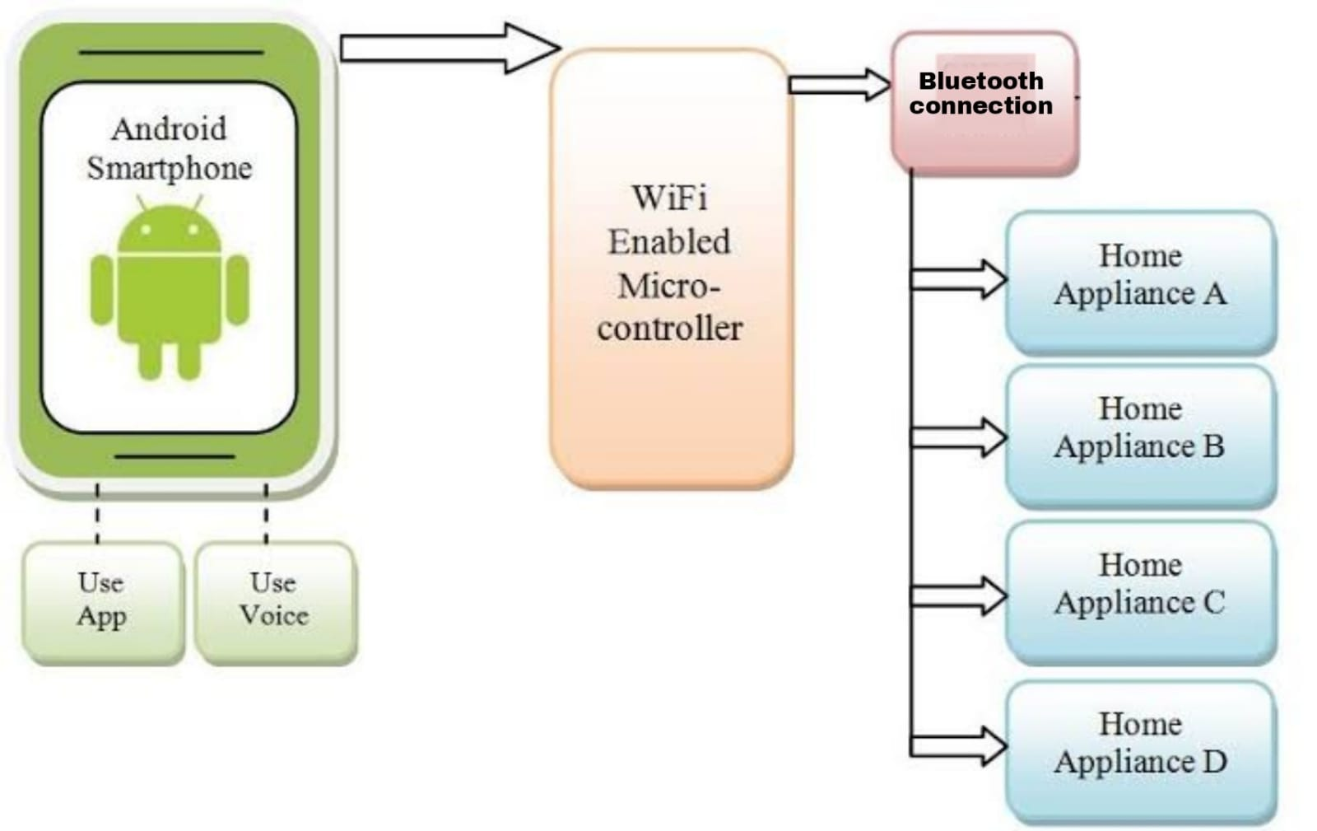
Design Scheme

Slide 6
Testing
During tests, our proposed model worked as expected. The equipments are tested to the best of our ability. We could observe accurately what is happening, in our system.
There is the App, which helps control fan ,light and changing the brightness of led. we connect our app through Bluetooth and found that we are able to change the colors easily through that.

Slide 7
Results, Analysis and Evaluation
In this project (smart home automation system)we connected electrical components (led,fan,oled)with raspberry pi pico the oled shows real time temprature and date time and with the help of mobile application we can control the brightness of light and turn it on and off we have installed a fan which will turn on if the temprature is above 20 degree however we can turn it on using mbile application whenever we want.

Slide 8
Socio-economic Issues Associated With The Project
Global impact
The Internet of Things (IoT) is a remarkable concept: In one way it is still very theoretical and in another way it is already a network that is used every single day. The physical world is being re-invented and the Internet of Things is changing the world, as we currently know it, by encouraging and supporting new opportunities that we almost cannot imagine.
This means that the objects that are connected to each other through the Internet are sending alerts to our phones, and thereby becoming specialized, personalized and intelligent, while adapting to our unique needs and demands.

Slide 9
Engineering Tools And Standards
Bluetooth module(HC-05)
Oled
Mortor driver
Raspberry pi pico
Jumper Wire
Buzzer
Cpu fan
Pir sensor

Slide 10
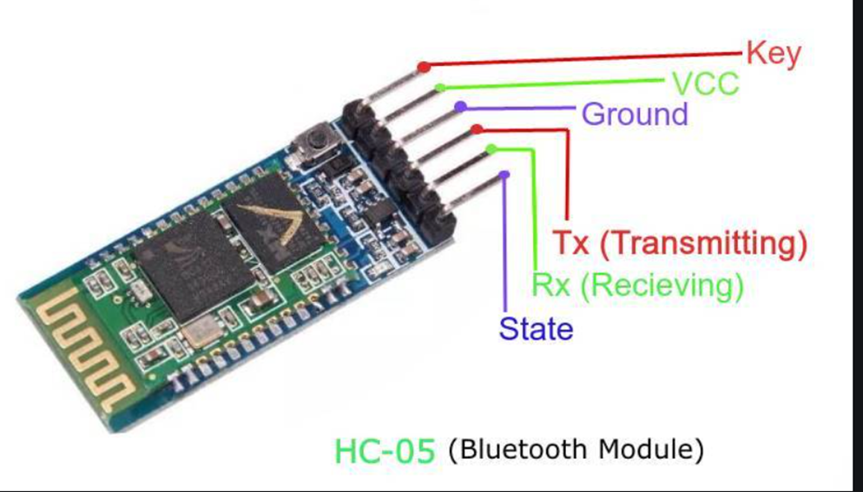
BLUETOOTH MODULE (HC-05)
Bluetooth module (Bluetooth module) refers to the basic circuit set of the chip with integrated Bluetooth function, used for short-range 2.4G wireless communication module. For the end user, the Bluetooth module is a semi-finished product.

Slide 11
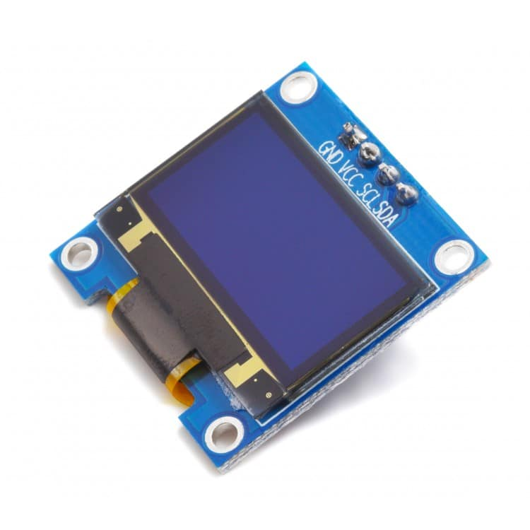
OLED
OLEDs are used to create digital displays in devices such as television screens, computer monitors, and portable systems such as smartphones and handheld game consoles. A major area of research is the development of white OLED devices for use in solid-state lighting applications.
Some other advantages are:
1-Superior viewing angle.
2-High brightness and contrast.
3-Fast response time.

Slide 12
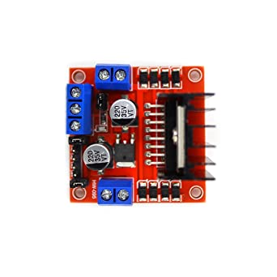
Mortor Driver
The Raspberry Pi Motor Driver Board gives your Pi the ability to drive two DC motors or one stepper motor.We use motor drivers to give high power to the motor by using a small voltage signal from a microcontroller or a control system.

Slide 13
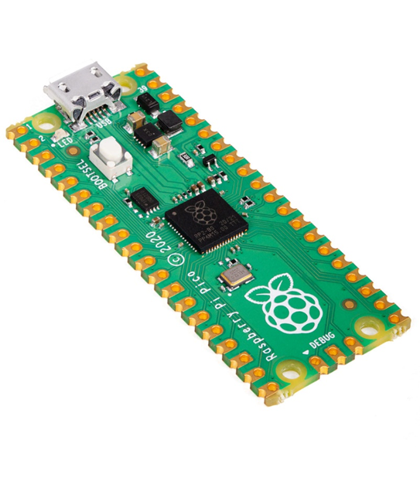
Raspberry pi pico
The Advantages & Disadvantages of Raspberry Pi is that it may be a low cost, credit-card sized computer i.e.; capable of little device which enable people to explore computing, and to find out the way to program in languages like Scratch and Python.

Slide 14
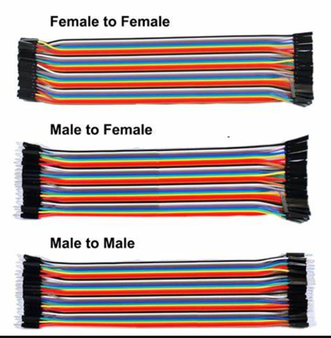
Jumper wire
A jump wire is an electrical wire, or group of them in a cable, with a connector or pin at each end (or sometimes without them – simply "tinned"), which is normally used to interconnect the components of a breadboard or other prototype or test circuit, internally or with other equipment or components, without soldering.

Slide 15
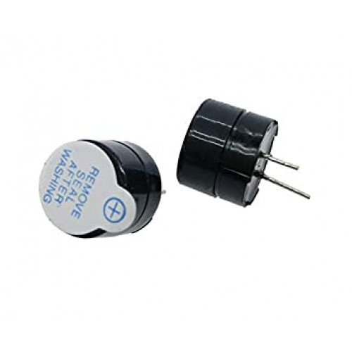
Buzzer
A buzzer or beeper is an audio signaling device, which may be mechanical, electromechanical.It generates audible sound due to potential differences between source and sinks in the circuit. The buzzing or beeping sound is created by vibrations developed in the diaphragm of the device when the circuit is complete.

Slide 16
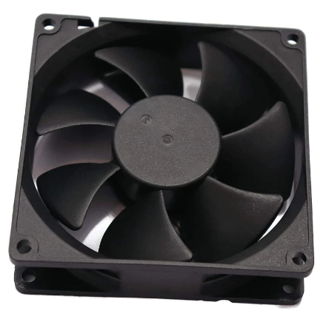
Cpu fan
It is a high performance ball bearing axial fan,It is a low cost effective cooling fan solution without sacrificing quality or relaibility.

Slide 17
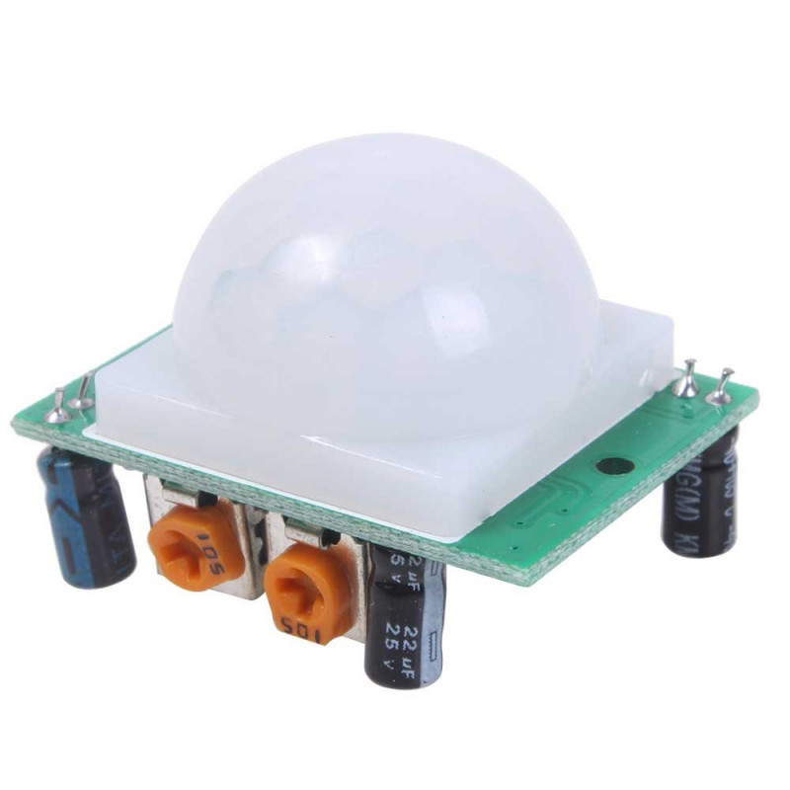
Pir sensor
PIR sensors are used in thermal sensing applications, such as security and motion detection.PIR sensors can detect human or animal motion. Humans emit infrared radiation. When a human comes into the sensing range of the PIR sensor, these changes in radiations are detected by the PIR sensor which causes the output of the sensor to go high.

Slide 18
Conclusion
Home Automation is undeniably a resource which can make a home environment automated. People can control their electrical devices via these Home Automation devices and set up controlling actions through Mobile. In future this product may have high potential for marketing.

Slide 19
References
1. Research Paper(Journal, conference etc)
2.https://create.arduino.cc/projecthub/
3.https://www.flyrobo.in/blog/
4.https://www.gadgetronicx.com
5. www.arduino.cc
6. www.allaboutcircuits.com

Slide 20


Slide 21


