Slide 1

Shark Attack EDA
Isabella Sturm

Slide 2
Variable Selection
Year: The year the attack occurred
Have attacks increased over time – may be hard to determine because of increase in traceability over time
Type: The type of attack (Provoked, Unprovoked, etc)
Are more shark attacks provoked or unprovoked
Gender: Whether the victim was male (0) or Female (1)
Are most victims male or female? Are you more likely to be attacked
Fatal: Whether or not the attack was Fatal
If you are a victim of a shark attack, is it likely to be fatal?
Age: Age of the victim
How does age affect fatality

Slide 3
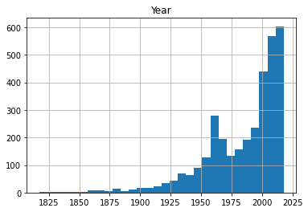
Year Histogram

Slide 4
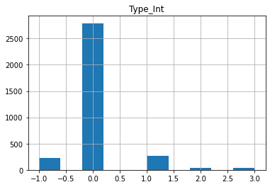
Type Histogram

Slide 5
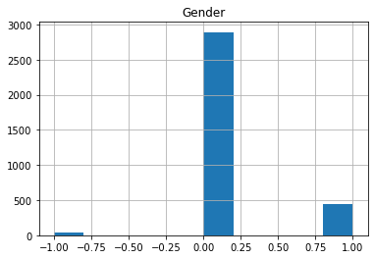
Gender Histogram

Slide 6
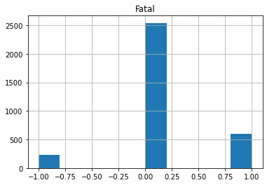
Fatal Histogram

Slide 7
Age Histogram
N\A – I had trouble getting rid of any string ages (non-numeric, non-real)

Slide 8
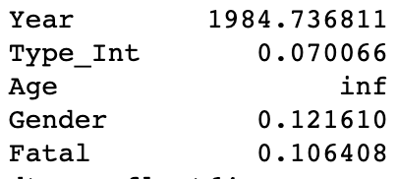
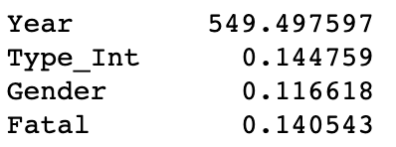
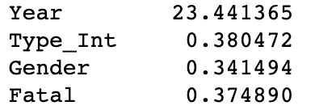
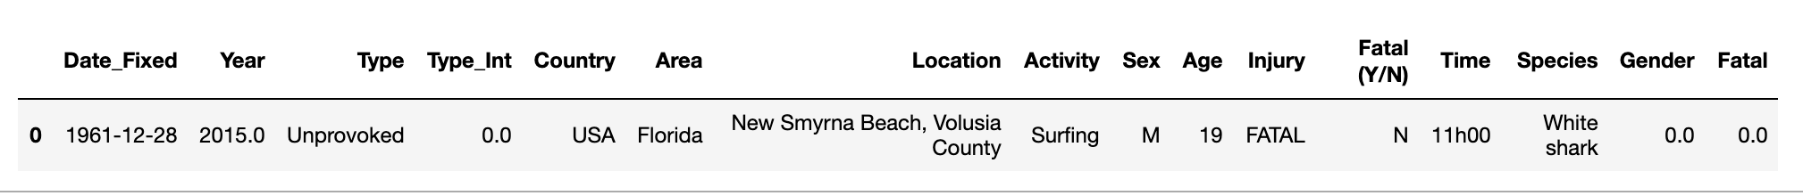
Descriptive Characteristics
MEAN
VARIANCE
STANDARD DEVIATION
MODE

Slide 9
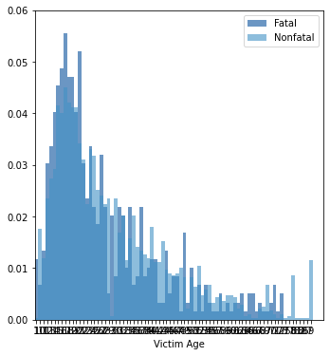
PMF
PMF for Victim Ages – Comparing Fatal and Nonfatal Shark Attacks

Slide 10
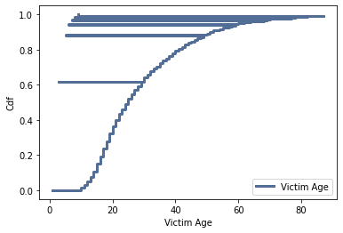
CDF of Victim Age
Given this CDF, the victims of more than 50% of shark attacks are under 40. The majority of victims are between 10 and 40.

Slide 11
Analytical Distribution
N\A
Unable to Analyze Victim Age because of issue with filtering out the string data

Slide 12
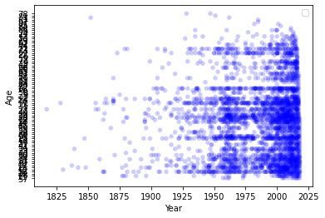
Age of Victim vs Year of Attack
There is no real trend of the age of the victim over time. The most dense areas are after 1950 most likely due to increase of shark attack tracking data

Slide 13
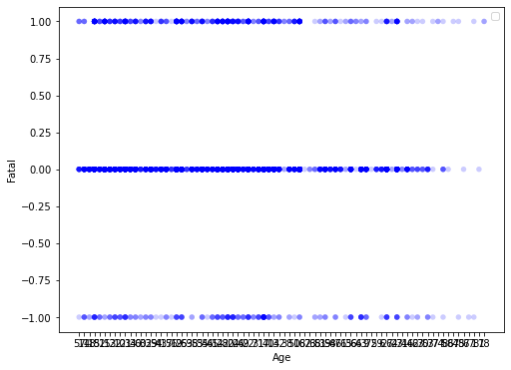
Fatality of Attack vs Age of Victim
Most shark attacks seem to be nonfatal, regardless of age. However, it appears as you get older you are less likely to be part of shark attack and for it to be fatal.
This is likely not because as you get older you are stronger against shark attacks but rather you are less likely to be participating in activities that put you at risk for being attacked by a shark

Slide 14
Hypothesis Test
The plan was to test how age affects fatality but because I couldn’t rid the dataset of string ages, I couldn’t perform this test

Slide 15
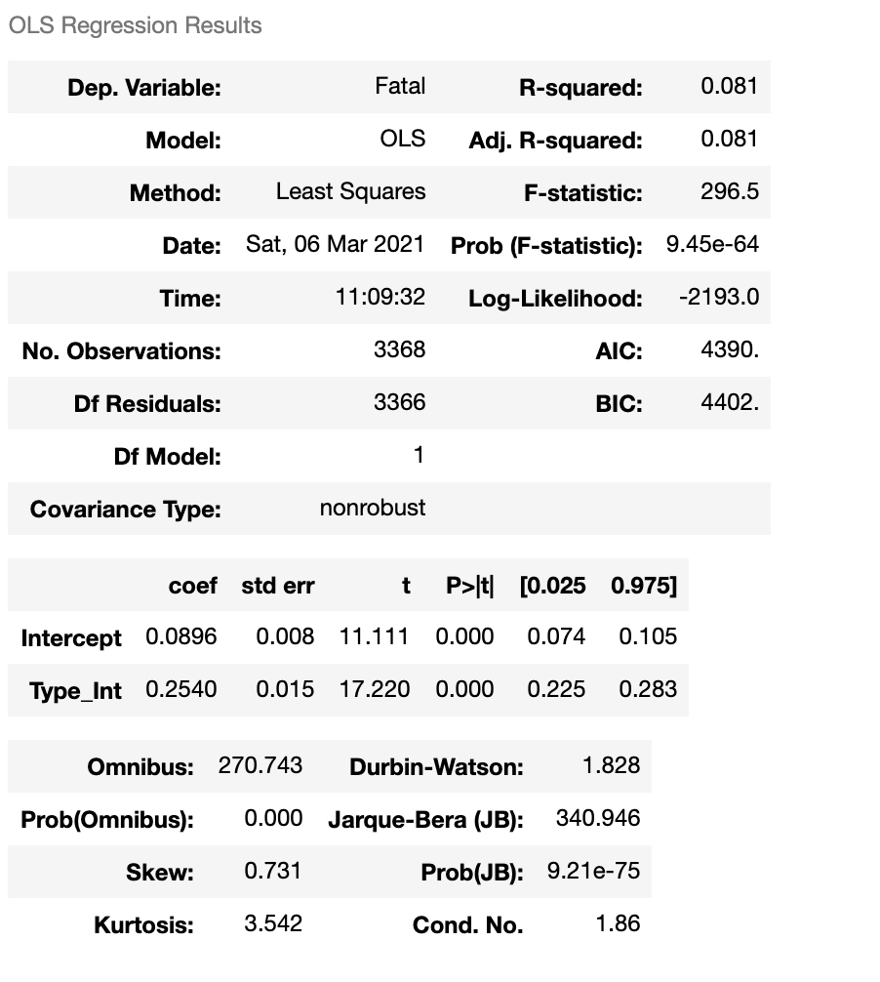
Regression Analysis
(Slope, Intercept) =
(0.08960975377217839, 0.2539845961827145)
R-squared = 0.08095882045837977
The results of the analysis show that the
Regression shows that only about 8% of the
data fit the model, which looked at
Fatality vs the Type of Attack

