Slide 1

Heart Attack Analysis
Isabella Sturm dsc 680

Slide 2
Business Problem
Heart Disease
Leading cause of death
Kills ~ 700,000 / year
Heart Attacks
Form of heart disease
Affects ~ 805,000 / year
Early detection can reduce damage to heart and save lives

Slide 3
Data
Dataset from IEEE.org
Combination of five heart disease datasets: Cleveland, Hungarian, Switzerland, Long Beach VA and Statlog (Heart) dataset
1190 rows (1180 without outliers)
11 features
Age of patient
Sex of patient
Chest pain type
Resting Blood Pressure (mm Hg)
Cholesterol
Fasting blood sugar
Resting ECG results
Max heart rate
Exercise angina
Old peak – ST Depression
ST Slope
Target

Slide 4
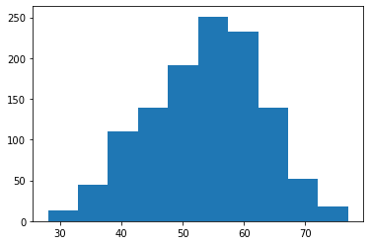
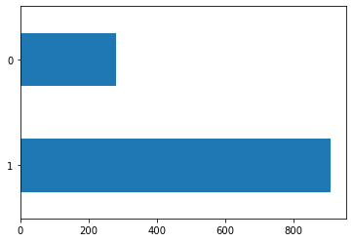
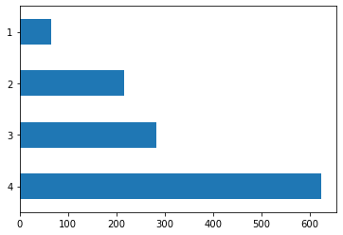
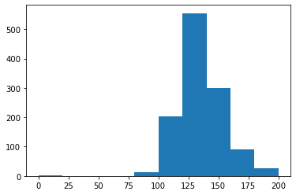
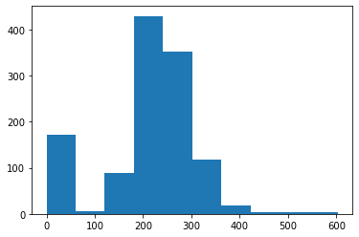
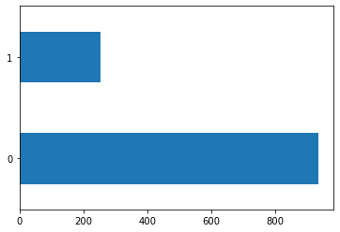
Exploratory Analysis - Features
Figure 1 Histogram of Age Feature
Figure 2 Bar Chart of Sex Feature
Figure 3 Bar Chart of Chest Pain Type
Figure 4 Histogram of Resting Blood Pressure Feature
Figure 5 Histogram of Cholesterol Feature
Figure 6 Bar Chart of Fasting Blood Sugar Feature

Slide 5
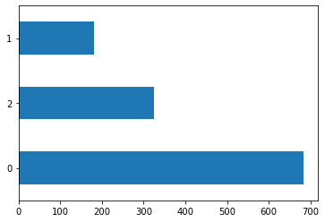
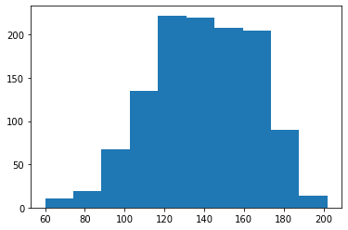
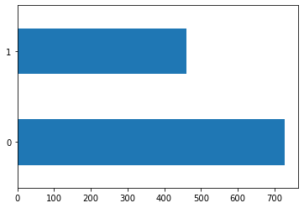
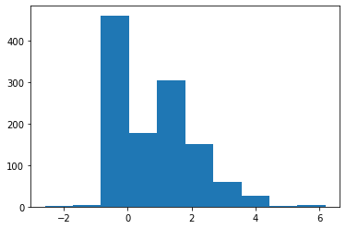
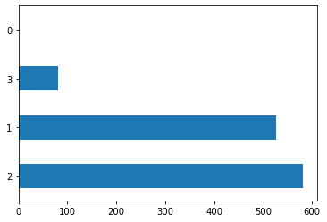
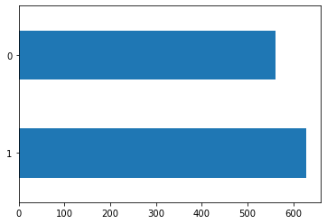
Exploratory Analysis - Features
Figure 7 Bar Chart of Resting ECG Feature
Figure 8 Histogram of Max Heart Rate Feature
Figure 9 Bar Chart of Exercise Angina Feature
Figure 10 Histogram of Old Peak Feature
Figure 11 Bar Chart of ST Slope Feature
Figure 12 Bar Chart of the Target

Slide 6
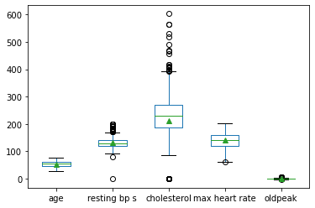
Exploratory Analysis – Finding Outliers

Slide 7
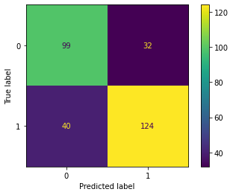
Model Analysis – K-Neighbors Classifier 75.593%

Slide 8
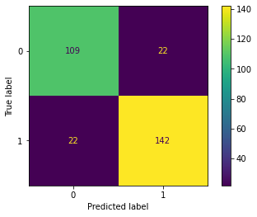
Model Analysis – Logistic Regression Classifier 85.085%

Slide 9
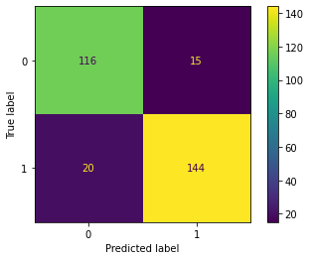
Model Analysis – Decision Tree Classifier 88.136%

Slide 10
Model Analysis – Random Forest Classifier 93.220%

Slide 11
Conclusion/Implementation
A Random Forest Classifier model would be deployed to predict if a person will have a heart attack with 93% accuracy
Would allow for early detection and early intervention for identifying and treating or possible preventing heart attacks

