Slide 1
6.878 Project Presentation Iris Xu, Dalesh S D
Motivation.
Data Preprocessing.
Alignment.
Clustering.
Visualization & Annotation.
Enrichment
Next Steps.

Slide 2
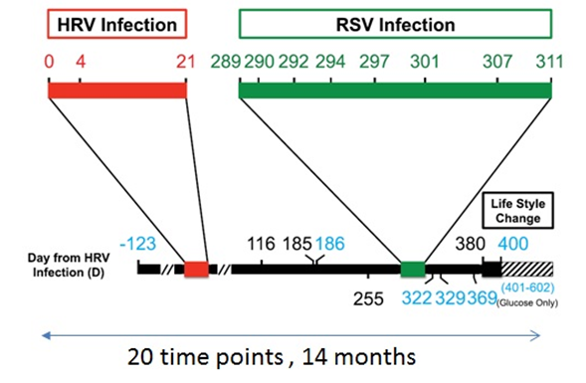
Motivation :
What has changed over time? How is it related to health?

Slide 3
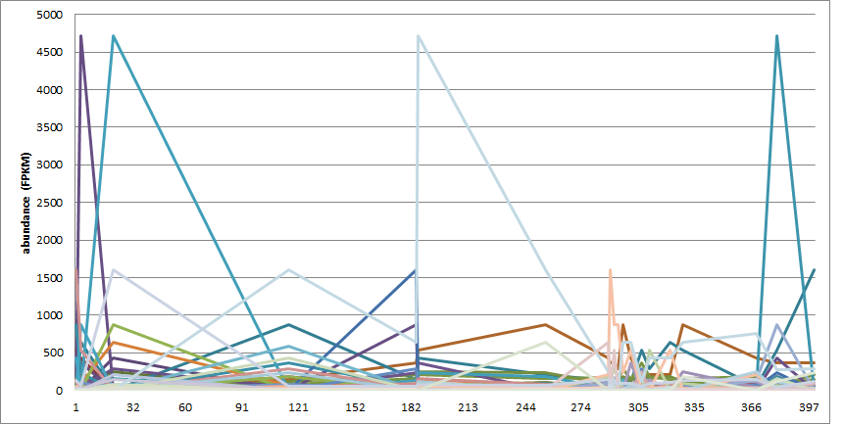
Preprocessing :
1. Primary Dataset : GSE33029 : "Integrated analysis of omics proles"
RNA-seq output from TopHat : .BAM files (120 GB)
TopHat
Cufflinks
Filtering,
Normalization
Additional expression time course Datasets :
2. GSE19392 "Dynamic responses of primary human bronchial epithelial cells to inuenza virus, viral RNA and interferon-beta“
3. GSE675 Time course analysis of response to HCMV infection

Slide 4
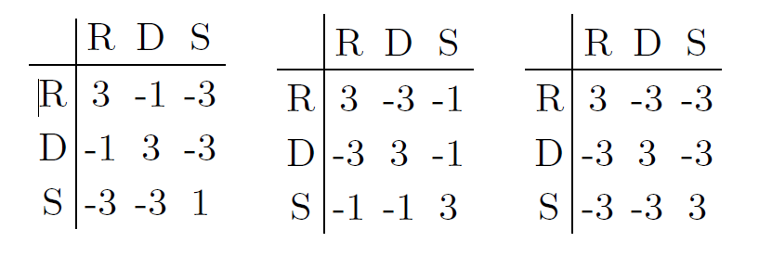
Alignment :
Convert to symbolic sequence:
‘R’ : Rise
‘S’ : Steady
‘D’ : Drop
'SDDRDRSSDSRRSDRRDSSR'
* Scoring matrices we tried.
* Time aware gap penalties.
Output:
Distance matrix between series
Needleman-Wunsch (dynamic programming)

Slide 5
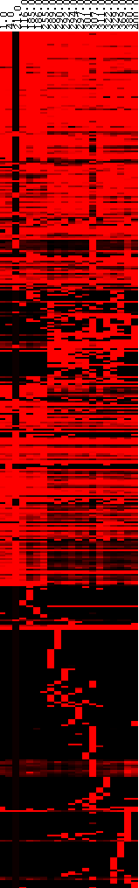
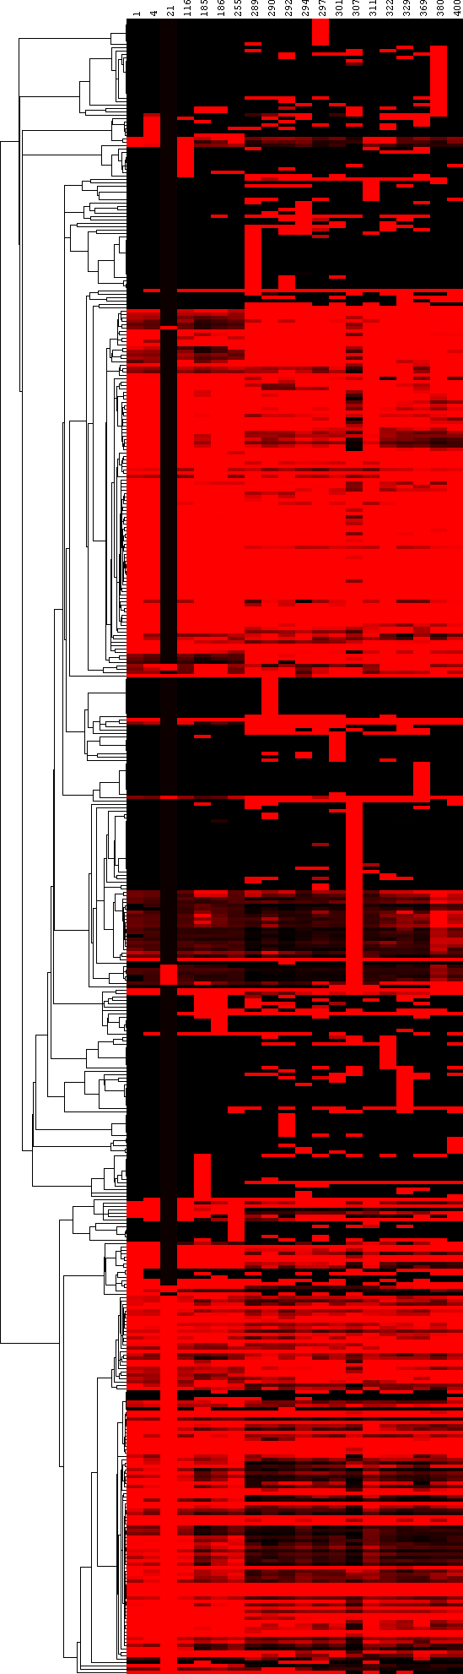
Clustering:
Aligned Affinity & Agglomerative
UPGMA
Input:
Distance Matrix
Clustering techniques:
Unsupervised: Agglomerative
Affinity Propagation
Output:
Clusters

Slide 6
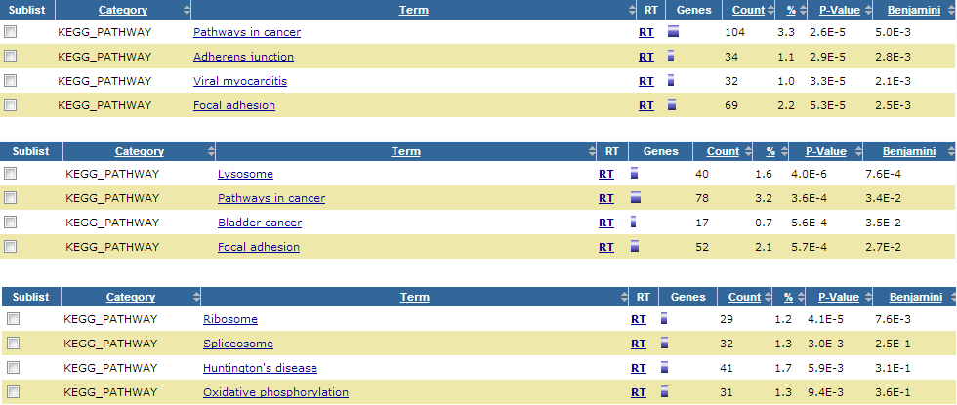
Enrichment :
Approaches :
1. Fischer's Exact test for Gene Ontology annotations.
2. We ran the gene list generated by our clusters through DAVID functional annotation tool.
GSE33029 :
No significant enriched pathways or terms when corrected for multiple hypothesis testing.
GSE19392 , GSE675:
We see enriched pathways and terms on David.

Slide 7
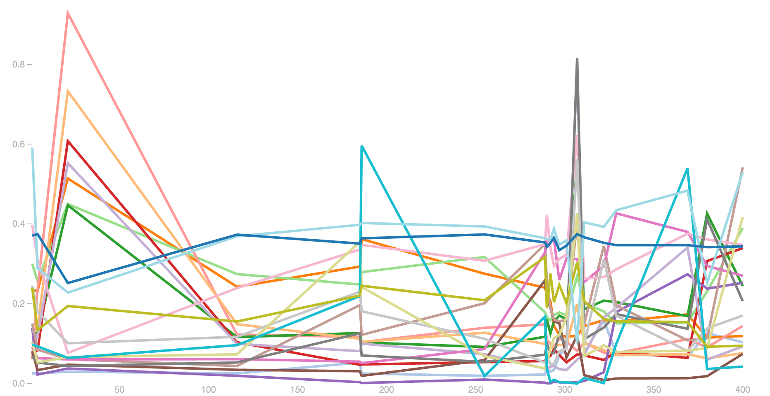
Visualization:
Demo.

Slide 8
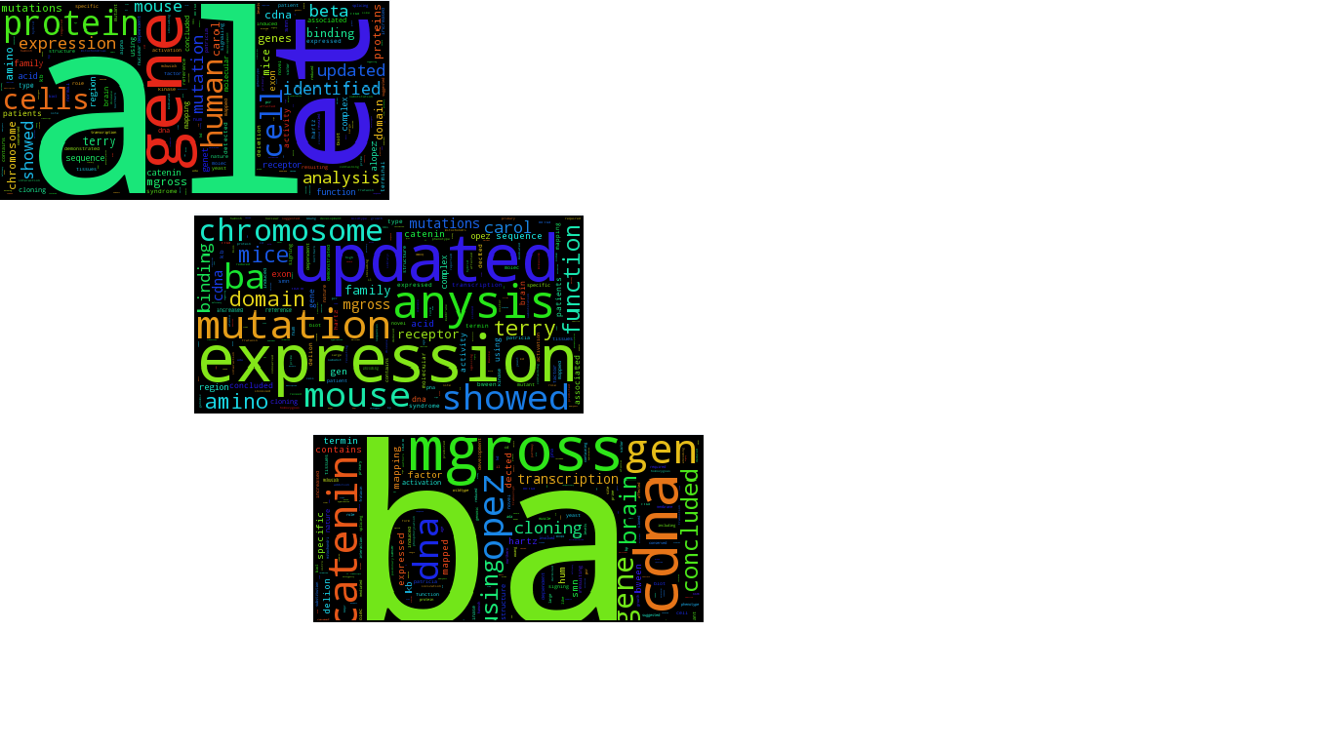
Annotation/Enrichment:
Annotation:
DAVID webservice
OMIM offline knowledgebase
Enrichment:
Fischer’s Exact test (genes annotated given Gene Ontology)

Slide 9
Next Steps:
Redo enrichment analysis
Redo noise correction and analyze root cause of the missing enrichment results for GSE33029 .
Future
Integration with SMART Genomics/GEO-compatible
With thanks to
Gerald Quon
Max Wolf
Manolis Kellis

