Slide 1
6.872 Project Presentation Iris Xu, Dalesh S D
Motivation.
Data Preprocessing.
Alignment.
Clustering.
Visualization & Annotation.
Enrichment
Next Steps.

Slide 2
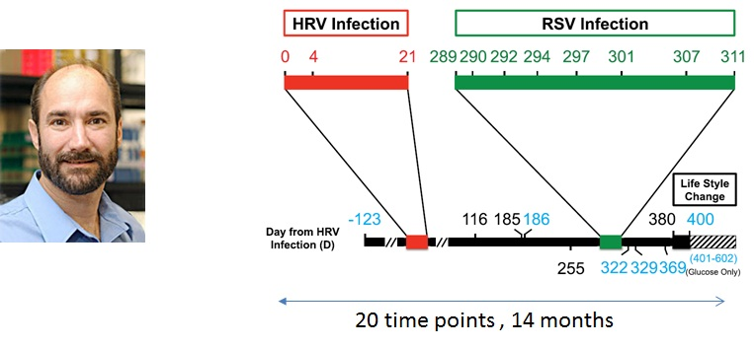
Motivation :
What has changed over time? How is it related to health?

Slide 3
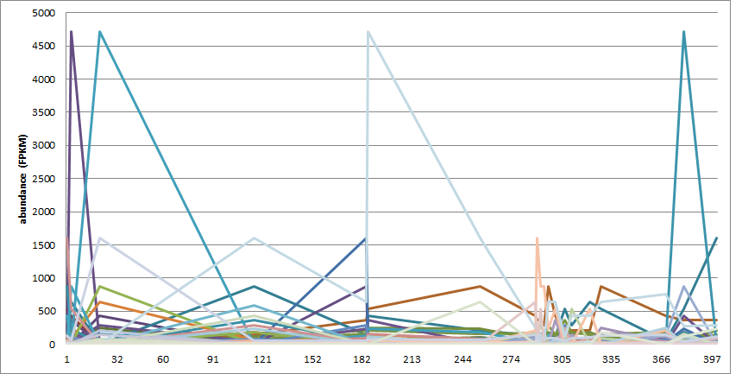
Preprocessing :
Input:
RNA-seq output from TopHat : .BAM files (120 GB)
TopHat
Cufflinks
Filtering,
Normalization

Slide 4
Alignment :
Convert to symbolic sequence:
‘R’ : Rise
‘S’ : Steady
‘D’ : Drop
'SDDRDRSSDSRRSDRRDSSR'
Output:
Distance matrix between series
Needleman-Wunsch (dynamic programming)

Slide 5
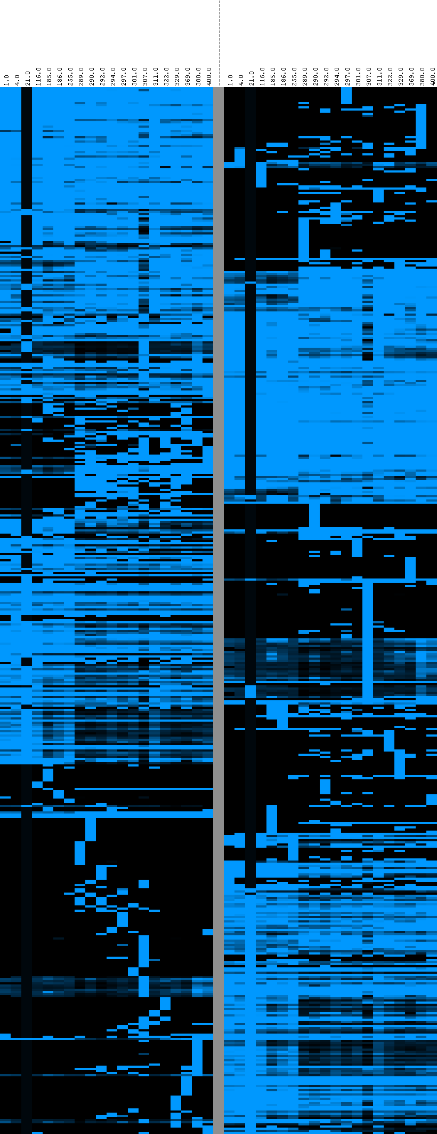
Clustering:
Aligned
Non-aligned
Input:
Distance Matrix
Clustering techniques:
Unsupervised: Agglomerative
Affinity Propagation
Output:
Clusters

Slide 6
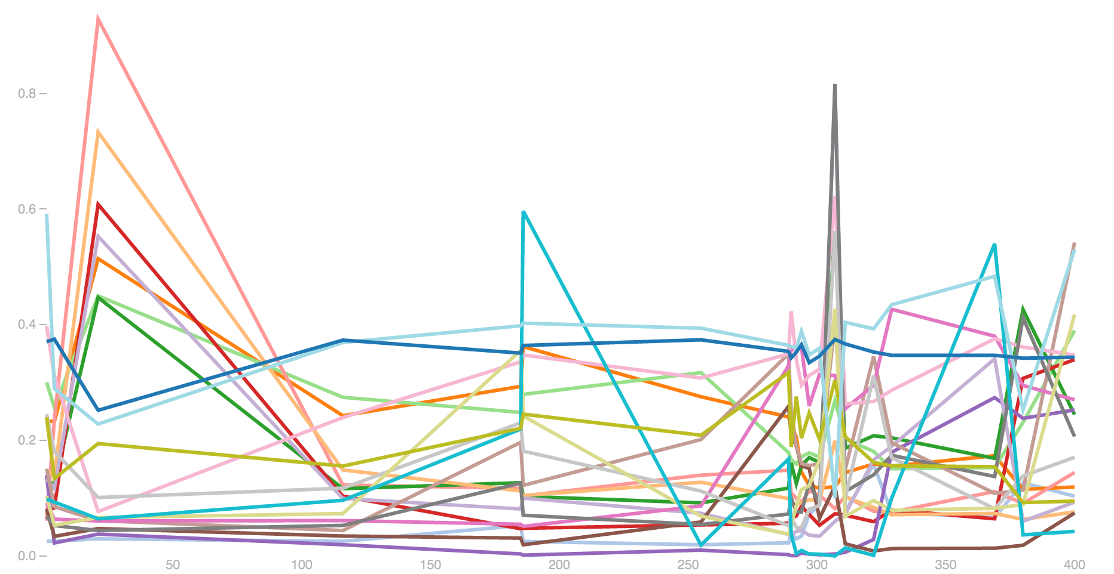
Visualization:
Demo.

Slide 7
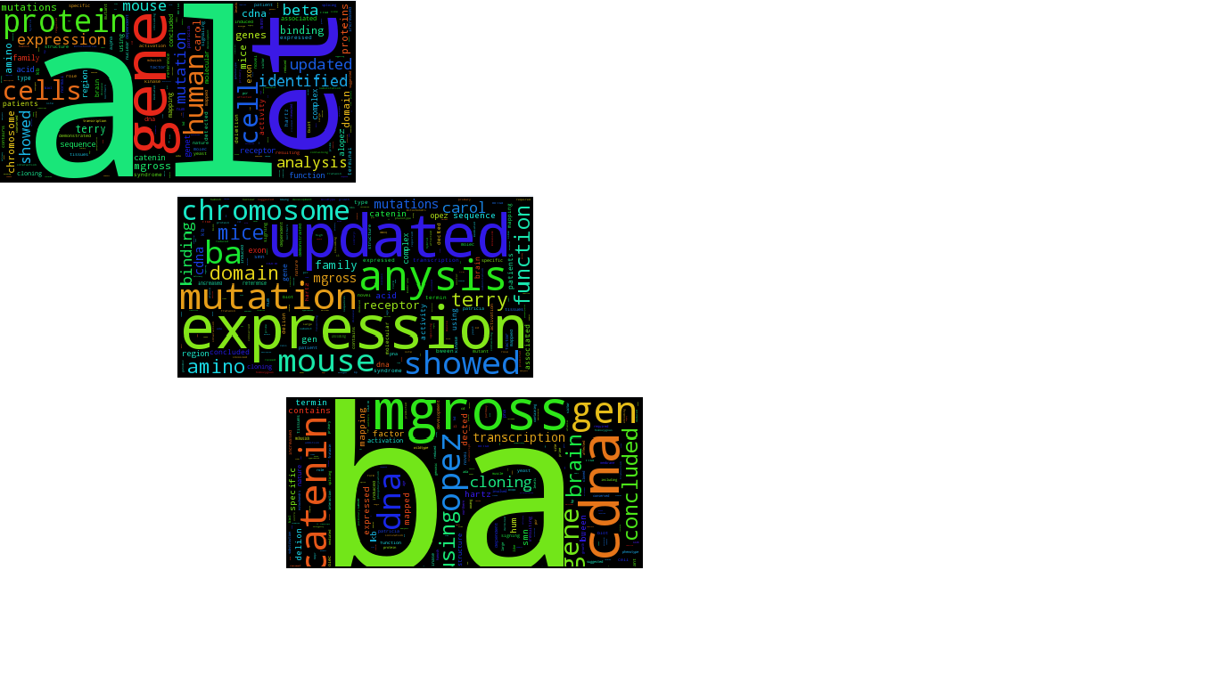
Annotation/Enrichment:
Annotation:
DAVID webservice
OMIM offline knowledgebase
Enrichment:
Fischer’s Exact test (genes annotated given Gene Ontology)

Slide 8
Next Steps:
Redo enrichment analysis
Redo noise correction/use alternative dataset
Future
Integration with SMART Genomics/GEO-compatible
With thanks to
Peter Szolovits
Gil Alterovitz
Gerald Quon

