Slide 1
Realized by:
BRACCHI Pierre
KABA Saran
KANDE Desse
PULLICINO Perrine
SIROUKANE Slimane
YUGANSAN Yogaratnam
Software Engineering
Project
Presentation (1)
GitHub :
https://github.com/kabasaran/Favorite_Places_Management

Slide 2



An App to share your favorite places !
This app will allow you to keep track of your favorite places and your upcoming events while sharing all of that with your friends !

Slide 3
System Definition
Mark a place down as one of your favourites in the world.
Plan your upcoming events.
Share your maps with your friends or make it available publicly.
Manage multiple maps, and combine them.
Add your own photos of the events and places you go to.
Find the shortest way to go where you want to go !

Slide 4





User permissions
There is only one type of user in this app : The regular one.
He is able to create, edit, manage and share maps.
On them, he can organize events, place points of interest and check what others have
decided to share.
He has the possibility to publish photos and messages, and to befriend others.

Slide 5
Business Objects : recap
The business objects would be :
The Users themselves.
The Places of interest a user can pinpoint.
The Events the users can schedule.
The Maps a user will create and manage.
The messages and pictures a user can send.

Slide 6
Business Objects : Diagram

Slide 7
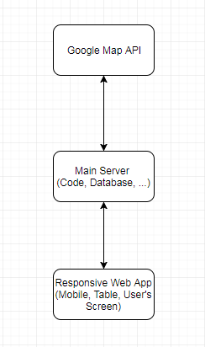
Technical Proposition
We have three main subsystems coexisting in our app :
The main server, holding the main database, and running the code.
The Google Map API, called to display the map to the user.
The user’s own screen, on which we will render said map.

Slide 8
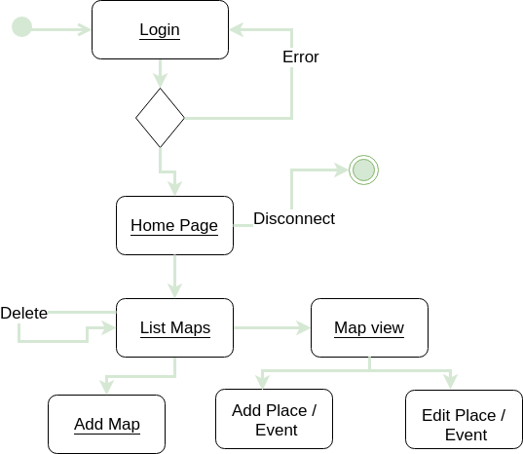
Navigation Diagram

Slide 9
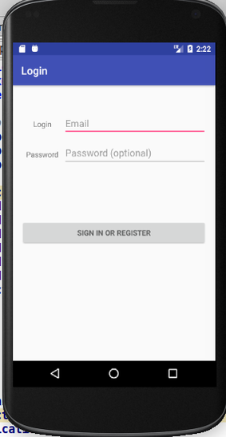
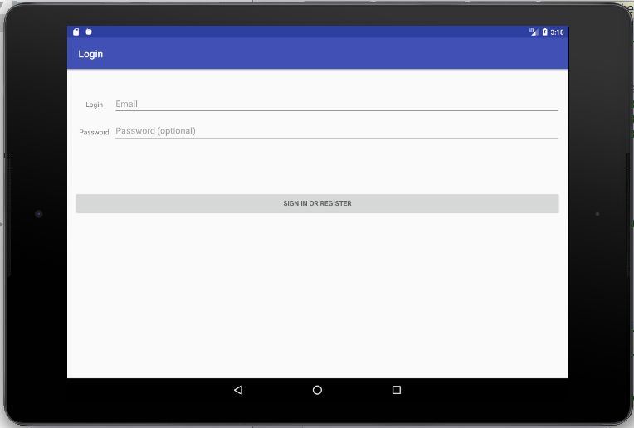
Mock-up : Sign IN (Tablet)
You need to be connected in order to access the app.

Slide 10
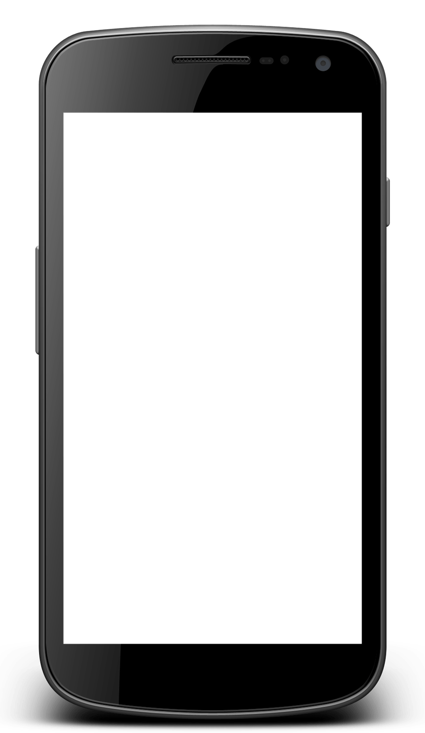

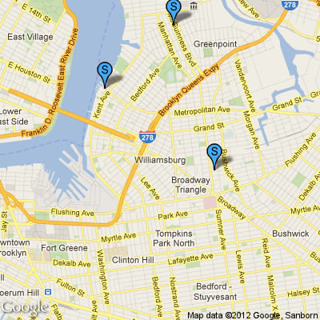


Mock-up : Homepage (mobile)
Azezzzerzerzerzefdf
erty
paris7
This would be your home page.
The idea is that as soon as you arrive on the homepage,
you can see the relevant information you might need.
In this case, it would be streets around you and thus
the potential interest points you or other people could have marked down.
You can then access any menu you would need from this page.

Slide 11
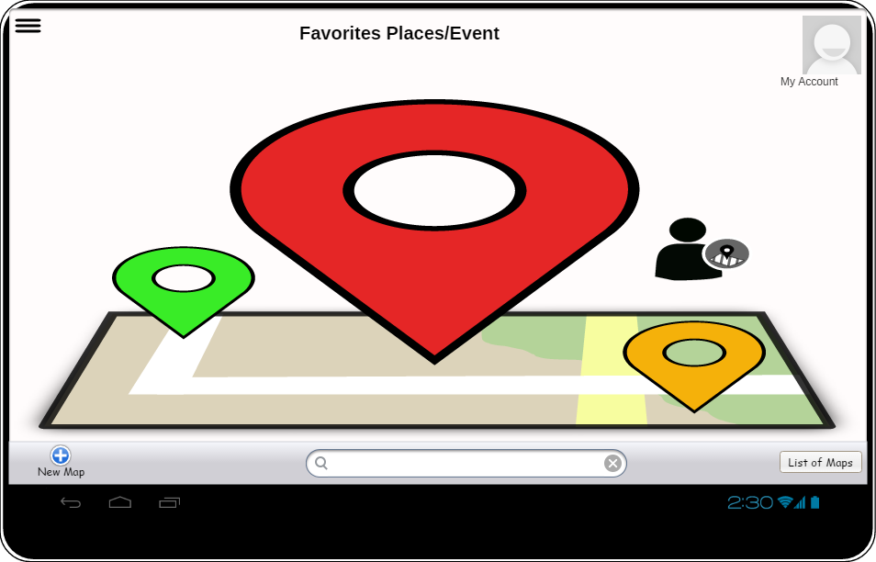
Mock-up : Homepage (Tablet)
Azezzzerzerzerzefdf
erty
paris7
This is mainly the same idea as the previous mock-up, but the interface would have to be revamped to better fit a tablet.

Slide 12

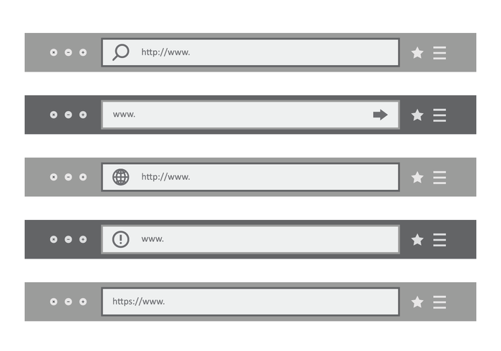
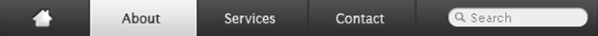
Mock-up : Homepage (Web browser)
Map
Place/event
user

Slide 13






Mock-up : Popu-up menu
This would be the main way of using our application :
Clicking on the cross sign would open a pop-up menu that would allow the user to select (à la Waze) what he wants to do with the app.
This seems to us to be the best way to provide maximum efficiency for the user.
Settings and profile
Consult map
Add map
Add event
Add place

Slide 14
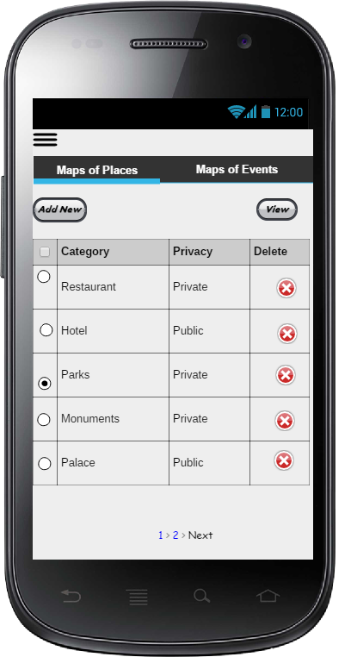
Mock-up : Map List (mobile)
This would act both as a Map List and a Map edit.
You would select the maps you want to activate on the general plan,
You could delete the ones you no longer want,
And you could change the visibility of said maps with a single click.

Slide 15
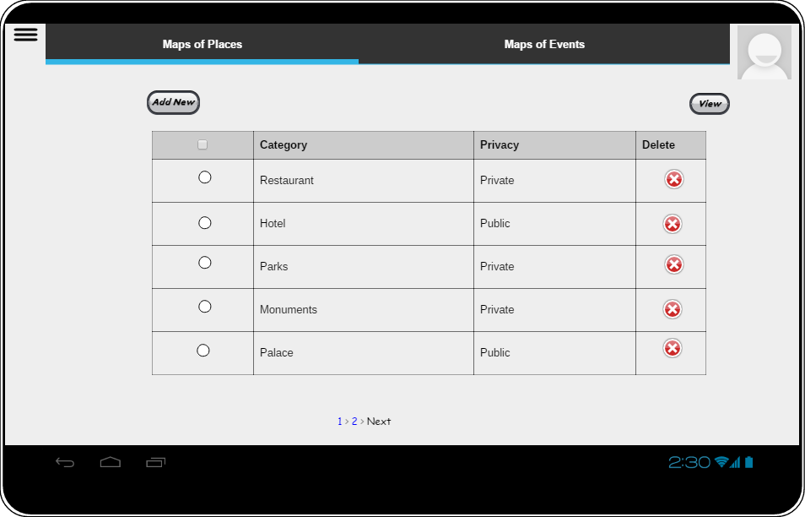
Mock-up : Map List (tablet)
This is mainly the same idea as the previous mock-up, but the interface would have to be revamped to better fit a tablet.

Slide 16
Backlog
To do | Priority | Difficulty
Manage place, events : Add, delete or edit them. | 5 | 3
Manage multiple maps : Add, delete, edit, share them. | 4 | 4-5
Filter by category : You can select a category to display on your map. | 4 | 5
Login/Logout protocol. | 3 | 2
Friendlist :Add a friend, delete a friend, share with them. | 3 | 1
Pictures : Add, delete, comment, share. | 3 | 3
Messages/Comments : Add, delete, edit, share. | 3 | 3
Pathfinding : Find the shortest path between two points. | 2 | 2
Search for a map (from friend or a public one) | 2 | 2
Search for a place (by name or by coordinates) | 2 | 2
Notes:
16

Slide 17
Web Services
Type | URL | Behavior
GET | /List_Map | Returns a list of maps
GET | /List_Map/{id_map} | Returns all the properties of a map
PUT | /List_Map/add | Add a new map
POST | /list_map/map_view/edit/{id_place} | Edit the infos of a place or an event
PUT | /list_map/map_view/add | Add a new place or event
DELETE | /list_map/delete/{id_map} | Delete a map
DELETE | /list_map/map_view/delete/{id_place} | Delete a place or an event
GET | /List_Map/map_view/{id_place} | Returns all the properties of a place or an event
Notes:
17

