Slide 1

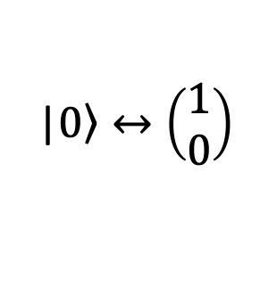



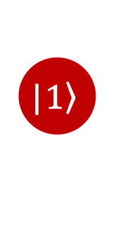
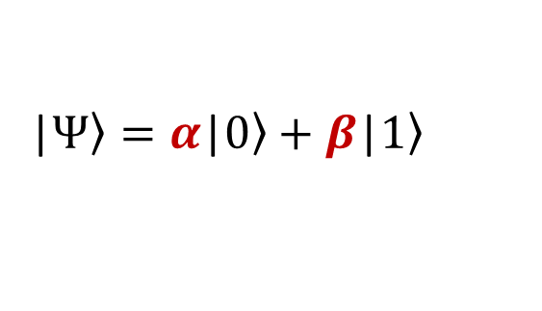
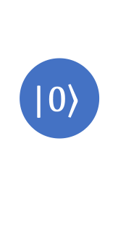
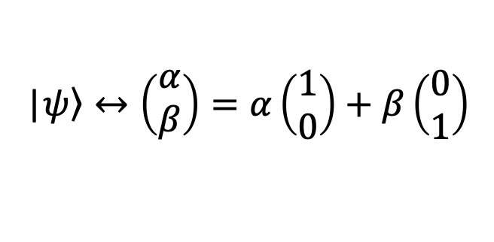





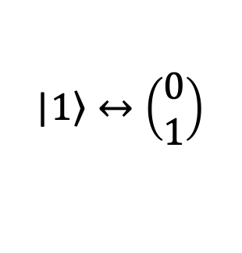



Qubit
Measurement
Superposition
Definition
|$\left.Ψ\right\rangle =α\text{|}\left.0\right\rangle +β\text{|}\left.1\right\rangle$
$${\left|α\right|}^{2}$$
$${\left|β\right|}^{2}$$
$$\text{|}\left.1\right\rangle$$
Complex numbers
$$\text{|}\left.0\right\rangle$$
Born rule
Geometric interpretation
$${P\left(0\right)+P\left(1\right)=\left|α\right|}^{2}+{\left|β\right|}^{2}=1$$
$$α=x+iy$$
$$y$$
$$α$$
Vector form
$$r$$
$$r∈ℝ$$
$\text{|}\left.0\right\rangle ↔\left(\begin{matrix}1 \\ 0\end{matrix}\right)$
$\text{|}\left.1\right\rangle ↔\left(\begin{matrix}0 \\ 1\end{matrix}\right)$
$$θ$$
$$0$$
$$x$$
$$\text{|}\left.ψ\right\rangle ↔\left(\begin{matrix}α \\ β\end{matrix}\right)=α\left(\begin{matrix}1 \\ 0\end{matrix}\right)+β\left(\begin{matrix}0 \\ 1\end{matrix}\right)$$
$${\left|α\right|}^{2}=x^{2}+y^{2}=r$$

Slide 2

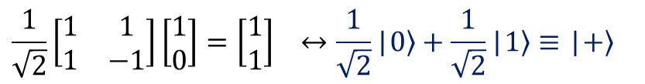
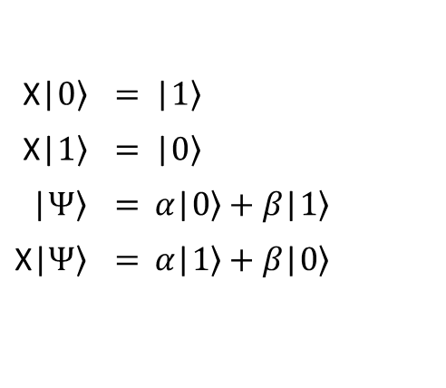

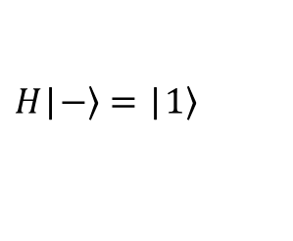
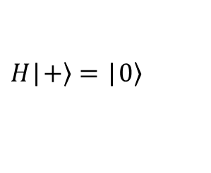
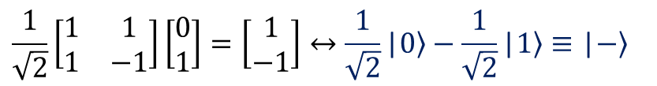
Some operations for qubit state
Hadamard operator (H)
$$H=\left[\begin{matrix}1 & 1 \\ 1 & −1\end{matrix}\right]$$
Relative phase
NOT operator (X)
$$\frac{1}{\sqrt{2}}\left[\begin{matrix}1 & 1 \\ 1 & −1\end{matrix}\right]\left[\begin{matrix}1 \\ 0\end{matrix}\right]=\left[\begin{matrix}1 \\ 1\end{matrix}\right] ↔\frac{1}{\sqrt{2}}\text{|}\left.0\right\rangle +\frac{1}{\sqrt{2}}\text{|}\left.1\right\rangle ≡\text{|}\left.+\right\rangle$$
$$X=\left[\begin{matrix}0 & 1 \\ 1 & 0\end{matrix}\right]$$
$$\text{X}\text{|}\left.0\right\rangle$$ | $$\text{=}$$ | $$\text{|}\left.1\right\rangle$$
$$\text{X}\text{|}\left.1\right\rangle$$ | $$\text{=}$$ | $$\text{|}\left.0\right\rangle$$
|$\left.Ψ\right\rangle$ | $$\text{=}$$ | $$α\text{|}\left.0\right\rangle +β\text{|}\left.1\right\rangle$$
X|$\left.Ψ\right\rangle$ | $$\text{=}$$ | $$α\text{|}\left.1\right\rangle +β\text{|}\left.0\right\rangle$$
$$\frac{1}{\sqrt{2}}\left[\begin{matrix}1 & 1 \\ 1 & −1\end{matrix}\right]\left[\begin{matrix}0 \\ 1\end{matrix}\right]=\left[\begin{matrix}1 \\ −1\end{matrix}\right]↔\frac{1}{\sqrt{2}}\text{|}\left.0\right\rangle −\frac{1}{\sqrt{2}}\text{|}\left.1\right\rangle ≡\text{|}\left.−\right\rangle$$
$$H\text{|}\left.+\right\rangle =\text{|}\left.0\right\rangle$$
Relative phase plays a crucial role!
$$H\text{|}\left.−\right\rangle =\text{|}\left.1\right\rangle$$

Slide 3
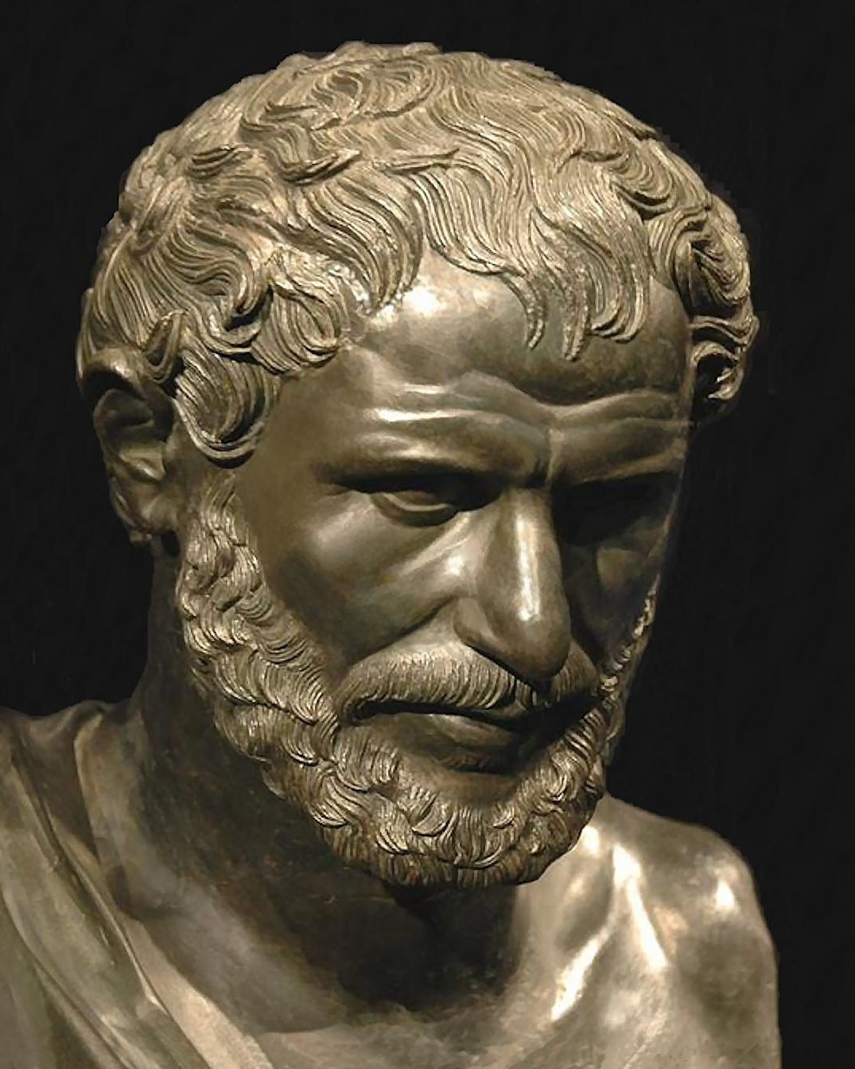
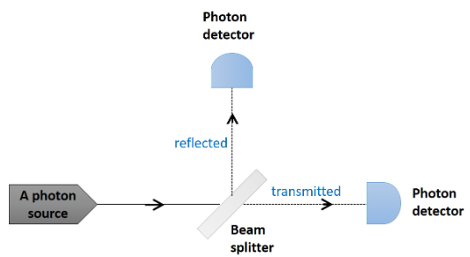




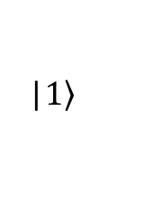
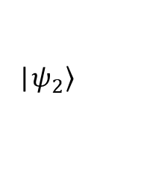
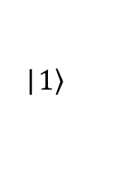
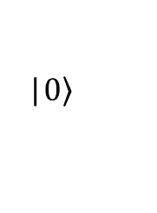
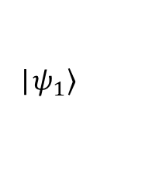
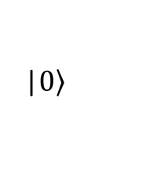
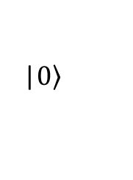




A physical example for H operator
Some philosophy:
$${\left|α\right|}^{2}$$
$$\sim 50\%$$
Light can be reflected and transmitted.
A photon is a light particle; the above rule apply to it as well.
How does a photon ‘decide’ whether to pass through glass or to be reflected? – It doesn’t.
Determinism: Wouldn’t experiments with the same conditions always give the same results? – Nope, sorry Heraclitus :/
$$\text{|}\left.1\right\rangle$$
$$\sim 50\%$$
$${\left|β\right|}^{2}$$
$$\text{|}\left.0\right\rangle$$
$$\text{|}\left.0\right\rangle$$
A retreat! But it doesn’t mean that we cannot do science anymore!
Initial state |$\left.ψ_{1}\right\rangle$ | : | $$\text{|}\left.0\right\rangle$$
State after BS |$\left.ψ_{2}\right\rangle$ | : | $$\frac{1}{\sqrt{2}}\text{|}\left.0\right\rangle +\frac{1}{\sqrt{2}}\text{|}\left.1\right\rangle$$
State after measurement | : | $\text{|}\left.0\right\rangle$ or $\text{|}\left.1\right\rangle$
$${\left|1/\sqrt{2}\right|}^{2}=1/2$$
$$\text{|}\left.0\right\rangle$$
H
|$\left.ψ_{1}\right\rangle$
|$\left.ψ_{2}\right\rangle$
$${\left|1/\sqrt{2}\right|}^{2}=1/2$$
$$\text{|}\left.1\right\rangle$$

Slide 4
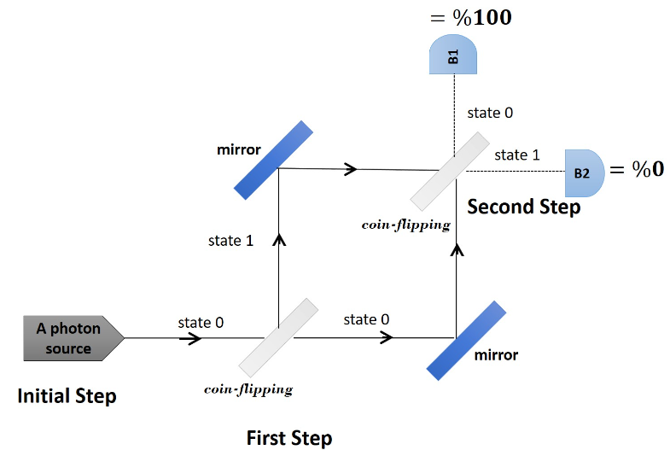

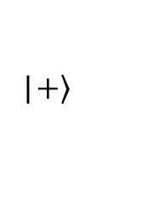
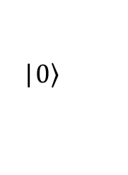
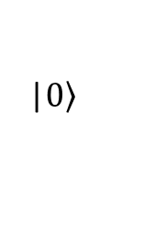
A physical example for H operator
H
H
|$\left.0\right\rangle$
|$\left.+\right\rangle$
|$\left.0\right\rangle$

Slide 5
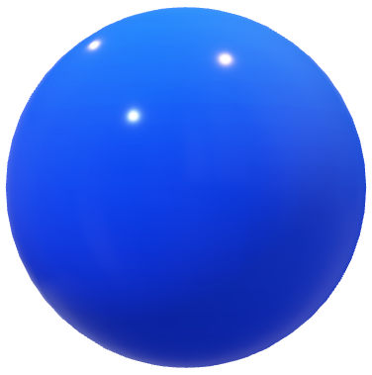
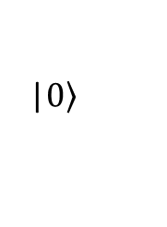
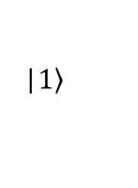
Bloch sphere
All qubit states can be represented by the points on the surface of a unit sphere.
|$\left.0\right\rangle$
R=1
|$\left.1\right\rangle$

Slide 6








Bloch sphere
Polar coordinates
|$\left.Ψ\right\rangle =α\text{|}\left.0\right\rangle +β\text{|}\left.1\right\rangle$
$$α=r_{1}e^{iφ_{1}}$$
$$α=x_{1}+iy_{1}$$
$$e^{iφ}=\cos{φ+i\sin{φ}}$$
$$β=r_{2}e^{iφ_{2}}$$
Euler’s formula
$$β=x_{2}+iy_{2}$$
$r_{1},r_{2},φ_{1}$, $φ_{2}$
: 4 real parameters!
4 real parameters!
Do we really need all these 4 parameters to define a qubit state completely?

Slide 7


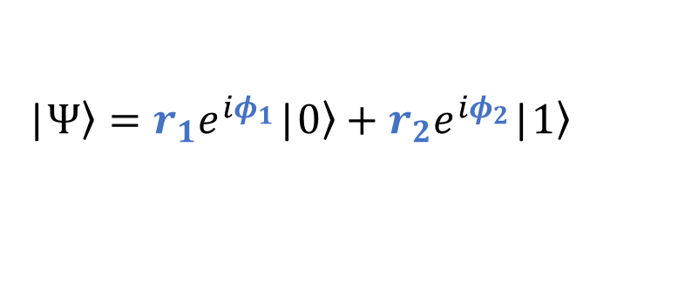

Bloch sphere
Do we really need all these 4 parameters to define a qubit state completely?
Short answer: No, we only need 2 !
|$\left.Ψ\right\rangle =r_{1}e^{iφ_{1}}\text{|}\left.0\right\rangle +r_{2}e^{iφ_{2}}\text{|}\left.1\right\rangle$
$$=e^{iφ_{1}}\left\{r_{1}\text{|}\left.0\right\rangle +r_{2}e^{i(φ_{2}−φ_{1})}\text{|}\left.1\right\rangle \right\}$$
$${\left|Ψ\right|}^{2}={\left|e^{iφ_{1}}\right|}^{2}{\left|\left\{⋯\right\}\right|}^{2}$$
Global phase has no
experimental meaning!
$$1$$

Slide 8
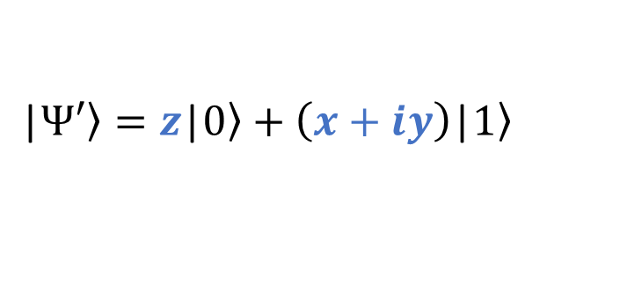
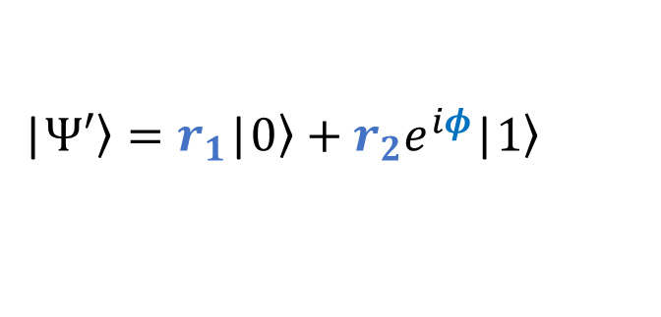
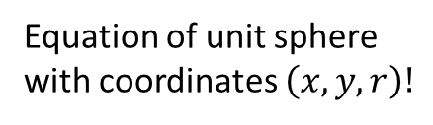

Bloch sphere
Without any loss of generality
Three real parameters!
$$\text{|}\left.Ψ′\right\rangle =r_{1}\text{|}\left.0\right\rangle +r_{2}e^{iφ}\text{|}\left.1\right\rangle$$
Back to Cartesian coordinates:
$$\text{|}\left.Ψ′\right\rangle =z\text{|}\left.0\right\rangle +\left(x+iy\right)\text{|}\left.1\right\rangle$$
Equation of unit sphere
with coordinates $\left(x,y,r\right)!$
Normalization condition:
$$x^{2}+y^{2}+z^{2}=1$$
Two real independent variables.

Slide 9













Bloch sphere
$$z$$
Spherical – Cartesian
transformation
$$x=\sin{θ}\cos{φ}$$
$$y=\sin{θ}\sin{φ}$$
$$r$$
$$z=\cos{θ}$$
$$θ$$
$$y$$
$$ϕ$$
$$\text{|}\left.Ψ′\right\rangle =z\text{|}\left.0\right\rangle +\left(x+iy\right)\text{|}\left.1\right\rangle$$
$$x$$
$$\cos{θ}$$
$$\sin{θ}\left(\cos{φ}+isin{φ}\right)$$
Unit sphere
Radius=1
Euler’s formula
$$e^{iφ}$$

Slide 10
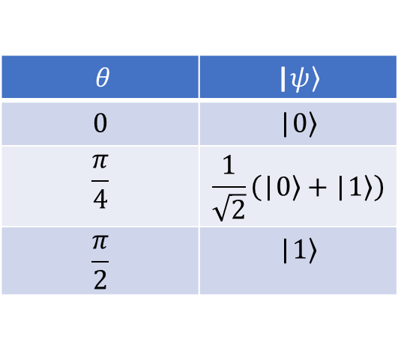
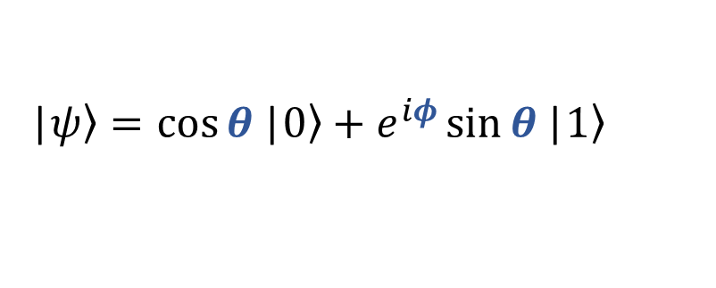
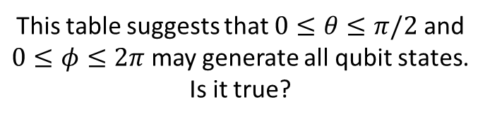
Bloch sphere
What do we have so far?
$$\text{|}\left.ψ\right\rangle =\cos{θ}\text{|}\left.0\right\rangle +e^{iφ}\sin{θ}\text{|}\left.1\right\rangle$$
$θ$ | $$\text{|}\left.ψ\right\rangle$$
$$0$$ | $$\text{|}\left.0\right\rangle$$
$$\frac{π}{4}$$ | $$\frac{1}{\sqrt{2}}\left(\text{|}\left.0\right\rangle +\text{|}\left.1\right\rangle \right)$$
$$\frac{π}{2}$$ | $$\text{|}\left.1\right\rangle$$
This table suggests that $0≤θ≤π/2$ and $0≤φ≤2π$ may generate all qubit states. Is it true?

Slide 11



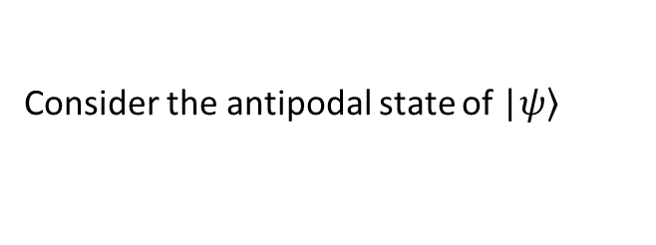



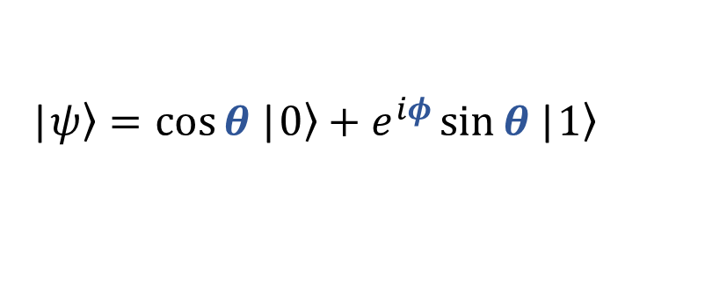

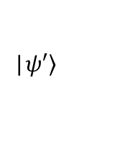
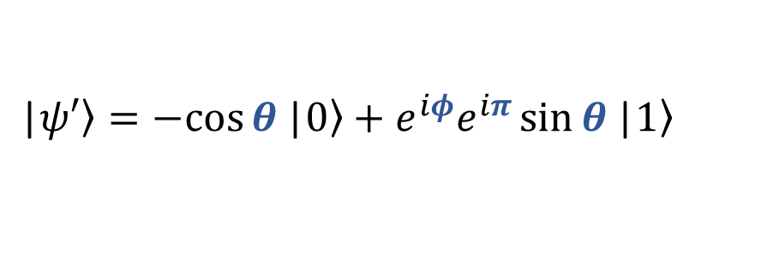

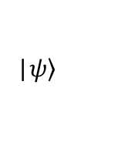


Bloch sphere
$$z$$
Consider the antipodal state of $\text{|}\left.ψ\right\rangle$
$$\text{|}\left.ψ\right\rangle =\cos{θ}\text{|}\left.0\right\rangle +e^{iφ}\sin{θ}\text{|}\left.1\right\rangle$$
$$\text{|}\left.ψ\right\rangle$$
$$\left(π−θ\right)$$
$$\left(φ+π\right)$$
$$θ$$
$$y$$
$$θ$$
$$θ$$
$$\text{|}\left.ψ′\right\rangle$$
$$\text{|}\left.ψ′\right\rangle =−cos{θ}\text{|}\left.0\right\rangle +e^{iφ}e^{iπ}\sin{θ}\text{|}\left.1\right\rangle$$
$$\text{|}\left.ψ′\right\rangle =\text{−}\text{|}\left.ψ\right\rangle$$
$$−1$$

Slide 12
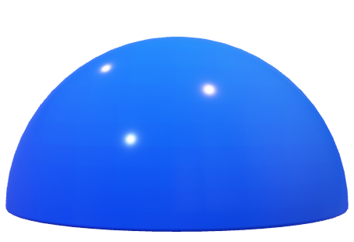
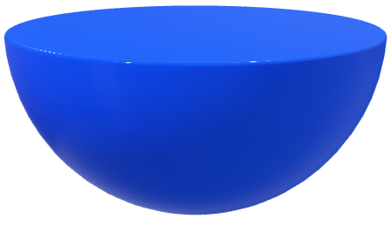
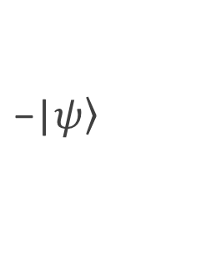

Bloch sphere
It is sufficient to consider only upper hemisphere; $0≤θ≤π/2$.
$$\text{|}\left.ψ\right\rangle$$
$$\text{−}\text{|}\left.ψ\right\rangle$$
The lower hemisphere only differs by a phase factor -1.

Slide 13
Bloch sphere
It is possible to “stretch” the upper hemisphere to create a full sphere.
In this way, equator becomes the south pole, and any qubit state can be represented by the points on a unit sphere

Slide 14


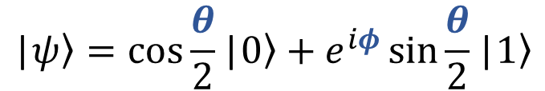

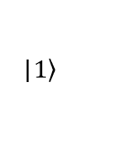


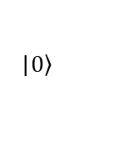
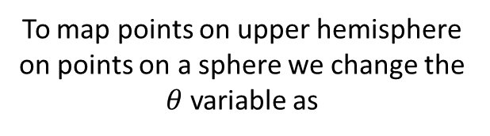
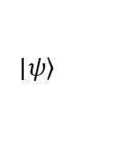
Bloch sphere
$$z$$
To map points on upper hemisphere on points on a sphere we change the $θ$ variable as
$$\text{|}\left.0\right\rangle$$
$$θ→\frac{θ}{2}$$
$$\text{|}\left.ψ\right\rangle$$
$$θ$$
$$R=1$$
$$y$$
$$ϕ$$
Bloch representation of a qubit
$$\text{|}\left.ψ\right\rangle =\cos{\frac{θ}{2}}\text{|}\left.0\right\rangle +e^{iφ}\sin{\frac{θ}{2}}\text{|}\left.1\right\rangle$$
$$x$$
$$\text{|}\left.1\right\rangle$$
$$θ∈[0,π]$$
and
$$φ∈[0,2π]$$

Slide 15






Bloch sphere
Opposite points are orthogonal
$$\text{|}\left.ψ\right\rangle =\cos{\frac{θ}{2}}\text{|}\left.0\right\rangle +e^{iφ}\sin{\frac{θ}{2}}\text{|}\left.1\right\rangle$$
Substitute: $θ→π−θ$ and $φ→φ+π$
$$\text{|}\left.ξ\right\rangle =\cos{\frac{π−θ}{2}}\text{|}\left.0\right\rangle +e^{i(φ+π)}\sin{\frac{π−θ}{2}}\text{|}\left.1\right\rangle$$
$$⋮$$
Informal assignment #1: Do intermediate steps
$$\left\langle ξ | ψ\right\rangle =\cos{\frac{π}{2}=0}$$

