Slide 1
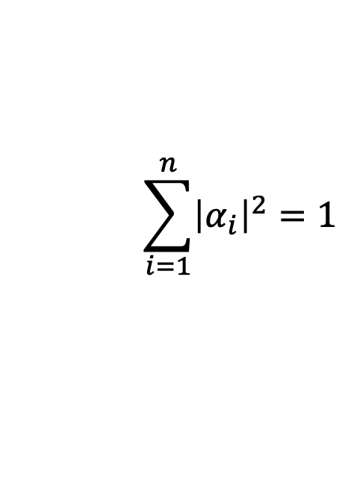
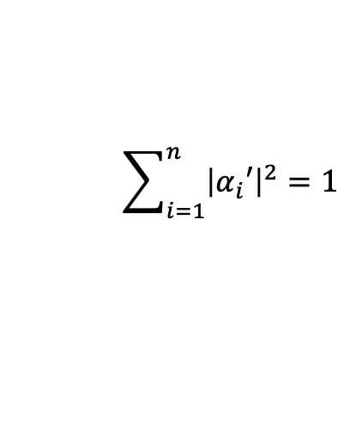
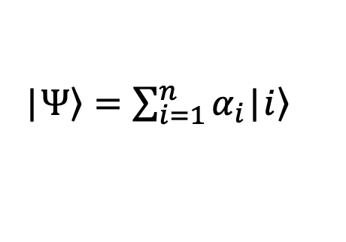
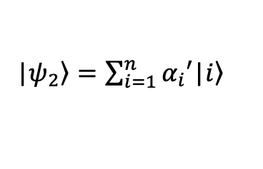
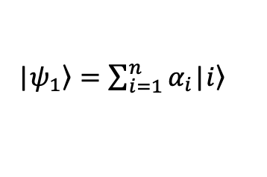

Unitary operator
Remember that we will be working with normalized quantum states in this class:
$$\sum_{i=1}^{n}{{\left|α_{i}\right|}^{2}}=1$$
|$\left.Ψ\right\rangle =\sum_{i=1}^{n}{α_{i}\text{|}\left.i\right\rangle }$
Normalization condition
$$α_{i}∈ℂ$$
Therefore, the operators acting on quantum states should not change above condition after transformations:
|$\left.ψ_{1}\right\rangle =\sum_{i=1}^{n}{α_{i}\text{|}\left.i\right\rangle }$
|$\left.ψ_{2}\right\rangle =\sum_{i=1}^{n}{α_{i}′\text{|}\left.i\right\rangle }$
$$\sum_{i=1}^{n}{{\left|α_{i}′\right|}^{2}=1}$$
The quantum operator satisfying the above condition is called a unitary operator.

Slide 2
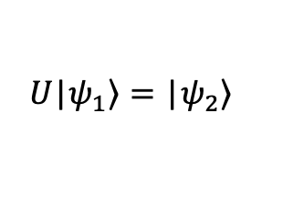


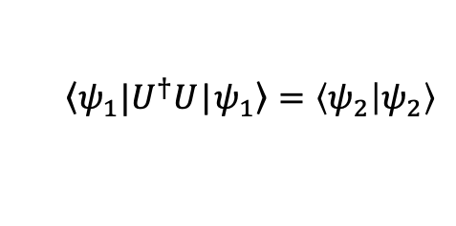
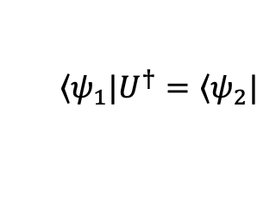
Unitary operator
A unitary operator satisfies the following property:
$$U^{†}U=UU^{†}=I$$
If an operator obey above property, it directly follows that
$$U\text{|}\left.ψ_{1}\right\rangle =\text{|}\left.ψ_{2}\right\rangle$$
$$\left\langle ψ_{1}|\right.U^{†}=\left\langle ψ_{2}|\right.$$
Dual space
$$\left\langle ψ_{1}|\right.U^{†}U\text{|}\left.ψ_{1}\right\rangle =\left\langle ψ_{2} | ψ_{2}\right\rangle$$
$$\left\langle ψ_{1} | ψ_{1}\right\rangle =\left\langle ψ_{2} | ψ_{2}\right\rangle$$

Slide 3



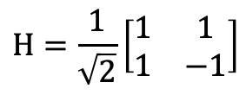




Unitary operator (Single qubit gates)
For example:
$$H=\frac{1}{\sqrt{2}}\left[\begin{matrix}1 & 1 \\ 1 & −1\end{matrix}\right]$$
$$H^{†}H=I$$
$$X=\left[\begin{matrix}0 & 1 \\ 1 & 0\end{matrix}\right]$$
$$X^{†}X=I$$
Pauli matrices
(operators, gates)
$$Y=\left[\begin{matrix}0 & −i \\ i & 0\end{matrix}\right]$$
$$Y^{†}Y=I$$
$$Z=\left[\begin{matrix}1 & 0 \\ 0 & −1\end{matrix}\right]$$
$$Z^{†}Z=I$$

Slide 4










Rotations on the Bloch sphere
$$z$$
$$R_{z}$$
$$R_{x}(θ)≡e^{−iθX/2}$$
$$R_{y}(θ)≡e^{−iθY/2}$$
$$R_{y}$$
$$y$$
$$R_{z}(θ)≡e^{−iθZ/2}$$
$$X,Y,Z$$
Pauli Matrices
$$x$$
$$R_{x}$$

Slide 5
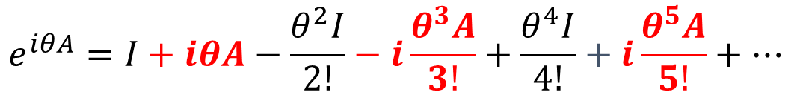
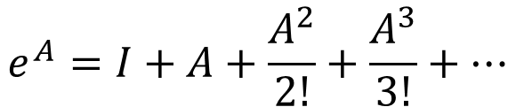


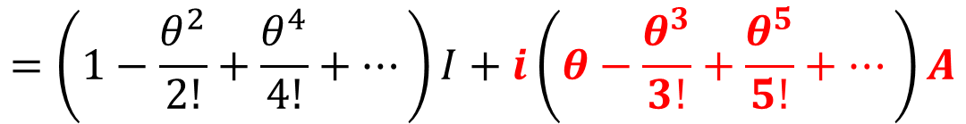
Rotations on the Bloch sphere
Algebraic behavior of matrix exponents
$$e^{A}=I+A+\frac{A^{2}}{2!}+\frac{A^{3}}{3!}+⋯$$
$$e^{iθA}=I+iθA−\frac{θ^{2}I}{2!}−i\frac{θ^{3}A}{3!}+\frac{θ^{4}I}{4!}+i\frac{θ^{5}A}{5!}+…$$
$$=\left(1−\frac{θ^{2}}{2!}+\frac{θ^{4}}{4!}+…\right)I+i\left(θ−\frac{θ^{3}}{3!}+\frac{θ^{5}}{5!}+…\right)A$$
$$\cos{θ}$$
$$\sin{θ}$$

Slide 6
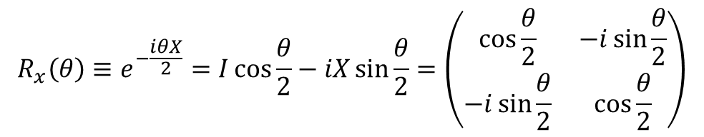



Rotations on the Bloch sphere
$$e^{iθA}=I\cos{θ}+iA\sin{θ}$$
$$R_{x}\left(θ\right)≡e^{−\frac{iθX}{2}}=I\cos{\frac{θ}{2}}−iX\sin{\frac{θ}{2}}=\left(\begin{matrix}\cos{\frac{θ}{2}} & −i\sin{\frac{θ}{2}} \\ −i\sin{\frac{θ}{2}} & \cos{\frac{θ}{2}}\end{matrix}\right)$$
$R_{y}\left(θ\right)≡$ $\left(\begin{matrix}\cos{\frac{θ}{2}} & −\sin{\frac{θ}{2}} \\ \sin{\frac{θ}{2}} & \cos{\frac{θ}{2}}\end{matrix}\right)$
$R_{z}\left(θ\right)≡$ $\left(\begin{matrix}e^{−i\frac{θ}{2}} & 0 \\ 0 & e^{i\frac{θ}{2}}\end{matrix}\right)$

Slide 7

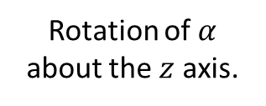
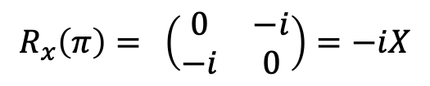

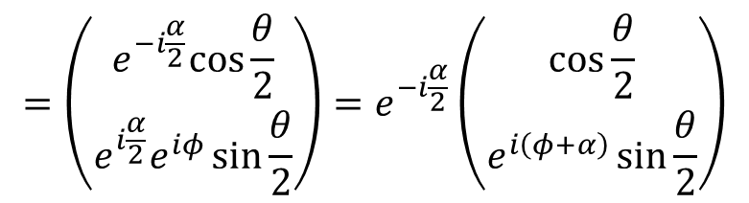
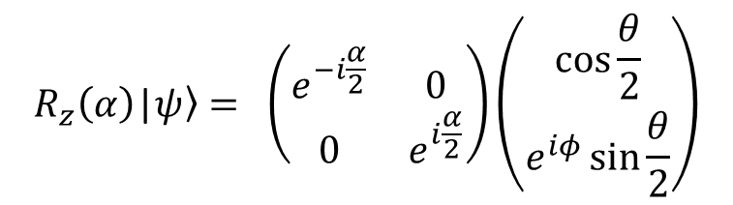
Rotations on the Bloch sphere
Some examples
$$R_{x}\left(π\right)= \left(\begin{matrix}0 & −i \\ −i & 0\end{matrix}\right)=−iX$$
$X$ provides ${180}^{o}$rotation about $x$ axis.
$$R_{z}\left(α\right)\text{|}\left.ψ\right\rangle = \left(\begin{matrix}e^{−i\frac{α}{2}} & 0 \\ 0 & e^{i\frac{α}{2}}\end{matrix}\right)\left(\begin{matrix}\cos{\frac{θ}{2}} \\ e^{iφ}\sin{\frac{θ}{2}}\end{matrix}\right)$$
$$=\left(\begin{matrix}e^{−i\frac{α}{2}}cos{\frac{θ}{2}} \\ e^{i\frac{α}{2}}e^{iφ}\sin{\frac{θ}{2}}\end{matrix}\right)=e^{−i\frac{α}{2}}\left(\begin{matrix}\cos{\frac{θ}{2}} \\ e^{i\left(φ+α\right)}\sin{\frac{θ}{2}}\end{matrix}\right)$$
$$φ→φ+α$$
Rotation of $α$ about the $z$ axis.

Slide 8


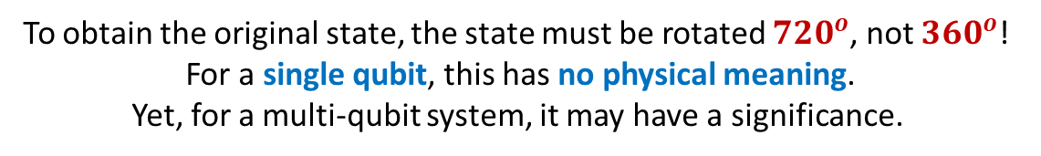


Rotations on the Bloch sphere
An interesting property
$$R_{z}\left(0\right) = I$$
$$R_{z}\left(2π\right)=−I$$
$$R_{z}\left(4π\right)= I$$
To obtain the original state, the state must be rotated ${720}^{o}$, not ${360}^{o}$!
For a single qubit, this has no physical meaning.
Yet, for a multi-qubit system, it may have a significance.

Slide 9










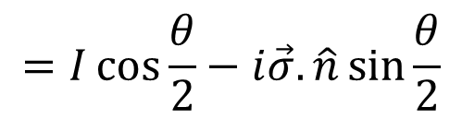
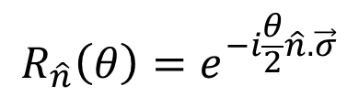



Rotations on the Bloch sphere
$$z$$
Rotation about an arbitrary axis
$$R_{\hat{n}}\left(θ\right)=e^{−i\frac{θ}{2}\hat{n}.\vec{σ}}$$
$$\hat{n}$$
$$=I\cos{\frac{θ}{2}}−i\vec{σ}.\hat{n}\sin{\frac{θ}{2}}$$
$$n_{z}$$
$$n_{y}$$
$$y$$
$$n_{x}$$
$$\hat{n}=n_{x}{\hat{x}+n}_{y}{\hat{y}+n}_{z}\hat{z}$$
$$(n_{i}∈ℝ)$$
$$\vec{σ}=X\hat{x}+Y\hat{y}+Z\hat{z}$$
$$x$$
Any unitary operator
$$U=e^{iα}R_{\hat{n}}\left(θ\right)$$

Slide 10



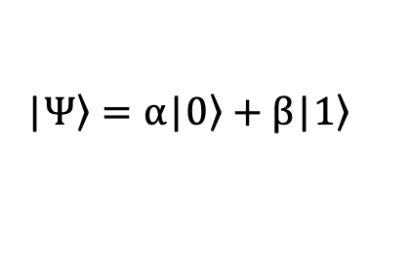


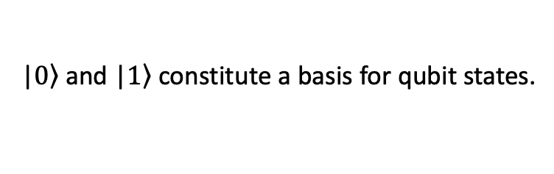
Measurement in arbitrary bases
|$\left.Ψ\right\rangle =α\text{|}\left.0\right\rangle +β\text{|}\left.1\right\rangle$
$$\left\langle 0 | 1\right\rangle =0$$
Orthogonal states
$\text{|}\left.0\right\rangle$ and $\text{|}\left.1\right\rangle$ constitute a basis for qubit states.
$$y$$
$$y′$$
$$x′$$
Remember:
$$x$$
In Cartesian space it is possible to represent a point in different bases.
Similarly, it is possible to express a quantum state in different bases.

Slide 11
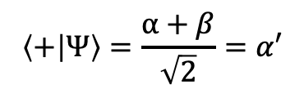
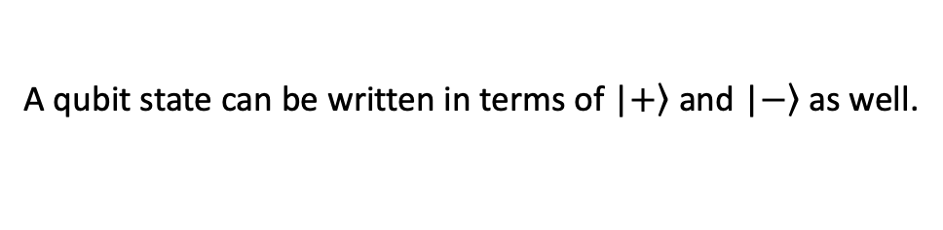
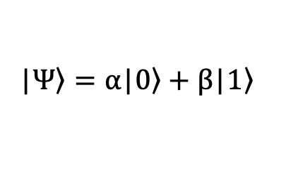
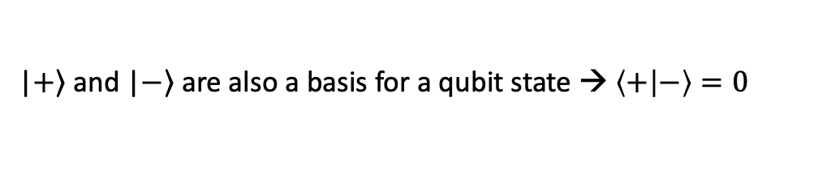
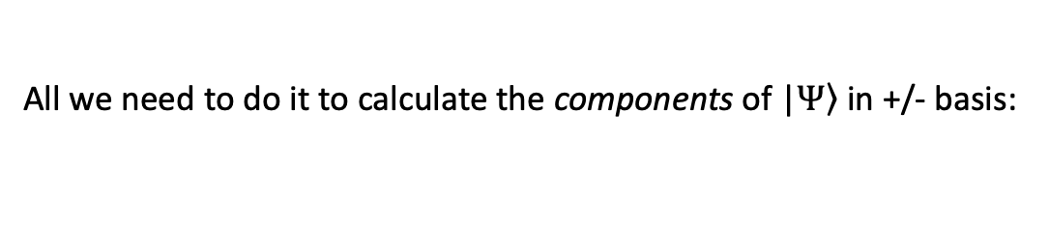
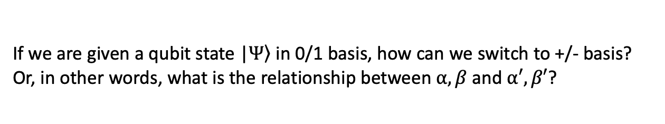
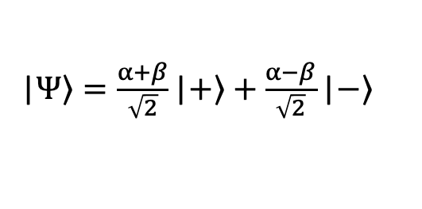
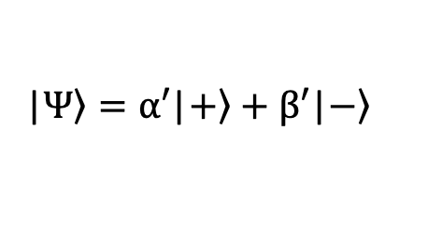
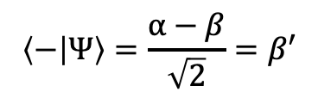
Measurement in arbitrary bases
For example:
$\text{|}\left.+\right\rangle$ and $\text{|}\left.−\right\rangle$ are also a basis for a qubit state → $\left\langle + | −\right\rangle =0$
A qubit state can be written in terms of $\text{|}\left.+\right\rangle$ and $\text{|}\left.−\right\rangle$ as well.
|$\left.Ψ\right\rangle =α\text{|}\left.0\right\rangle +β\text{|}\left.1\right\rangle$
|$\left.Ψ\right\rangle =α′\text{|}\left.+\right\rangle +β′\text{|}\left.−\right\rangle$
If we are given a qubit state |$\left.Ψ\right\rangle$ in 0/1 basis, how can we switch to +/- basis? Or, in other words, what is the relationship between $α,β$ and $α′,β′$?
All we need to do it to calculate the components of |$\left.Ψ\right\rangle$ in +/- basis:
$$\left\langle + | Ψ\right\rangle =\frac{α+β}{\sqrt{2}}=α′$$
$$\left\langle − | Ψ\right\rangle =\frac{α−β}{\sqrt{2}}=β′$$
|$\left.Ψ\right\rangle =\frac{α+β}{\sqrt{2}}\text{|}\left.+\right\rangle +\frac{α−β}{\sqrt{2}}\text{|}\left.−\right\rangle$

Slide 12
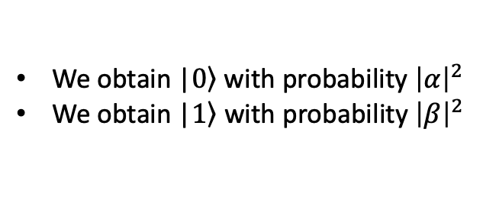
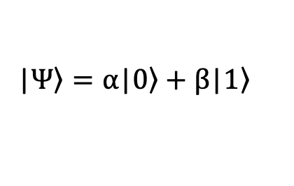
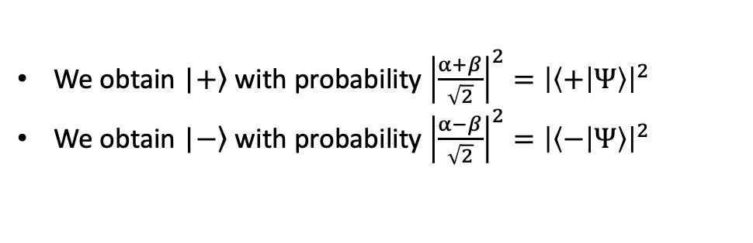
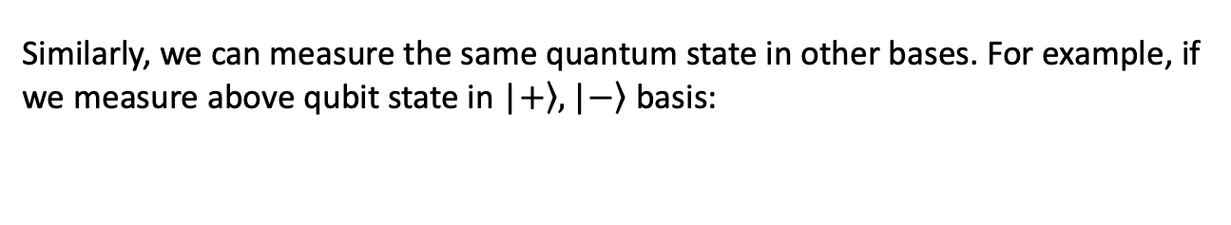

Measurement in arbitrary bases
We know that when we measure a qubit state
|$\left.Ψ\right\rangle =α\text{|}\left.0\right\rangle +β\text{|}\left.1\right\rangle$
We obtain $\text{|}\left.0\right\rangle$with probability ${\left|α\right|}^{2}$
We obtain $\text{|}\left.1\right\rangle$ with probability ${\left|β\right|}^{2}$
From now on we will call this a measurement in $\text{|}\left.0\right\rangle$, $\text{|}\left.1\right\rangle$ basis.
Similarly, we can measure the same quantum state in other bases. For example, if we measure above qubit state in $\text{|}\left.+\right\rangle ,\text{|}\left.−\right\rangle$ basis:
We obtain $\text{|}\left.+\right\rangle$ with probability ${\left|\frac{α+β}{\sqrt{2}}\right|}^{2}={\left|\left\langle + | Ψ\right\rangle \right|}^{2}$
We obtain $\text{|}\left.−\right\rangle$ with probability ${\left|\frac{α−β}{\sqrt{2}}\right|}^{2}={\left|\left\langle − | Ψ\right\rangle \right|}^{2}$

Slide 13
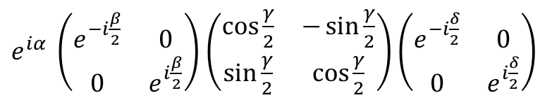


Z-Y Decompositions
Any unitary operator can be decomposed into three rotations
$$U=e^{iα}R_{z}\left(β\right)R_{y}\left(γ\right)R_{z}\left(δ\right)={e^{iα}R}_{\hat{n}}\left(θ\right)$$
$e^{iα} \left(\begin{matrix}e^{−i\frac{β}{2}} & 0 \\ 0 & e^{i\frac{β}{2}}\end{matrix}\right)$ $\left(\begin{matrix}\cos{\frac{γ}{2}} & −\sin{\frac{γ}{2}} \\ \sin{\frac{γ}{2}} & \cos{\frac{γ}{2}}\end{matrix}\right)$ $\left(\begin{matrix}e^{−i\frac{δ}{2}} & 0 \\ 0 & e^{i\frac{δ}{2}}\end{matrix}\right)$
Example
$$(α,β,γ,δ)=(π/2,0,π,π)$$
$$X=e^{iπ/2}R_{z}(0)R_{y}(π)R_{z}(π)$$

