Slide 1

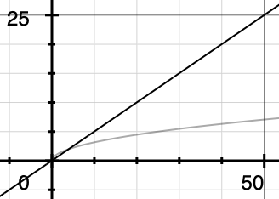
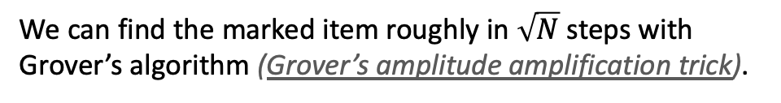

The search problem
We would like to find a marked item on a list:
…
X
…
1
2
3
4
k
N-1
N
with classical approach
We have to check N/2 of the boxes on average. In the worst case, we have to check all N of them.
with quantum approach
We can find the marked item roughly in $\sqrt{N}$ steps with Grover’s algorithm (Grover’s amplitude amplification trick).
N/2
Quadratic speed up!
$\sqrt{N}$
Database size

Slide 2


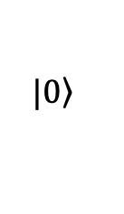





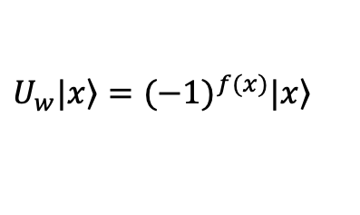

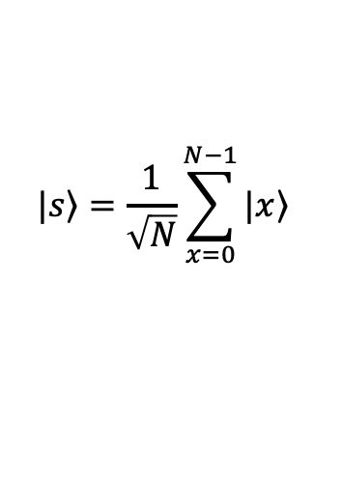

Grover’s algorithm
$$r$$
$$H^{⊗n}$$
$$U_{w}$$
$$U_{s}$$
$$|\left.0\right\rangle$$
n qubits
$$2^{n}=N$$
$$n$$
dimensional space
It defines the size of the database
$$|\left.s\right\rangle =\frac{1}{\sqrt{N}}\sum_{x=0}^{N−1}{|\left.x\right\rangle }$$
1) Initialize
2) Perform $U_{s}U_{w}$ $r$ times.
$$f:\left\{0,1,2,…,N\right\}→\left\{0,1\right\}$$
$$U_{w}|\left.x\right\rangle ={(−1)}^{f(x)}|\left.x\right\rangle$$
Quantum oracle
The domain indicates the database. f(x)=1 only if the data x satisfies the search criterion.
$$U_{s}=2\left|\left.s\right\rangle \left\langle s\right.\right|−I$$
Grover’s diffusion operator
3) Measure the resulting quantum state on the computational basis.

Slide 3
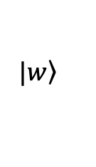
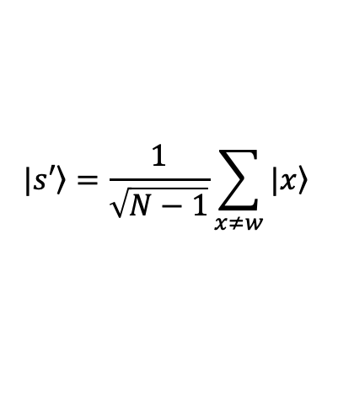
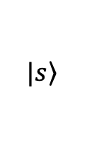

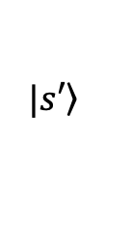

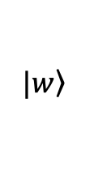
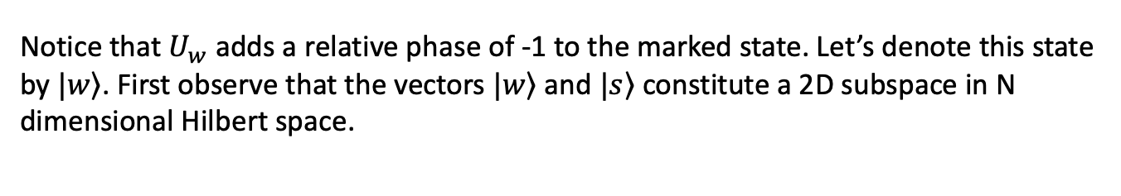
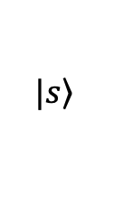
Grover’s algorithm
(How does it work? – Geometric approach)
Notice that $U_{w}$ adds a relative phase of -1 to the marked state. Let’s denote this state by $|\left.w\right\rangle$. First observe that the vectors $|\left.w\right\rangle$ and $|\left.s\right\rangle$ constitute a 2D subspace in N dimensional Hilbert space.
$|\left.w\right\rangle$
The state we want to measure at the end.
$|\left.s\right\rangle$
Initial state of the system
Let’s define another vector $|\left.s′\right\rangle$ so that $|\left.w\right\rangle$ and $|\left.s′\right\rangle$ span this 2D subspace:
$|\left.w\right\rangle$
$$|\left.s′\right\rangle =\frac{1}{\sqrt{N−1}}\sum_{x≠w}{|\left.x\right\rangle }$$
$$\left\langle s′ | w\right\rangle =0$$
$|\left.s\right\rangle$
$|\left.s′\right\rangle$

Slide 4
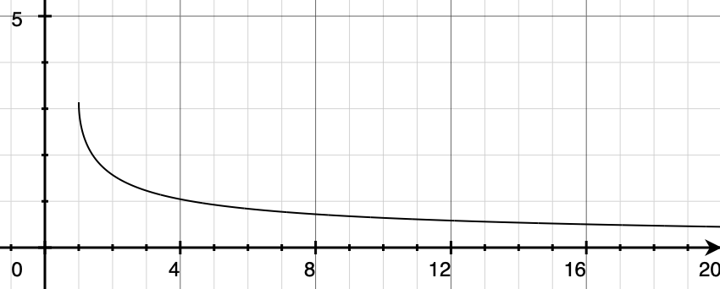

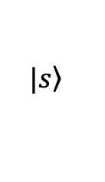

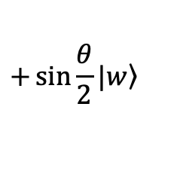
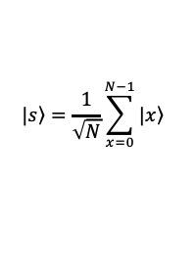



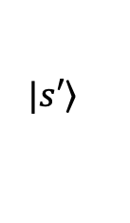



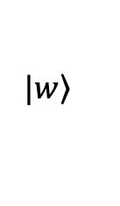

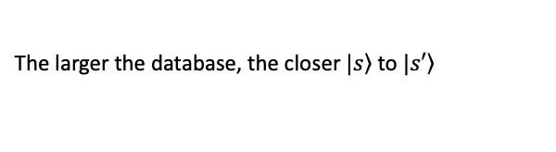
Grover’s algorithm
(How does it work? – Geometric approach)
$|\left.w\right\rangle$
$$|\left.s\right\rangle =\cos{\frac{θ}{2}}|\left.s′\right\rangle$$
$$+\sin{\frac{θ}{2}}|\left.w\right\rangle$$
$|\left.s\right\rangle$
$|\left.s′\right\rangle$
Let us assume that this angle is $θ/2$.
What actually is this $θ/2$?
$$|\left.s\right\rangle =\frac{1}{\sqrt{N}}\sum_{x=0}^{N−1}{|\left.x\right\rangle }$$
$$\left\langle w | s\right\rangle =\frac{1}{\sqrt{N}}=\sin{\frac{θ}{2}}$$
Geometry
$$θ=2\sin^{−1}{\frac{1}{\sqrt{N}}}$$
It is defined by N: The size of the database
$$θ$$
The larger the database, the closer $|\left.s\right\rangle$ to $|\left.s′\right\rangle$
$$N$$

Slide 5

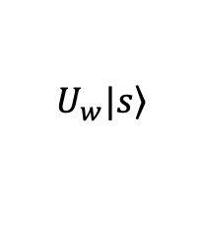


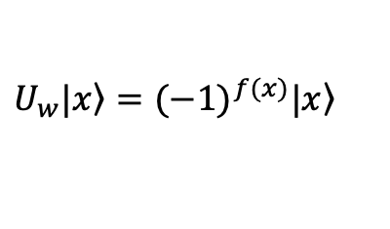
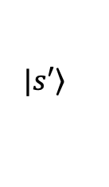

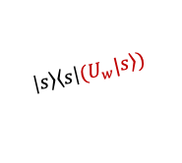
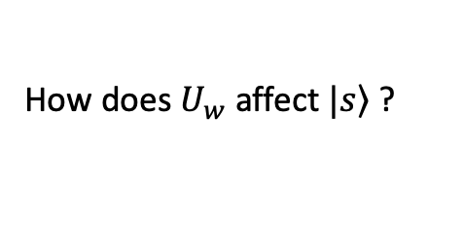
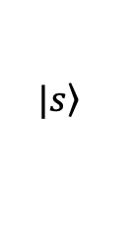
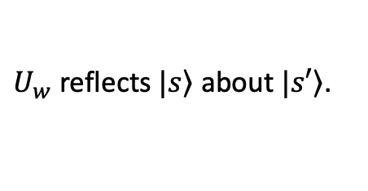
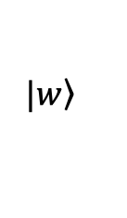

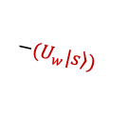
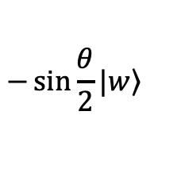
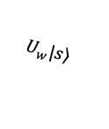
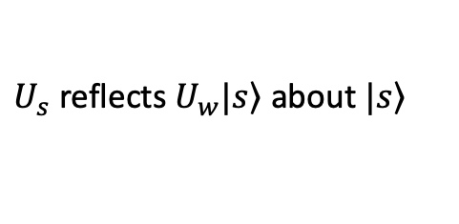
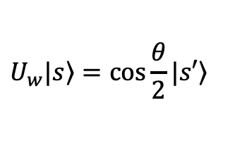
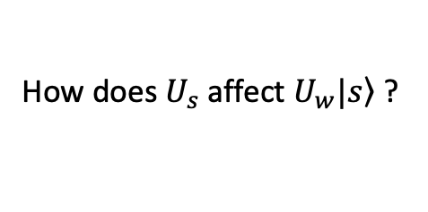
Grover’s algorithm
(How does it work? – Geometric approach)
How does $U_{w}$affect $|\left.s\right\rangle$ ?
$|\left.w\right\rangle$
$$U_{w}|\left.x\right\rangle ={(−1)}^{f(x)}|\left.x\right\rangle$$
$$U_{w}|\left.s\right\rangle =\cos{\frac{θ}{2}}|\left.s′\right\rangle$$
$$−\sin{\frac{θ}{2}}|\left.w\right\rangle$$
$|\left.s\right\rangle$
$|\left.s′\right\rangle$
$U_{w}$ reflects $|\left.s\right\rangle$ about $|\left.s′\right\rangle$.
$$U_{w}|\left.s\right\rangle$$
How does $U_{s}$affect $U_{w}|\left.s\right\rangle$ ?
$|\left.w\right\rangle$
$$U_{s}=2\left|\left.s\right\rangle \left\langle s\right.\right|−I$$
$$\left|\left.s\right\rangle \left\langle s\right.\right|(U_{w}|\left.s\right\rangle )$$
$$U_{s}(U_{w}|\left.s\right\rangle )=2\left|\left.s\right\rangle \left\langle s\right.\right|(U_{w}|\left.s\right\rangle )−(U_{w}|\left.s\right\rangle )$$
$$−(U_{w}|\left.s\right\rangle )$$
$$θ$$
$|\left.s\right\rangle$
$U_{s}$ reflects $U_{w}|\left.s\right\rangle$ about $|\left.s\right\rangle$
$|\left.s′\right\rangle$
$$U_{w}|\left.s\right\rangle$$

Slide 6
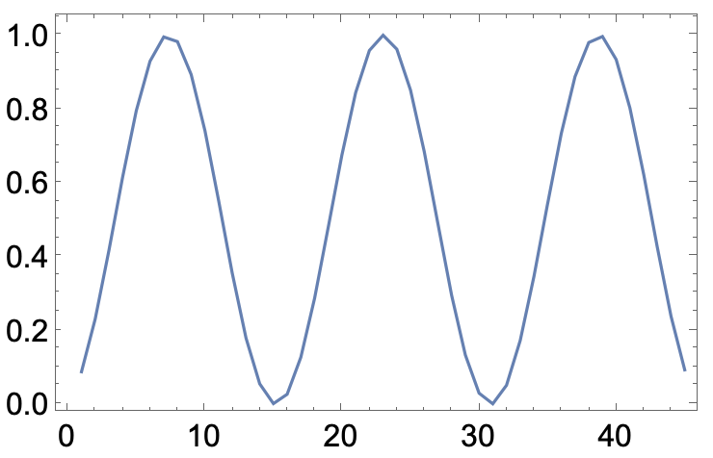

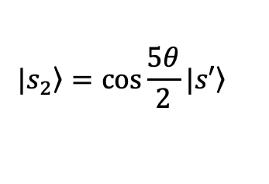

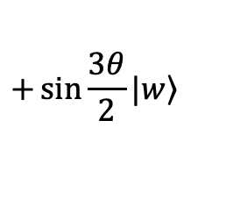


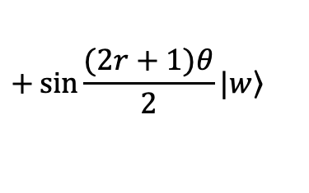
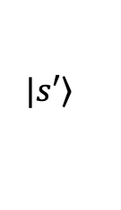
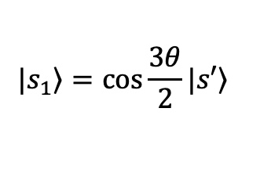
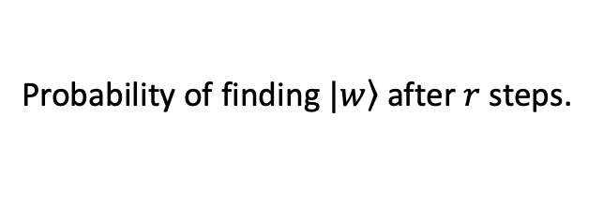


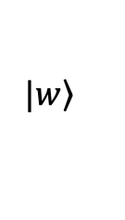


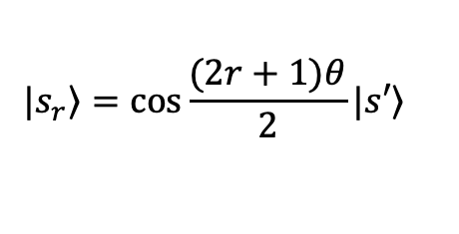


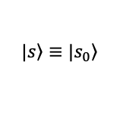

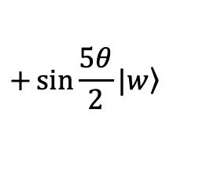



Grover’s algorithm
(How does it work? – Geometric approach)
Every time we apply ${U_{s}U}_{w}$the state approaches to $|\left.w\right\rangle$ by an angle of $θ$
$|\left.w\right\rangle$
$$|\left.s_{1}\right\rangle =\cos{\frac{3θ}{2}}|\left.s′\right\rangle$$
$$+\sin{\frac{3θ}{2}}|\left.w\right\rangle$$
$${\left({U_{s}U}_{w}\right)}^{2}|\left.s\right\rangle =|\left.s_{2}\right\rangle$$
$${U_{s}U}_{w}|\left.s\right\rangle =|\left.s_{1}\right\rangle$$
$$|\left.s_{2}\right\rangle =\cos{\frac{5θ}{2}}|\left.s′\right\rangle$$
$$+\sin{\frac{5θ}{2}}|\left.w\right\rangle$$
$$θ$$
$$θ$$
$$|\left.s\right\rangle ≡|\left.s_{0}\right\rangle$$
$|\left.s′\right\rangle$
$$θ$$
$$|\left.s_{r}\right\rangle =\cos{\frac{(2r+1)θ}{2}}|\left.s′\right\rangle$$
$$+\sin{\frac{(2r+1)θ}{2}}|\left.w\right\rangle$$
$$\left\langle w | s_{r}\right\rangle =\sin{\frac{(2r+1)θ}{2}}$$
$$N=100$$
$$2\sin^{−1}{\frac{1}{\sqrt{N}}}$$
$${\left|\left\langle w | s_{r}\right\rangle \right|}^{2}=\sin^{2}{\frac{(2r+1)θ}{2}}$$
$${\left|\left\langle w | s_{r}\right\rangle \right|}^{2}$$
Probability of finding $|\left.w\right\rangle$ after $r$ steps.
$$r^{∗}$$
$$r$$

Slide 7















Grover’s algorithm
(How does it work? – Geometric approach)
How many step should we take to obtain max probability for a given N?
We want $\frac{(2r+1)θ}{2}$ to be as close to $\frac{π}{2}$ as possible.
$$\frac{(2r+1)θ}{2}=\frac{π}{2}$$
$$r=\frac{π}{2θ}−\frac{1}{2}$$
This is not an integer in general, but we only take integer steps.
$$θ=2\sin^{−1}{\frac{1}{\sqrt{N}}}$$
$$θ≈\frac{2}{\sqrt{N}}$$
$$r=\frac{\sqrt{N}π}{4}−\frac{1}{2}$$
$$N≫1$$
A mathematical identity:
$\left[x−\frac{1}{2}\right]$:
Closest integer to $x−\frac{1}{2}$
$$\left[x−\frac{1}{2}\right]=\left\lfloor x\right\rfloor$$
$$x∈ℝ$$
for
$$r^{∗}=\left[\frac{\sqrt{N}π}{4}−\frac{1}{2}\right]$$
$$r^{∗}=\left\lfloor \frac{π}{4}\sqrt{N}\right\rfloor$$
$$r^{∗}$$
$$N$$

Slide 8













Grover’s algorithm
(Terminology)
Grover’s diffusion operator
$$U_{s}=2\left|\left.s\right\rangle \left\langle s\right.\right|−I$$
$|\left.w\right\rangle$
$$|\left.s_{2}\right\rangle$$
$$|\left.s_{1}\right\rangle$$
The initial state $|\left.s\right\rangle$ ”diffuses” in the phase space.
$$θ$$
$$θ$$
$$|\left.s\right\rangle$$
$|\left.s′\right\rangle$
$$θ/2$$
Grover’s amplitude amplification trick
$$\left\langle w | s_{r}\right\rangle =\sin{\frac{(2r+1)θ}{2}}$$
The algorithm increases the amplitude of the projection of state $|\left.s\right\rangle$ on $|\left.w\right\rangle$
$$r^{∗}=\left\lfloor \frac{π}{4}\sqrt{N}\right\rfloor$$
We stop the algorithm when the amplitude is the greatest.

