Slide 1
GUESSING NUMBER GAME
Team members name : reg_no :
Bavani kumar a 18mis1023
Prasanna m 18mis1111
Kamalesh kumar s 18mis1080

Slide 2
OBJECTIVES:
In JAVA there is a Random predefined function. Which can create Random number according to the given boundary value. By this game our main objective is we are interacting with the computer to find the guessing Number. By some Mathematical Task.
SOFTWARE REQUUIREMENTS:
JAVA DEVELOPMENT KIT -8 OR -9
INTELLIJ(BY JET BRAINS)-INTEGRATED DEVELOPMENT ENVIRONMENT
FXML
PLATFORM:
Linux, Windows etc.,
It is platform independent.
WORK DONE:
Creating a random number from computer
Given mathematical task
We have to find the computer created Random number
Who found the random number from the given task they are won…

Slide 3
ALGORITHM:
START:
Random number :?
Step 1: selecting level
“Requires some thinking capability”:
Step 2: if (easy)
Step 2.1: level 1 and level 2 and level 3 and level 4 and level 5
Step 2.2: Level 1: attempts:5 Task: Finding number b/w 100
Step 2.3: Level 2:attempts:5 Task: Finding number b/w 200
Step 2.4: Level 3:attempts:5 Task: Finding number b/w 500
Step 2.5: Level 4:attempts:5 Task: Finding number b/w 750
Step 2.6: Level 5:attempts:5 Task: Finding number b/w 1000

Slide 4
“Requires some mathematical knowledge”
Step 3: else if (medium)
Step 3.1: level 1 and level 2 and level 3 and level 4 and level 5
Step 3.2; level1:attempts:b/w 5 to 20 addition of the number b/w 10
Step 3.3: level2:attempts: b/w 5 to 20 addition of the number b/w 100
Example: random number 1 is 50 and random number 2 is 50 addition of two number random will display as 100 we have to find the random 1 and random 2 as a=50 and b=50
Step 3.4: level3:attempts: b/w 5 to 20 difference of the number b/w 100
Example: random number 1 is 50 and random number 2 is 10 difference of two number random will display as ‘40’ we have to find the random 1 and random 2 as a=50 and b=10
Step 3.5: level4:attempts: b/w 5 to 20 multiplication of the number b/w 100
Example: random number 1 is 50 and random number 2 is 10 multiplication of two number random will display as ‘500’ we have to find the random 1 and random 2 as a=50 and b=10.
Step 3.6: level5:attempts: b/w 5 to 20 division of the number b/w 100

Slide 5
Ex:ample: random number 1 is 50 and random number 2 is 5 division of two number random will display as ‘10’ we have to find the random 1 and random 2 as a=50 and b=2
Note: in the above examples I used own values . While executing random number will be taken by computer.
“Requires more mathematical knowledge”:
Step 4:else if(hard)
Step 4.1: level1 and level 2 and level 3 and level 4 and level 5
Step 4.2: level1:attempts: user finding squares()^2 b/w 10
Example: we have to give the square values of that which computer computer guessed number if Random number is 4 we have to find like by entering 4.
Step 4.3: level2:attempts: user finding squares()^2 b/w 20
Step 4.4: level3: attempts: user finding cubes()^3 b/w 10
Step 4.5: level4: attempts: user finding cubes()^3 b/w 20
Step 4.6: level5: attempts: single attempt finding number b/w 1000
Step 5: you have completed this guessing number game!!!

Slide 6
SMALL MINDMAP OF THIS GAME
GUESSUNG NUMBER-→SELECTING LEVEL-->EASY || MEDIUM || HARD
EASY→LEVEL:1 || LEVEL:2 || LEVEL:3 || LEVEL:4 || LEVEL:5
LEVEL 1: GIVEN TASK….
LEVEL 2: GIVEN TASK….
LEVEL 3: GIVEN TASK….
LEVEL 4: GIVEN TASK….
LEVEL 5: GIVEN TASK….
MEDIUM→ LEVEL:1 || LEVEL:2 || LEVEL:3 || LEVEL:4 || LEVEL:5
LEVEL 1: GIVEN TASK….
LEVEL 2: GIVEN TASK….
LEVEL 3: GIVEN TASK….
LEVEL 4: GIVEN TASK….
LEVEL 5: GIVEN TASK….
HARD→ LEVEL:1 || LEVEL:2 || LEVEL:3 || LEVEL:4 || LEVEL:5
LEVEL 1: GIVEN TASK….
LEVEL 2: GIVEN TASK….
LEVEL 3: GIVEN TASK….
LEVEL 4: GIVEN TASK….
LEVEL 5: GIVEN TASK….
→IF YOU COMPLETED THE GIVEN TASK STEP BY STEP IN EACH LEVEL YOU HAVE COMPLETED THIS

Slide 7
EXAMPLE FOR EASY LEVEL
EXAMPLE FOR MEDIUM LEVEL
EXAMPLE FOR HARD LEVEL

Slide 8
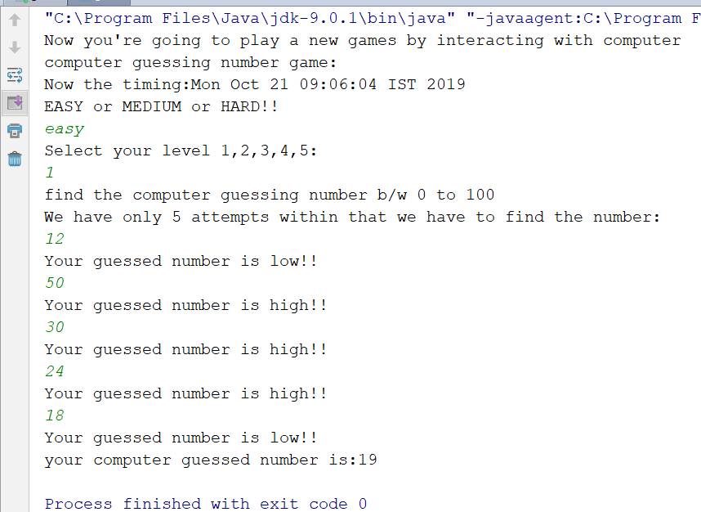

Slide 9
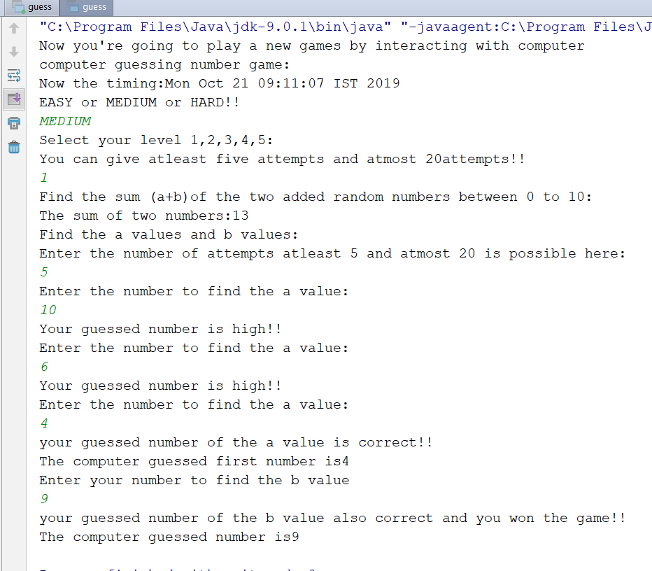

Slide 10
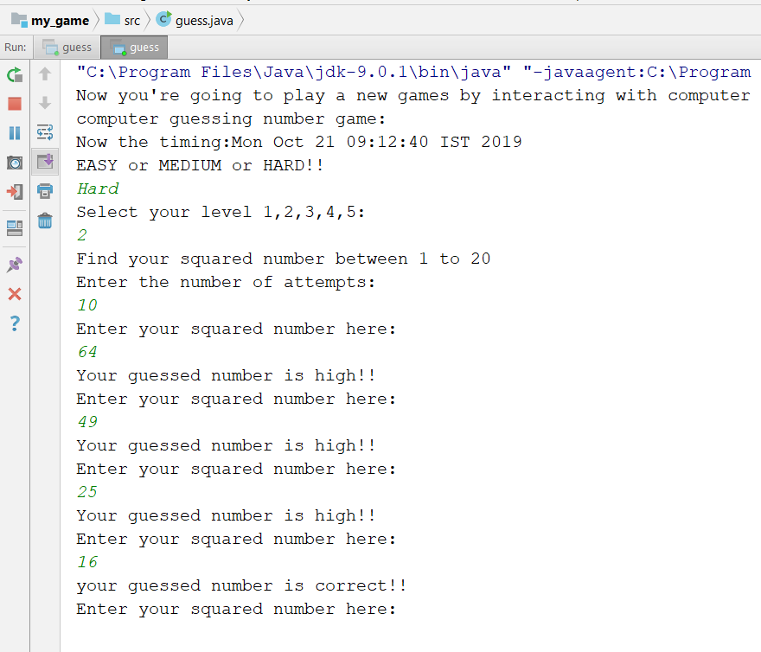

Slide 11
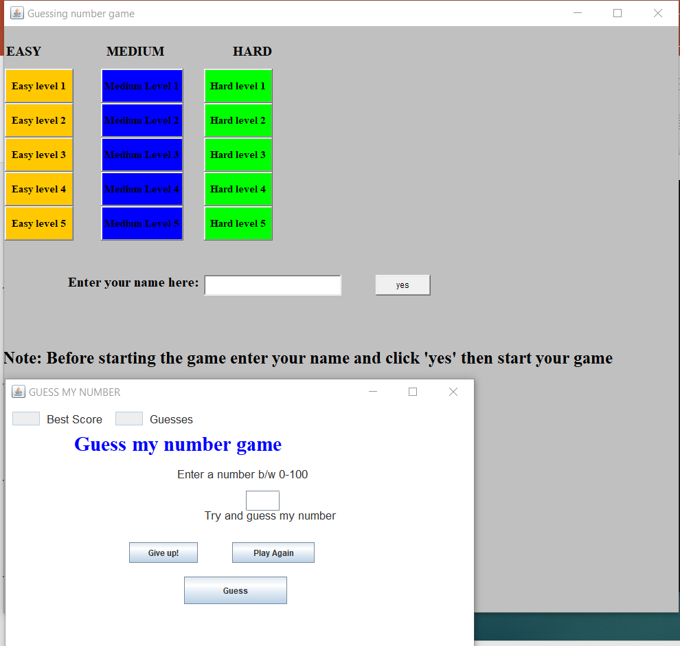

After adding swing

Slide 12
BY ADDING FXML

Slide 13
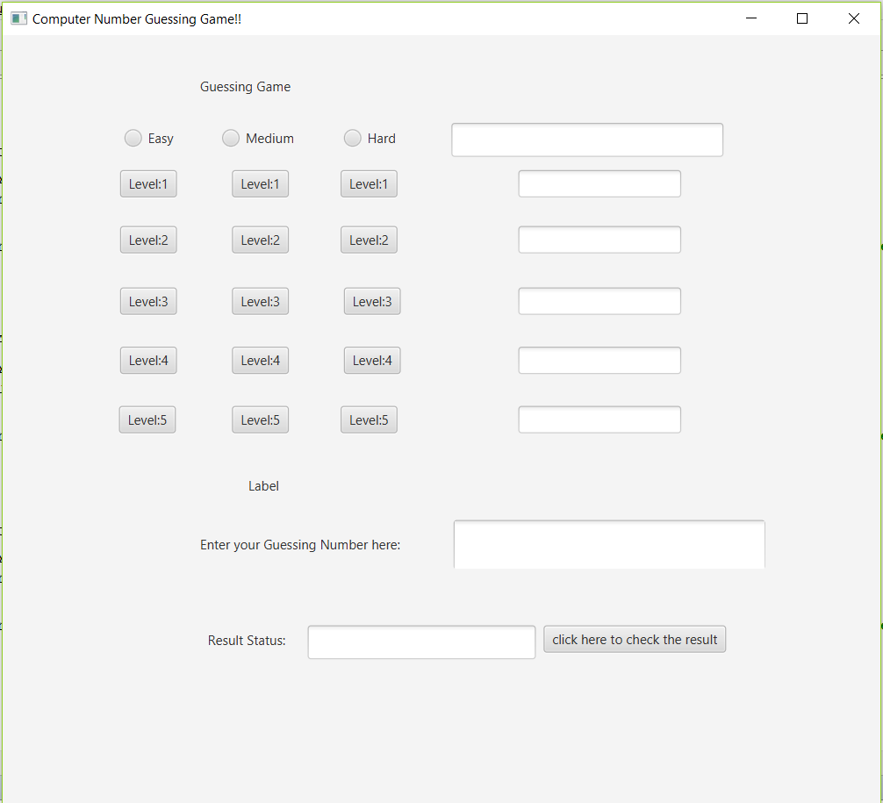

Slide 14




REFERENCES
Complete reference Java Text Book
Javatpoint.com
Geeksforgeeks.com
W3schools.com

