Slide 1
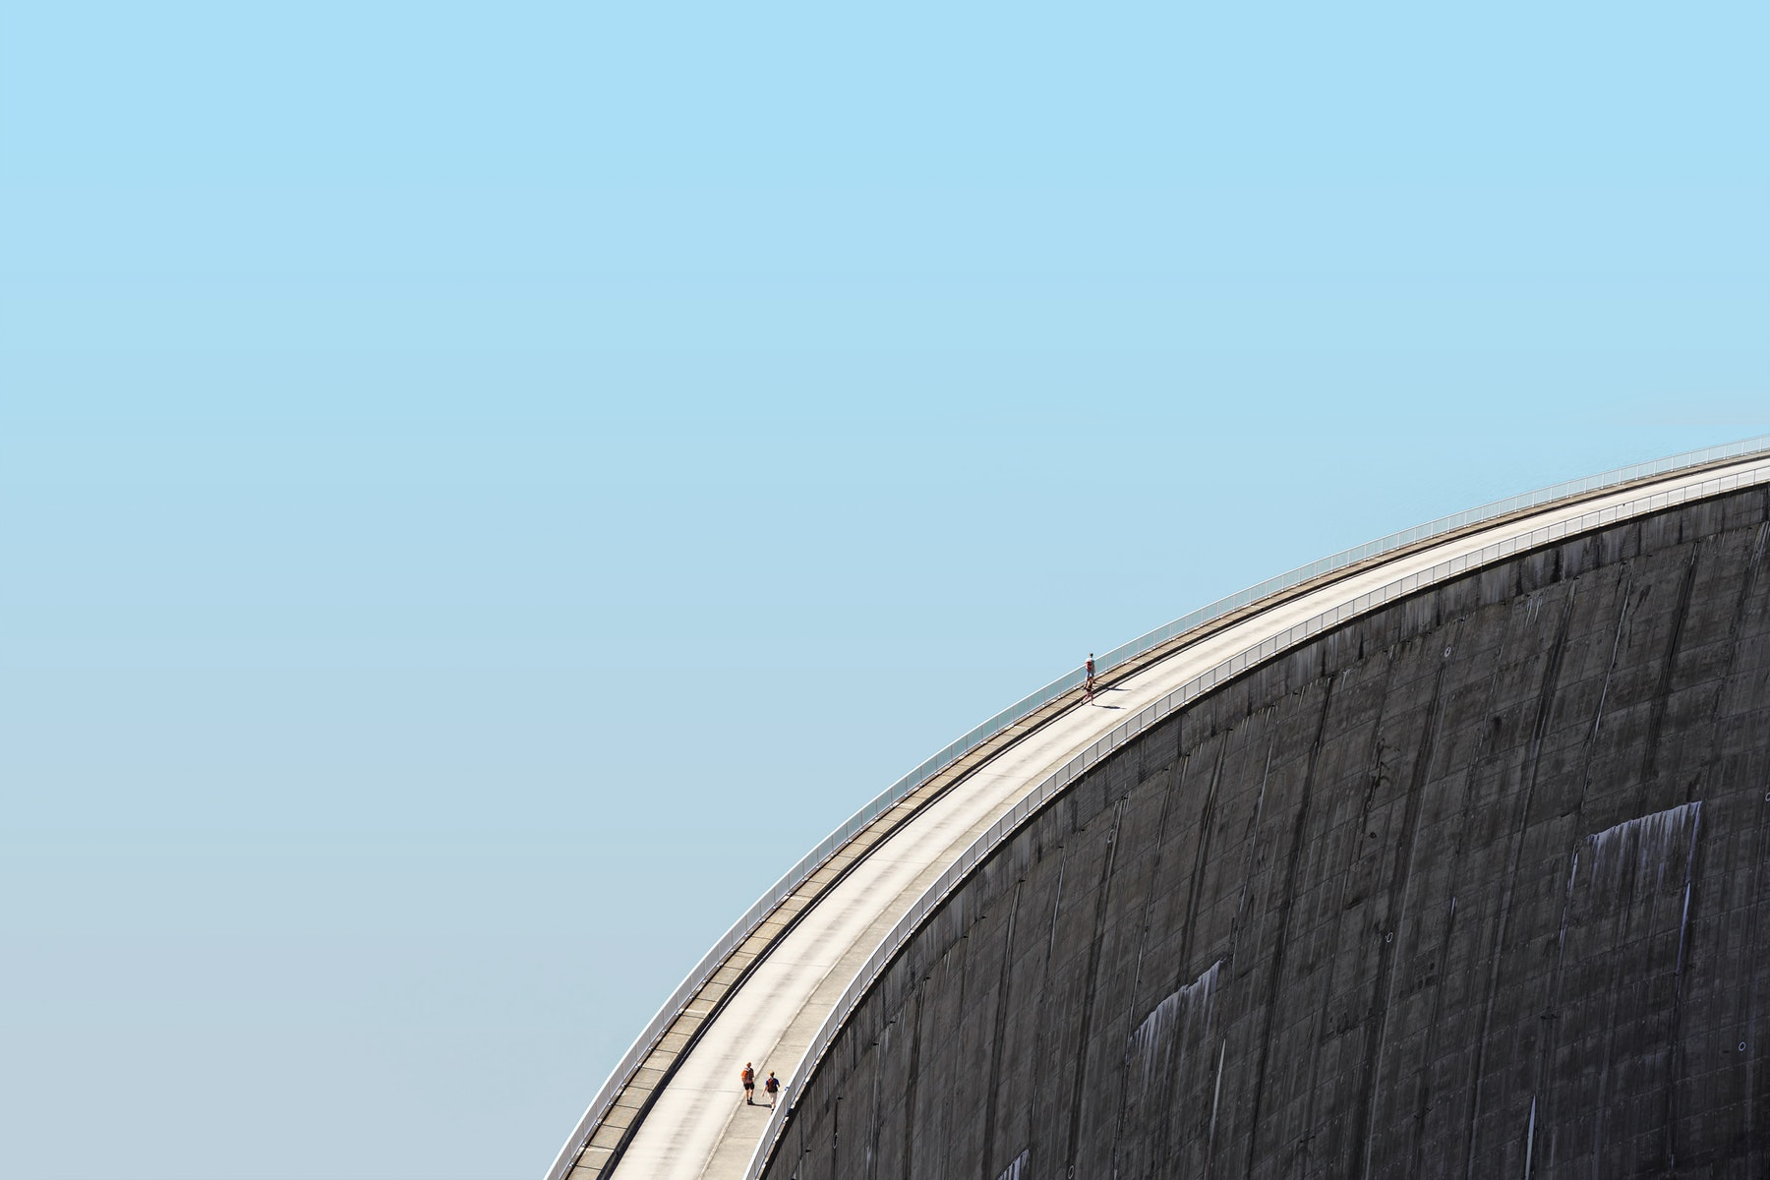
Hydro energy
Iyán Méndez Veiga
Seminar Energy Supply, Climate Change and Nuclear Fusion Research
WS 19-20
Photo: International Energy Agency

Slide 2
Contents
Introduction
  A bit of history and some formulas
The big and small picture
  Hydroelectricity in the World and Germany
Estimation for Germany
Discussion and conclusions
  Advantages & disadvantages, role in the balance sheet

Slide 3
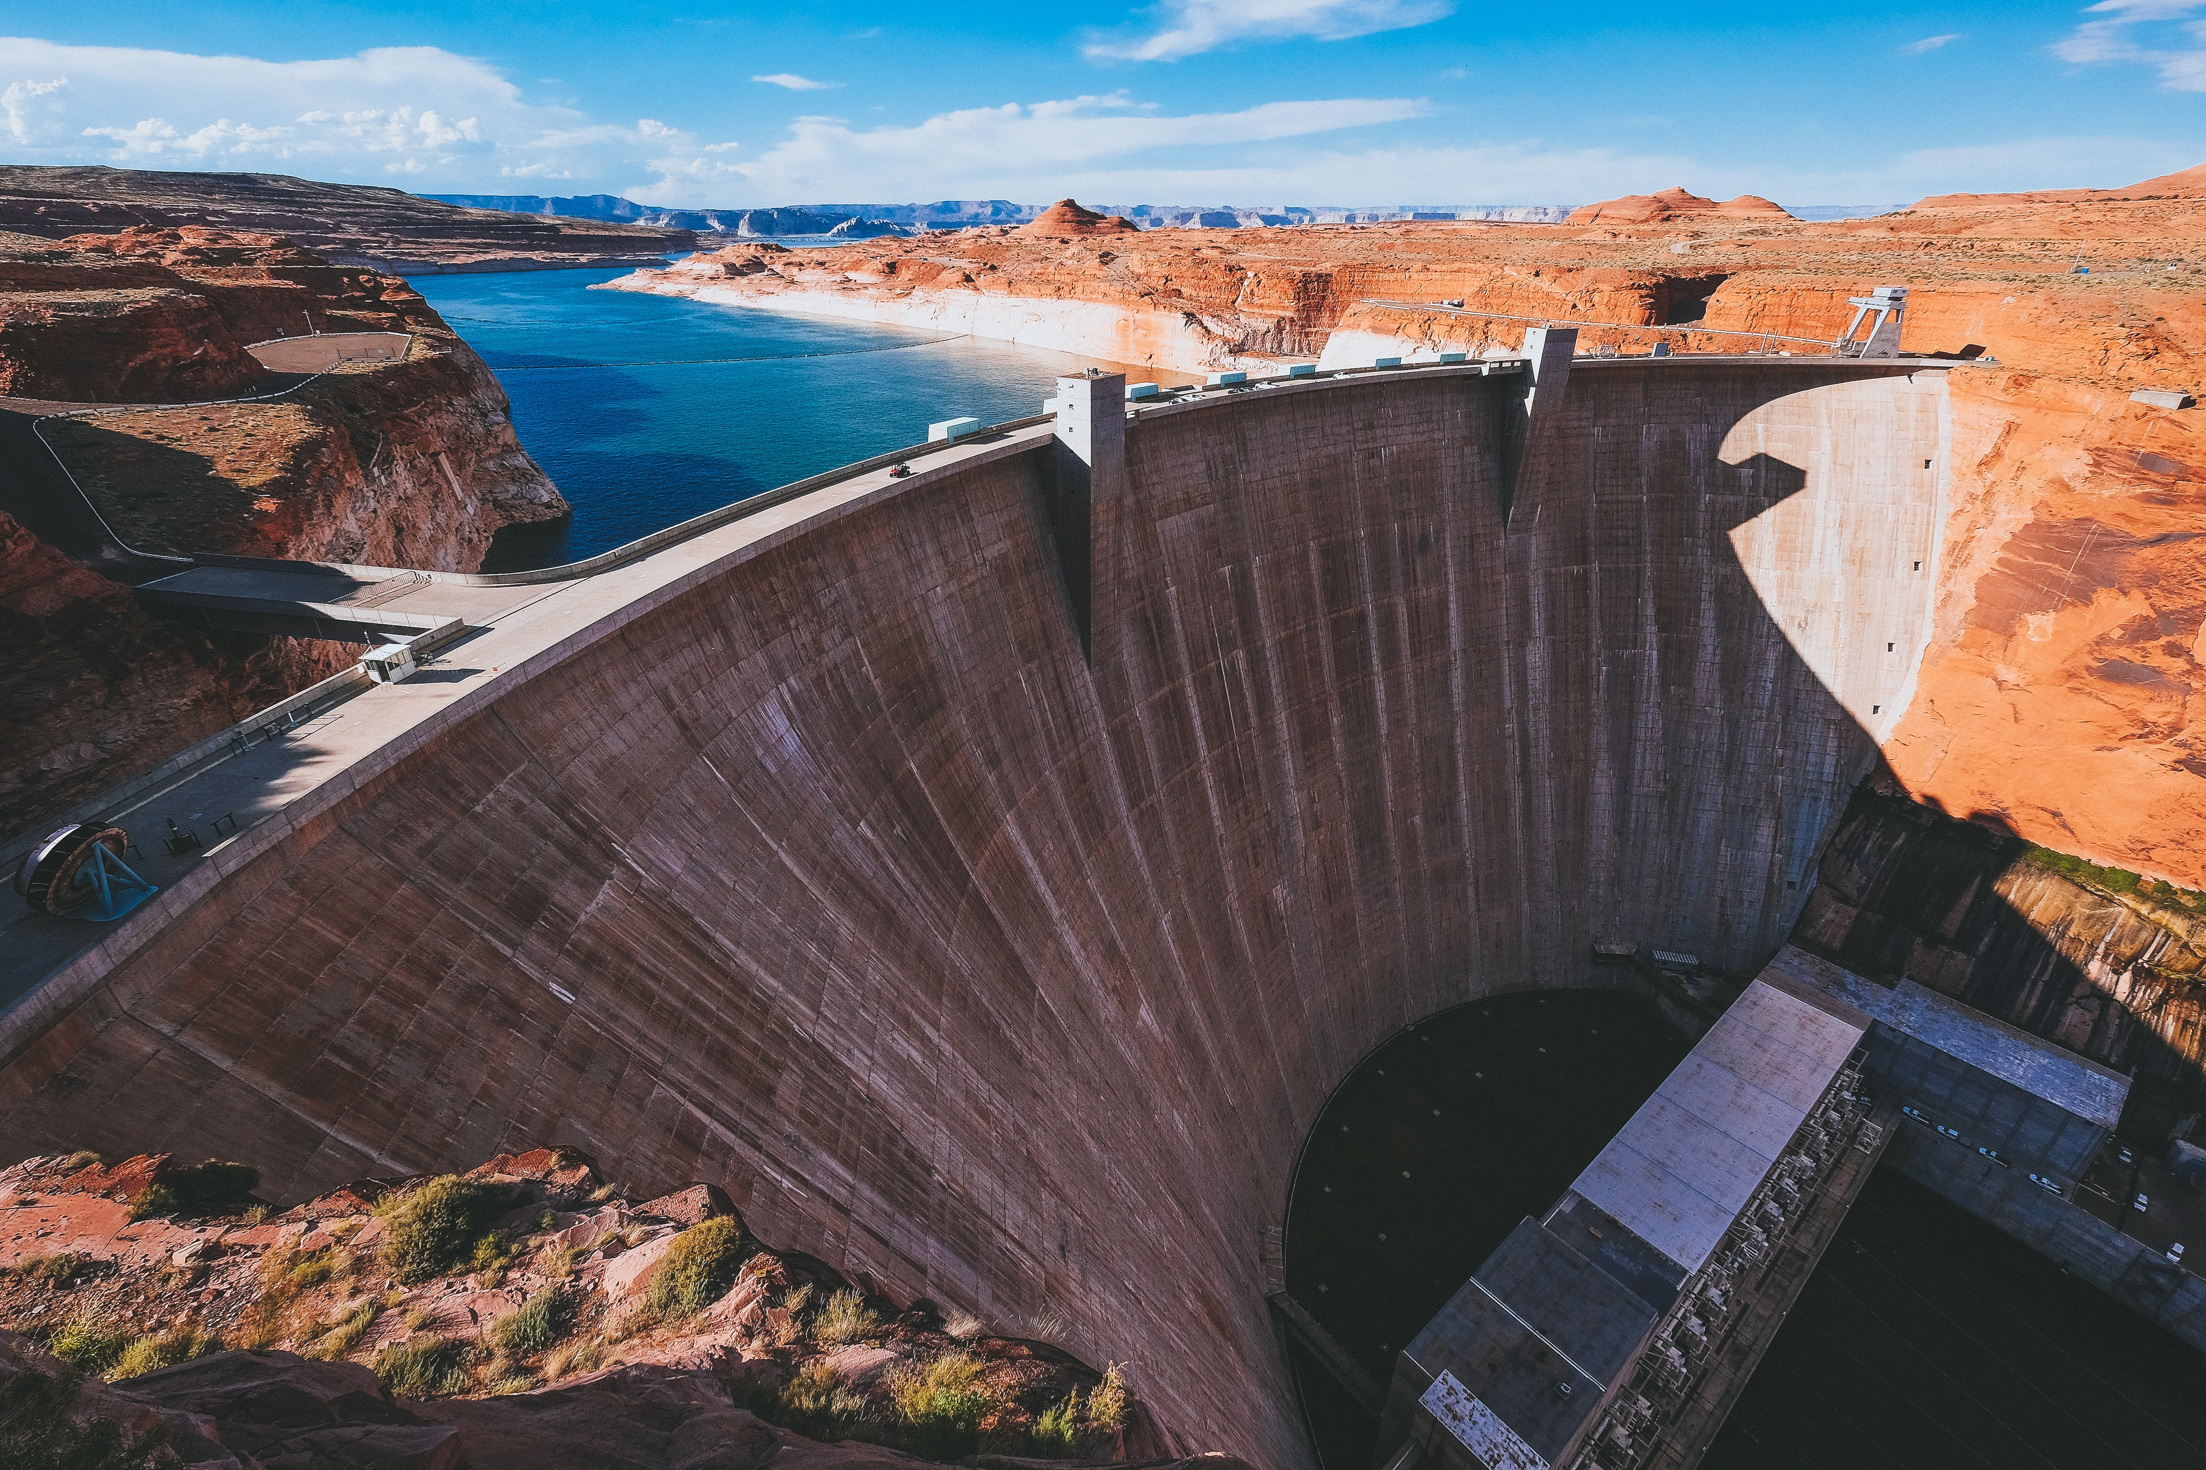
Introduction
Photo: John Gibbons
https://unsplash.com/photos/E2TVn-NpCU4

Slide 4
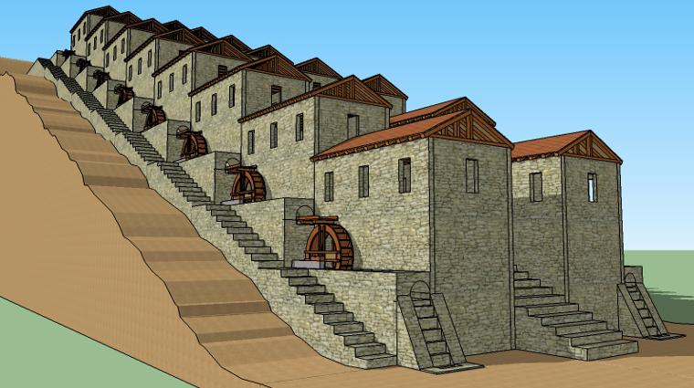
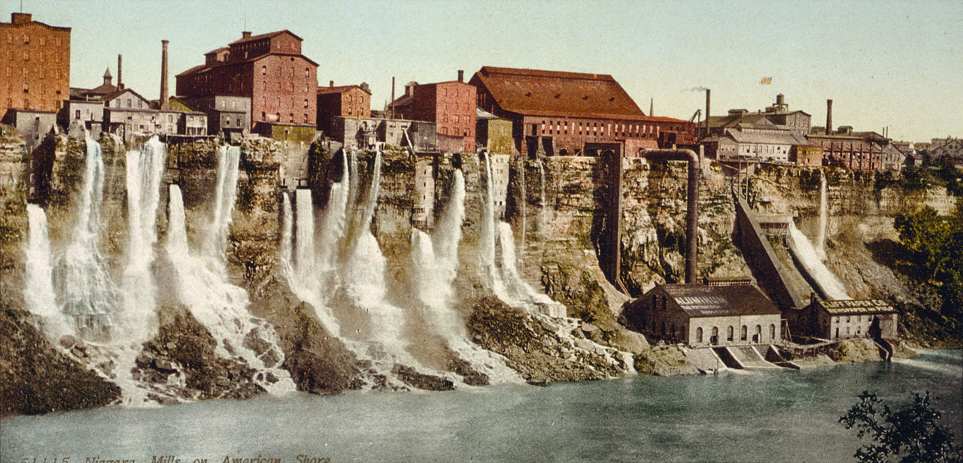
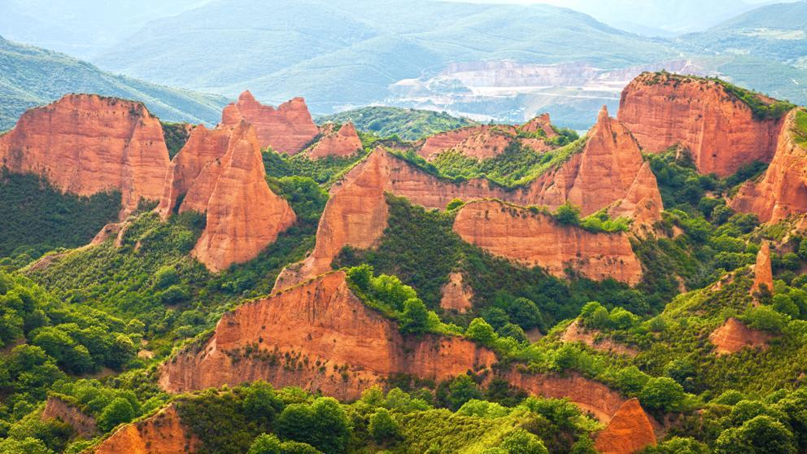
Hydropower
Hydropower is the power derived from flowing water
It has been used by humans for thousands of years (Persian Empire, Egypt, Roman Empire…)
First electric generators around 1880s in UK, US and Canada
Model of the Roman watermill complex at Barbegal (France)
Source: Prof. Dr. Stephen ressler personal website
https://stephenjressler.com/portfolio/roman-mill-complex-at-barbegal/
Photo of the old Schoelkopf power station (US) in 1900
Las Médulas (Spain), the most important gold mine, as well as the largest open-pit gold mine, in the entire Roman Empire.
Source: Wikipedia “Schoellkopf Power Station” (visited on 6.12.2019)
https://en.wikipedia.org/wiki/Schoellkopf_Power_Station
Source: Newspaper “La Vanguardia” (20.09.2019)
http://tiny.cc/l7tlhz
Notes:
Examples of early uses of hydropower: to produce flour from grain, to saw (serruchar) timber (wood, madera) and stone, and even to extract metal ores.
Close to Niagara Falls

Slide 5
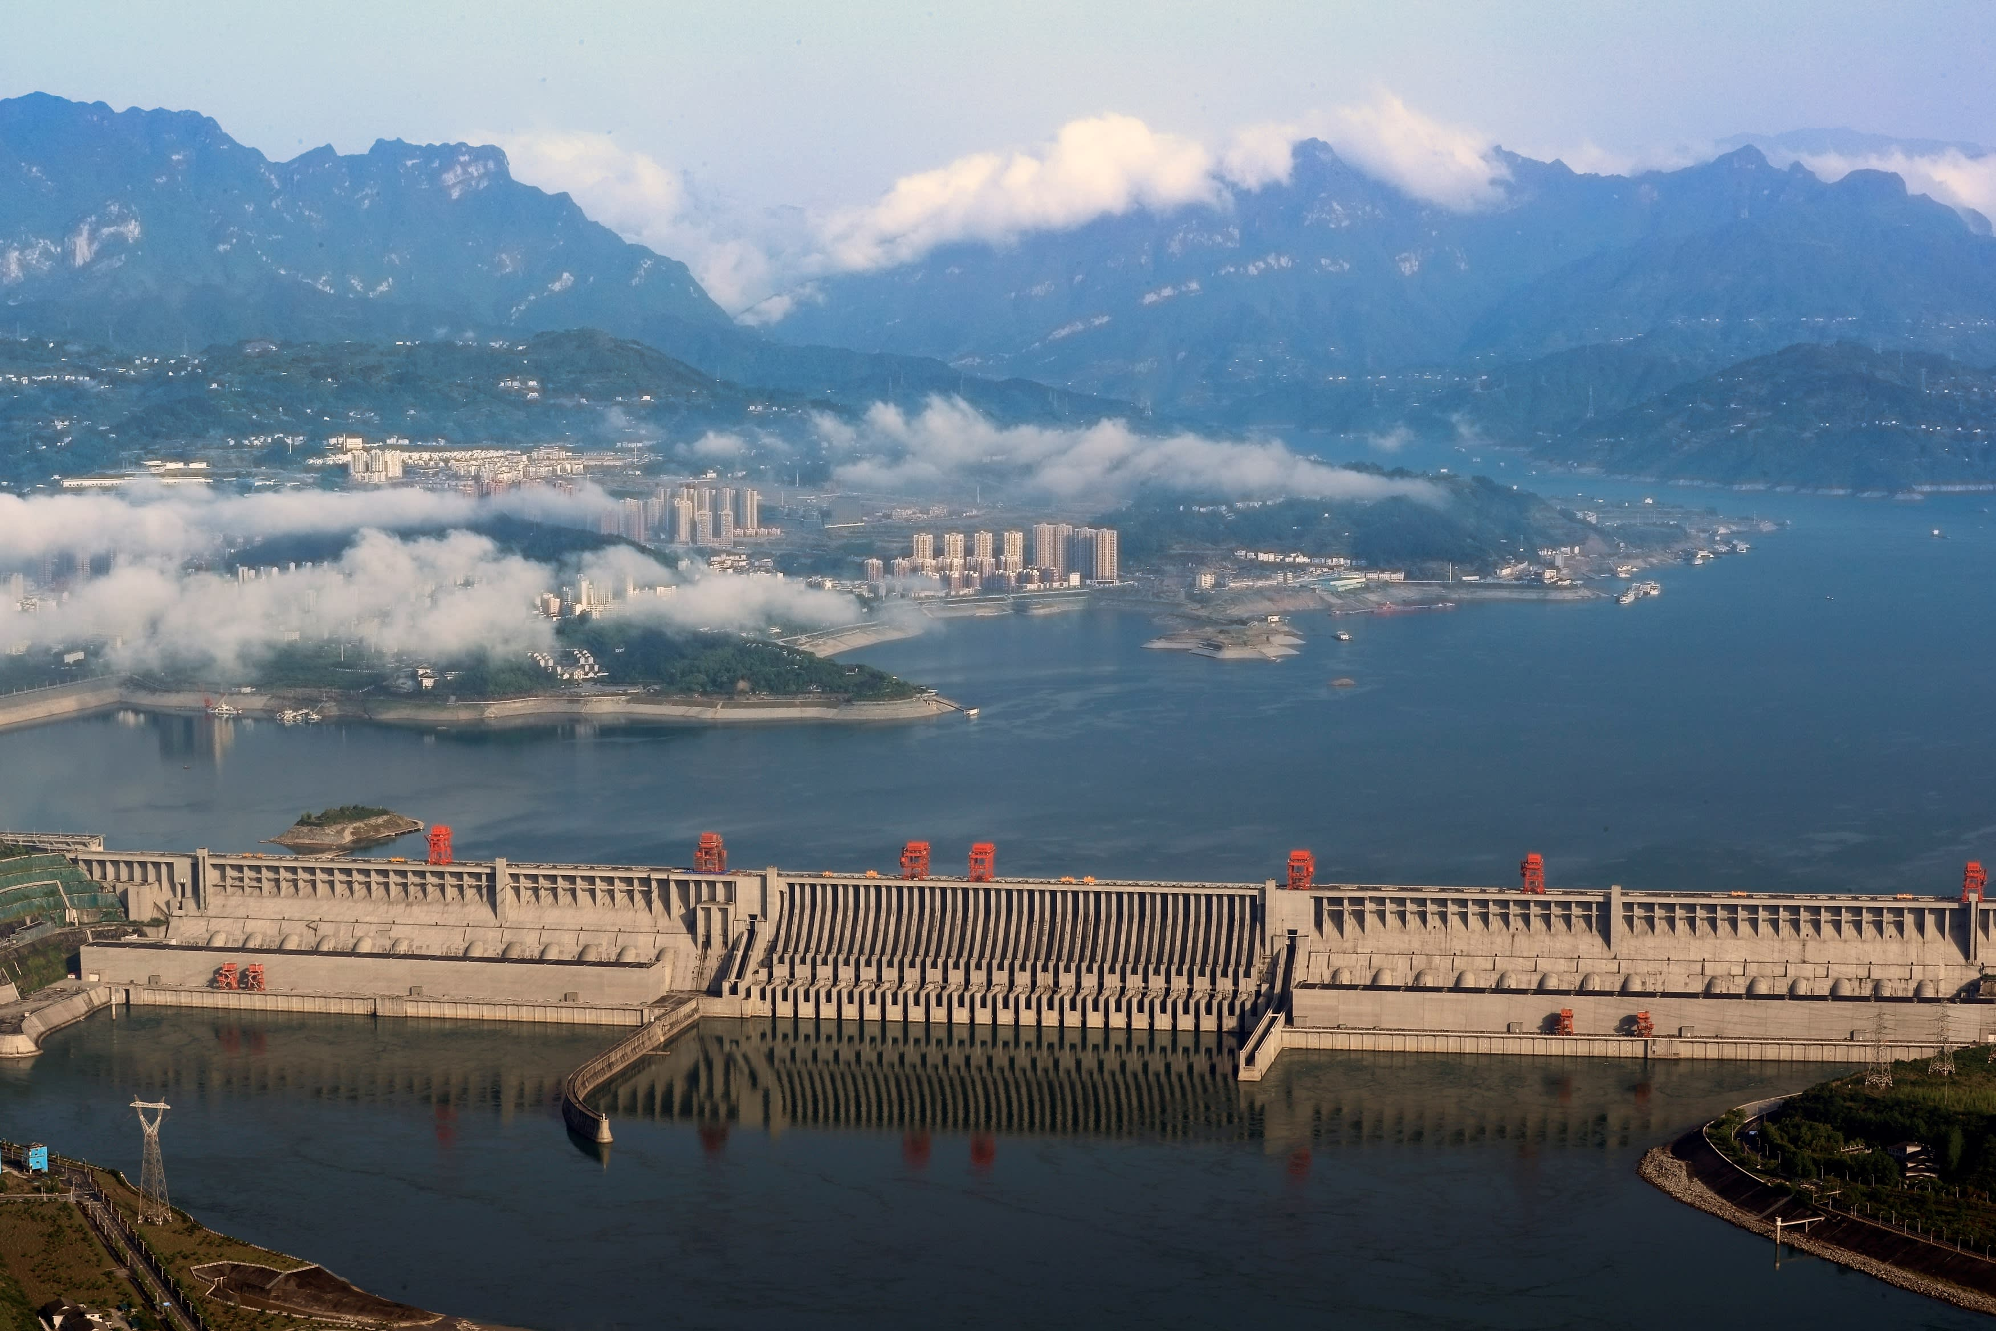
Hydroelectricity (I)
Many small hydroelectric stations constructed at the beginning of 20th century
Large stations from second half of 20th century
There is no official classification but we can divide facilities into: large (>100 MW), small (~10 MW), micro (<100 kW) and pico (<5 kW)
Different methods to generate electricity
  Conventional
  Run-of-the-river (ROR)
  Tide/Wave
  Pumped-storage
The Three Gorges Dam (China) is the biggest hydroelectric power station with a capacity of 22.5 GW
(talk 9.1.2020)
Source: Nikkei Asian Review (visited on 6.12.2019)
https://asia.nikkei.com/Business/Companies/China-s-Three-Gorges-rules-out-new-domestic-hydro-projects
(next talk)
Notes:
I will define capacity on the next slide, I just want to show the number and compare it with the capacity of an average nuclear plant, for example.
The Gundremmingen Nuclear Power Plant produces 2.5 GW.
The biggest nuclear power plant produces almost 8 GW.
Construction started on December 14, 1994. Full operation until May 2012.

Slide 6
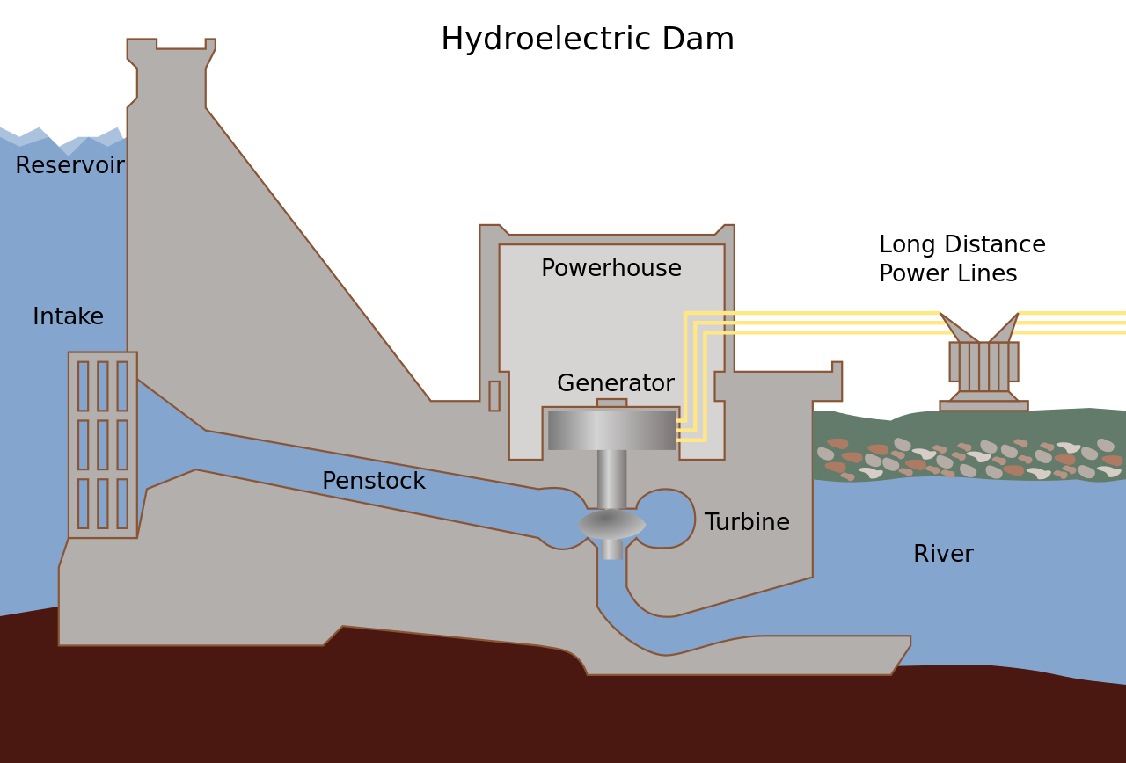
Hydroelectricity (II): Conventional (dam + reservoir)
Conventional hydroelectric power stations use the potential energy of dammed water driving a water turbine and generator
The capacity depends on the the volume flow rate and the height difference between the source and the water's outflow (usually the term head from fluid dynamics is used for this)
Efficiency is often higher (~1) in stations with larger and modern turbines
Volume flow rate can be regulated using the reservoir
Cross section of a conventional hydroelectric dam
Source: Wikipedia “Hydroelectricity” (visited on 10.12.2019)
https://en.wikipedia.org/wiki/Hydroelectricity

Slide 7
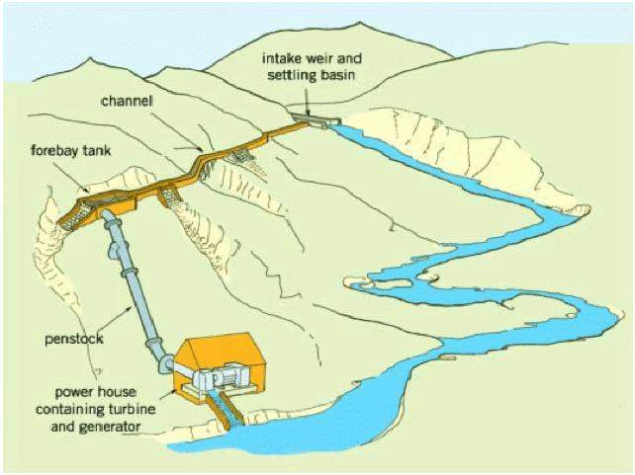
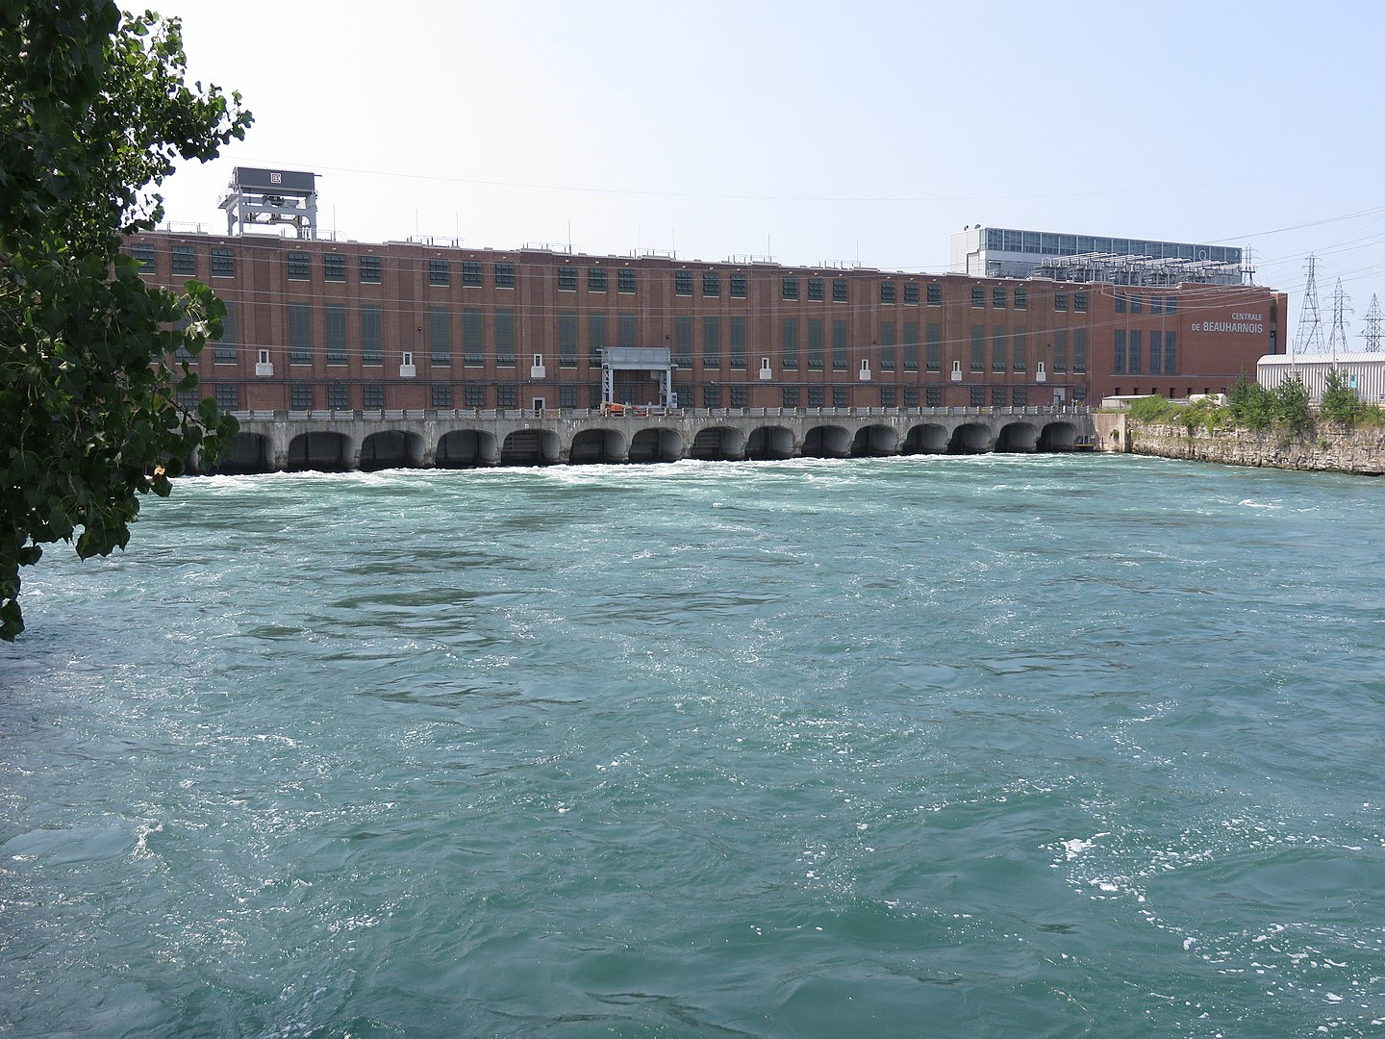
Hydroelectricity (III): Run-of-the-river (ROR)
Same idea but ROR power stations have no reservoir
The volume flow rate is subject to seasonal river flows
Previous formula still valid, but what is the head now?
Alternative (but equivalent) derivation (analogous to Wind power)
Example of a ROR power station where a part of the river flow is deviated to a turbine
Source: Mbaka, John & Mwaniki, Mercy. (2017). Small Hydro-power Plants in Kenya: A Review of Status, Challenges and Future Prospects. Journal of Renewable Energy and Environment. 3. 20-26.
Hint to proof equivalency: Bernoulli's equation (conservation of energy for incompressible fluids)
Beauharnois ROR hydroelectric power station in Quebec (Canada)
Source: Wikipedia “Beauharnois generating station” (visited on 13.12.2019)
Notes:
ROR stations can have a very limited amount of storage and this is called “pondage”
The power station 'Böfinger Halde' is the most powerful hydroelectric power station of Stadtwerke Ulm / Neu-Ulm and was commissioned in 1953.
The average annual production of the power plant is 51 GWh, which corresponds to an average power of 5.8 MW.

Slide 8
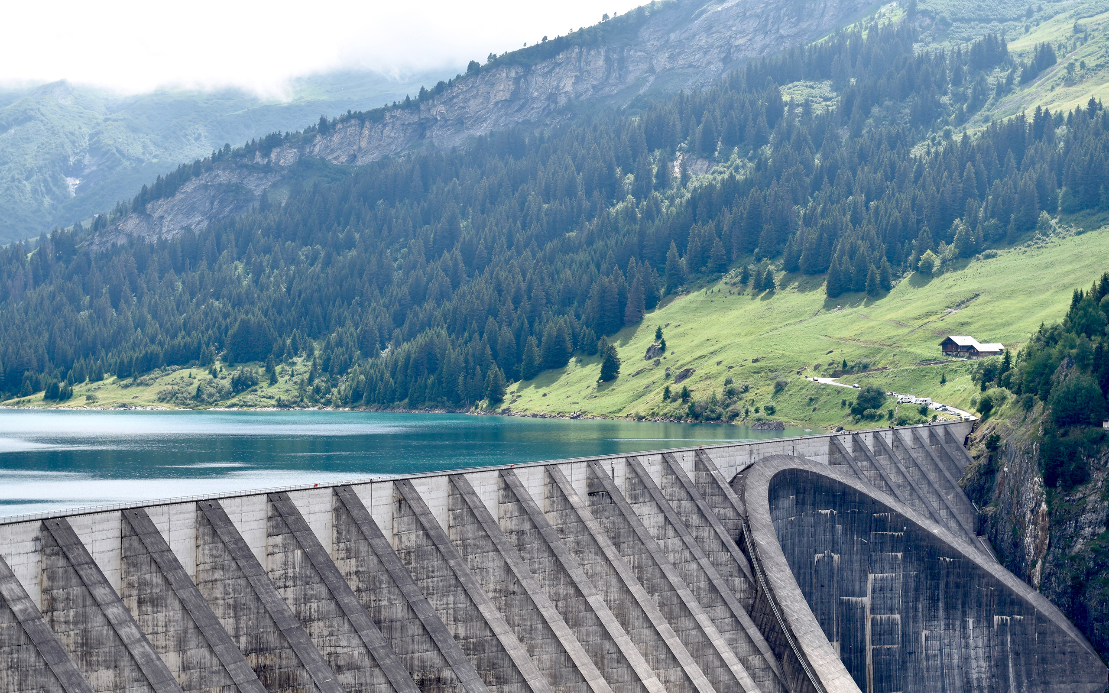
Some numbers
Photo: Anthony Da Cruz
https://unsplash.com/photos/SGOm1cy4O5Q

Slide 9
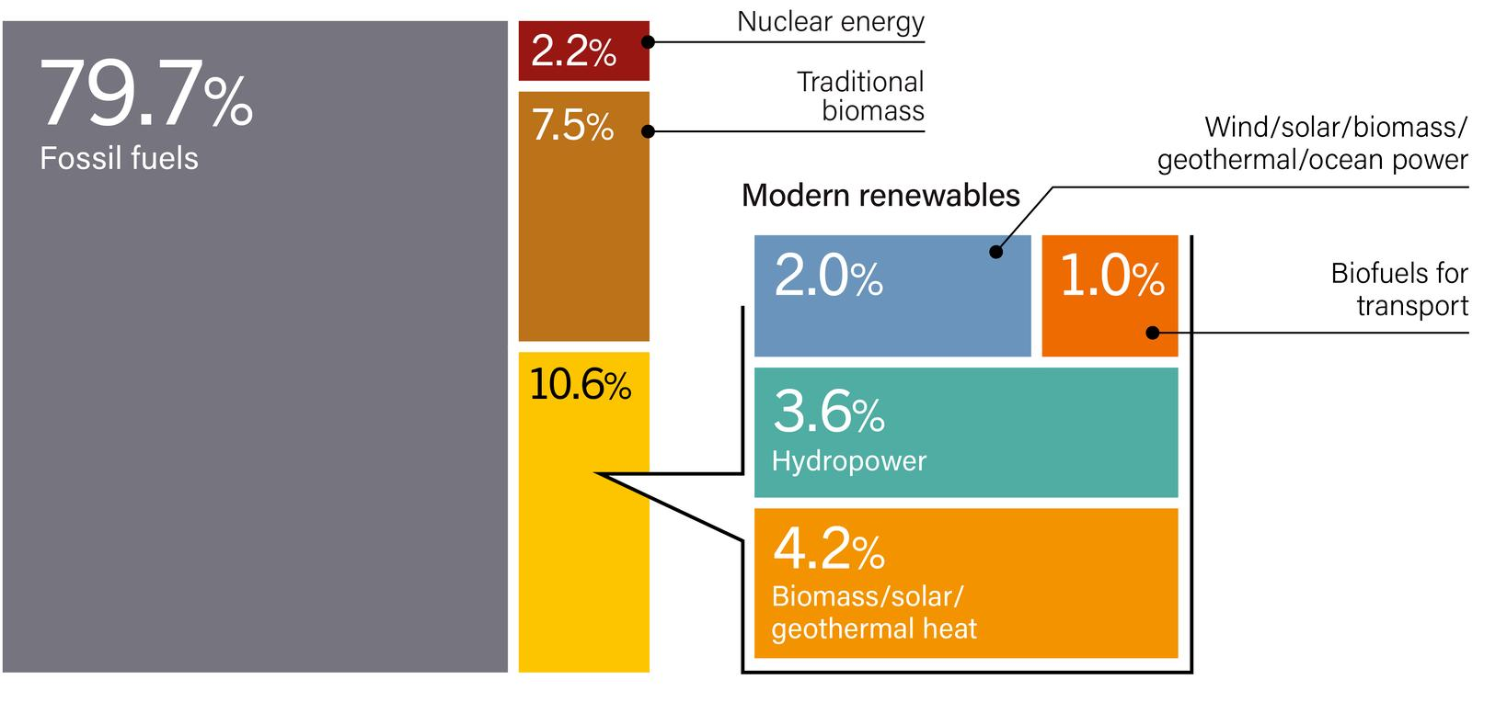
The big picture (I)
Estimation of the renewable share of the total final energy consumption (TFEC) in the world in 2017
Renewables 2019 Global Status Report
https://ren21.net
Based on OECD/IEA, World Energy Balances and Statistics, 2018 edition (Paris, 2018)
https://www.iea.org/statistics/balances/

Slide 10
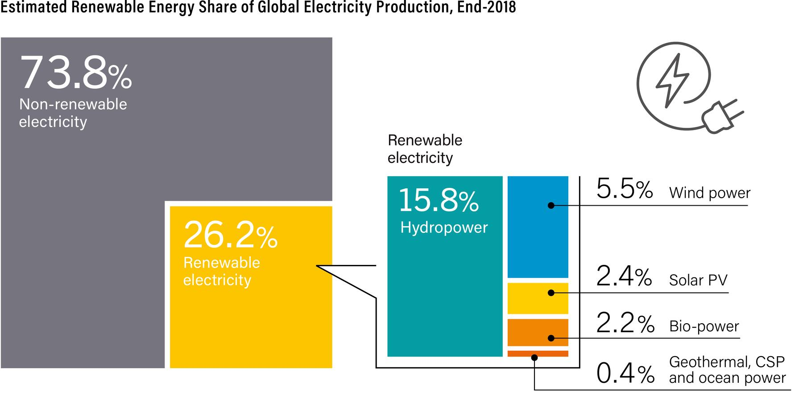
The big picture (I)
Renewables 2019 Global Status Report
https://ren21.net
60% of renewable electricity comes from hydropower

Slide 11
The big picture (II)
The total hydropower capacity install worldwide is about 1132 GW
Worldwide generation from hydropower in 2018 is estimated 4210 TWh (enough to supply “1.1 Germanies”) → ~2 kWh/d/p
Global renewable power capacity grew to around 2378 GW in 2018
After PV (~55%) and wind (~28%), hydropower accounts for ~11% of the total renewable power generation growth (new ~ 20 GW added)
China leads the investment raking in new hydropower facilities followed by Brazil, Pakistan and Turkey
Hydropower accounted for ~60% of renewable electricity production in 2018, followed by wind power (~21%), solar PV (~9%) and bio-power (~8%)
Notes:
Germany energy consuption: 3777 TWh
The energy production varies each year with shifts in weather patterns and other local conditions

Slide 12
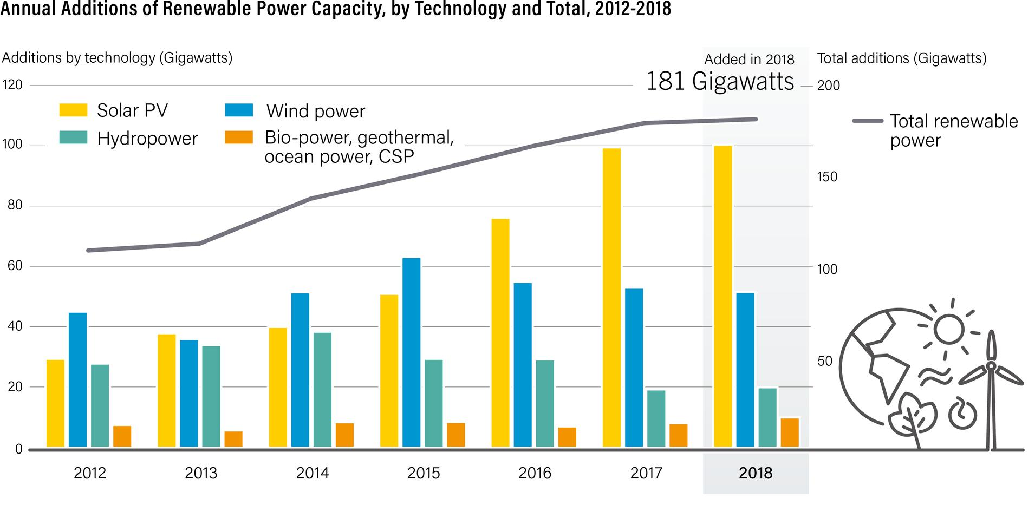
The big picture (III)
Renewables 2019 Global Status Report
https://ren21.net

Slide 13
The small picture (Germany)
The installed hydropower capacity in Germany is 11.258 MW (including 6.806 MW of pumped storage), this is ~1% of world hydropower capacity (in 2018)
Hydropower generation produced 16.290 GWh in 2018 → ~0.5 kWh/d/p
Due to drought, hydropower generation dropped almost 15%, and contributed 2.6% of total power production, accounting for just over 7% of total generation from renewables
The majority of the country’s hydropower resources are located in the mountainous southern provinces, with 50% of all projects located in Bayern and 20% in Baden-Württemberg
These two states account for over 80% of annual German hydropower production

Slide 14
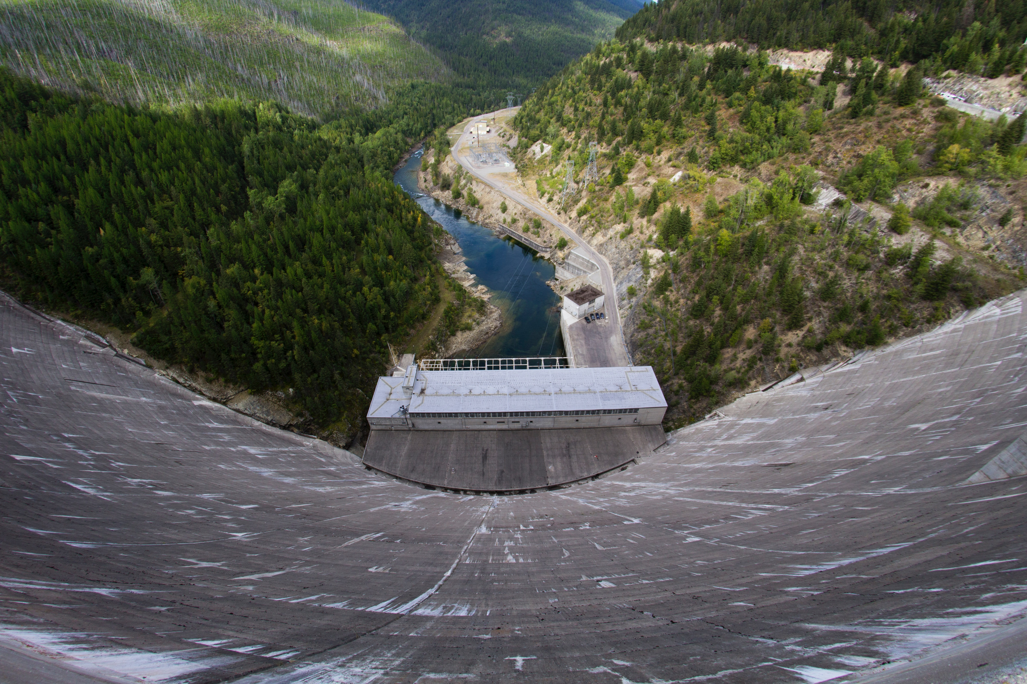
My estimation for Germany
Photo: Steve Halama
https://unsplash.com/photos/JHaFjDuri2A

Slide 15
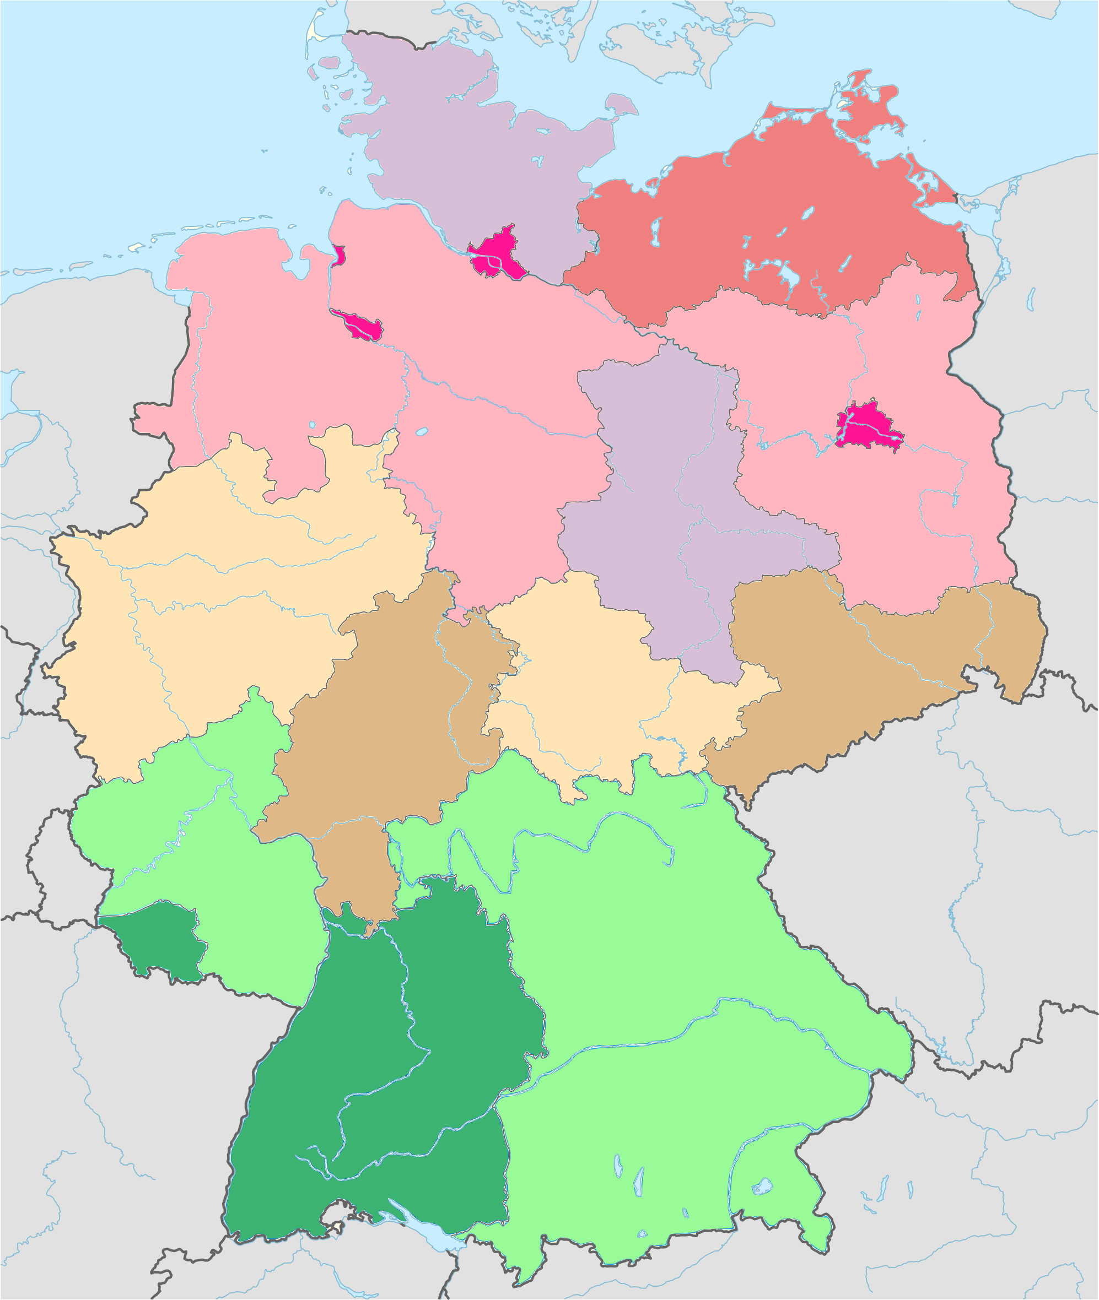
Method
Divide Germany in three regions: southern, central and northern states
Calculate annual rainfall averages for each region
Calculate average altitude of each region
Plug numbers into formula above to get the theoretical upper bound for hydropower per unit area in each region
Estimate plausible practical limit from the upper bound
Reference: David JC MacKay, “Sustainable Energy – without the hot air” (p.55)
https://www.withouthotair.com/c8/page_55.shtml
Original file: Wikimedia “Germany adm location map.svg”
https://commons.wikimedia.org/wiki/File:Germany_adm_location_map.svg
Notes:
1 mm = 1L/m^2

Slide 16
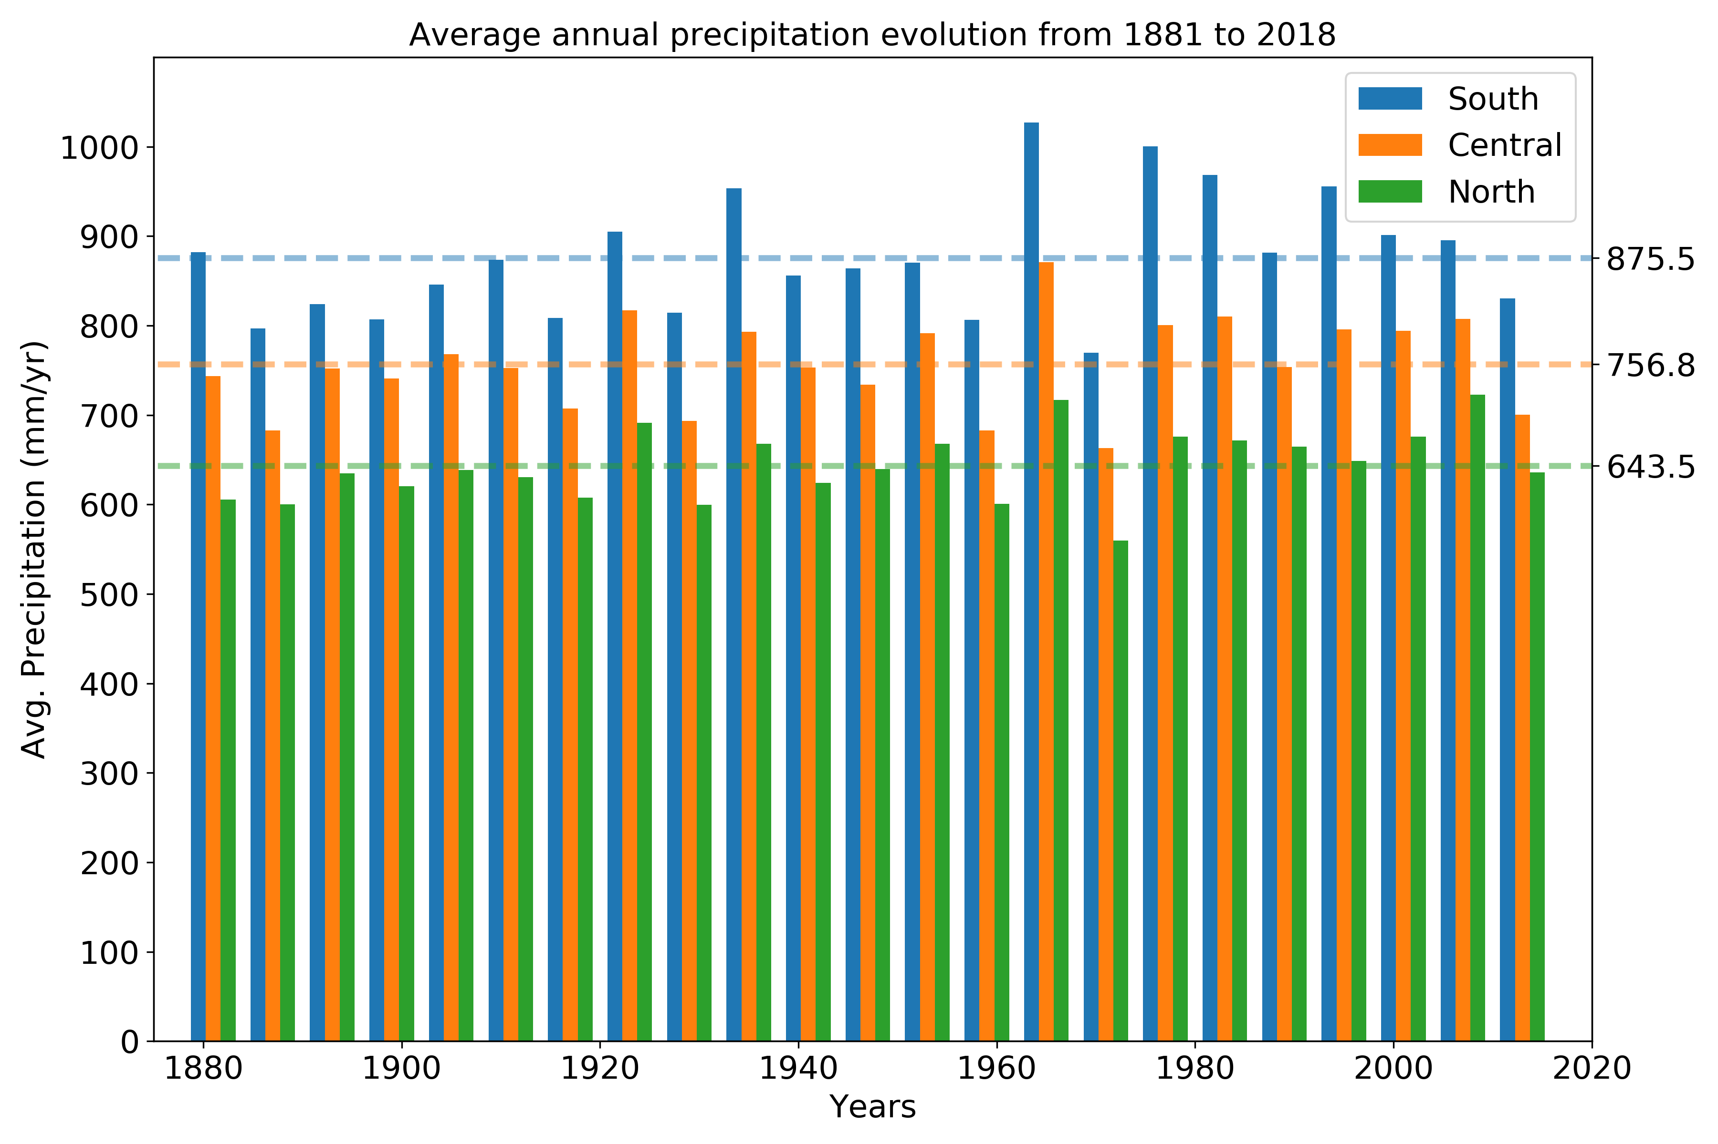
Annual rainfall averages
Raw data from the Deutscher Wetterdienst (DWD)
http://tiny.cc/eg5lhz

Slide 17
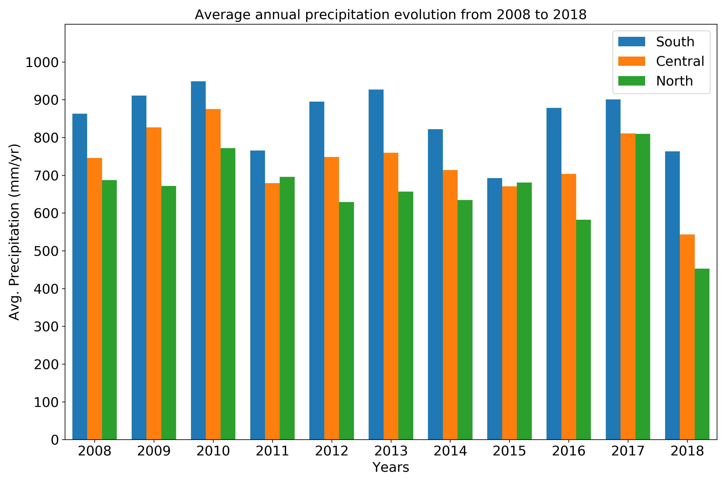
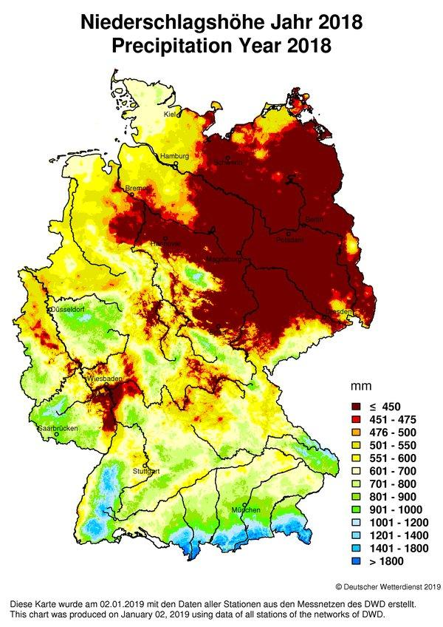
Drought in 2018 (and 2019)
A decrease in precipitations has affected the amount of hydroelectricity produced in Germany

Slide 18
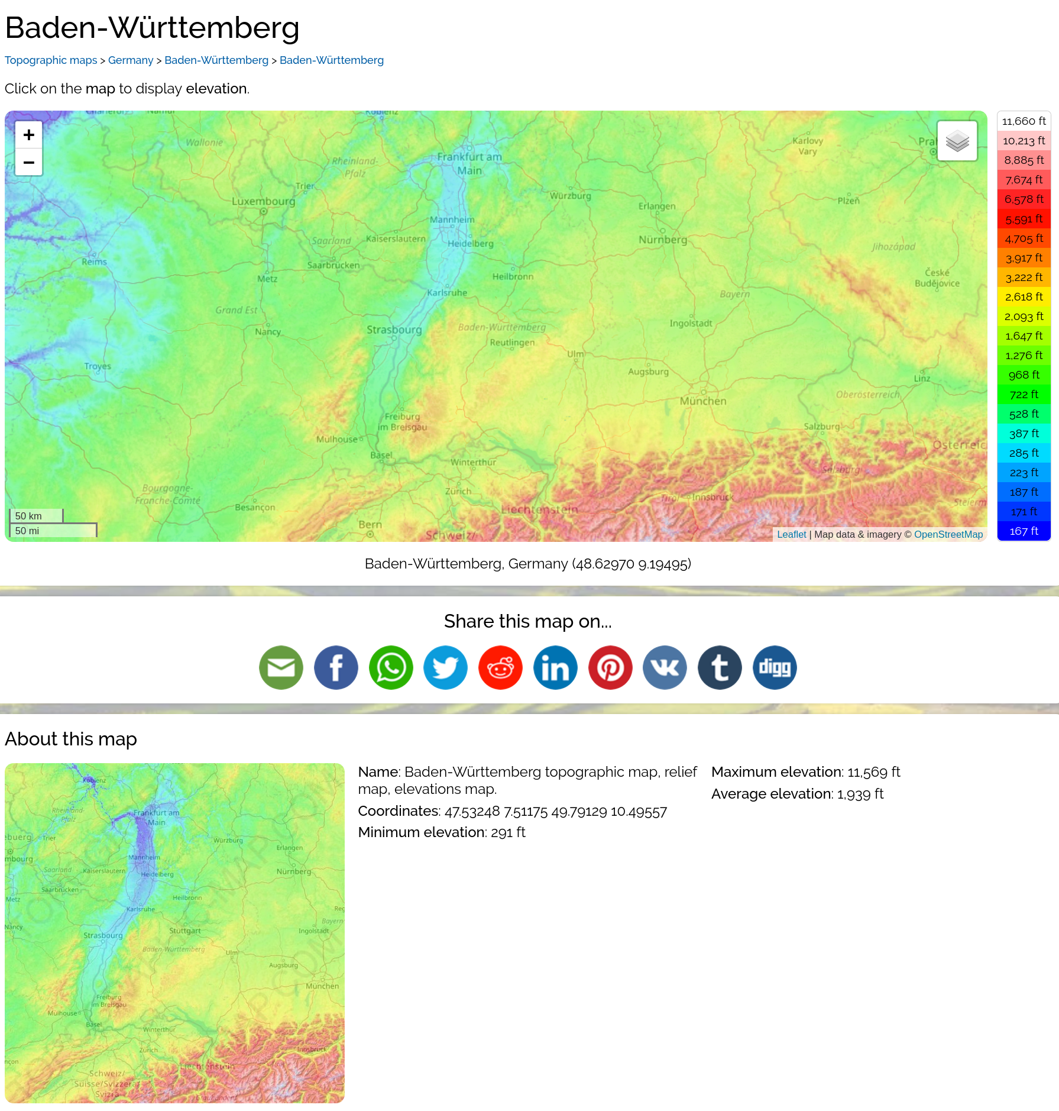

Average altitudes
Average altitude for each state obtained from topographic-map.com
Average altitude for each region computed as the weighted (with areas) average
Average altitude of southern states = 562 m
Average altitude of central states = 255 m
Average altitude of northern states = 89 m
Example for Baden-Württemberg state
Source: https://en-gb.topographic-map.com/maps/lpy6/Baden-W%C3%BCrttemberg/

Slide 19
Theoretical upper bound power per unit area
Region | Rainfall (mm/yr) | Altitude (m) | Upper bound (W/m²) | Upper bound (kWh/d/p)
Southern | 876 | 562 | 0.16 | 5.9
Central | 757 | 255 | 0.06 | 1.6
Northern | 643 | 89 | 0.02 | 0.7

Slide 20
Estimation
Region | Upper bound (kWh/d/p) | Estimation (kWh/d/p) | Actual real number (kWh/d/p)
Southern | 5.9 | 1.2 | ?
Central | 1.6 | 0.3 | ?
Northern | 0.7 | 0.1 | ?
Germany | 8.2 | 1.6 | 0.5

Slide 21
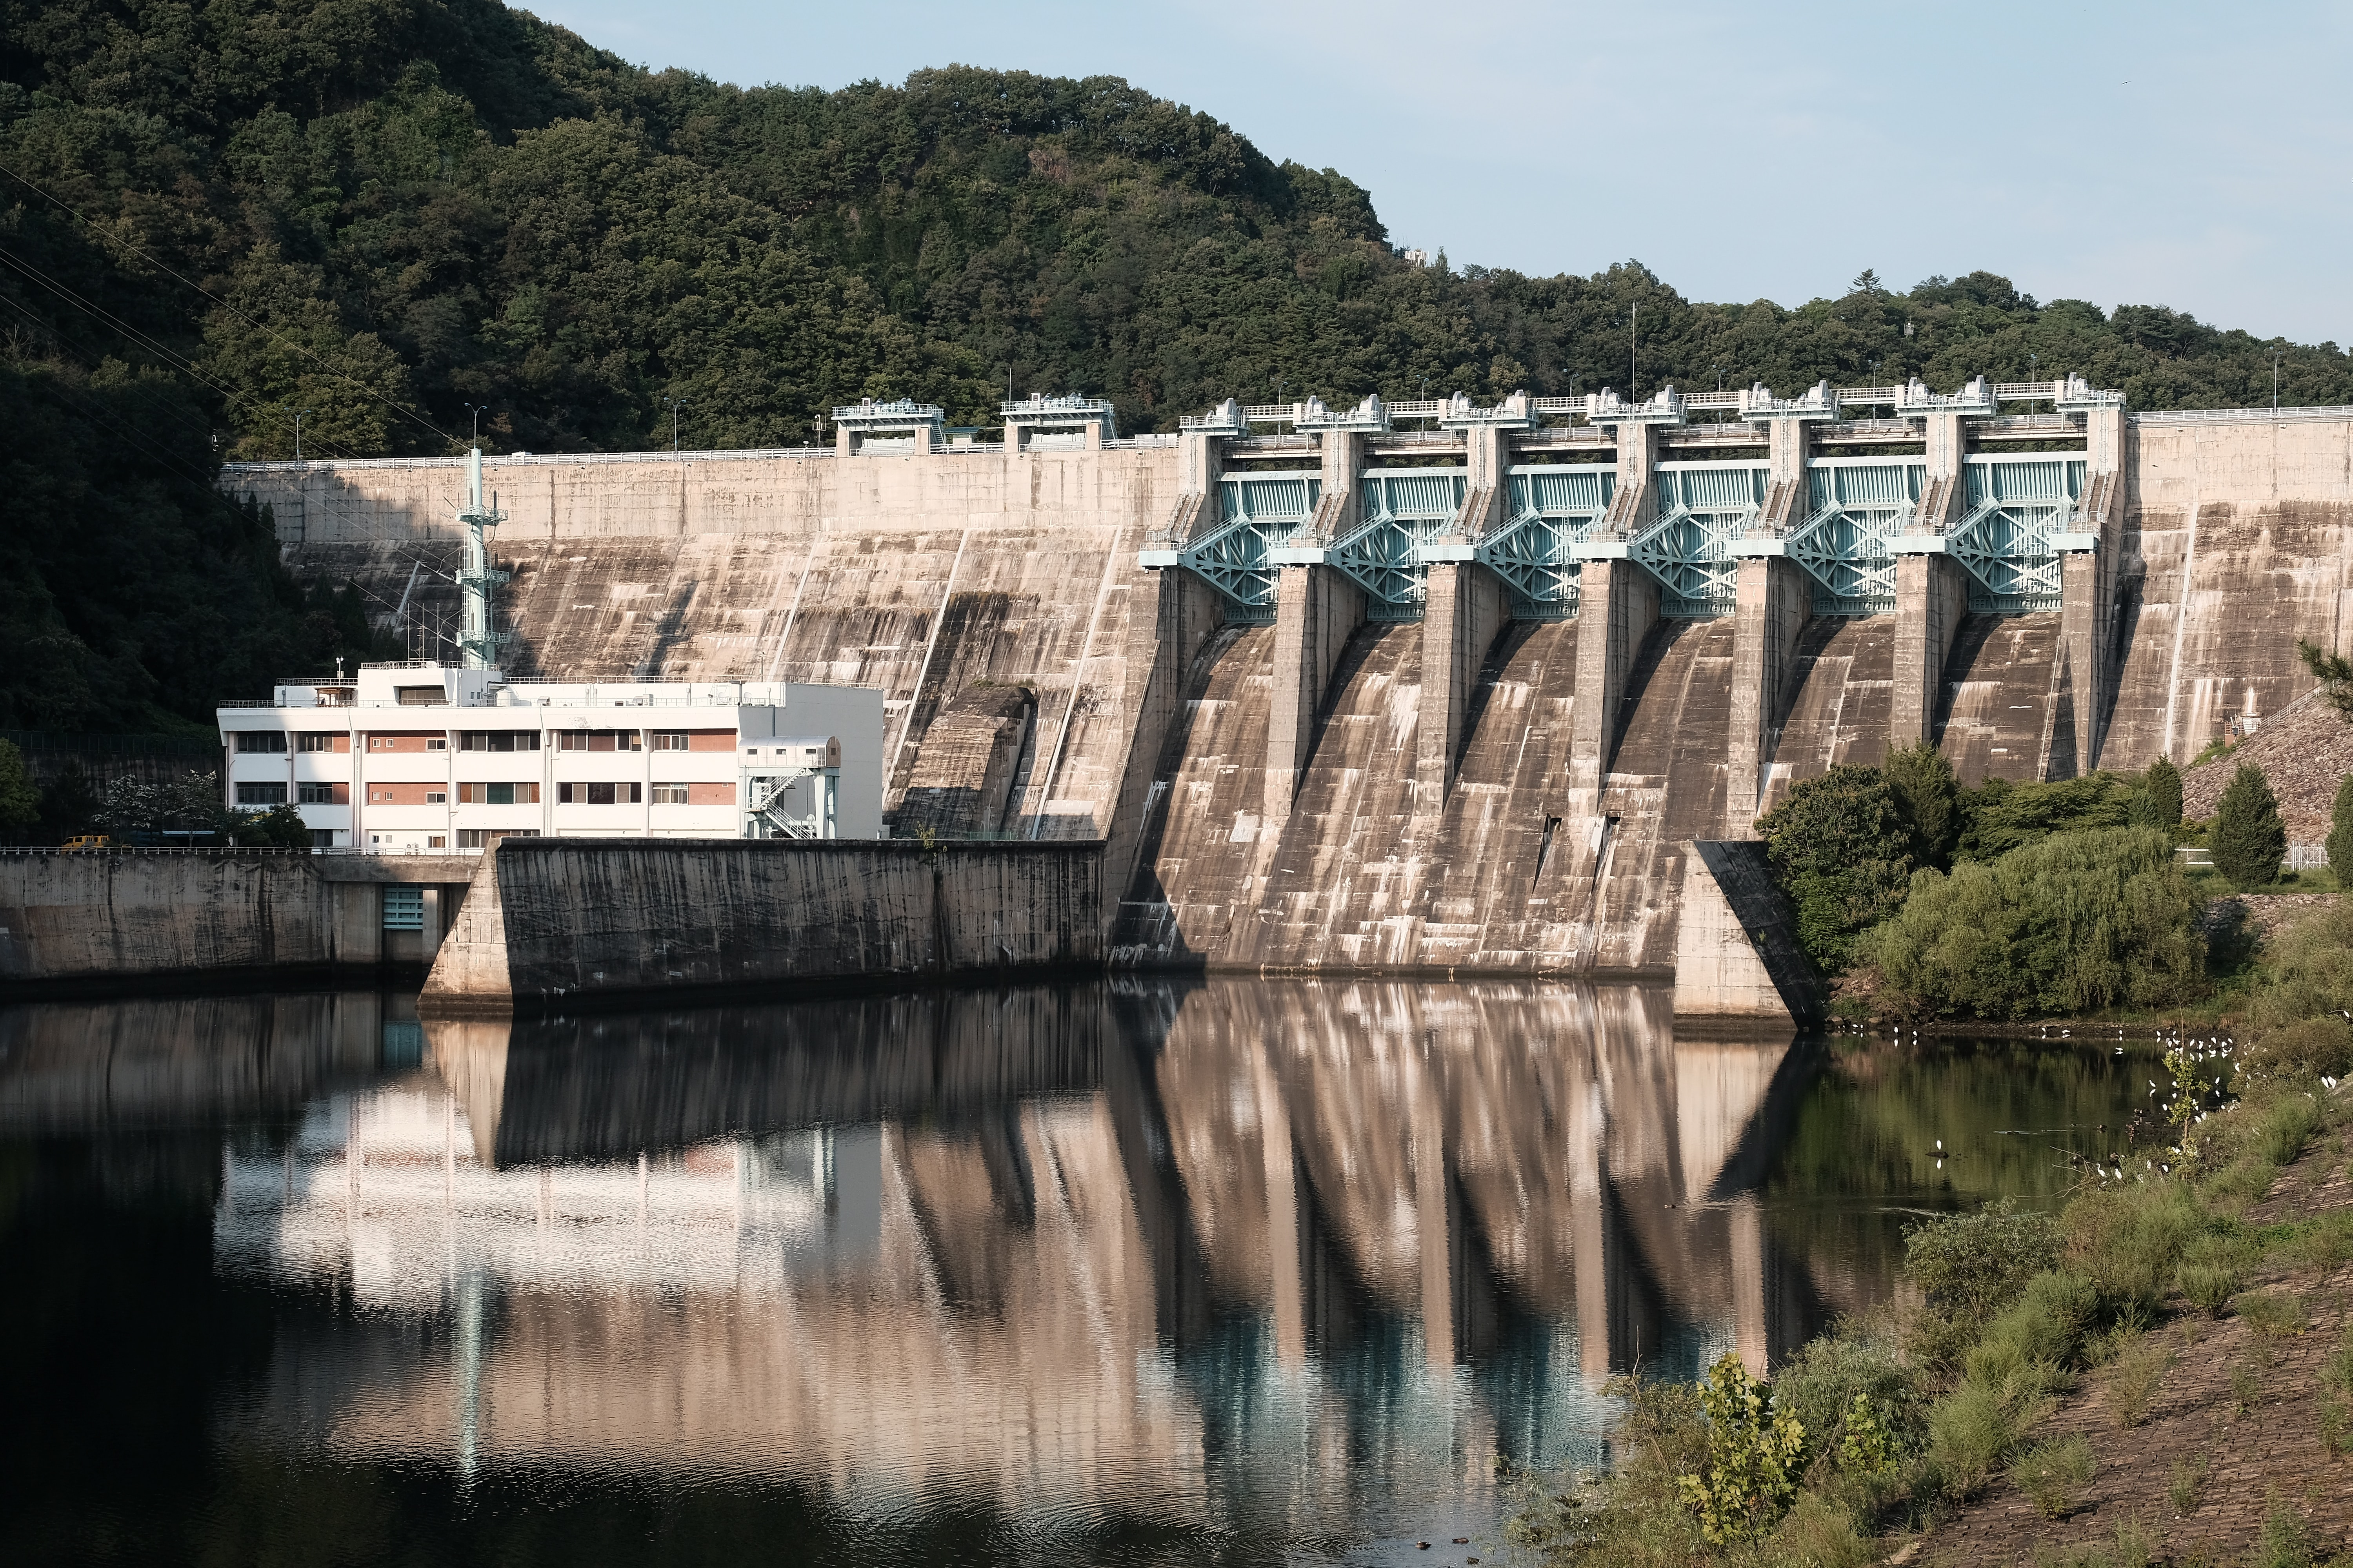
Discussion and conclusions
Photo: Hanbyul Jeong
https://unsplash.com/photos/7kwODn2_b2o

Slide 22
Advantages & Disadvantages
Advantages
It is a renewable energy source
Flexibility (~1 min from cold start-up to full load)
Low cost and high value
Low CO₂ emissions
It can support the use of intermittent sources of renewable energy (PV, Wind...)
Disadvantages
Damage ecosystem
Loss of land
Water loss
Methane emissions
Relocation of people
Failures and disasters
Most (if not all) of the disadvantages and negative effects arise from the use of dams and reservoirs, not from the hydroelectric stations
Notes:
Methane emissions → due to plant material in flooded areas decaying in an anaerobic environment and forming methane, a greenhouse gas.
Between 40 and 80 million people relocated worldwide.
As of June 2008, China relocated 1.24 million residents as 13 cities, 140 towns and 1350 villages either flooded or were partially flooded by the reservoir

Slide 23
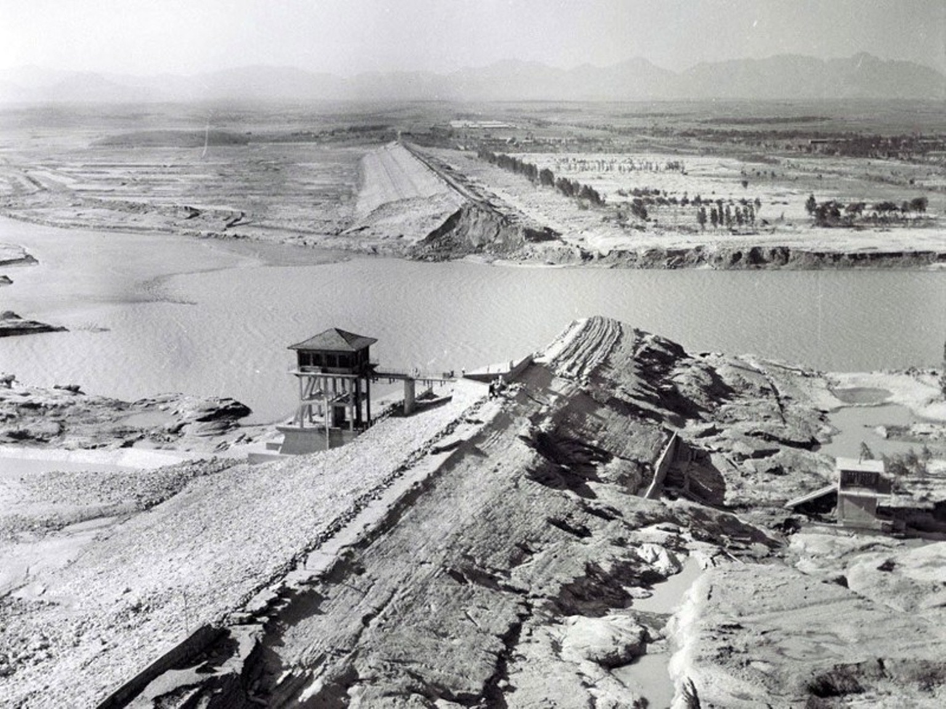
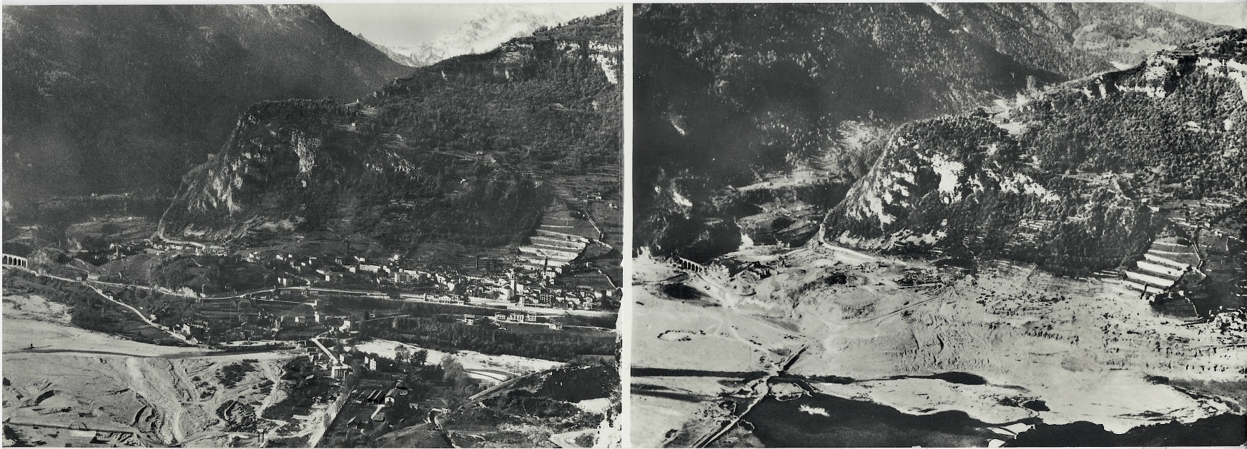
Accidents
Almost all accidents related to the failure of the dam
Natural disasters or sabotage can be catastrophic to downriver settlements and infrastructure
Longarone (Italy), before and after 50 million cubic metres of water overtopped the dam in a wave of 250 metres
Source: Wikipedia “Vajont Dam” https://en.wikipedia.org/wiki/Vajont_Dam
Banqiao Dam was the world’s deadliest infrastructure failure ever
Source: https://www.ozy.com/flashback/230000-died-in-a-dam-collapse-that-china-kept-secret-for-years/
Notes:
Almost 2000 people died in Italy

Slide 24
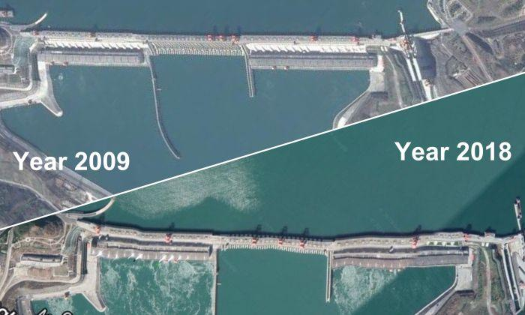
Future accidents?
Aerial photos of the Three Gorges Dam (China) in 2009 and 2018
Source: http://www.visiontimes.com/2019/08/16/satellite-photos-raise-fears-about-condition-of-three-gorges-dam.html
Notes:
Tricky comparison. Not really the same angle, so hard to compare. Anyway, mention some of the concerns about this huge dam.

Slide 25
Role of hydro energy in the balance sheet
(As of 2017) it has an important role within the renewables
In Germany (and many other countries) it will not be relevant in terms of kWh/d/p
It may have a role as integration element of other renewables (PV, wind) and to deal with intermittency
160 GW (6806 MW in Germany) of pumped storage capacity worldwide. Is this enough/relevant? (maybe next talk?)

Slide 26
Summary
Hydropower is the power derived from flowing water
We saw two methods to generate electricity: conventional and ROR
Hydropower generation in Germany produced around 0.5 kWh/d/p
My estimation (20% of theoretical upper bound) was about 1.6 kWh/d/p
Not relevant (~1%) for Germany with a consuption of 126 kWh/d/p
It may help integrating other renewables and dealing with intermittency

Slide 27
References
MacKay, David J. C. Sustainable Energy — without the Hot Air. Cambridge, England (2009)
Renewables 2019 Global Status Report (REN21) (http://www.ren21.net/gsr-2019/)
International Hydropower Association (https://www.hydropower.org/country-profiles/germany)
“Hydropower” article from Wikipedia (https://en.wikipedia.org/wiki/Hydropower)
“Hydroelectricity” article from Wikipedia (https://en.wikipedia.org/wiki/Hydroelectricity)
International Energy Agency (https://www.iea.org/reports/tracking-power-2019/hydropower)
Yang, Xiankun & Lu, X.X.. (2013). Ten years of the Three Gorges Dam: A call for policy overhaul. Environmental Research Letters. 8. 1006-. 10.1088/1748-9326/8/4/041006.

Slide 29
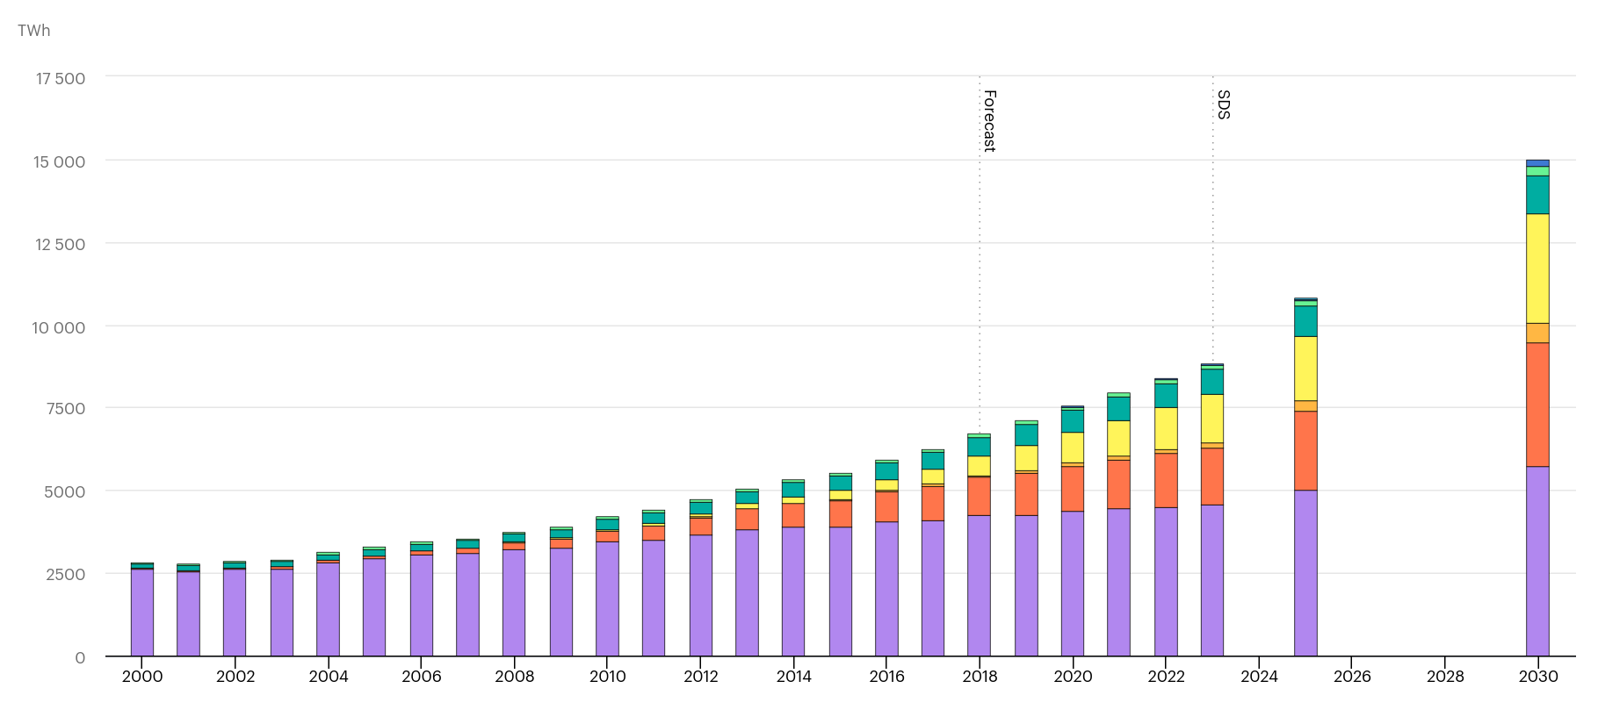
Renewable power generation by technology
Tracking power from IEA
Source: https://www.iea.org/data-and-statistics/charts/renewable-power-generation-by-technology-in-the-sustainable-development-scenario-2000-2030

Slide 30
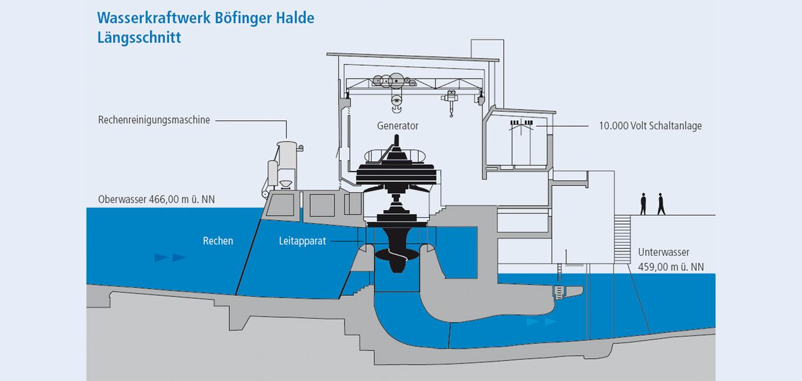
https://www.swu.de/privatkunden/unternehmen/erzeugung/kraftwerke/wasserkraftwerk-boefinger-halde/

