Slide 1
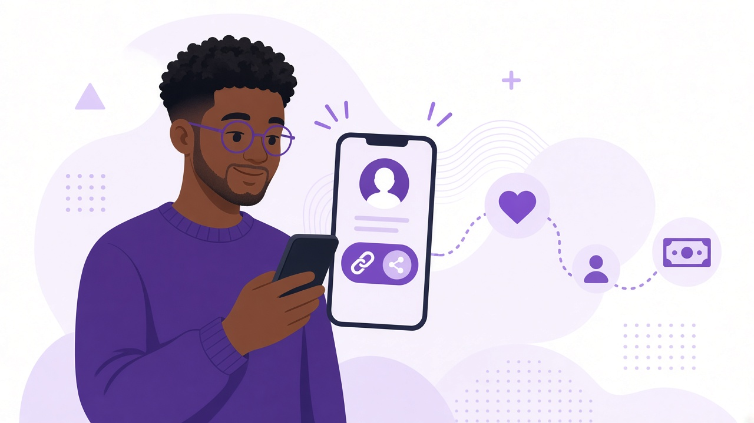
TippyMe
01
LIVE PRODUCT | SOLO FOUNDER
Support shouldn't require
a bank account in a DM.
One link for everyone who wants to support your work.
tippyme.click ->
Investor conversation | 2026
Notes:
TippyMe gives creators one personal link where their community can support their work. The product is live and was built by one founder. This is not a concept deck; it is an invitation to help turn a working product into a focused, repeatable business.

Slide 2
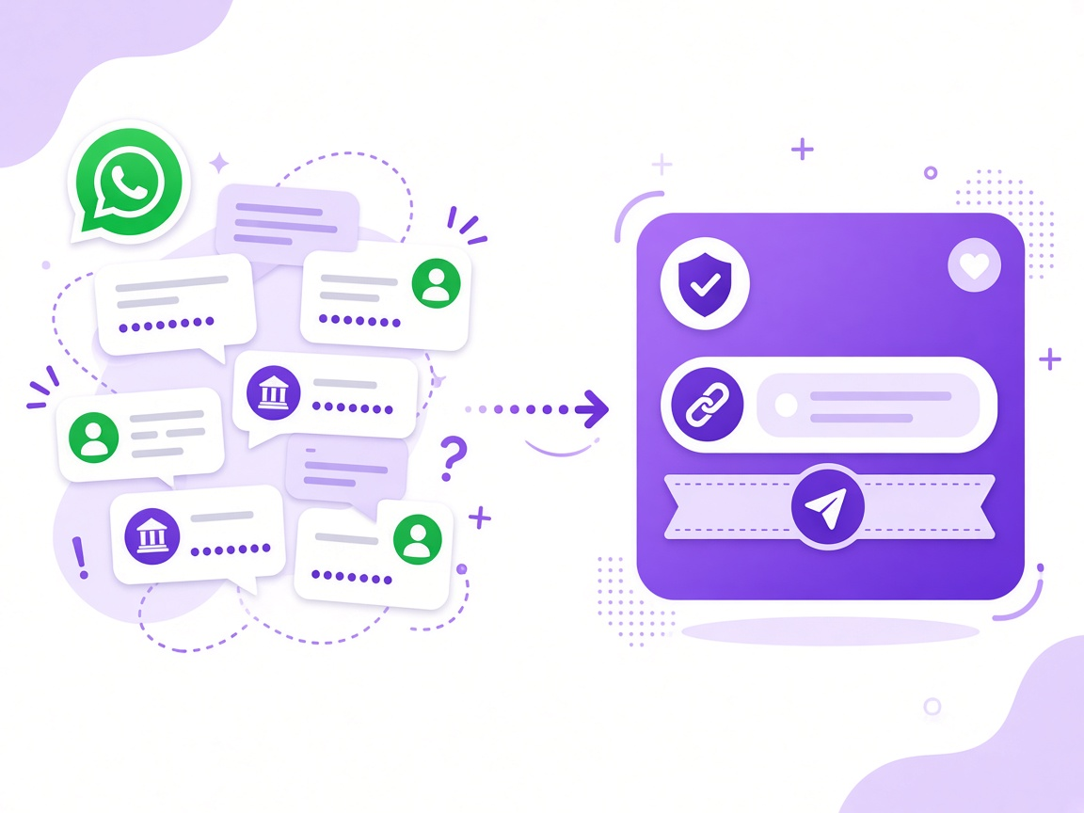
TippyMe
TippyMe
02
THE PROBLEM
The desire to support exists.
The experience gets in the way.
01
Bank details in chats
Account numbers get copied into DMs and group chats.
02
Scattered payment tools
Support becomes a multi-step task instead of a simple thank you.
03
A narrow creator lens
Builders, writers and community makers are often left out.
Friction sits between gratitude and payment.
Notes:
People already want to support developers, writers, artists and community builders. The problem is the experience: bank details in chats, multiple tools and a creator economy that often assumes everyone is an influencer. TippyMe removes the friction between gratitude and payment.

Slide 3
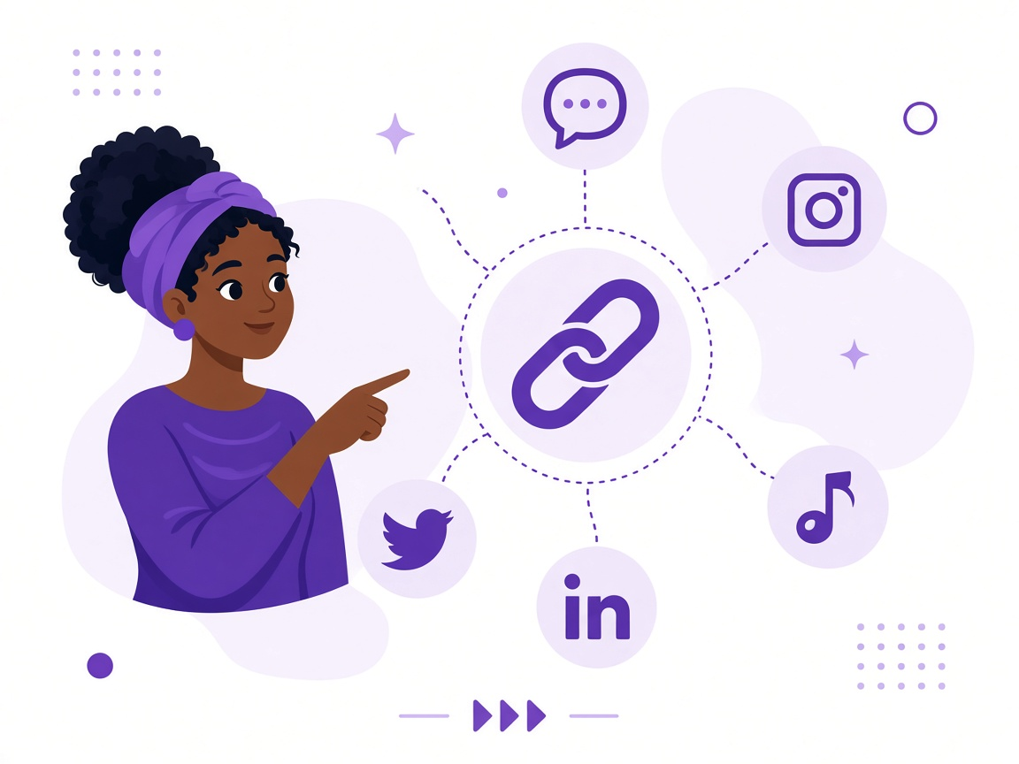
TippyMe
03
THE SOLUTION
One link. Three simple moments.
TippyMe turns support into a clear, human journey.
1
Create
Claim a personal page in minutes.
2
Share
Use one link across social, newsletters and websites.
3
Receive
Supporters pay and leave a message - no account needed.
MESSAGES | GOALS | INSIGHTS | PAYOUTS
Notes:
The flow is deliberately simple. A creator creates a page and shares one link. A supporter chooses an amount, optionally leaves a personal or anonymous message, and pays without opening a TippyMe account. The creator sees support, goals, insights and payout information in one dashboard.

Slide 4
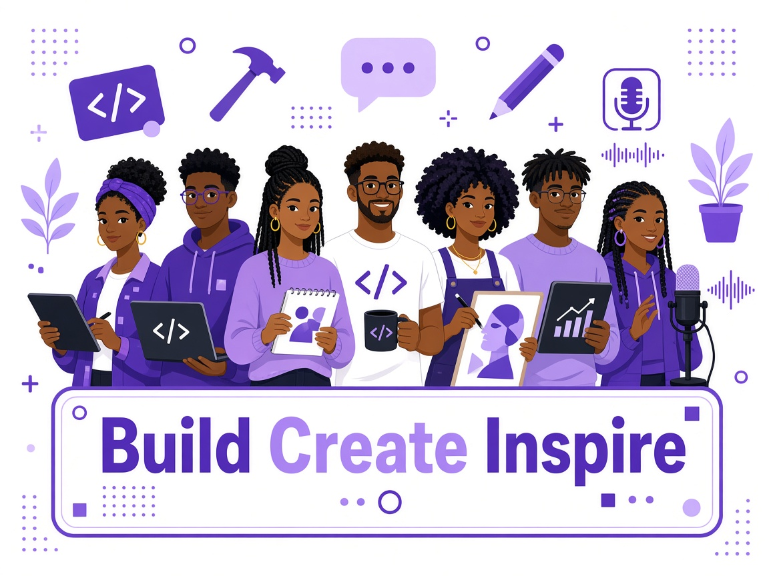
TippyMe
04
WHY TIPPYME
More personal than a payment link.
A creator-support experience, not another wallet.
One reusable link
No supporter sign-up
No bank details pasted into chats.
Less friction between intent and action.
Support feels human
Built for African makers
Messages and anonymity preserve the personal moment.
Developers, writers, artists and community builders.
TippyMe owns the creator experience.
Bachs moves the money.
Notes:
TippyMe is not trying to become a bank or payment processor. It owns the creator page and supporter relationship, while Bachs handles the movement of money. That lets the product focus on what makes support easy, personal and useful for African makers.

Slide 5
TippyMe
05
CUSTOMER + MODEL
A focused customer. A simple model.
CURRENT BUSINESS MODEL
Start with people whose work already creates value for an online community.
5%
default platform fee
per successful tip
WHO
African independent creators
and digital builders
Supporter pays
Simple checkout
Developers
Writers
Designers
Creator receives
Support + message
Artists
Researchers
Podcasters
TippyMe earns
Only when value moves
Open source
Community builders
Bachs handles payment processing and payouts.
Notes:
The initial focus is African independent creators and builders who already have an online community. Creators use TippyMe; supporters fund them. The current model is a configurable platform fee, defaulting to five percent of successful tips. TippyMe earns only when value moves through the platform.

Slide 6
TippyMe
TippyMe
06
WHY BACK IT NOW
A live product built by one founder.
NEXT PHASE
The next milestone is evidence: focused adoption, repeat support and a clear scaling plan.
Recruit a focused first creator cohort
Measure conversion and repeat support
LIVE
BUILT
FOCUSED NEXT
tippyme.click
Onboarding -> payouts
Pilot and learn
Strengthen reliability and payment operations
A public product, not a prototype.
The core creator and supporter journey exists.
Prove what drives support and repeat use.
Define the raise from validated milestones
Back the next phase of creator support in Africa.
Let's build the proof together.
Notes:
One founder has already built and launched the core product. I am not presenting an arbitrary funding number today. I am looking for investors and strategic partners who can help recruit a focused first cohort, validate repeat behavior, strengthen operations and define the right raise from evidence. The invitation is simple: help turn a live product into a repeatable creator-support business.

