Slide 1
ENGS 3302 · WEEK 1 · VIDEOS 1.1–1.4
Introduction to Pattern Recognition
Notes §1.1–1.7 · Duda Chapter 1
Notes:
One deck for the four content videos. Each video starts at its own section slide.

Slide 2
VIDEO 1.1
What is pattern recognition?
After this video you can define pattern recognition and give examples with their raw data and classes.

Slide 3
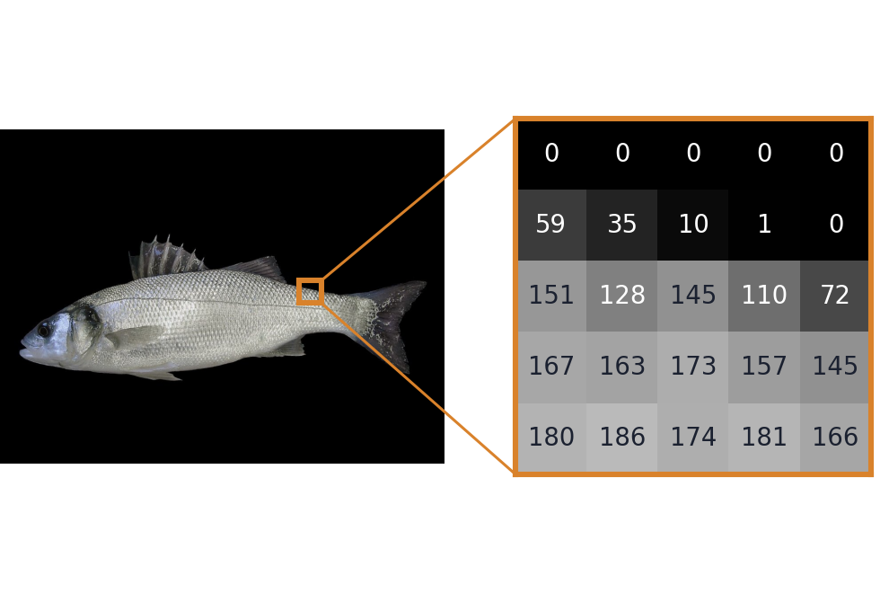
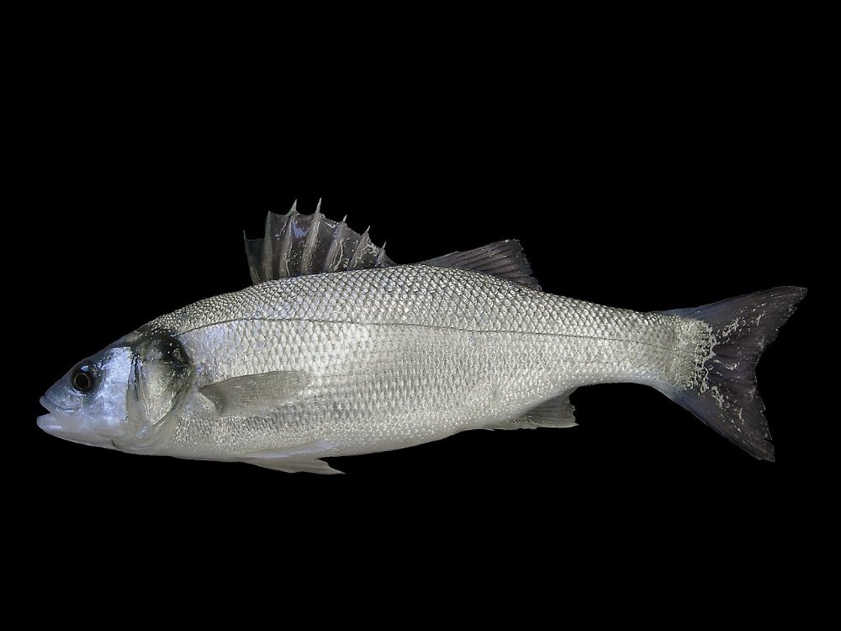
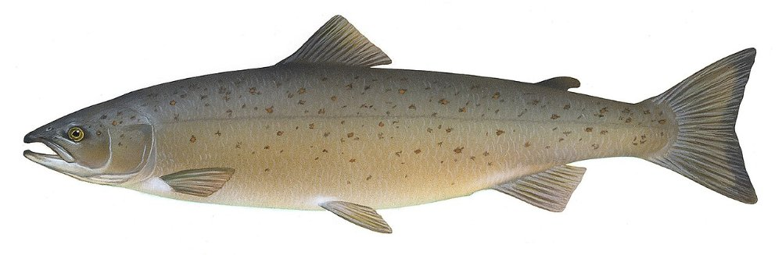
A definition
“the act of taking in raw data and taking an action based on the ‘category’ of the pattern.” Duda, Hart & Stork, p. 1
Possible answers:
box A
sea bass
sea bass
belt
salmon
box B
salmon
gate
raw data
what the sensor gives
A photo is a grid of numbers: 0 = black, 255 = white.
category = class
the possible answers
A fixed list, decided before we start.
action
what we do with the answer
A gate pushes each fish into its box.
Photos: sea bass, Hans Hillewaert, CC BY-SA 4.0 · salmon, T. Knepp, USFWS, public domain · Wikimedia Commons
Week 1 · Video 1.1
Notes:
Run one example through the three words. Raw data: the zoomed square shows that the camera gives only numbers (the top row is the black background, the lower rows are the fish). Class: the answer must be one item from this list. Action: the gate moves. Then ask: for face unlock, what are the raw data, the classes and the action?

Slide 4
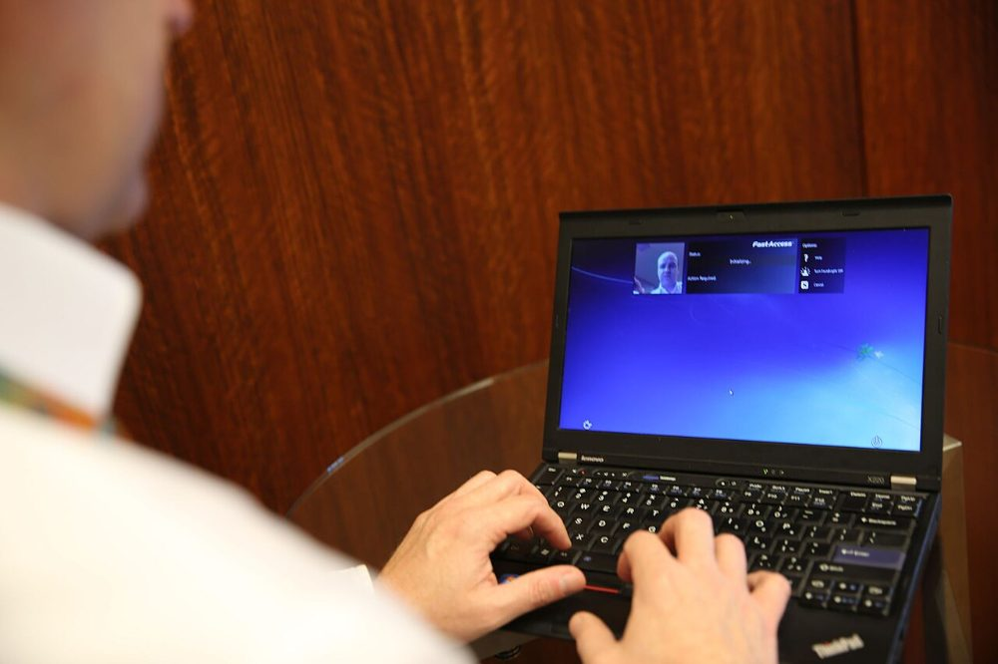

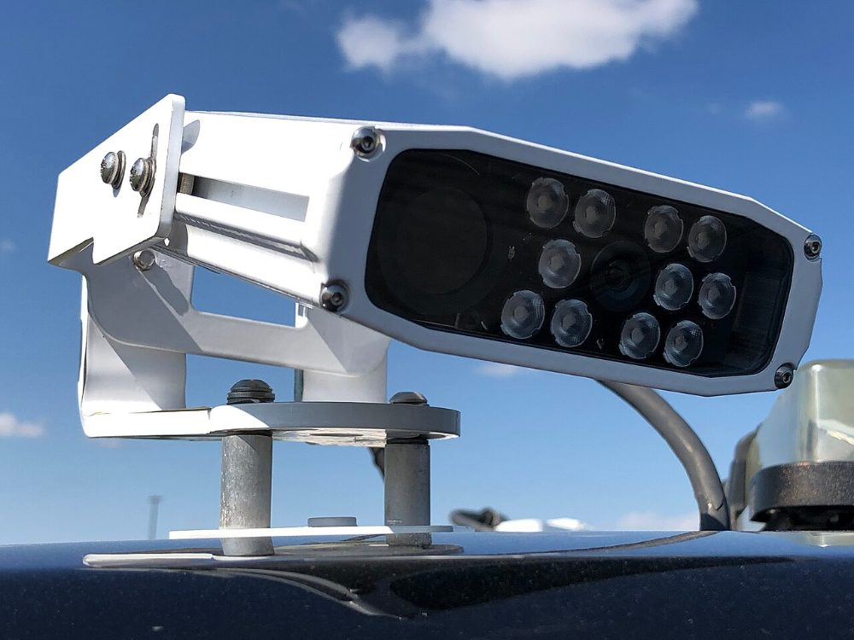
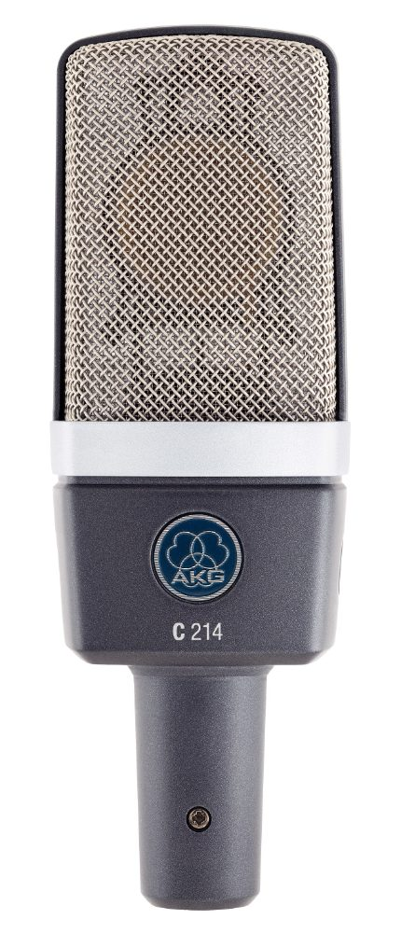

Raw data and classes
Notes §1.1, table
 | Application | Raw data | Classes
 | Face unlock | camera image | owner / not the owner
 | Spam filter | e-mail text | spam / not spam
 | Number-plate reading | image of a car | 0–9, A–Z
 | Voice commands | sound | “call”, “stop”, …
 | Machine monitoring | temperature, vibration | normal / faulty
Week 1 · Video 1.1
Notes:
Pause: ask students to add one row from their own life before you move on.

Slide 5
VIDEO 1.2
Sorting fish: choosing a feature
After this video you can read a feature histogram and count the errors of a threshold rule.

Slide 6
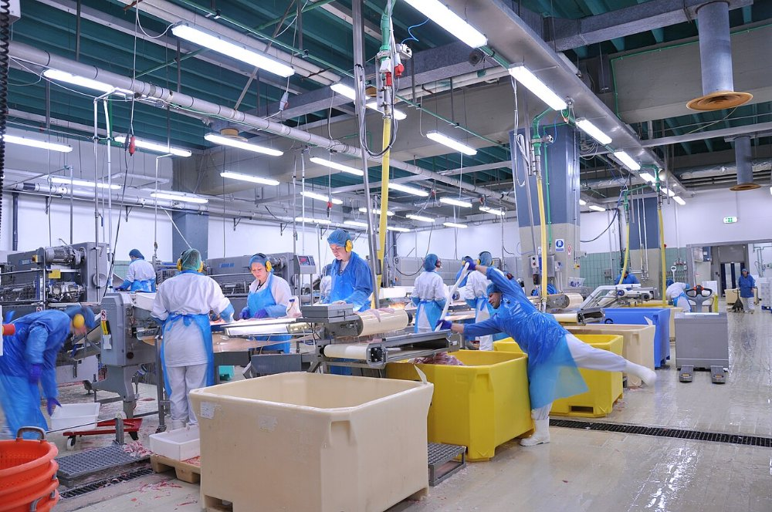
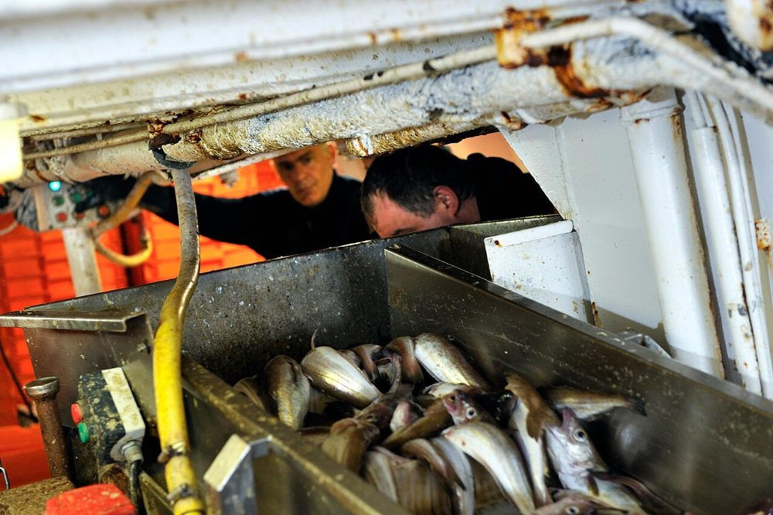
The problem: a fish-packing plant
Fish arrive on a belt and must go to the right box
Photo: Jabbi · CC BY-SA 3.0 · Wikimedia Commons
Photo: Olivier Dugornay / IFREMER · CC BY 4.0 · Wikimedia Commons
Today people sort by eye. Can a camera above the belt do it automatically?
Week 1 · Video 1.2
Notes:
Left: a fish-processing line. Right: fishermen sorting the catch by hand. This is the setting of Duda's example in Chapter 1, and of Section 1.2 of the Notes.

Slide 7
Two species to separate
What could a camera measure to tell them apart?
Photo: Hans Hillewaert · CC BY-SA 4.0 · Wikimedia Commons
Photo: Timothy Knepp, U.S. Fish and Wildlife Service · Public domain · Wikimedia Commons
Sea bass
Salmon
Candidates: length, width, lightness, shape of the fins, position of the mouth, spots…
Week 1 · Video 1.2
Notes:
Pause: ask students to list three features they could measure from an image. The numbers that follow (length, lightness, width) are the textbook's teaching example, not real measurements of these species. Salmon picture: a scientific illustration from the U.S. Fish and Wildlife Service.

Slide 8
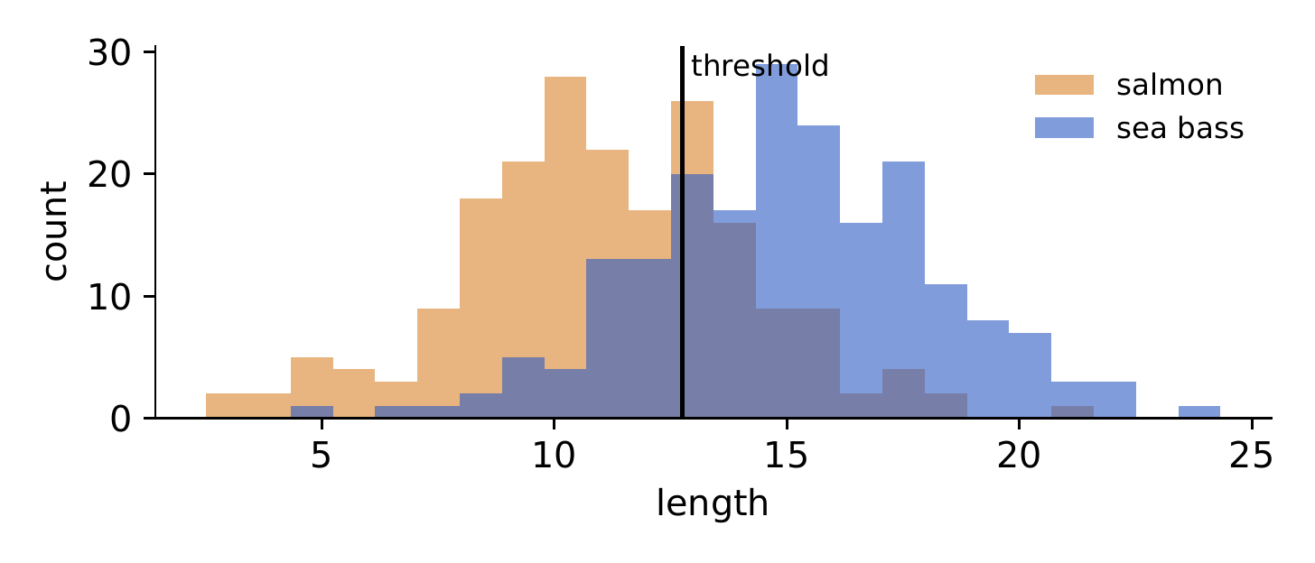
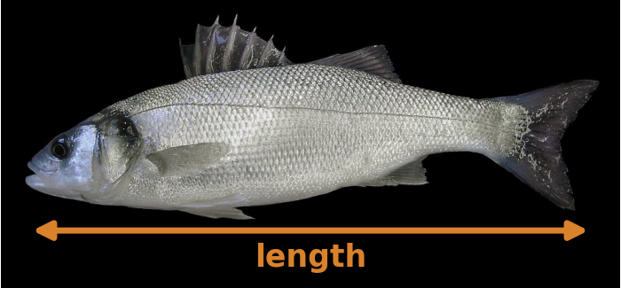
Feature 1: length
Sea bass are longer… on average
≈ 26%
errors, even with the best threshold
Photo: Hans Hillewaert · CC BY-SA 4.0 · Wikimedia Commons
The two groups overlap too much. Length is a poor feature for this task.
Week 1 · Video 1.2
Notes:
Notes Figure 1. The small picture shows how the feature is measured from the image: from the mouth to the tip of the tail. Move the threshold in your mind: every position leaves many fish on the wrong side.

Slide 9
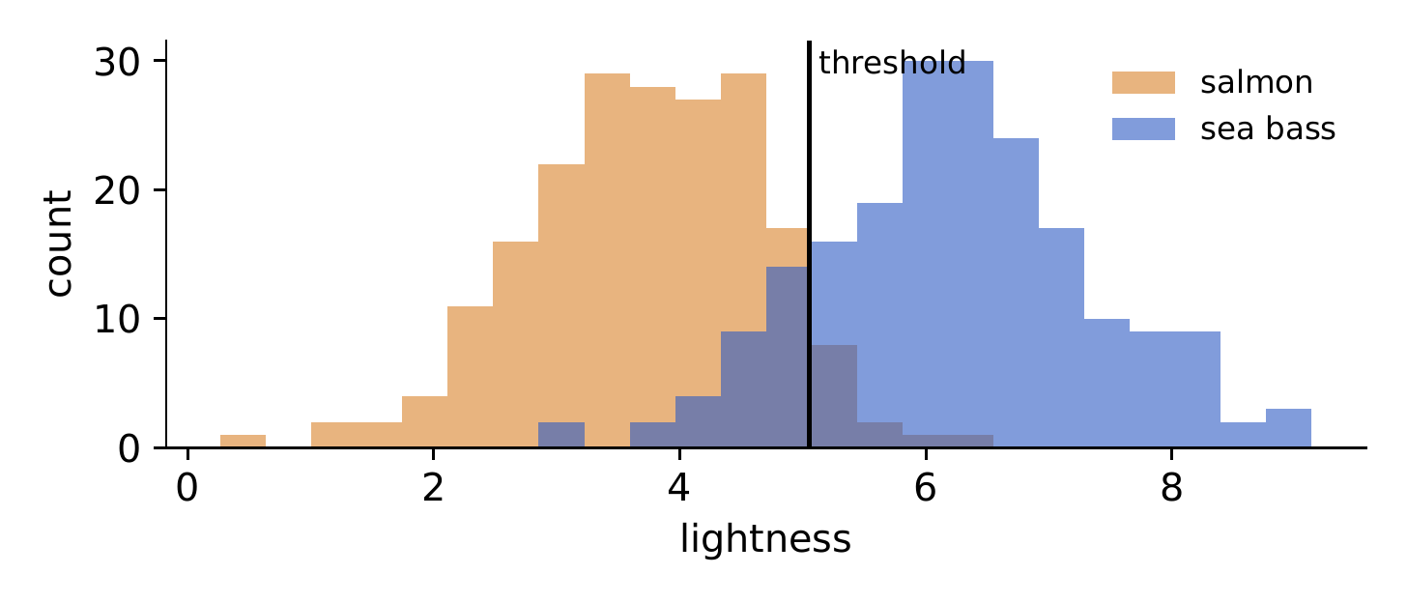
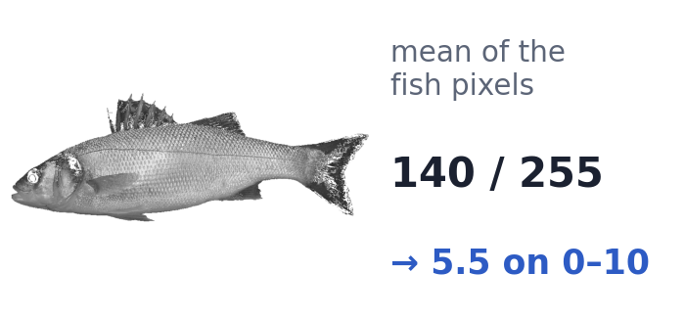
Feature 2: lightness
Salmon are darker
≈ 10%
errors with the best threshold
Photo: Hans Hillewaert · CC BY-SA 4.0 · Wikimedia Commons
A good feature: similar values within a class, different values between classes.
Week 1 · Video 1.2
Notes:
The small picture: keep only the fish pixels (the black background removed) and take their mean; for this photo it is 140 out of 255, about 5.5 on a 0 to 10 scale. This is the key idea box of Section 1.2. Then switch to the Feature Space Explorer: Iris, one feature, setosa with petal length gives 0 errors; versicolor vs virginica gives about 7 errors at best.

Slide 10
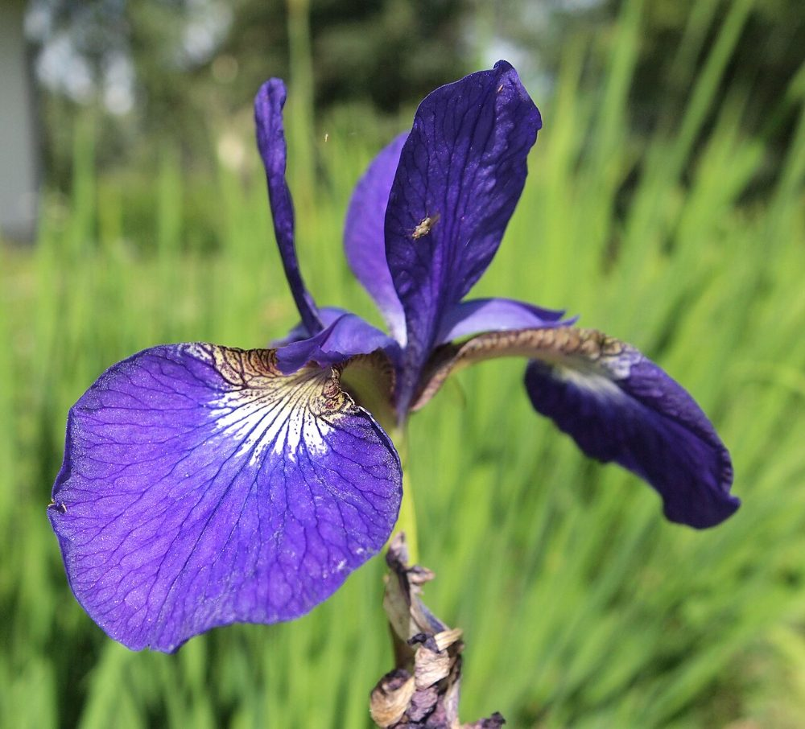
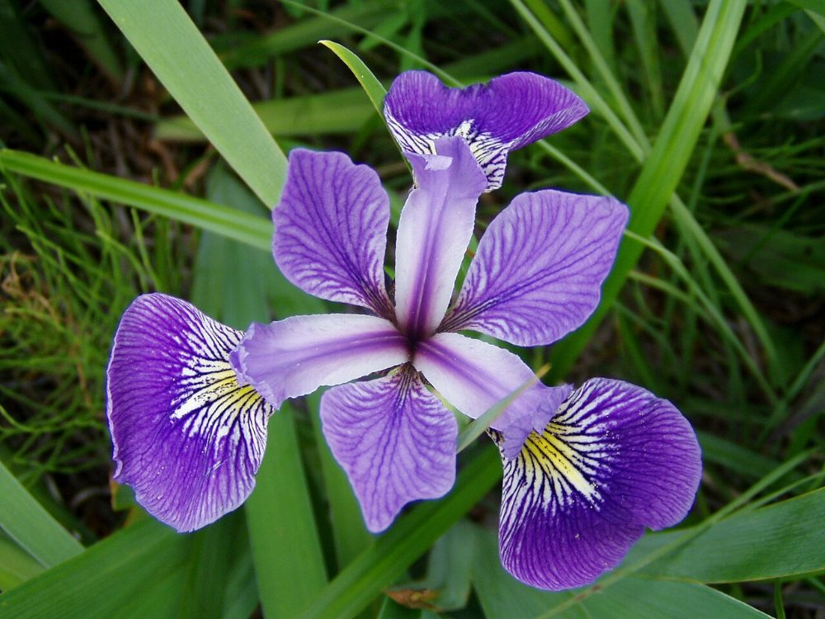
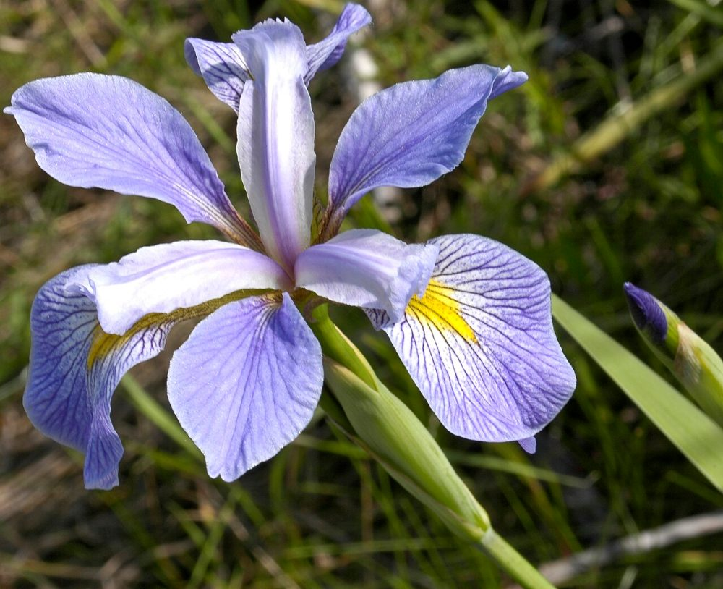
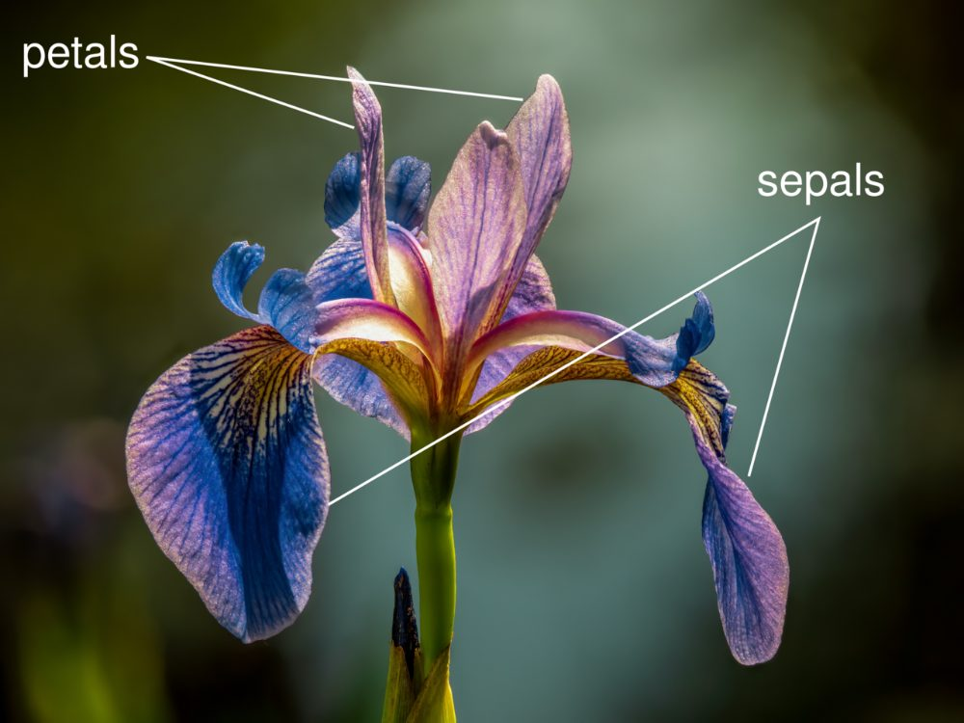
A second data set: Iris flowers
150 flowers, 3 species, 4 measurements (cm) · used in the Explorer and in Lab 1
Iris setosa
Iris versicolor
Iris virginica
sepal & petal: length and width
Setosa is easy to spot. Versicolor and virginica look alike: which measurement separates them?
Week 1 · Video 1.2
Notes:
Introduce Iris before switching to the Explorer. The four features are sepal length, sepal width, petal length and petal width. Photo credits are on the last slide.

Slide 11
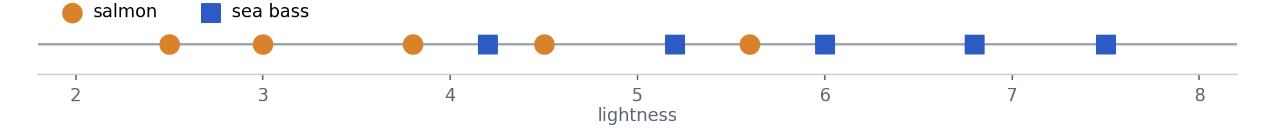
Ten fish, one rule
Worked example 1.1 · rule: sea bass if lightness > 5.0
lightness
Salmon | 2.5 | 3.0 | 3.8 | 4.5 | 5.6
Sea bass | 4.2 | 5.2 | 6.0 | 6.8 | 7.5
Pause the video: where would you put the threshold? Which fish does “lightness > 5.0” get wrong?
Week 1 · Video 1.2
Notes:
Give students time to find the two mistakes.

Slide 12
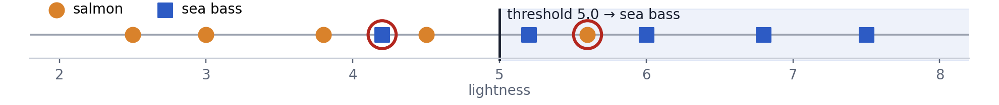
Ten fish, one rule
Worked example 1.1 · rule: sea bass if lightness > 5.0
lightness
Salmon | 2.5 | 3.0 | 3.8 | 4.5 | 5.6
Sea bass | 4.2 | 5.2 | 6.0 | 6.8 | 7.5
2 errors out of 10 = 20%. No threshold on lightness does better on these ten fish.
Week 1 · Video 1.2
Notes:
Highlighted: the salmon with 5.6 and the sea bass with 4.2. Try 5.4 aloud: 3 errors.

Slide 13
VIDEO 1.3
Feature space and generalization
After this video you can place objects in feature space, use a line as a decision boundary, and explain why simpler boundaries often work better.

Slide 14
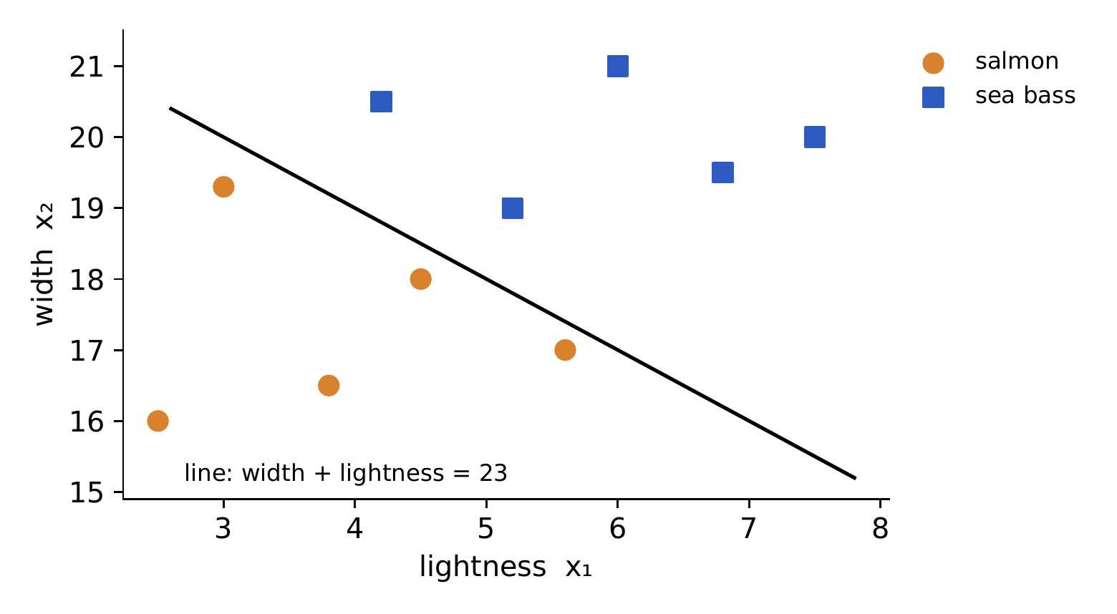
Two features: each fish is a point
x = (lightness, width) is the feature vector
Rule
sea bass if width + lightness > 23
0 errors on the ten fish. Lightness alone: 2 errors. Width alone: at least 1.
Week 1 · Video 1.3
Notes:
Worked example 1.2. Check two fish aloud: salmon (2.5, 16.0) gives 18.5; sea bass (4.2, 20.5) gives 24.7. Then show the Explorer with two features: versicolor vs virginica drops from 7 to about 4 errors.

Slide 15
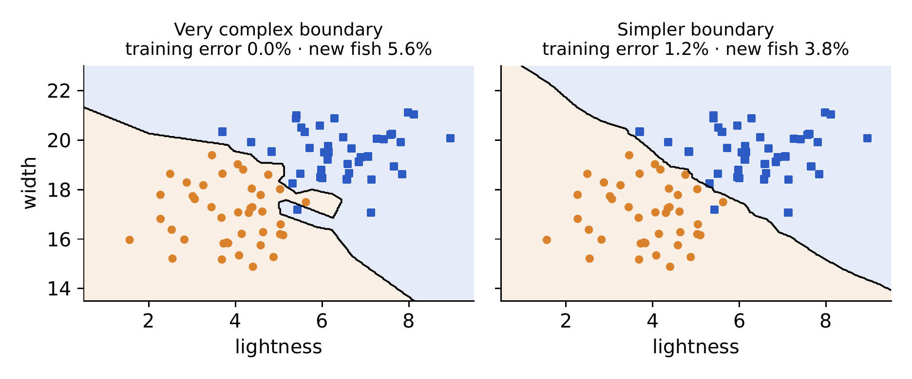
Zero training errors is not the goal
What matters is new fish: generalization
Complex: 0% training, 5.6% new
Simpler: 1.2% training, 3.8% new
Always judge a classifier on data it has not seen (Week 6). Prefer the simpler boundary unless the complex one is clearly needed.
Week 1 · Video 1.3
Notes:
Notes Figure 4. The complex boundary learned accidents of the training set. Mention Occam's razor in one sentence.

Slide 16
VIDEO 1.4
Systems, design and learning
After this video you can name the stages of a pattern recognition system, describe the design cycle, and tell the three kinds of learning apart.

Slide 17
The stages of a system
Notes §1.5 · Duda Figure 1.1
1 Sensing a camera above the belt
2 Pre-processing & segmentation remove background, separate each fish
3 Feature extraction lightness, width
4 Classification sea bass or salmon?
5 Post-processing act: send it to the right box
Photo: Jabbi · CC BY-SA 3.0 · Wikimedia Commons
Same stages in a number-plate reader: camera → find the plate and each character → features of each character → letter or digit → check the plate format.
Week 1 · Video 1.4
Notes:
Explain each stage in one sentence with the fish, then repeat with the number plate.

Slide 18
The design cycle
How we build a system, and where each step is in this course
Collect data
Choose features
Choose a model
Train
Evaluate
→
→
→
→
Lab 1
Weeks 2, 9
Weeks 4–12
Weeks 5, 7–12
Week 6
↺ Not good enough? Go back to an earlier step.
Your final project follows this cycle: define a problem, choose features and an algorithm, build it, and test it.
Week 1 · Video 1.4
Notes:
This slide doubles as a map of the semester. Link the last sentence to the project stages (decision 18).

Slide 19
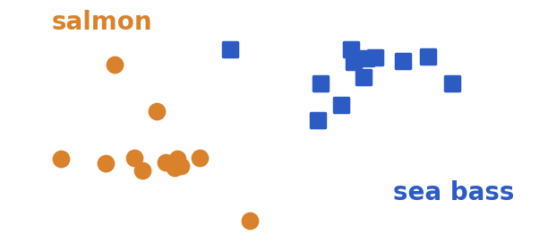
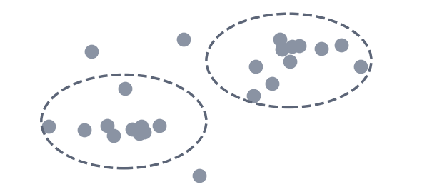
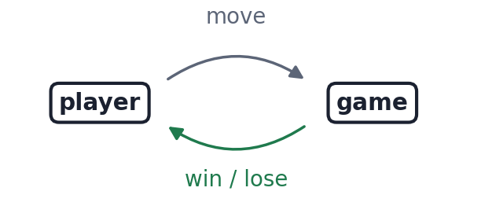
Three kinds of learning
Supervised
Unsupervised
Reinforcement
every sample has its correct class (a label)
e.g. fish with known species
no labels: find natural groups
e.g. group customers by habits (Week 11)
only a right / wrong signal
e.g. a game player learning from wins
Most of this course: supervised. Week 11: unsupervised. Reinforcement learning is not part of this course.
Week 1 · Video 1.4
Notes:
Pause: ask students to classify 'grouping songs without labels' (answer: unsupervised).

Slide 20
REMEMBER
Features decide everything
A good feature separates the classes. A boundary must work on new data. Read Notes §1.1–1.7, then do Lab 1.
Notes:
Close the week. Point to the Check yourself questions at the end of the Notes.

Slide 21
Image credits
All photos from Wikimedia Commons, used under the licences shown
Image | Author | Licence
Grandi fish processing conveyor belt1 2011.jpg | Jabbi | CC BY-SA 3.0
Pêcheurs au tri de la pêche du jour… (Ifremer 00776-88788 - 48325).jpg | Olivier Dugornay / IFREMER | CC BY 4.0
Dicentrarchus labrax (Belgium).jpg | Hans Hillewaert | CC BY-SA 4.0
Salmo salar.jpg | Timothy Knepp, U.S. Fish and Wildlife Service | Public domain
Iris setosa 2.jpg | Tiia Monto | CC BY-SA 4.0
Iris versicolor 3.jpg | Dlanglois | CC BY-SA 3.0
Iris virginica.jpg | Frank Mayfield | CC BY-SA 2.0
Iris petal sepal.png | Esmu Igors | CC BY-SA 4.0
Notes:
Not shown in the video; kept for licence compliance.

