Slide 1
ENGS 3302 · WEEK 2 · VIDEOS 2.1–2.5
Features, Distance and the Nearest-Mean Classifier
Notes §2.1–2.7 · Duda §4.6, §2.6.1 · ISLP §2.2
Notes:
One deck for the five content videos. Each video starts at its own section slide. Before Video 2.1, students should have done the Math Toolkit and the Math check.

Slide 2
VIDEO 2.1
Features: turning objects into numbers
After this video you can give examples of features from images, sounds and text, and tell numerical from categorical features.

Slide 3
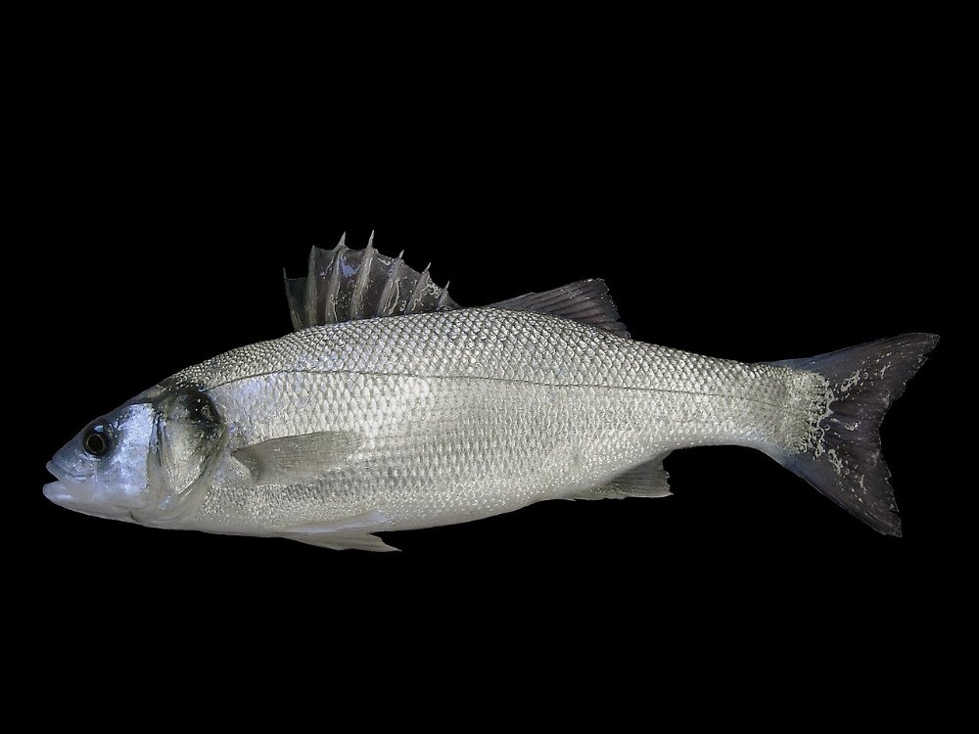
A classifier only sees numbers
Feature extraction: raw data in, a few useful numbers out
lightness 5.5
width 21.0
→
→
classifier
Photo: Hans Hillewaert · CC BY-SA 4.0 · Wikimedia Commons
Lightness 5.5: the mean of the fish pixels in this photo (140 of 255), on a 0–10 scale. See the Week 1 Math Toolkit.
Week 2 · Video 2.1
Notes:
The photo is millions of numbers; we keep two. Choosing those two is feature extraction. Lightness 5.5 is really computed from this photo: keep the fish pixels, take their mean, divide by 25.5.

Slide 4
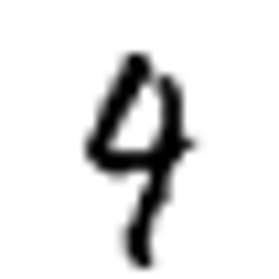



Features from different kinds of data
Notes §2.1, table
Image of a digit
amount of ink: 11% of the image
Sound
loudness, pitch, duration
E-mail
count of “free”, number of links
Customer record
city, payment method (categorical)
Numerical: size has a meaning (20 cm > 16 cm). Categorical: a label from a list (Gaza, Rafah, Khan Younis).
Week 2 · Video 2.1
Notes:
The 11% is computed from this real MNIST digit: the mean darkness of its pixels. Pause: ask students to name one feature for a photo of a car number plate.

Slide 5
Categorical features need coding
One-hot encoding: one 0/1 column per category
port
Gaza
Rafah
Gaza
Khan Younis
port_Gaza | port_Khan Younis | port_Rafah
1 | 0 | 0
0 | 0 | 1
1 | 0 | 0
0 | 1 | 0
→
Why not Gaza = 1, Rafah = 2, Khan Younis = 3? Because then Khan Younis would be “further” from Gaza than Rafah is, and a distance would believe it.
Week 2 · Video 2.1
Notes:
The lab shows pd.get_dummies. Keep the argument about fake order: numbers invite distances.

Slide 6
VIDEO 2.2
Measuring distance
After this video you can compute the Euclidean and the Manhattan distance between two feature vectors.

Slide 7
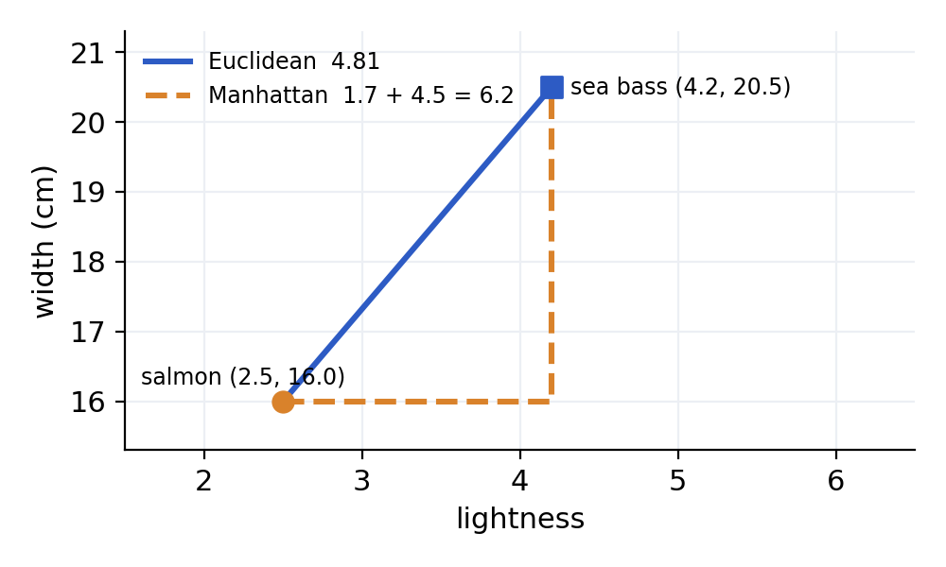
Two ways to measure distance
Notes §2.2 · Worked example 2.1
Euclidean
straight line: √(1.7² + 4.5²) ≈ 4.81
Manhattan
along the axes: 1.7 + 4.5 = 6.2
Default in this course: Euclidean.
Week 2 · Video 2.2
Notes:
Compute both on the slide, step by step. Manhattan is the distance a taxi drives in a city with a grid of streets.

Slide 8
Your turn
Pause the video and compute, then continue
Salmon (3.8, 16.5) and sea bass (6.0, 21.0).
Compute the Euclidean and the Manhattan distance.
Week 2 · Video 2.2
Notes:
This is Lab Task 1 too. Pause, then show the next slide.

Slide 9
Your turn: answer
Differences: 3.8 − 6.0 = −2.2 and 16.5 − 21.0 = −4.5
Euclidean: √(2.2² + 4.5²) = √25.09 ≈ 5.01
Manhattan: 2.2 + 4.5 = 6.7
Week 2 · Video 2.2
Notes:
Both answers checked in code (Lab Task 1).

Slide 10
VIDEO 2.3
When the units decide
After this video you can explain why the units of a feature can change a distance-based decision.

Slide 11
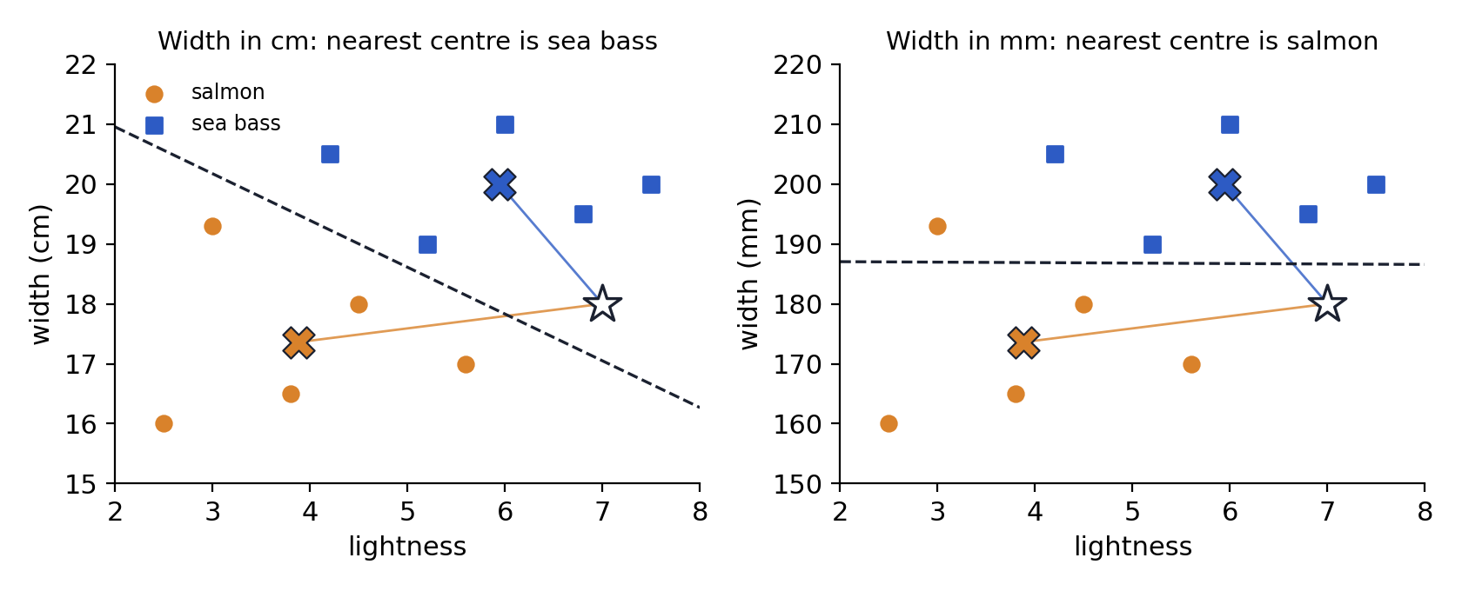
Same fish, different units, different answer
Notes §2.3 · Worked example 2.2
Week 2 · Video 2.3
Notes:
Left, width in cm: distances 3.18 to salmon and 2.26 to sea bass, so sea bass. Right, width in mm: 7.12 and 20.03, so salmon. Nothing about the fish changed. In mm, width differences are 10 times larger and take over.

Slide 12
The numbers behind the picture
 | to salmon centre | to sea bass centre | decision
width in cm | √(3.12² + 0.64²) ≈ 3.18 | √(1.06² + 2.00²) ≈ 2.26 | sea bass
width in mm | √(3.12² + 6.4²) ≈ 7.12 | √(1.06² + 20²) ≈ 20.03 | salmon
A distance only sees numbers. Features with large ranges take over. Bring all features to a common scale first.
Week 2 · Video 2.3
Notes:
Then switch to the Distance and Scaling Explorer: move the new fish, switch cm/mm, and watch the decision change.

Slide 13
VIDEO 2.4
Normalization
After this video you can normalize features with min-max scaling and the z-score, using numbers from the training data.

Slide 14
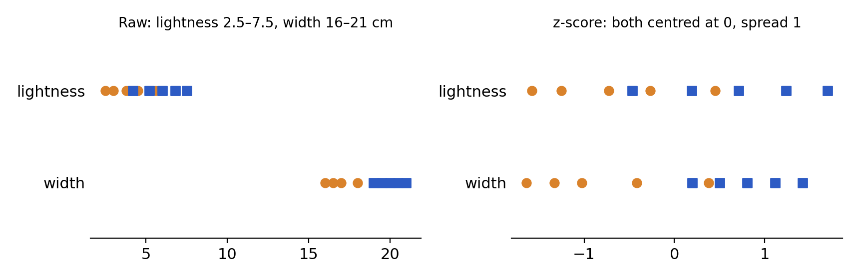
Two ways to put features on one scale
Notes §2.4
Min-max
x' = (x − min) / (max − min)
result between 0 and 1
z-score
z = (x − mean) / std
result has mean 0 and std 1
Week 2 · Video 2.4
Notes:
Each feature is scaled separately. The picture shows the ten fish on two number lines before and after the z-score: after it, both features are centred and have the same spread.

Slide 15
Normalizing the new fish (7.0, 18.0)
Worked example 2.3 · training numbers from the ten fish
 | lightness | width (cm)
min, max | 2.5, 7.5 | 16.0, 21.0
mean, std | 4.91, 1.529 | 18.68, 1.638
min-max | (7.0 − 2.5) / 5.0 = 0.90 | (18.0 − 16.0) / 5.0 = 0.40
z-score | (7.0 − 4.91) / 1.529 ≈ 1.37 | (18.0 − 18.68) / 1.638 ≈ −0.42
After either method the nearest centre is sea bass, in cm or in mm.
Week 2 · Video 2.4
Notes:
Do the two z-scores aloud. Mention that 180 mm gives exactly the same z-score as 18.0 cm: the unit disappears.

Slide 16
Use the training numbers for everything
Otherwise: data leakage
transform training data
training data
fit: mean, std
(min, max)
transform new / test data
Wrong: computing the mean and std on all the data, or again on the test data. The test data then leaks into training, and the test score looks better than it really is.
Week 2 · Video 2.4
Notes:
This is the rule students forget most. In scikit-learn: scaler.fit(X_train), then scaler.transform(X_train) and scaler.transform(X_test). A pipeline does it for you. Test data is introduced properly in Video 2.5; here it is enough to say: data kept aside to check the classifier.

Slide 17
VIDEO 2.5
The nearest-mean classifier
After this video you can classify a new sample with the nearest-mean classifier, say when it fails, and measure it on test data.

Slide 18
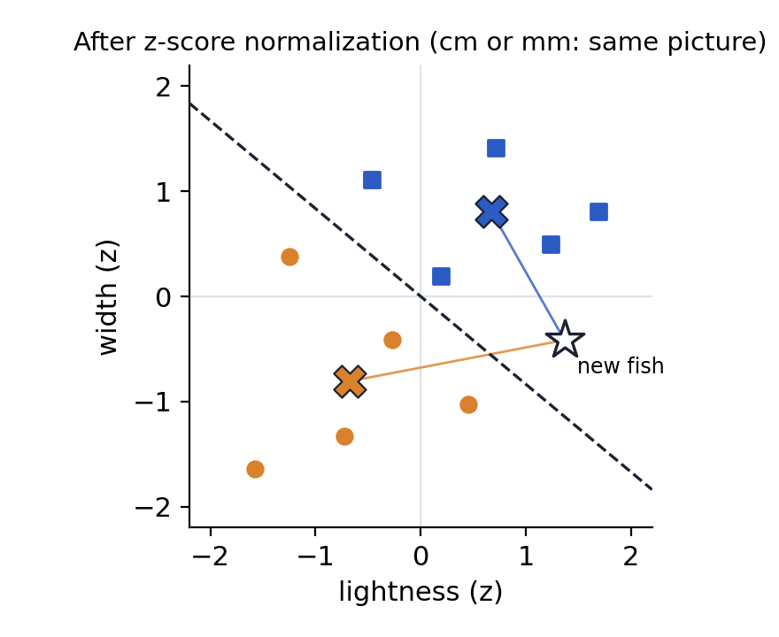
Your first classifier, in two steps
Notes §2.5 · Duda §2.6.1: the minimum-distance classifier
1 Train
compute the mean of each class: one centre per class
2 Classify
measure the distance to every centre and choose the nearest
The boundary is the straight line halfway between the two centres, at a right angle.
Week 2 · Video 2.5
Notes:
Worked example 2.4: salmon centre (3.88, 17.36) from the five salmon; sea bass (5.94, 20.00). New fish (7.0, 18.0): 3.18 vs 2.26, sea bass. All ten training fish are on the right side. The picture is in z-scores.

Slide 19
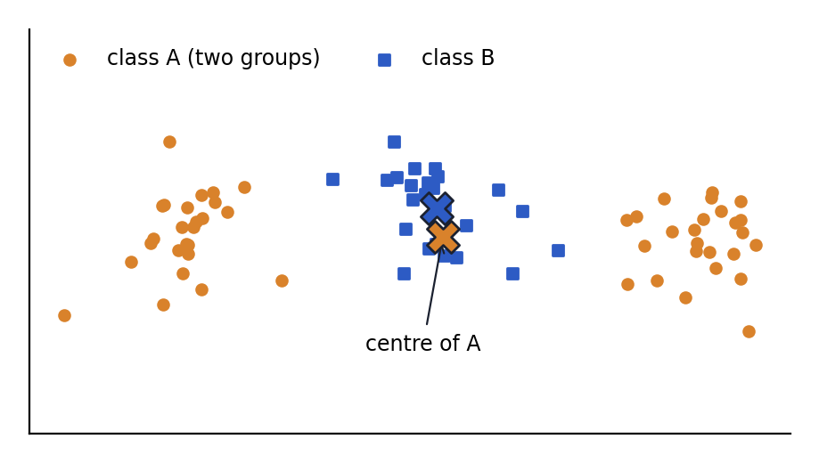
When it fails
One centre per class works only if each class is one compact group
Class A is two groups. Its mean falls in the middle, inside class B.
29 of 75 points misclassified.
Week 6 (k-NN) handles this case.
Week 2 · Video 2.5
Notes:
Ask for an everyday example: 'adult' as a class made of two groups, people under 30 and over 60, if age and hobby were the features. Students will find better ones.

Slide 20
Training data and test data
Judge a classifier on samples it has never seen
training data
70% · learn everything here
test data
30% · kept aside
accuracy =
correct / test samples
error rate = 1 − accuracy
Memorizing the training data gives 100% on it, and says nothing about new samples.
Penguins (342 samples): train on 239, test on 103.
Nearest mean with z-score: 100 of 103 right → accuracy 100/103 ≈ 0.97, error rate ≈ 0.03.
train_test_split(X, y, test_size=0.3, random_state=0, stratify=y)
Week 2 · Video 2.5
Notes:
Notes §2.6 (ISLP §2.2). We have built a classifier; now: how good is it? We build for new samples, so we measure on samples the classifier has not seen. Test data is kept aside and used once, at the end. Penguin numbers are from Lab 2, section 1.6: 100 of 103 with z-score, 65 of 103 without. stratify keeps the class shares; random_state gives everyone the same split. Ten fish are too few to split. Week 6 returns to evaluation in depth.

Slide 21
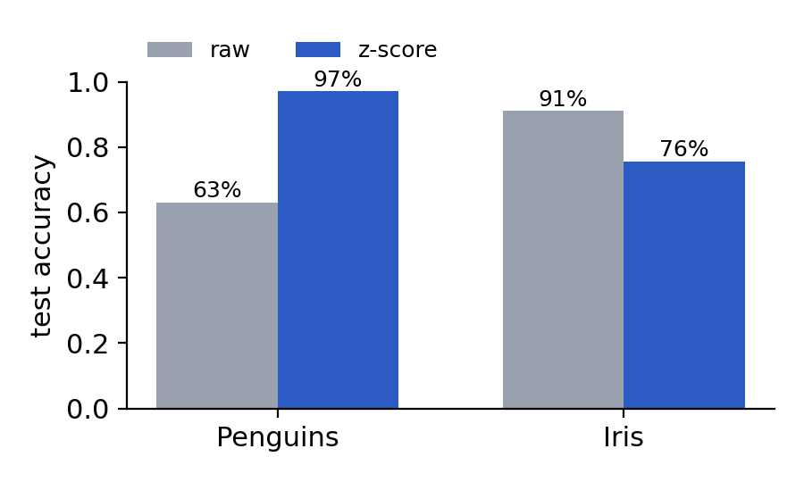
Is normalizing always better?
Nearest mean, 30% test data, from the lab
Penguins: bills in mm, body mass in grams (2700–6300). Unscaled, the mass decides: 63%. Scaled: 97%.
Iris: four lengths, all in cm. Scaling makes a noisy feature as loud as the useful ones: 91% falls to 76%.
Normalize when ranges differ for reasons unrelated to the classes. Always check on test data.
Week 2 · Video 2.5
Notes:
Numbers are from Lab 2, section 1.6 (random_state=0, stratified 30% test split). Penguin data: Palmer Penguins (Horst, Hill & Gorman 2020, CC0). This answers the question left open in Video 2.4. The lesson: normalization is a tool, not a ritual.

Slide 22
In Python
Normalization and nearest mean in one pipeline
from sklearn.pipeline import make_pipeline
from sklearn.preprocessing import StandardScaler
from sklearn.neighbors import NearestCentroid
model = make_pipeline(StandardScaler(), NearestCentroid())
model.fit(X, y) # learns mean/std, then the centres
model.predict([[7.0, 18.0]]) # array(['sea bass'])
fit uses only the training data; predict reuses the same numbers. The pipeline follows the leakage rule for you.
Week 2 · Video 2.5
Notes:
Output verified by running the code on the ten fish. The lab builds the same classifier by hand first (Task 3).

Slide 23
REMEMBER
Scale first, then measure
Features become numbers; distances compare them; normalize with training numbers; the nearest centre decides. Read Notes §2.1–2.7, then do Lab 2 and Assignment 2.
Notes:
Close the week. Point to Check yourself at the end of the Notes, and to the assignment deadline in the week guide.

Slide 24
Image credits
All photos from Wikimedia Commons, used under the licences shown
Image | Author | Licence
Dicentrarchus labrax (Belgium).jpg | Hans Hillewaert | CC BY-SA 4.0
MnistExamples.png | Josef Steppan | CC BY-SA 4.0
Notes:
Not shown in the video; kept for licence compliance.

